Slide 1
Acts 6:3–4
³ Therefore, brothers, pick out from among you seven men of good repute, full of the Spirit and of wisdom, whom we will appoint to this duty. ⁴ But we will devote ourselves to prayer and to the ministry of the word.”

Slide 4
Let your desire be known.
1 Timothy 3:1
Titus 1:5
Do you have the character of a shepherd?
1 Timothy 3:2–7; Titus 1:5–9
Are you able and willing to do the work?
Ephesians 4:11–16

Slide 5
Submit the name of someone else.
Acts 6:2–6

Slide 6
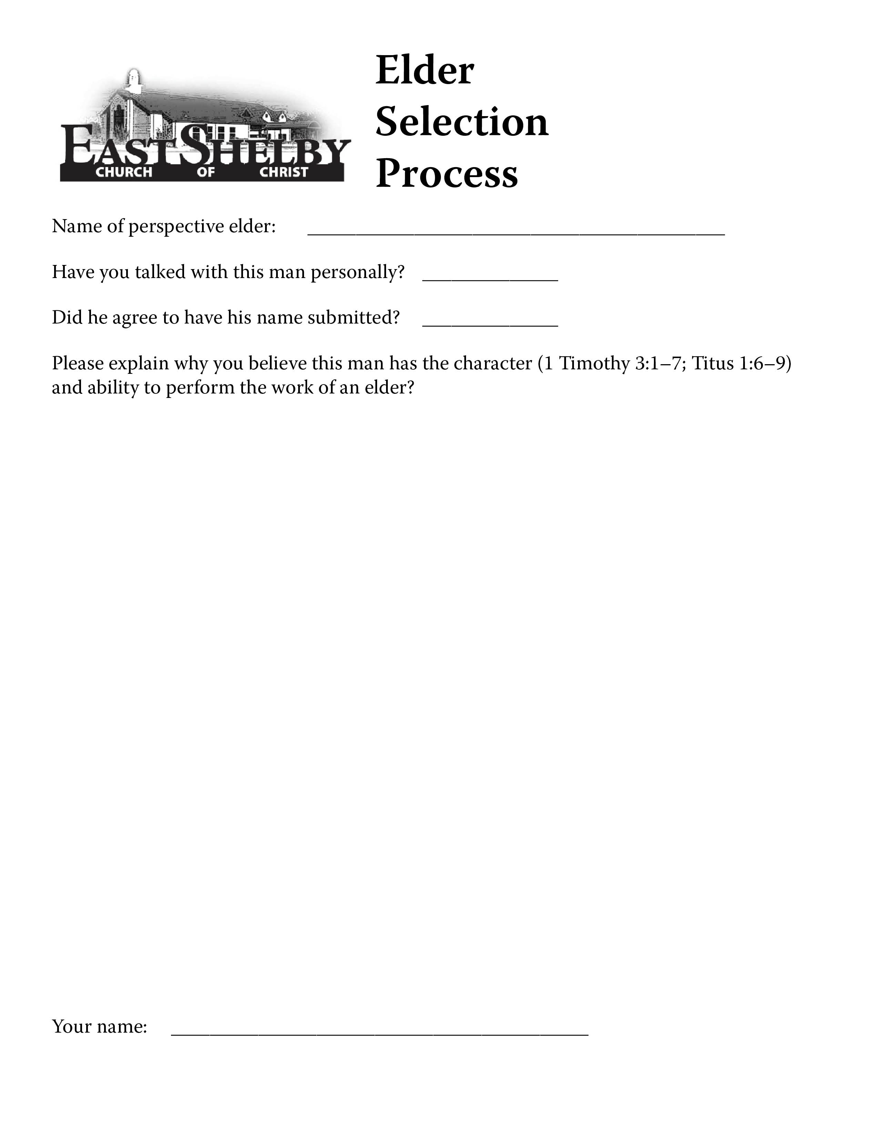

Slide 9
More work…
The elders will read through all of the forms and consider each name submitted.
A select group of men will be put before the congregation for consideration.
Any objections must be scripture-based.
After a set time, the man or men will be appointed.

Slide 10
Remember…
This should be a peaceful process.
We need more shepherds.

