Slide 1
Hebrews 13:17
¹⁷ Obey your leaders and submit to them, for they are keeping watch over your souls, as those who will have to give an account. Let them do this with joy and not with groaning, for that would be of no advantage to you.

Slide 4
SPIRITUAL GROWTH
Attendance is an indicator of maturity.
Hebrews 10:24–25; John 4:23–24

Slide 5
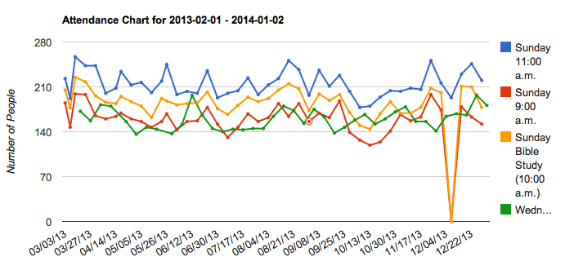

Slide 6
Member Attendance
55%

Slide 7
Member Attendance
58%

Slide 8
Member Attendance
73%

Slide 9
Member Attendance

Slide 10
Spiritual Growth
Attendance is an indicator of maturity.
Hebrews 10:24–25; John 4:23–24
In 2014, every member will receive quarterly attendance reports.
2013 Restoration:
6 baptisms
6 restorations
We are available to help you with your spiritual needs (James 5:3–16).

Slide 11
2014 Spiritual Growth Plans
Question & Answer Lessons on fifth Sundays.
Prayer & Praise assemblies quarterly.
Marriage Class quarterly.
Jr. High and High School Training Class on the third Wednesday of every month.

Slide 13
FINANCIAL
In 2012, we ended the year with a slight positive cash flow.
In 2013, we have been blessed financially.
2 Corinthians 9:6–7
In 2013 we have:
Made significant improvements to the building.
Set aside a capital improvement fund.

Slide 14
2014
The church is not a money-making business.
We are immediately adding $24,000.00 in outside support.

Slide 17
2014
The church is not a money-making business.
We are immediately adding $24,000.00 in outside support.
Our weekly budgeted contribution will remain at $7,700.00 weekly.

Slide 18
LEADERSHIP
Since 2012, we have emphasized the shepherding model of leadership.
In 2014, we will actively pursue the possibility of adding more shepherds.
A series of lessons will be presented on the eldership.
We will ask you to submit names of those who are qualified to shepherd this flock.

Slide 19
Effective Leadership
1 Peter 5:1–3
Ephesians 4:11–16

