Slide 1
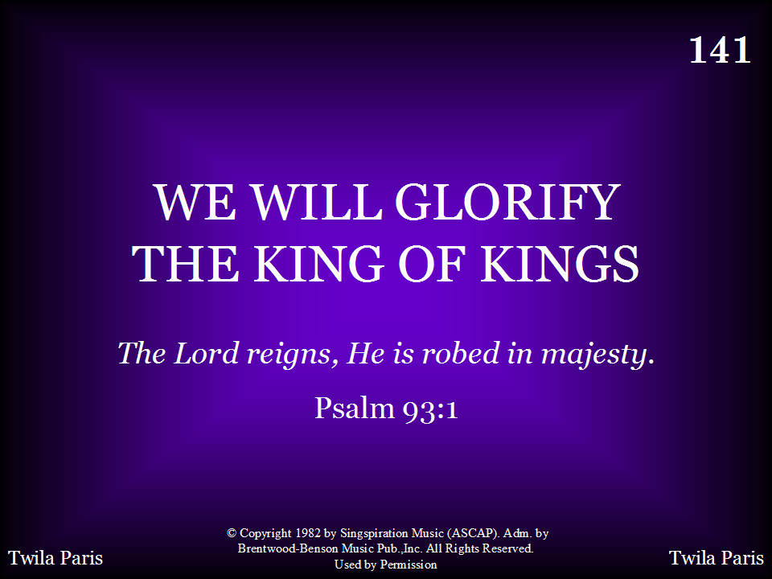
141 - We Will Glorify The King Of Kings - Title

Slide 2
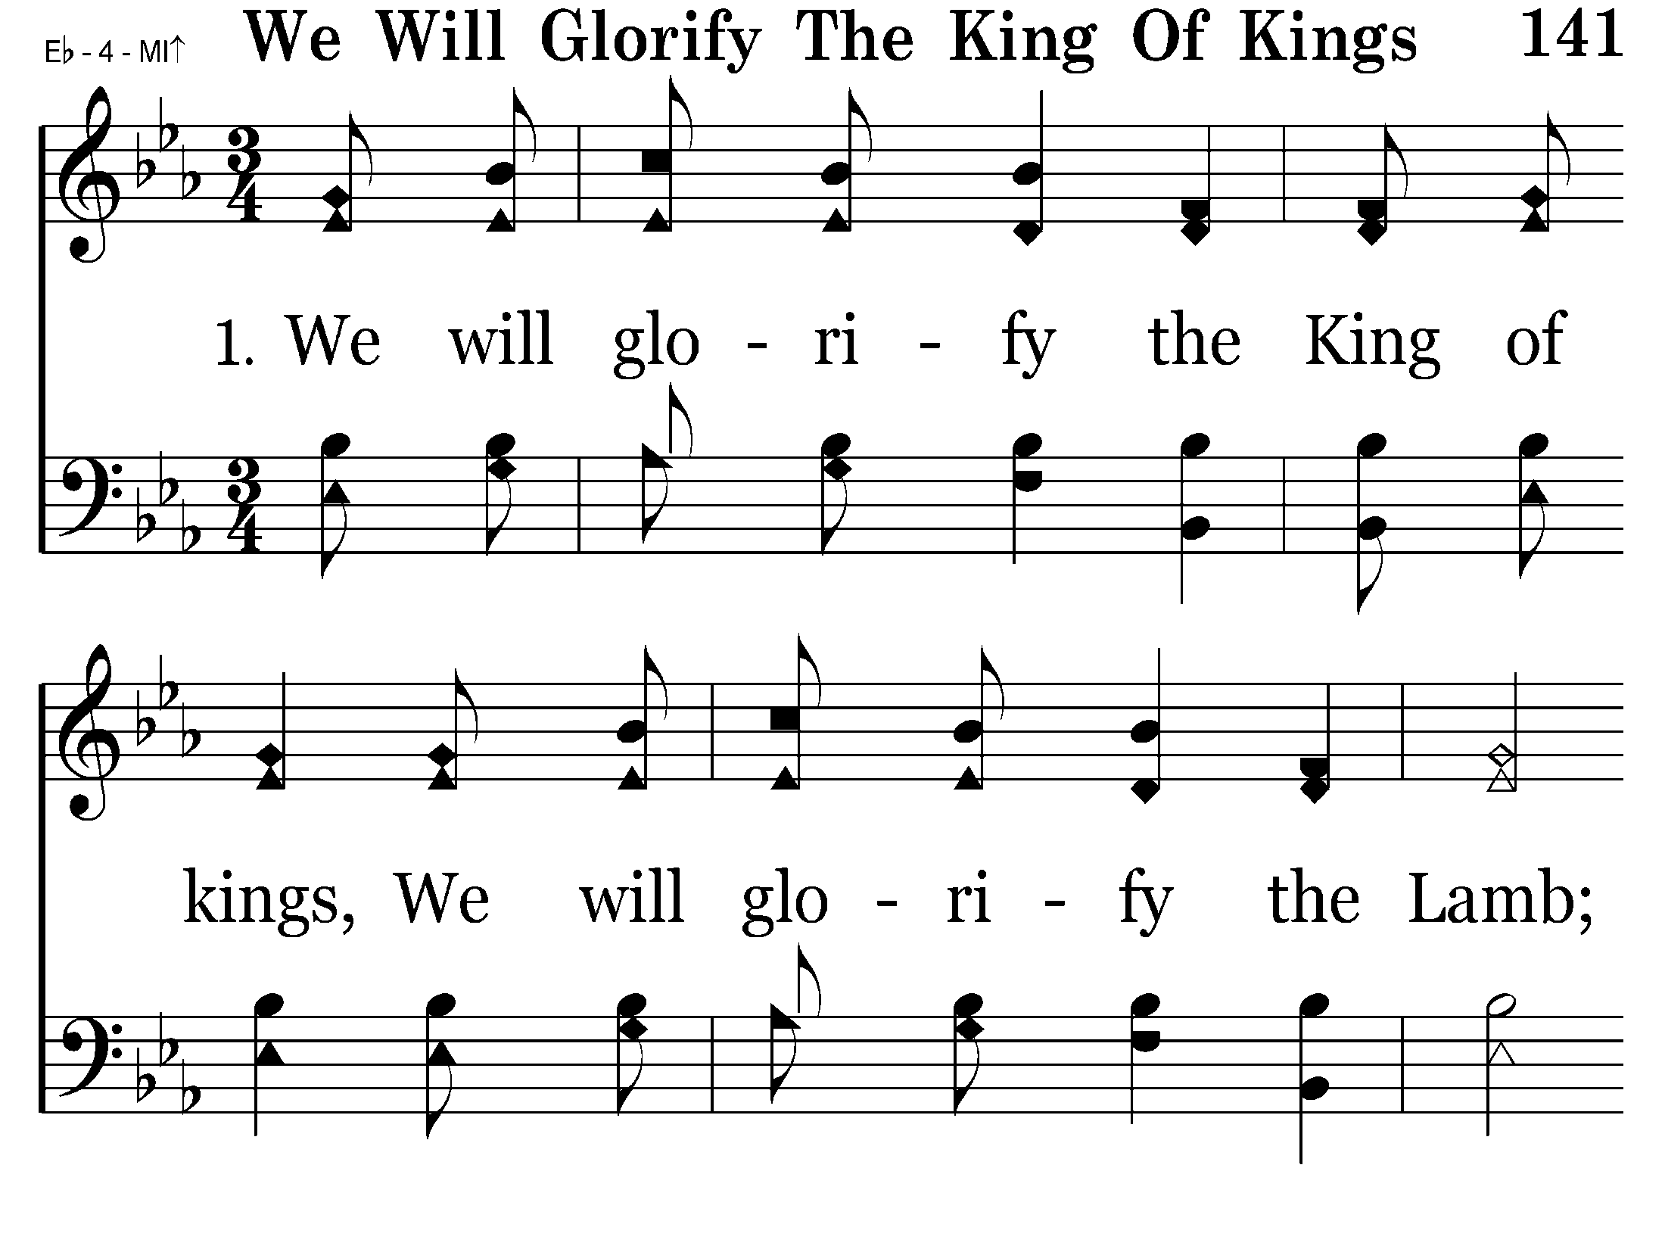
141 - We Will Glorify The King Of Kings - 1.1

Slide 3
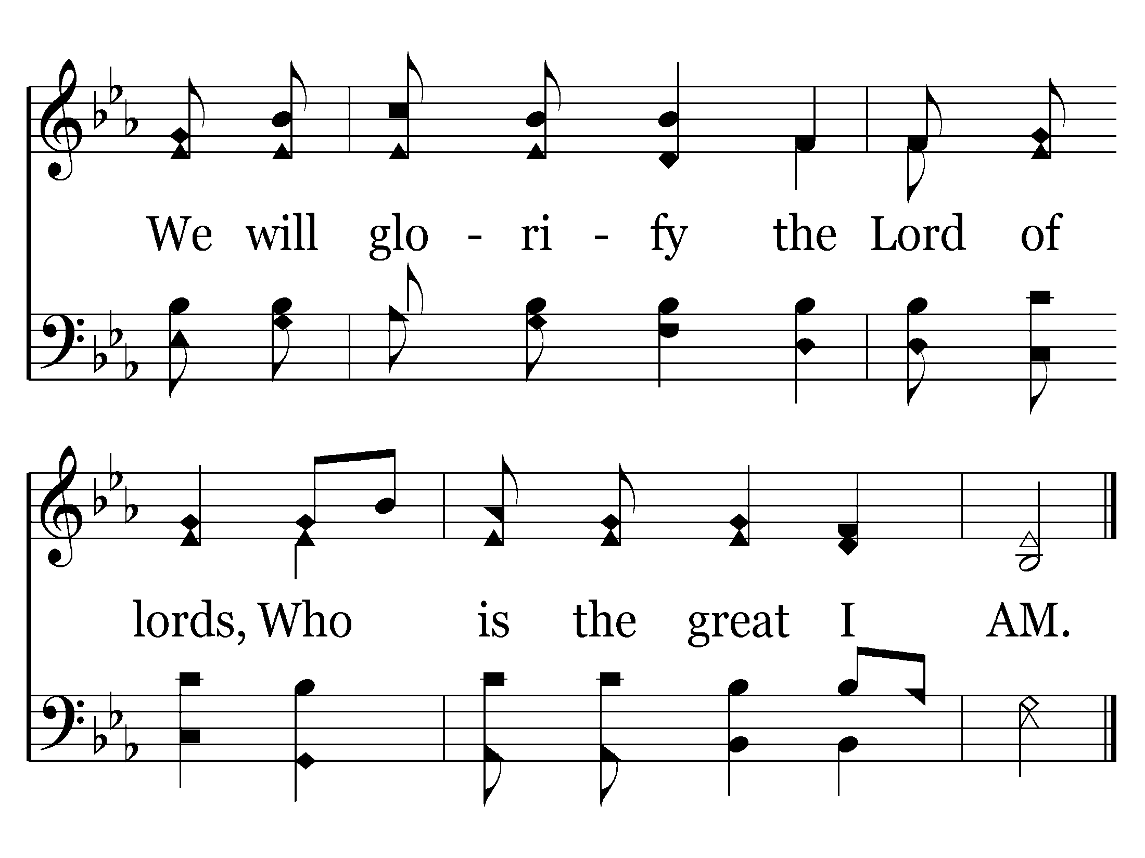
141 - We Will Glorify The King Of Kings - 1.2
End of Verse 1

Slide 4
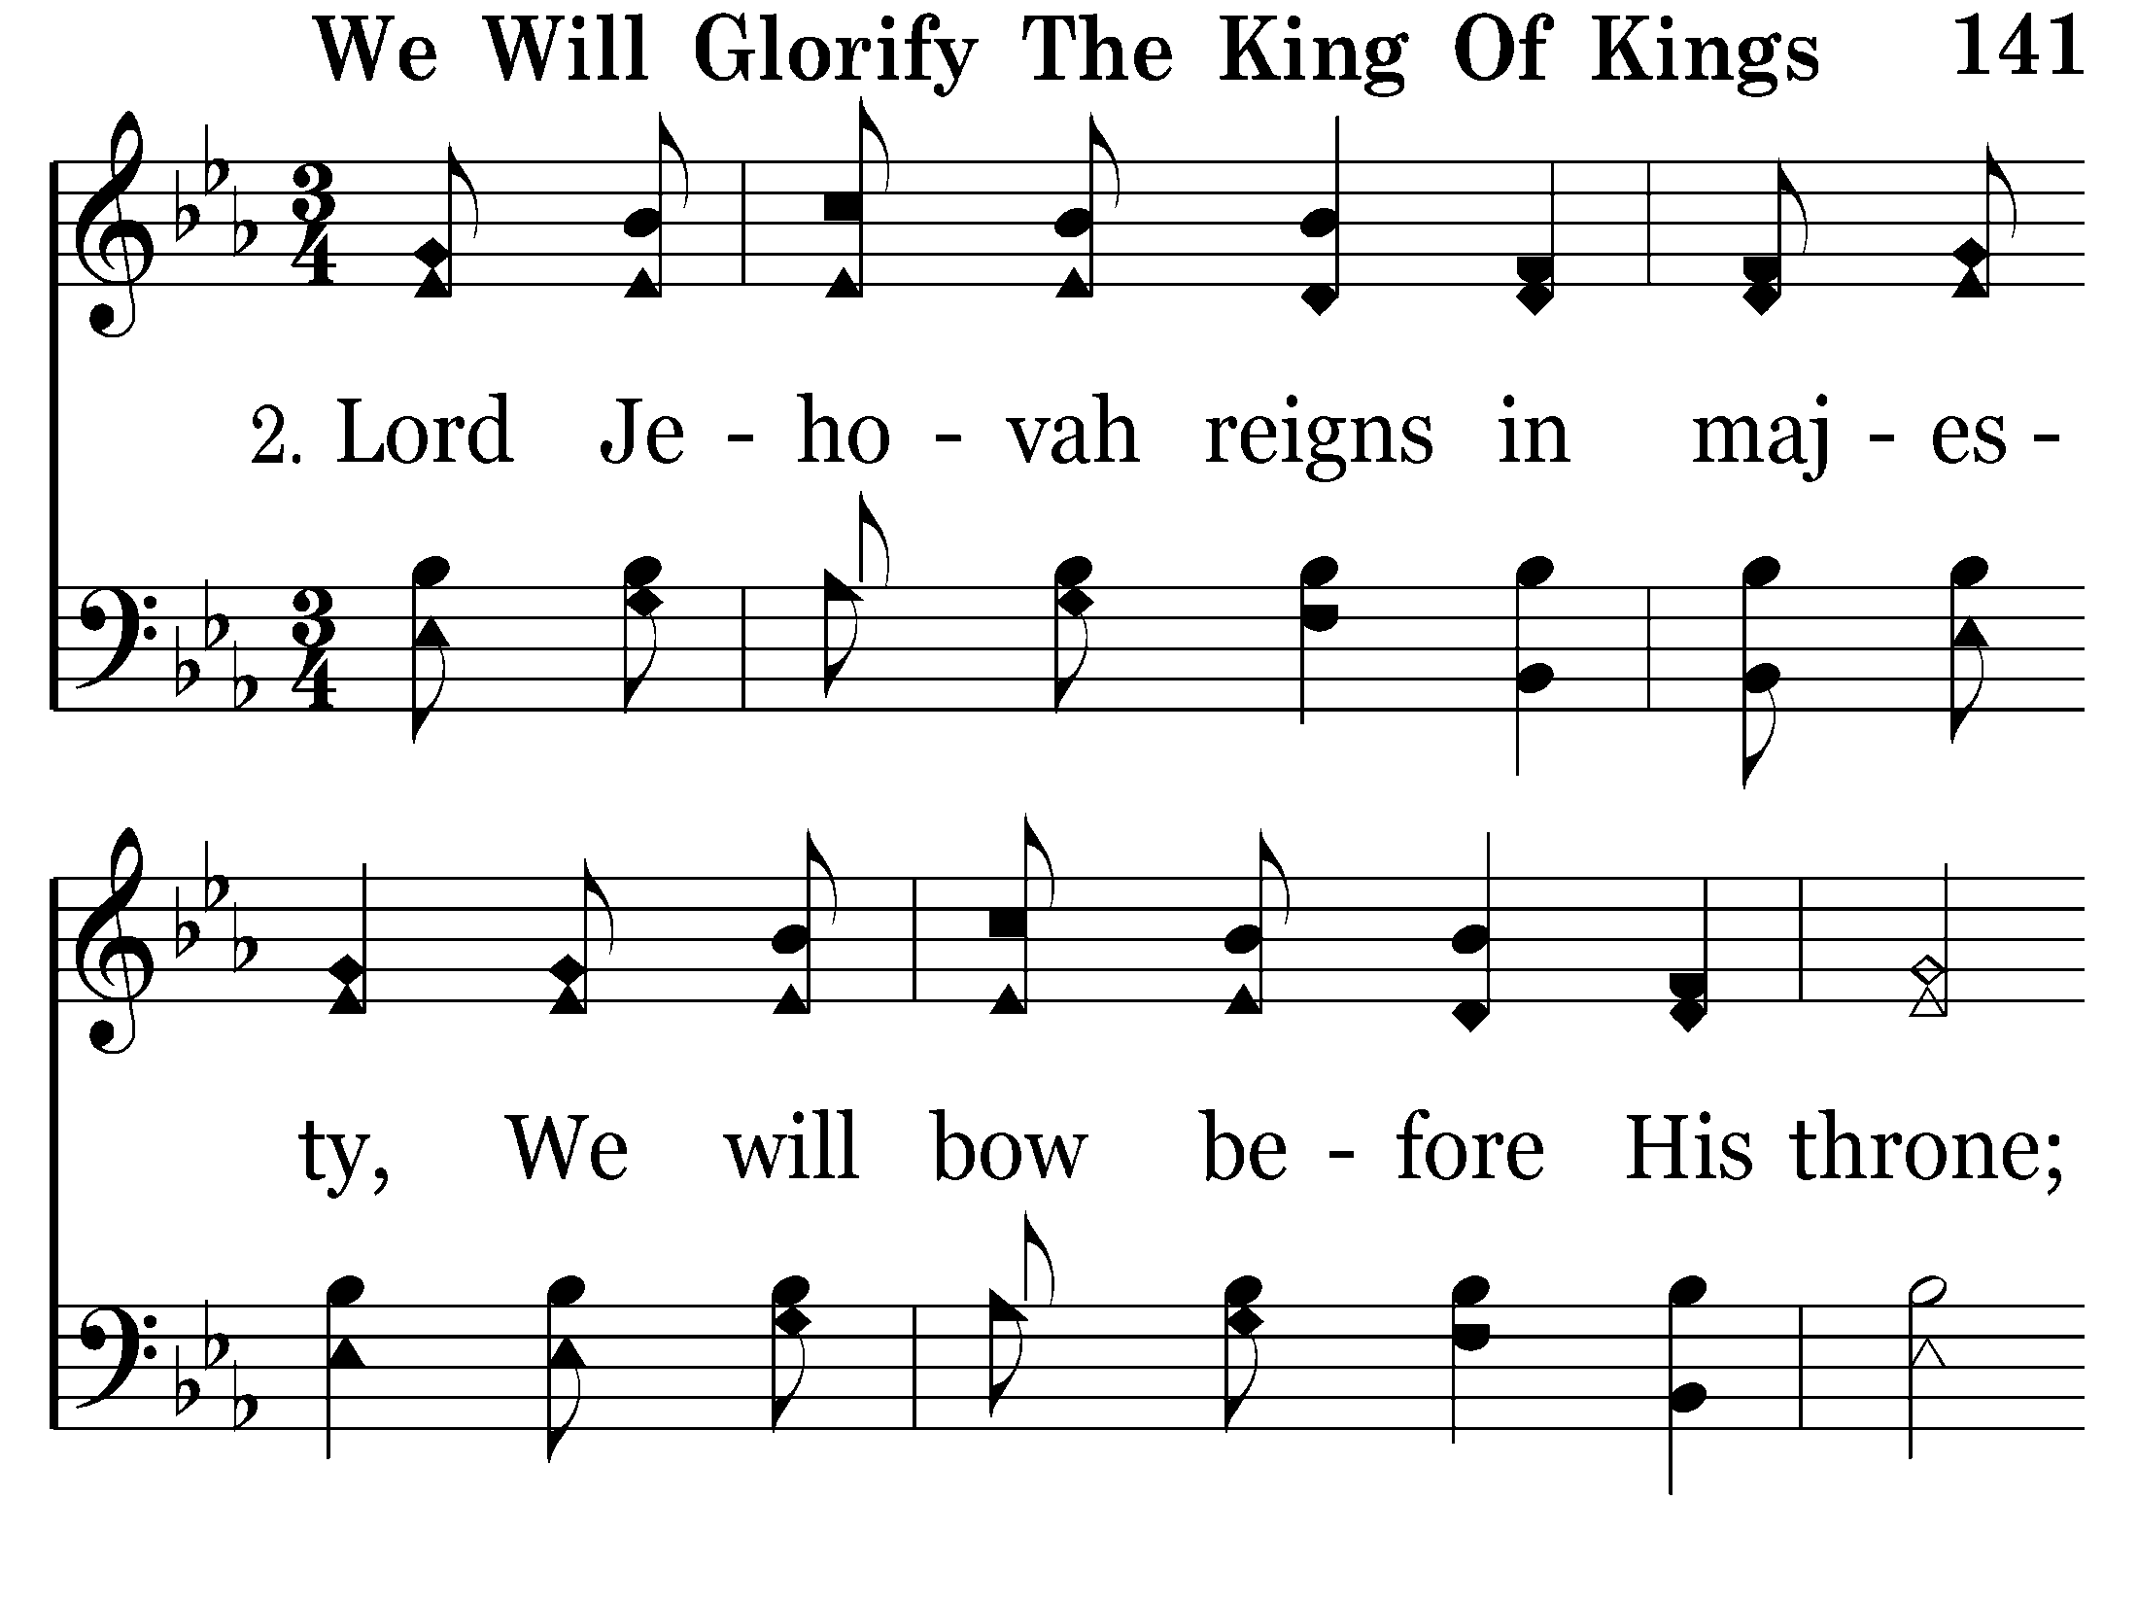
141 - We Will Glorify The King Of Kings - 2.1

Slide 5
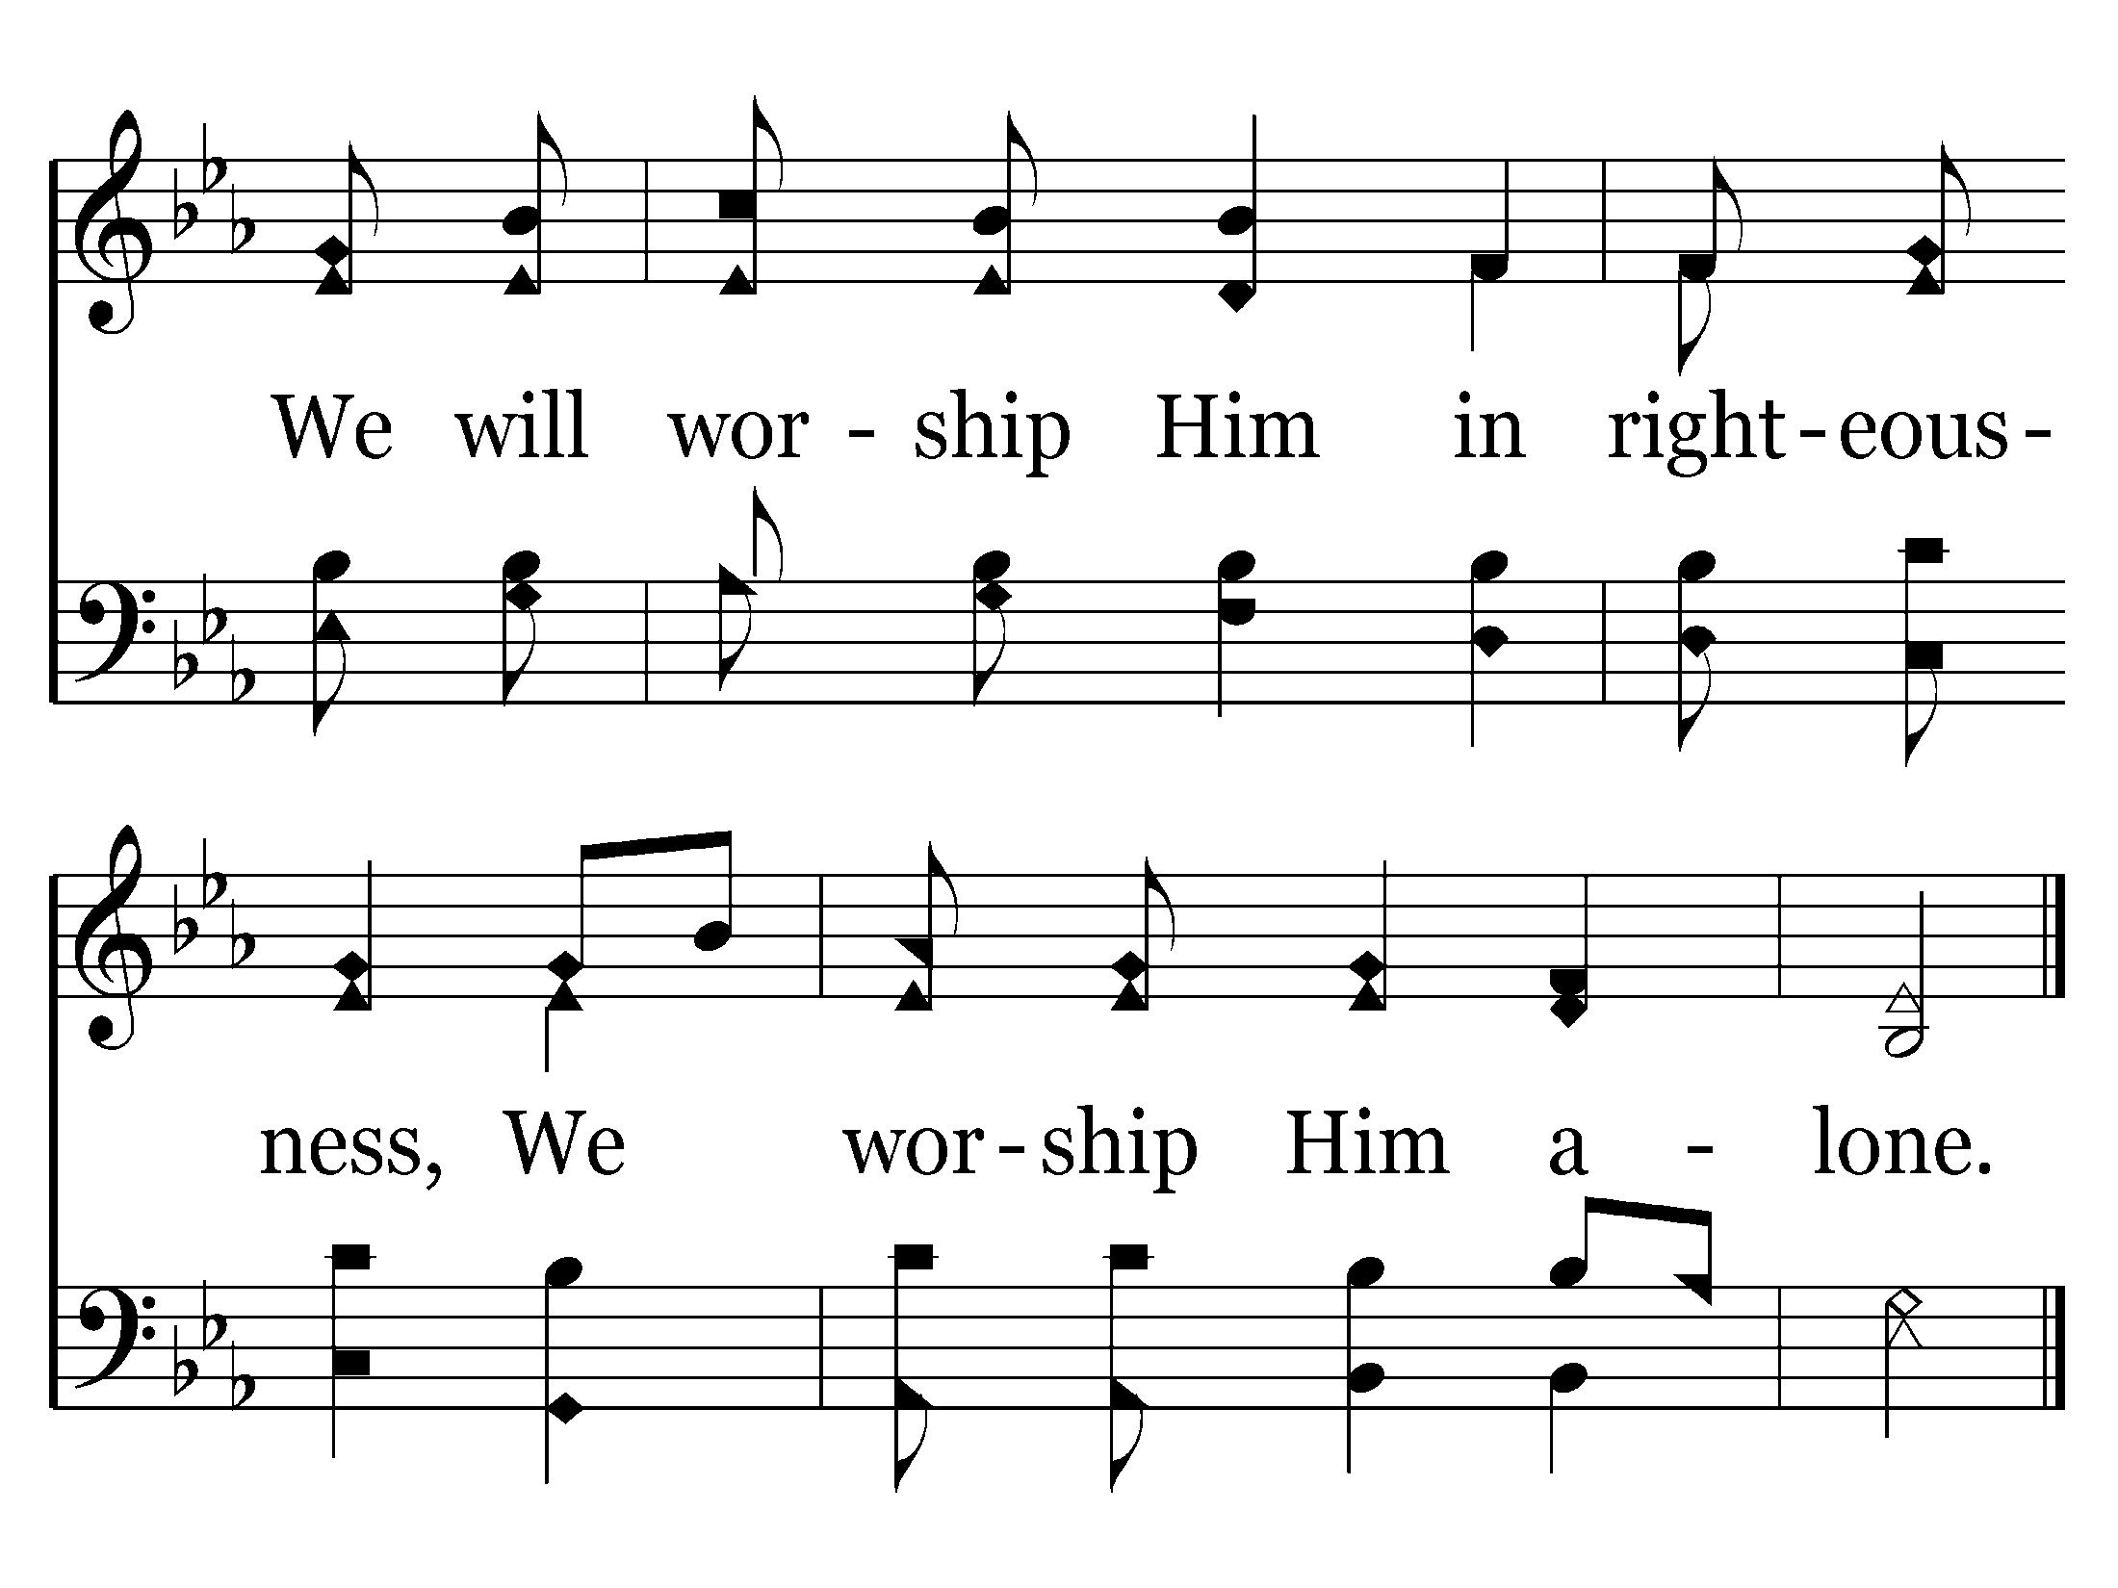
141 - We Will Glorify The King Of Kings - 2.2
End of Verse 2

Slide 6
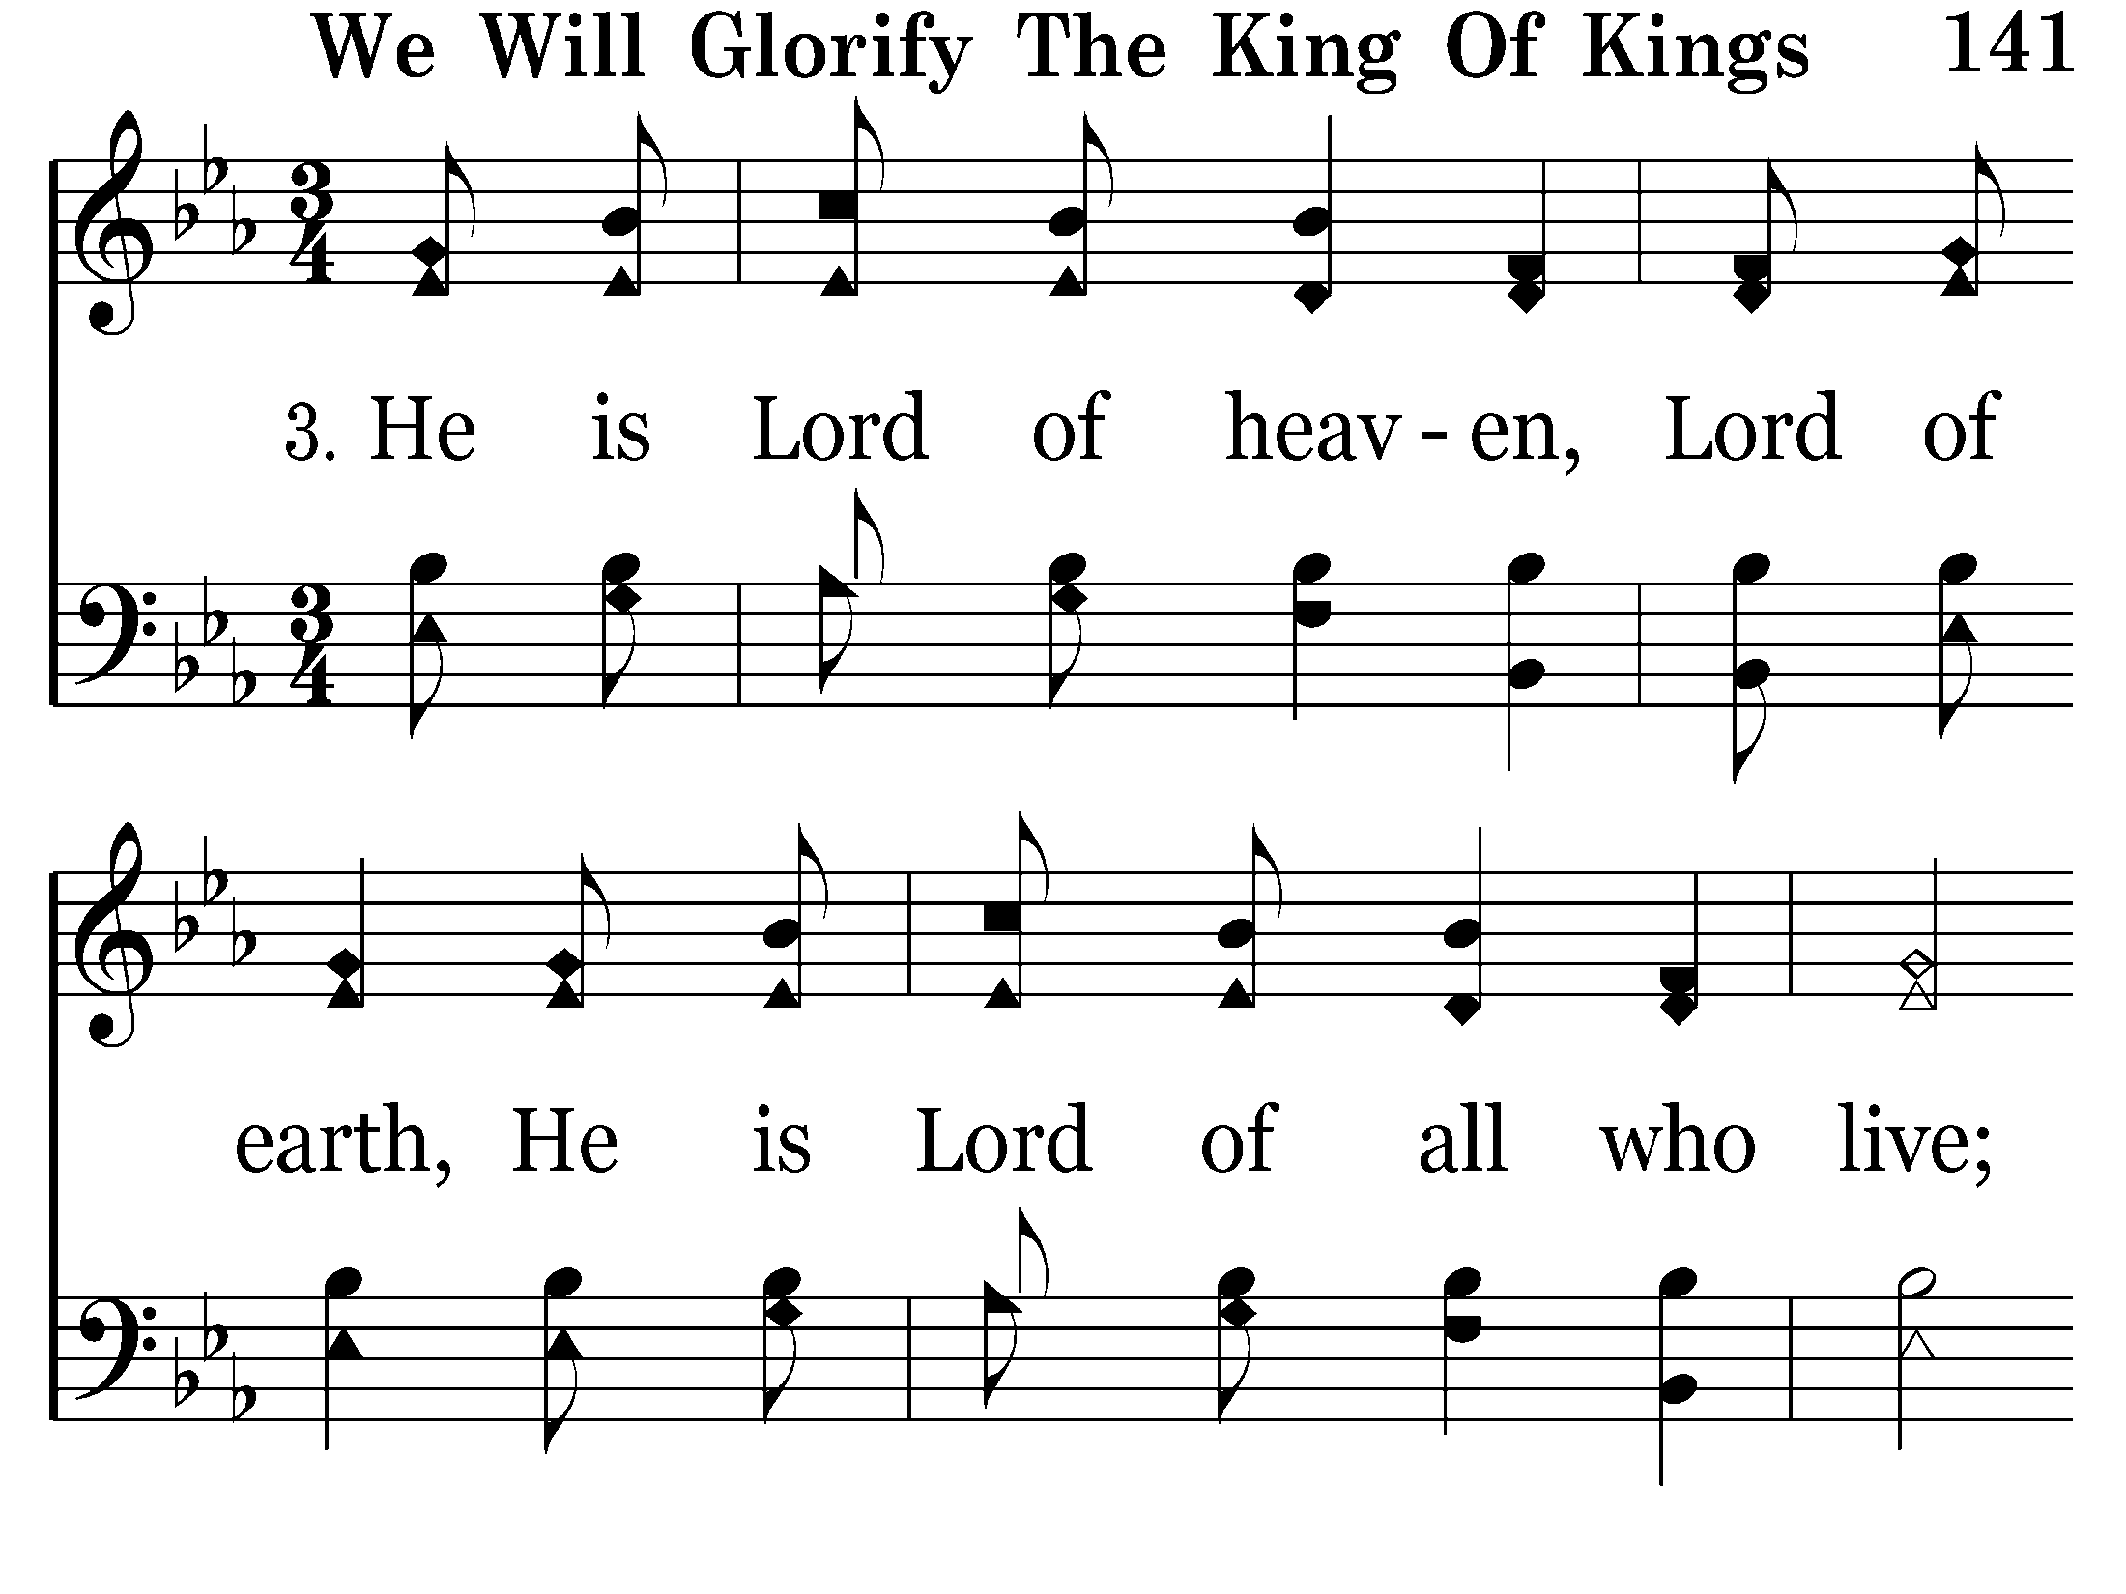
141 - We Will Glorify The King Of Kings - 3.1

Slide 7
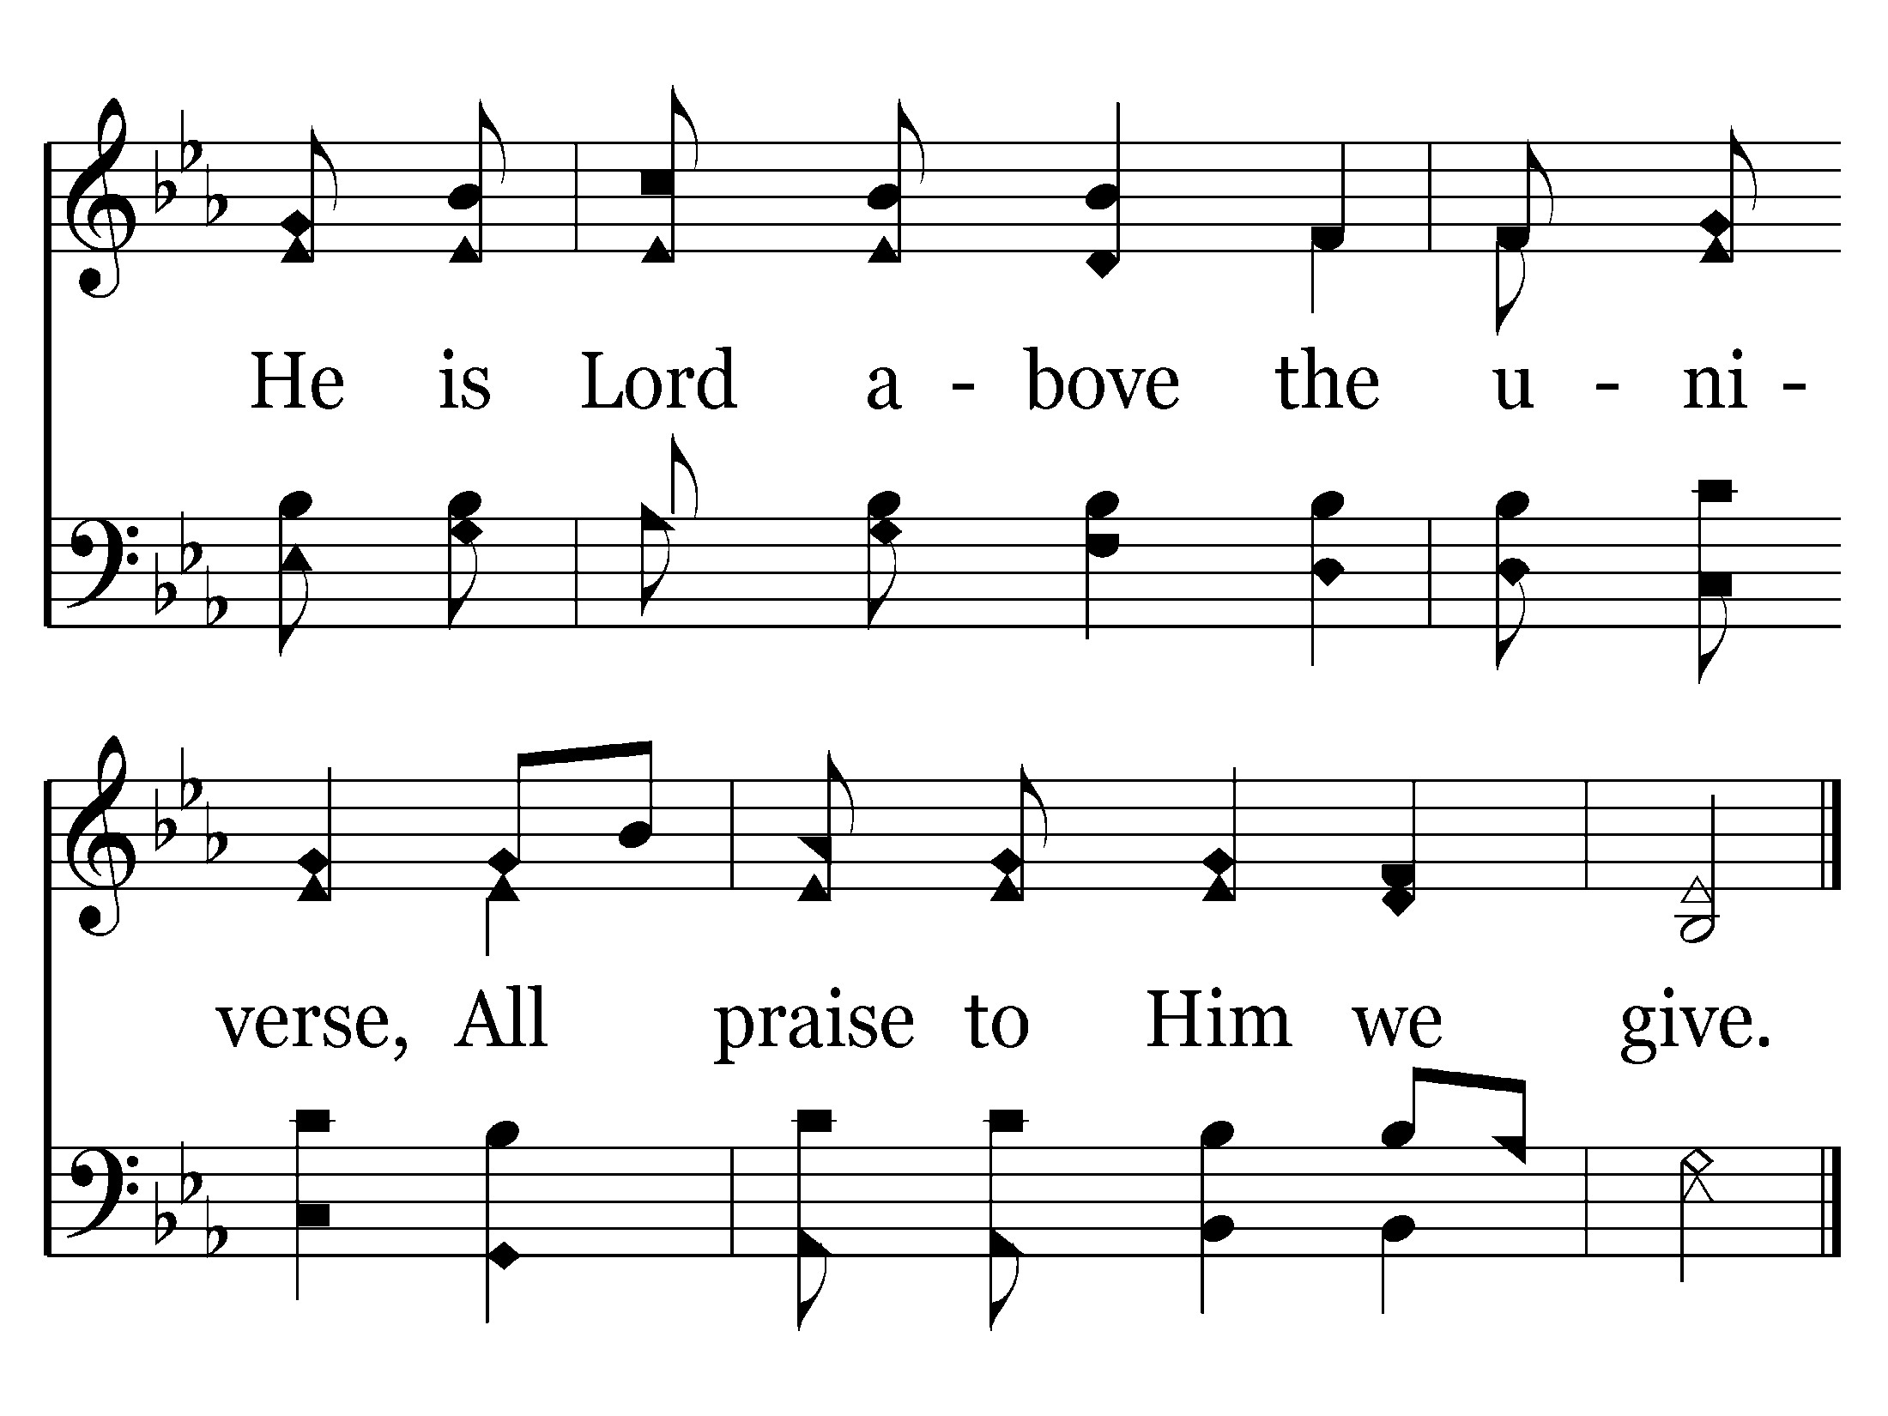
141 - We Will Glorify The King Of Kings - 3.2
End of Verse 3

Slide 8
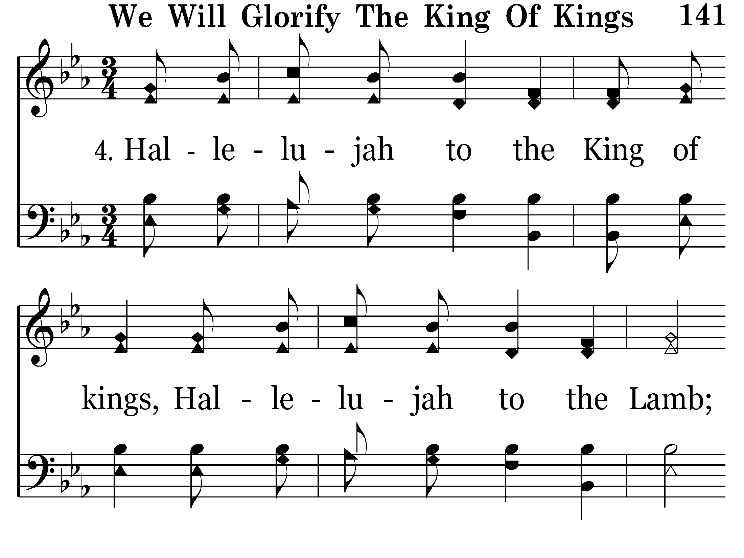
141 - We Will Glorify The King Of Kings - 4.1

Slide 9
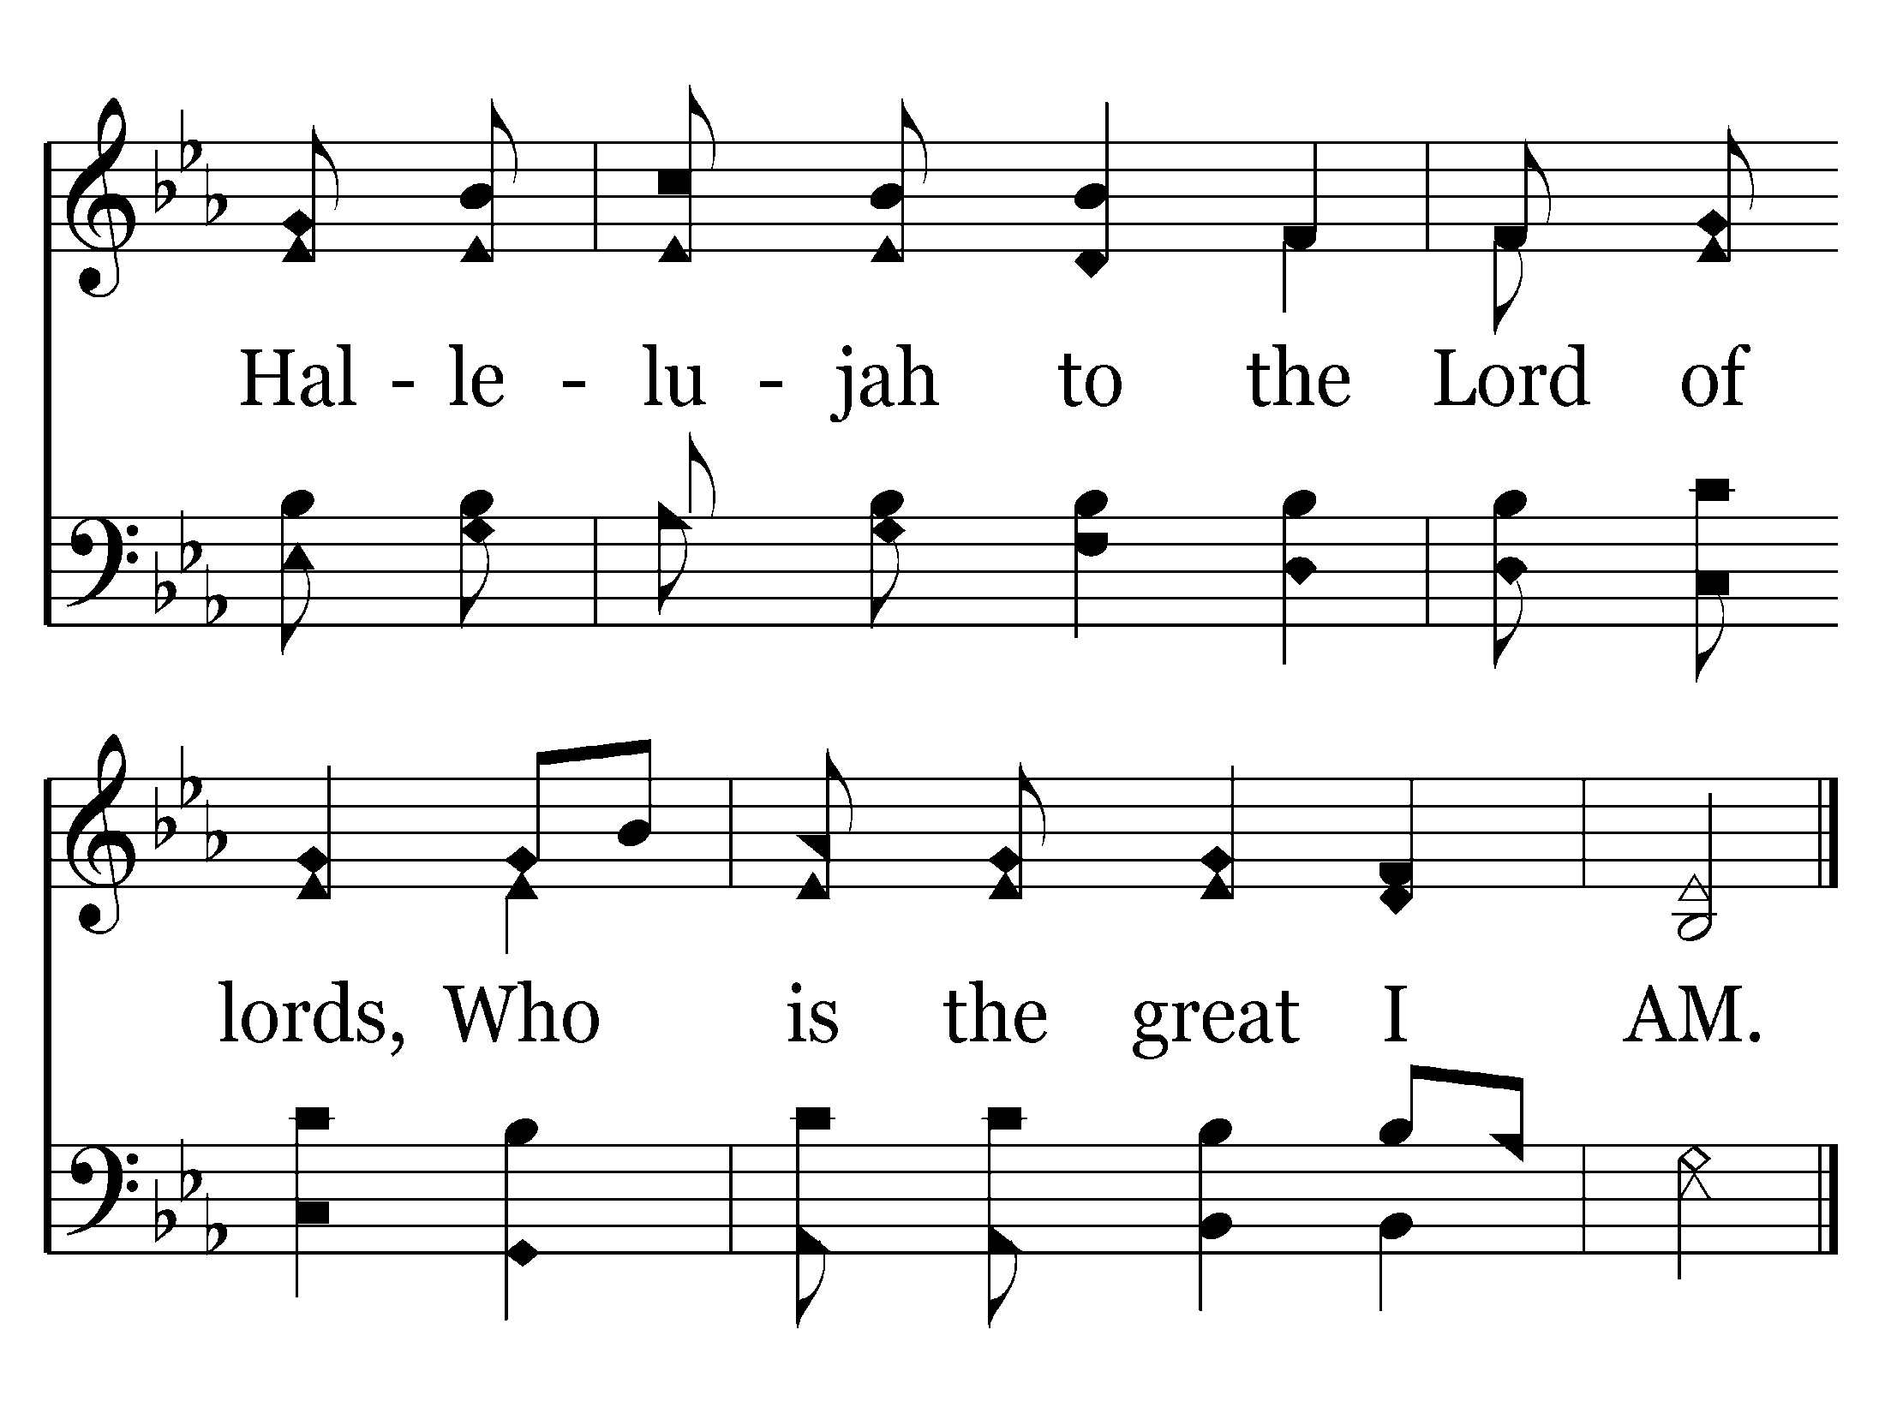
141 - We Will Glorify The King Of Kings - 4.2
End of Song

Slide 10

205 - Amazing Grace - Title

Slide 11
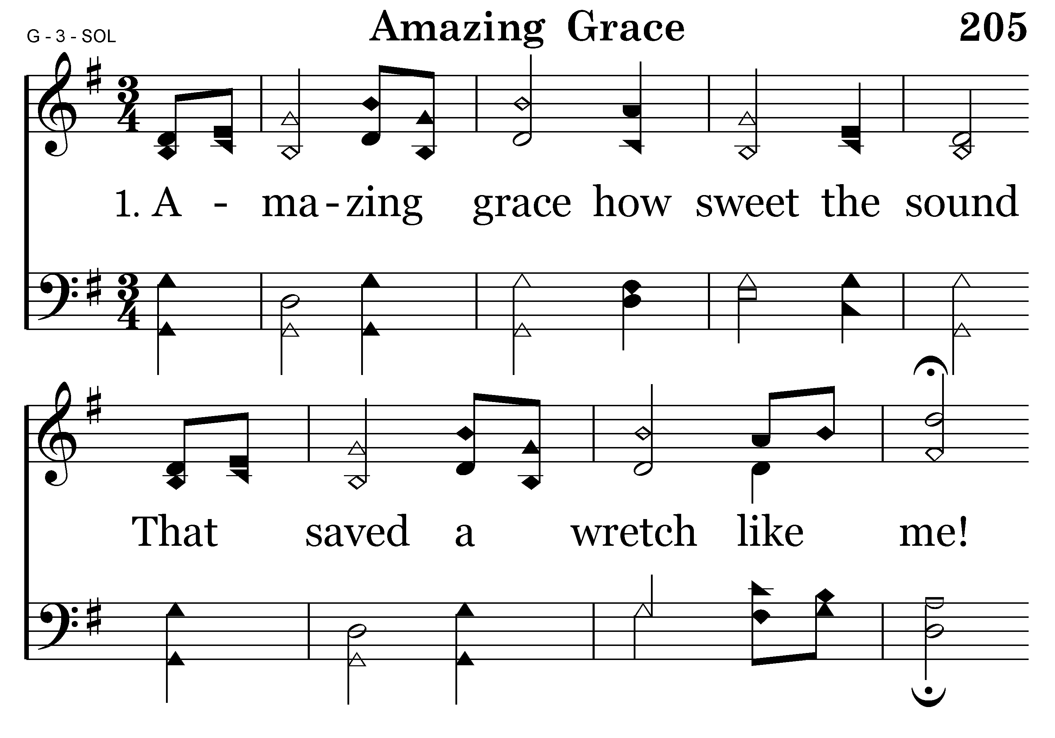
205 - Amazing Grace - 1.1

Slide 12
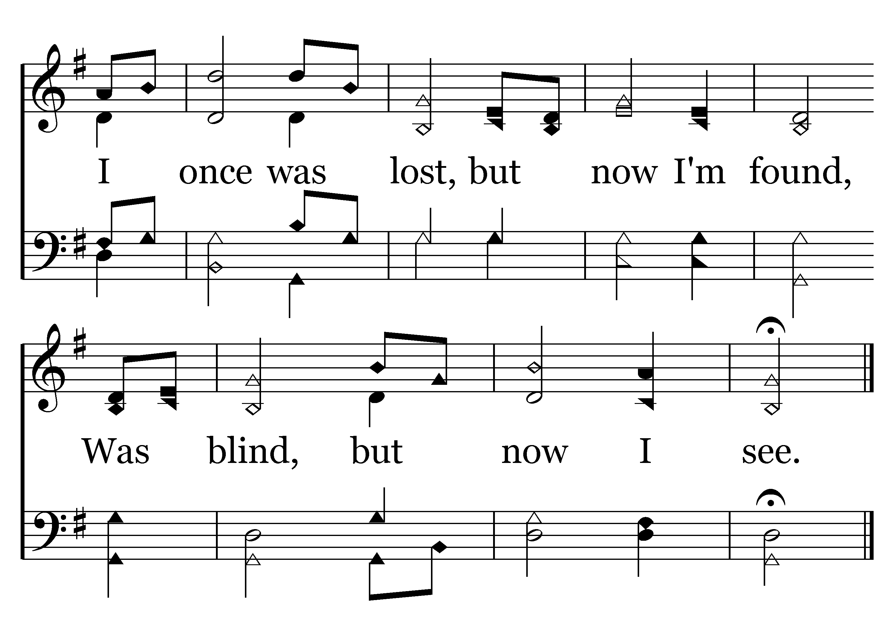
205 - Amazing Grace - 1.2
End of Verse 1

Slide 13
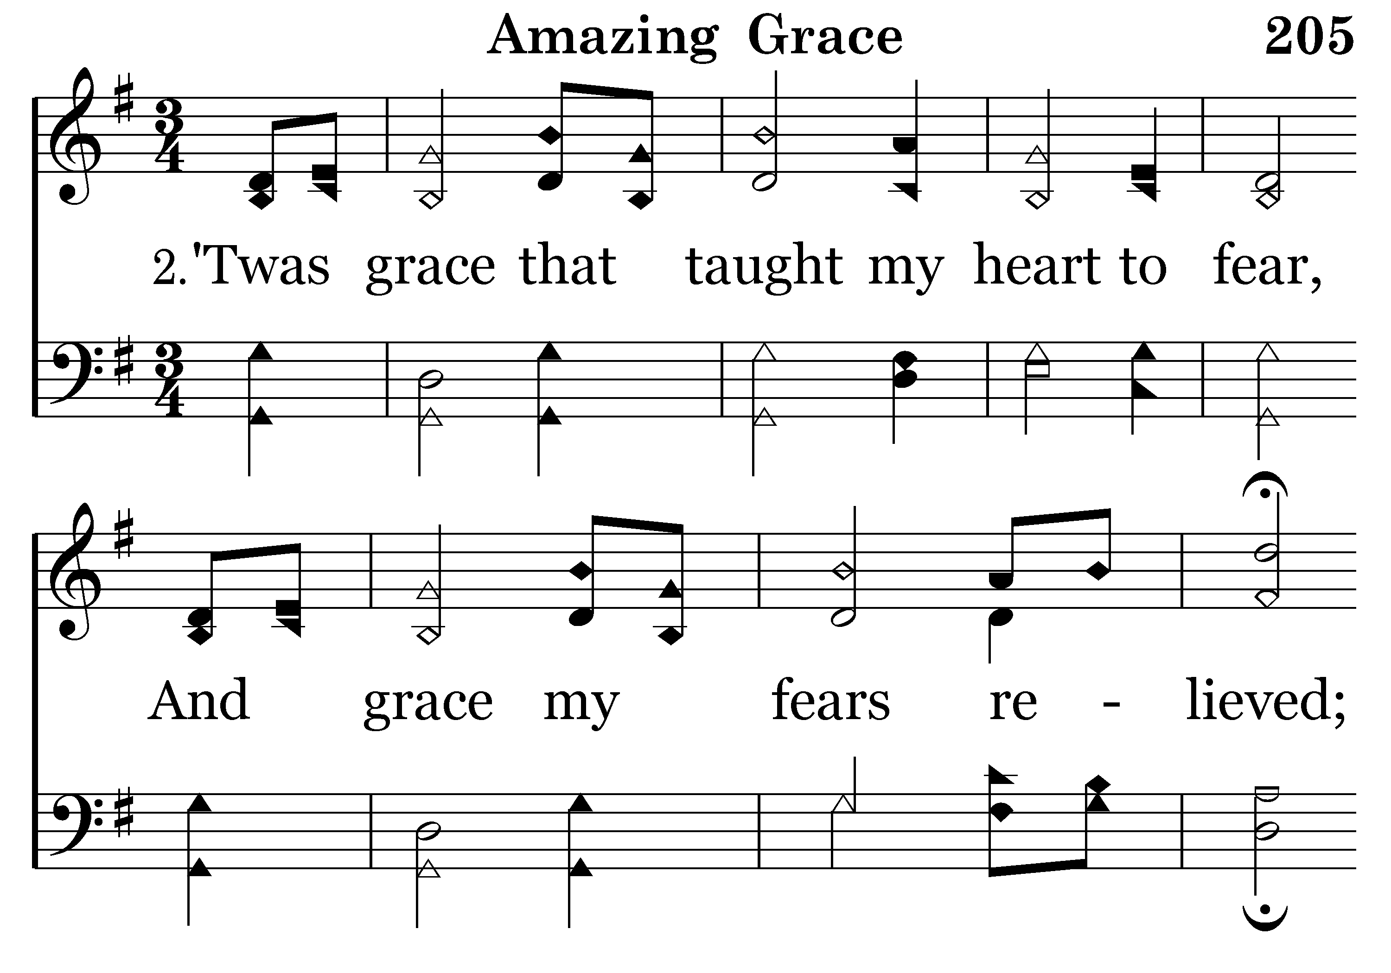
205 - Amazing Grace - 2.1

Slide 14
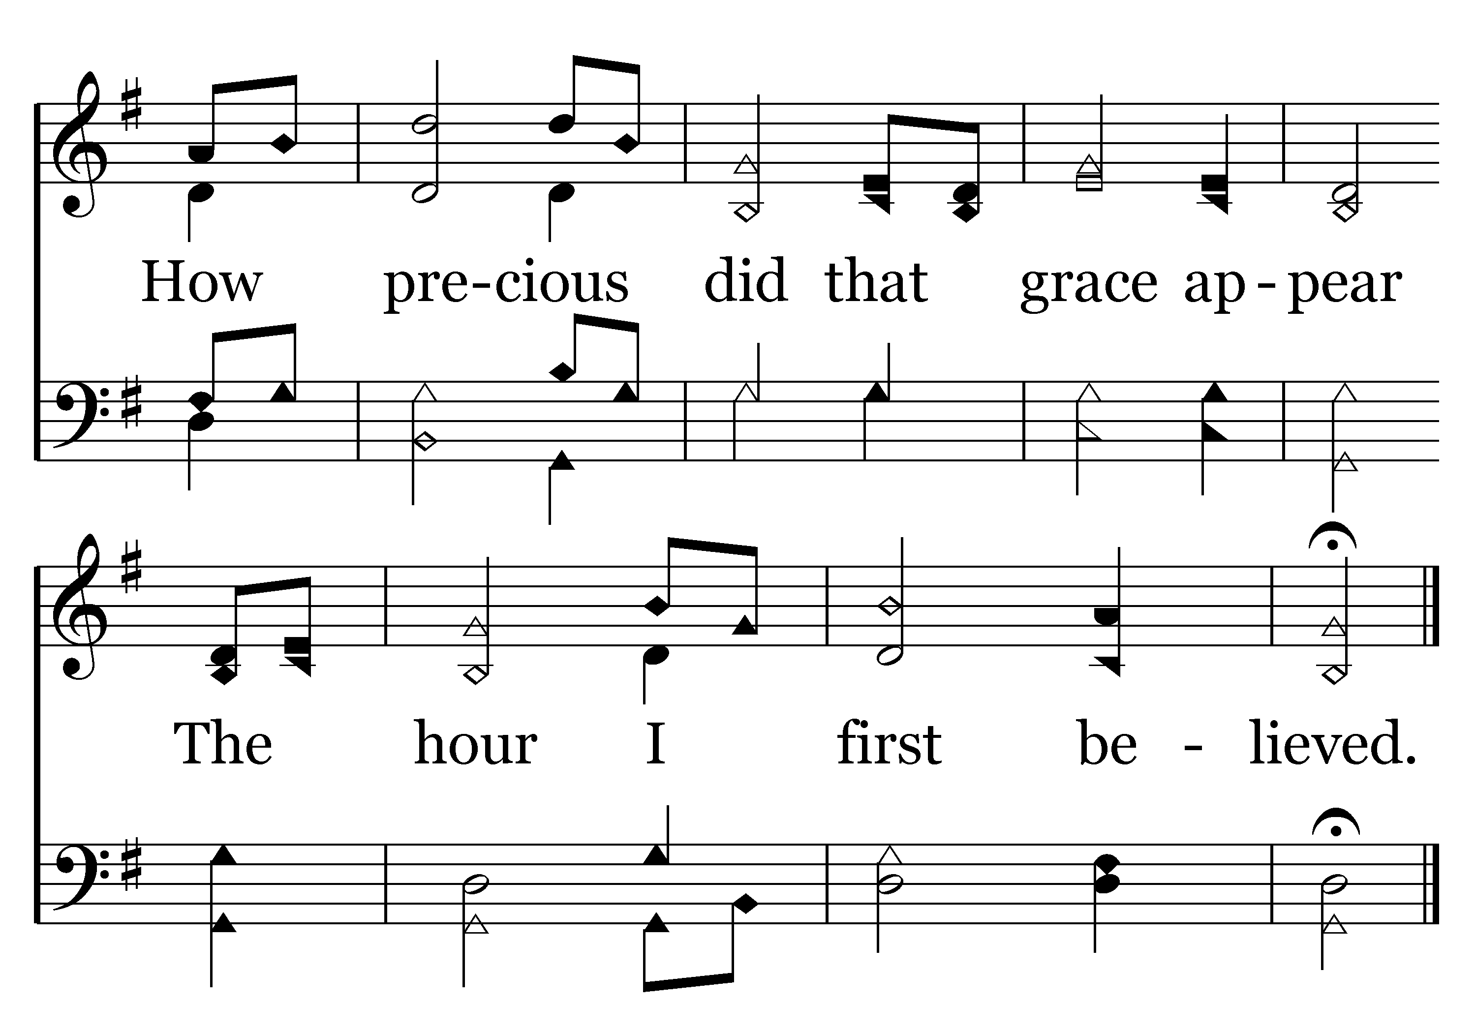
205 - Amazing Grace - 2.2
End of Verse 2

Slide 15
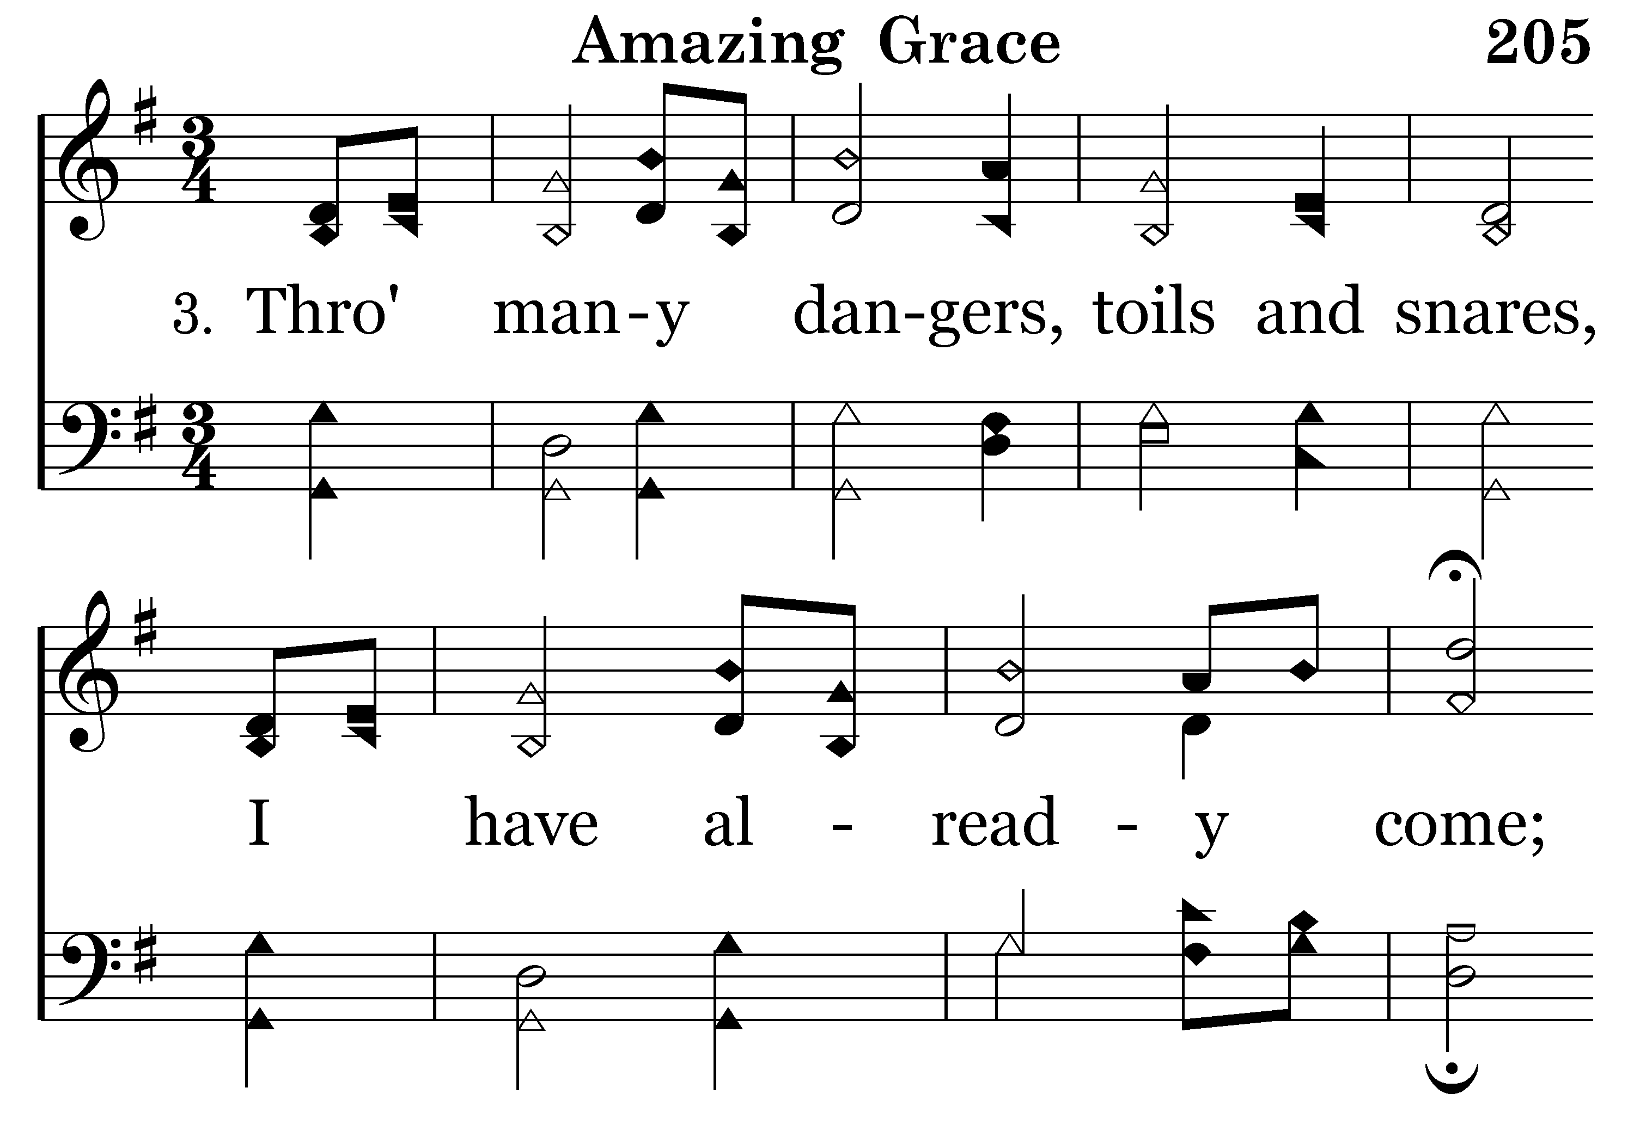
205 - Amazing Grace - 3.1

Slide 16
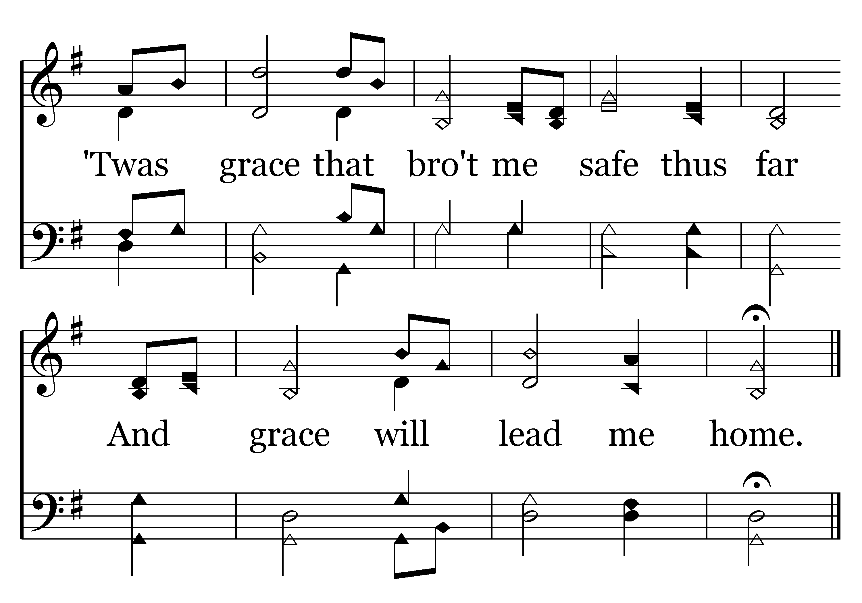
205 - Amazing Grace - 3.2
End of Verse 3

Slide 17
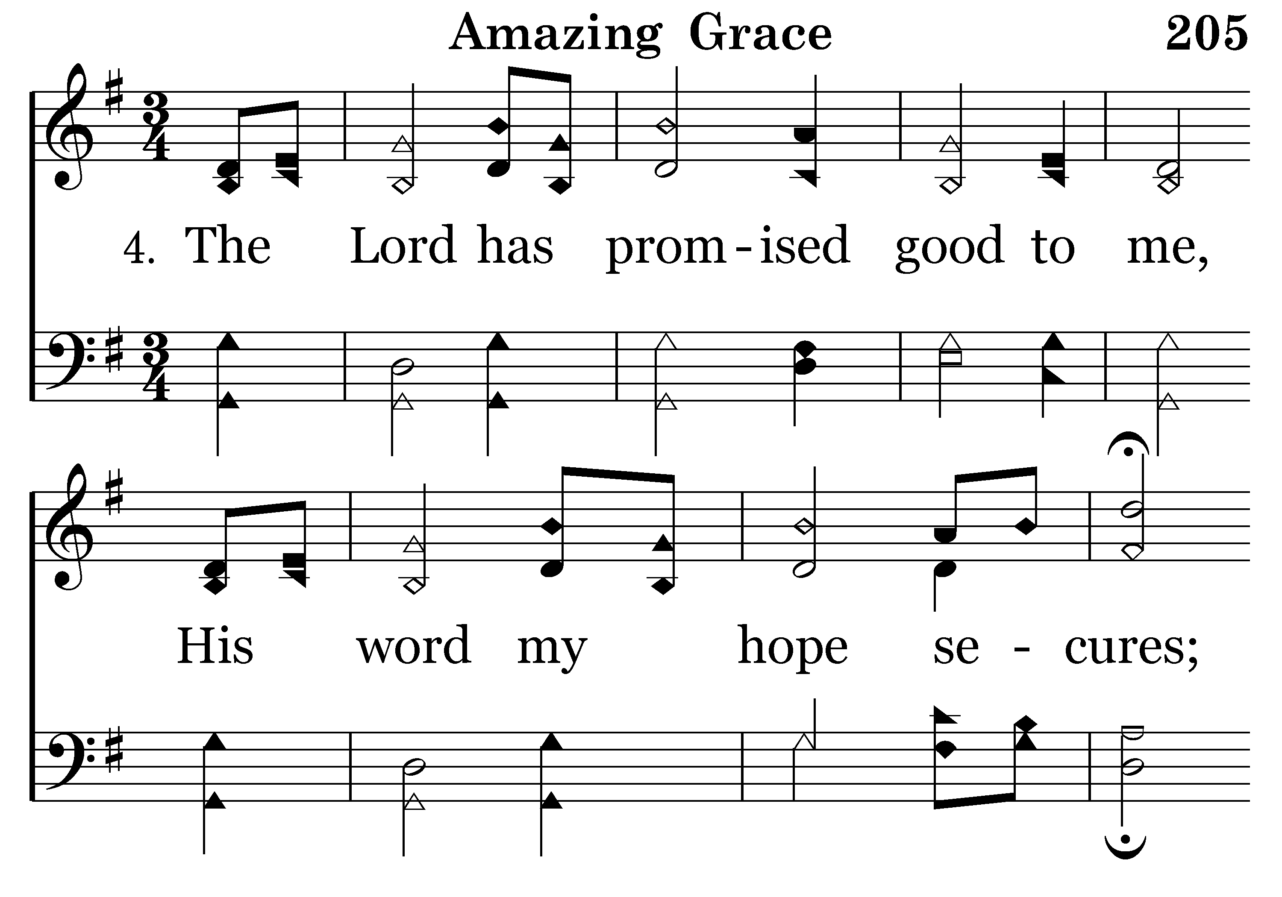
205 - Amazing Grace - 4.1

Slide 18
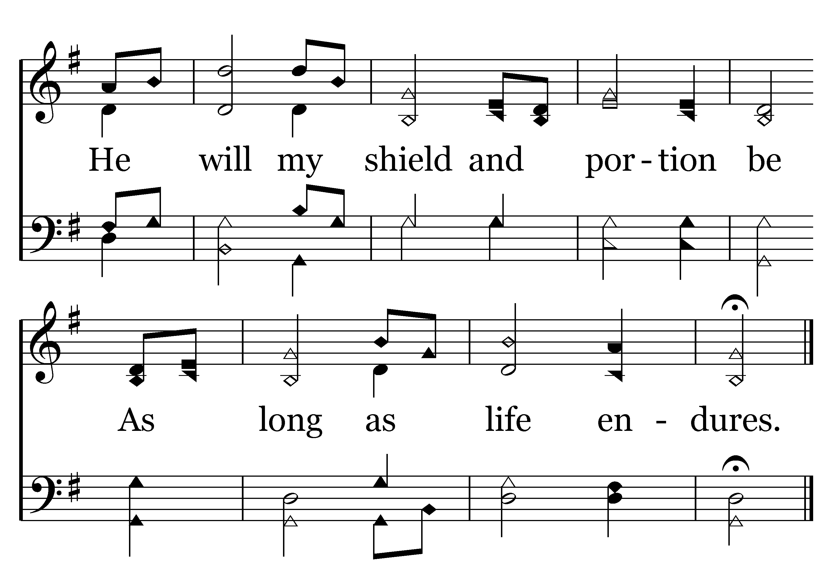
205 - Amazing Grace - 4.2
End of Verse 4

Slide 19
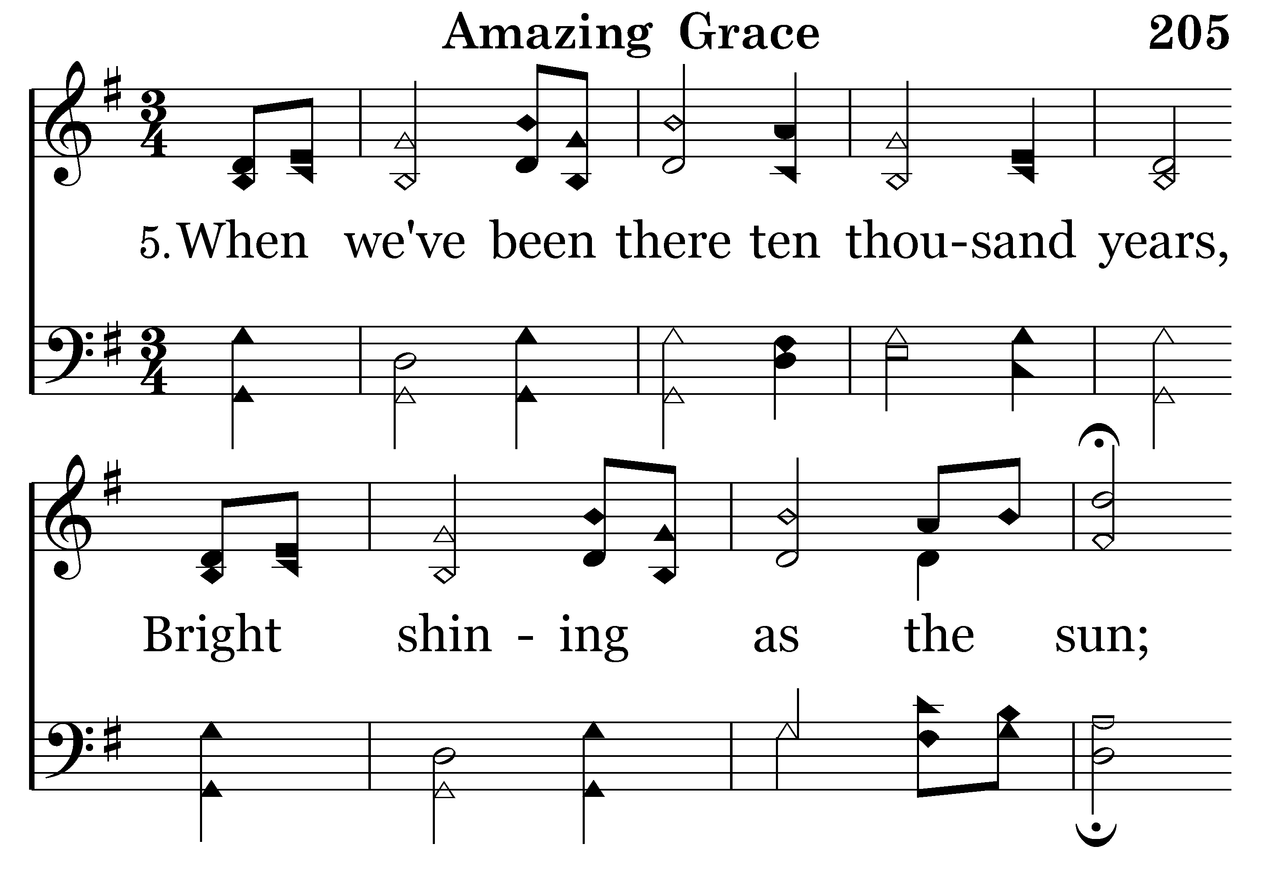
205 - Amazing Grace - 5.1

Slide 20
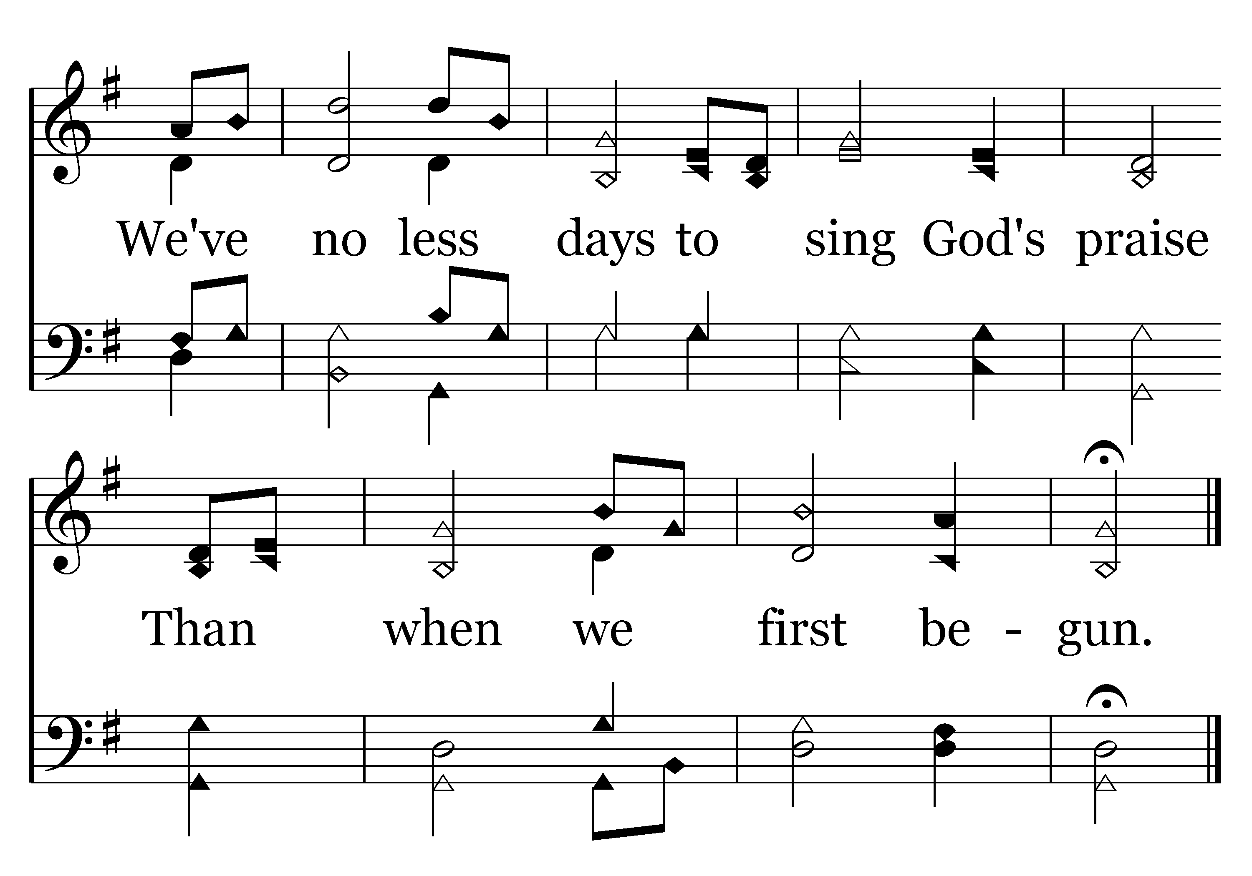
205 - Amazing Grace - 5.2
End of Song

Slide 21
1 Timothy 3:4–5
⁴ He must manage his own household well, with all dignity keeping his children submissive, ⁵ for if someone does not know how to manage his own household, how will he care for God’s church?

Slide 23


Slide 24
Keep it in the context.
The man must be considered based on his character and the work.
There is no “safe” out.

Slide 25
Timothy’s list:
“Husband of one wife”
“Self-controlled”
“Hospitable”
“Not a drunkard”
“Not violent”
“Above reproach”
“Sober-minded”
“Able to Teach”
“Not a lover of money”
“Keeping his children submissive”
“Respectable”
“Gentle”
“Not quarrelsome”
“Not a recent convert”
“Well thought of by outsiders”
Our list:
“Husband of one wife”
“Self-controlled”
“Hospitable”
“Not a drunkard”
“Not violent”
“Blameless”
“Disciplined”
“Able to give instructions”
“Not greedy for gain”
“His children are believers”
“Respectable”
“Gentle”
“Not quarrelsome”
“Not a recent convert”
“Well thought of by outsiders”
“Not arrogant”
“Not quick Tempered”
“A lover of good”
“Upright”
“Holy”
Titus’ list:
“Husband of one wife”
“Self-controlled”
“Hospitable”
“Not a drunkard”
“Not violent”
“Blameless”
“Disciplined”
“Able to give instructions”
“Not greedy for gain”
“His children are believers”
“Not arrogant”
“Not quick Tempered”
“A lover of good”
“Upright”
“Holy”

Slide 26
Keep it in the context.
The man must be considered based on his character and the work.
There is no “safe” out.
  1 Timothy 3:2–7
  Titus 1:6–7

Slide 27
The issue of “faithful” children.
Titus 1:6
1 Timothy 3:4–5
1 Timothy 3:12
We should consider this qualification on the basis of the man’s character.

Slide 28
What about his marriage?
1 Timothy 3:2
Titus 1:6
We must answer these questions in the context of the man’s character and his work.

