Slide 1
2 Timothy 4:7–8
⁷I have fought the good fight, I have finished the race, I have kept the faith. ⁸Henceforth there is laid up for me the crown of righteousness, which the Lord, the righteous judge, will award to me on that Day, and not only to me but also to all who have loved his appearing.

Slide 4
Some don’t finish. Why?
Pride.
Weariness.
Influence of culture.
Worldliness.

Slide 5
Finishing is a choice.
Joshua 24:15
How do we finish strong?
Desire the finish.
Train for the finish.

Slide 6
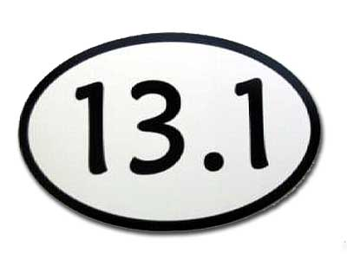
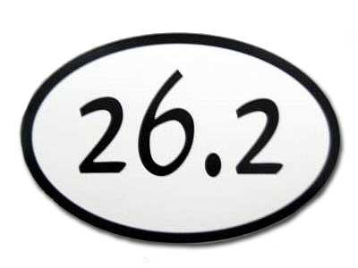

Slide 8
Finishing is a choice.
Joshua 24:15
How do we finish strong?
Desire the finish.
Train for the finish.
Have fellowship with other finishers.

Slide 9
When you finish, heaven is the reward.
Choosing to finish is choosing heaven.
Choosing anything but finishing is choosing anything but heaven.
2 Timothy 4:7–8

