Slide 1
Ephesians 4:20–22
20 But that is not the way you learned Christ!— 21 assuming that you have heard about him and were taught in him, as the truth is in Jesus, 22 to put off your old self, which belongs to your former manner of life and is corrupt through deceitful desires,

Slide 2
Ephesians 4:23–24
23 and to be renewed in the spirit of your minds, 24 and to put on the new self, created after the likeness of God in true righteousness and holiness.

Slide 6
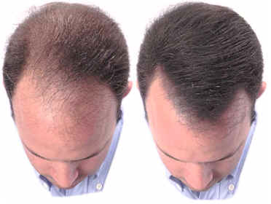

Slide 8
The Before Man…
…lives in vanity (v. 17).
…lives in ignorance (v. 18).
…becomes callous (v. 19).
…becomes immoral (v. 19).

Slide 9
The After Man…
…has learned Christ (v. 20).
…has a new standard (v. 21).
…has a new lifestyle (v. 22).
…has a new thought process (v. 23).

Slide 10
Before
After
Lives in vanity.
Lives in ignorance.
Becomes callous.
Becomes immoral.
Has learned Christ.
Has a new standard.
Has a new lifestyle.
Has a new thought process.

Slide 12
Ephesians 4:20–24 (ESV)
20 But that is not the way you learned Christ!— 21 assuming that you have heard about him and were taught in him, as the truth is in Jesus, 22 to put off your old self, which belongs to your former manner of life and is corrupt through deceitful desires, 23 and to be renewed in the spirit of your minds, 24 and to put on the new self, created after the likeness of God in true righteousness and holiness.

