Slide 1
John 3:11-15
Most assuredly, I say to you, We speak what We know and testify what We have seen, and you do not receive Our witness. ¹² If I have told you earthly things and you do not believe, how will you believe if I tell you heavenly things? ¹³ No one has ascended to heaven but He who came down from heaven, that is, the Son of Man who is in heaven. ¹⁴ And as Moses lifted up the serpent in the wilderness, even so must the Son of Man be lifted up, ¹⁵ that whoever believes in Him should not perish but have eternal life.

Slide 3
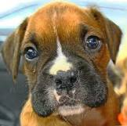

Slide 4
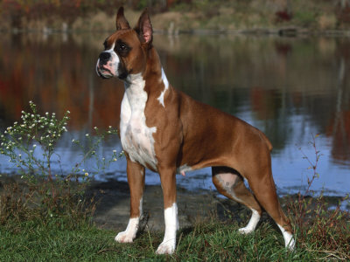

Slide 5
BELIEF

Slide 6
Luke 7:1-2
Now when He concluded all His sayings in the hearing of the people, He entered Capernaum. ² And a certain centurion’s servant, who was dear to him, was sick and ready to die.

Slide 7
Luke 7:3
So when he heard about Jesus, he sent elders of the Jews to Him, pleading with Him to come and heal his servant

Slide 8
Luke 7:4-5
And when they came to Jesus, they begged Him earnestly, saying that the one for whom He should do this was deserving, “for he loves our nation, and has built us a synagogue.”

Slide 9
Luke 7:6
Then Jesus went with them. And when He was already not far from the house, the centurion sent friends to Him, saying to Him, “Lord, do not trouble Yourself, for I am not worthy that You should enter under my roof

Slide 10
Luke 7:7
Therefore I did not even think myself worthy to come to You. But say the word, and my servant will be healed.

Slide 11
Luke 7:8
For I also am a man placed under authority, having soldiers under me. And I say to one, ‘Go,’ and he goes; and to another, ‘Come,’ and he comes; and to my servant, ‘Do this,’ and he does it.

Slide 12
Luke 7:9 -10
When Jesus heard these things, He marveled at him, and turned around and said to the crowd that followed Him, “I say to you, I have not found such great faith, not even in Israel!” ¹⁰ And those who were sent, returning to the house, found the servant well who had been sick.

Slide 13
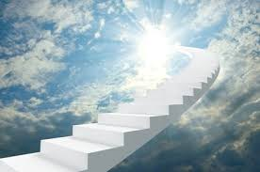

Slide 14
Matthew 8:11-12
And I say to you that many will come from east and west, and sit down with Abraham, Isaac, and Jacob in the kingdom of heaven. ¹² But the sons of the kingdom will be cast out into outer darkness. There will be weeping and gnashing of teeth

