Slide 1
Proverbs 3: 4-5
Trust in the Lord with all your heart, And lean not on your own understanding; ⁶ In all your ways acknowledge Him, And He shall direct your paths

Slide 3
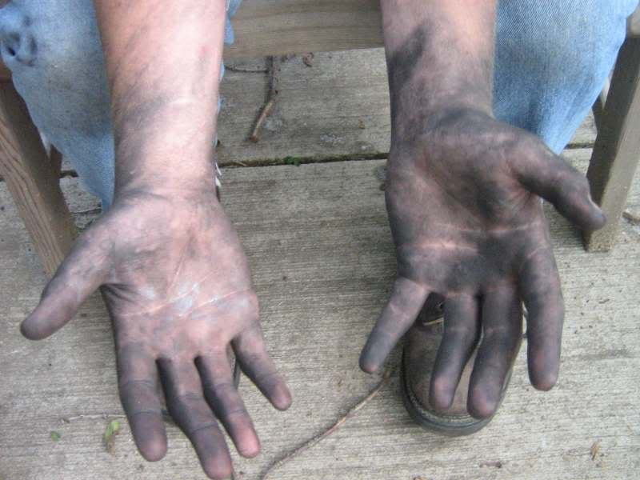
Unacceptable Hands

Slide 4
Leviticus 10:1-2
Then Nadab and Abihu, the sons of Aaron, each took his censer and put fire in it, put incense on it, and offered profane fire before the Lord, which He had not commanded them. ² So fire went out from the Lord and devoured them, and they died before the Lord

Slide 5
Leviticus 10:3
And Moses said to Aaron, “This is what the Lord spoke, saying:
‘By those who come near Me I must be regarded as holy; And before all the people I must be glorified.’”
So Aaron held his peace.

Slide 6
Leviticus 8:1-3
And the Lord spoke to Moses, saying: ² “Take Aaron and his sons with him, and the garments, the anointing oil, a bull as the sin offering, two rams, and a basket of unleavened bread; ³ and gather all the congregation together at the door of the tabernacle of meeting.”

Slide 7
Leviticus 8:35-36
Therefore you shall stay at the door of the tabernacle of meeting day and night for seven days, and keep the charge of the Lord, so that you may not die; for so I have been commanded.” ³⁶ So Aaron and his sons did all the things that the Lord had commanded by the hand of Moses.

Slide 8
Leviticus 9:7-8
And Moses said to Aaron, “Go to the altar, offer your sin offering and your burnt offering, and make atonement for yourself and for the people. Offer the offering of the people, and make atonement for them, as the Lord commanded.”
⁸ Aaron therefore went to the altar and killed the calf of the sin offering, which was for himself

Slide 9
Leviticus 9:24-10:2
²⁴ and fire came out from before the Lord and consumed the burnt offering and the fat on the altar. When all the people saw it, they shouted and fell on their faces.
10 Then Nadab and Abihu, the sons of Aaron, each took his censer and put fire in it, put incense on it, and offered profane fire before the Lord, which He had not commanded them.

Slide 10
Jeremiah 17:10
I, the Lord, search the heart, I test the mind, Even to give every man according to his ways, According to the fruit of his doings.

Slide 11
Psalms 24:3-4
Who may ascend into the hill of the Lord? Or who may stand in His holy place? ⁴ He who has clean hands and a pure heart, Who has not lifted up his soul to an idol, Nor sworn deceitfully.

Slide 12
John 14:6
Jesus said to him, “I am the way, the truth, and the life. No one comes to the Father except through Me

Slide 13
Leviticus 10:3
By those who come near Me I must be regarded as holy; And before all the people I must be glorified

