Slide 1
Ephesians 4:20-24
But you have not so learned Christ, ²¹ if indeed you have heard Him and have been taught by Him, as the truth is in Jesus: ²² that you put off, concerning your former conduct, the old man which grows corrupt according to the deceitful lusts, ²³ and be renewed in the spirit of your mind, ²⁴ and that you put on the new man which was created according to God, in true righteousness and holiness

Slide 3
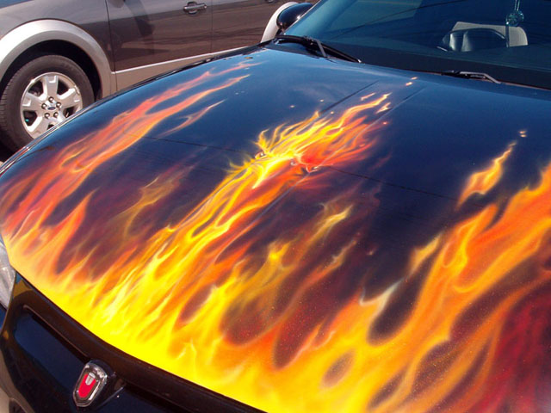
1980 Datsun 200

Slide 4
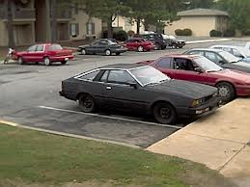

Slide 5
GOD Takes Trade-ins

Slide 6
John 11:1-2
Now a certain man was sick, Lazarus of Bethany, the town of Mary and her sister Martha. ² It was that Mary who anointed the Lord with fragrant oil and wiped His feet with her hair, whose brother Lazarus was sick.

Slide 7
John 11:5-6
Now Jesus loved Martha and her sister and Lazarus. ⁶ So, when He heard that he was sick, He stayed two more days in the place where He was.

Slide 8
John 11:4
When Jesus heard that, He said, “This sickness is not unto death, but for the glory of God, that the Son of God may be glorified through it.”

Slide 9
John 11:7-8
⁷ Then after this He said to the disciples, “Let us go to Judea again.”
⁸ The disciples said to Him, “Rabbi, lately the Jews sought to stone You, and are You going there again?”

Slide 10
John 11:14-15
Then Jesus said to them plainly, “Lazarus is dead. ¹⁵ And I am glad for your sakes that I was not there, that you may believe. Nevertheless let us go to him.”

Slide 11
John 11:35-36
Jesus wept. ³⁶ Then the Jews said, “See how He loved him!”

Slide 12
John 11:39
Jesus said, “Take away the stone.”
Martha, the sister of him who was dead, said to Him, “Lord, by this time there is a stench, for he has been dead four days.”

Slide 13
John 11:40
Jesus said to her, “Did I not say to you that if you would believe you would see the glory of God?”

Slide 14
2 Corinthians 5:17
Therefore, if anyone is in Christ, he is a new creation; old things have passed away; behold, all things have become new.

Slide 15
John 11:43-44
Now when He had said these things, He cried with a loud voice, “Lazarus, come forth!” ⁴⁴ And he who had died came out bound hand and foot with graveclothes, and his face was wrapped with a cloth. Jesus said to them, “Loose him, and let him go

Slide 16
Colossians 3:5-7
Therefore put to death your members which are on the earth: fornication, uncleanness, passion, evil desire, and covetousness, which is idolatry. ⁶ Because of these things the wrath of God is coming upon the sons of disobedience, ⁷ in which you yourselves once walked when you lived in them.

Slide 17
Colossians 3:8-10
But now you yourselves are to put off all these: anger, wrath, malice, blasphemy, filthy language out of your mouth. ⁹ Do not lie to one another, since you have put off the old man with his deeds, ¹⁰ and have put on the new man who is renewed in knowledge according to the image of Him who created him

Slide 18
John 10:10
The thief does not come except to steal, and to kill, and to destroy. I have come that they may have life, and that they may have it more abundantly

