Slide 1
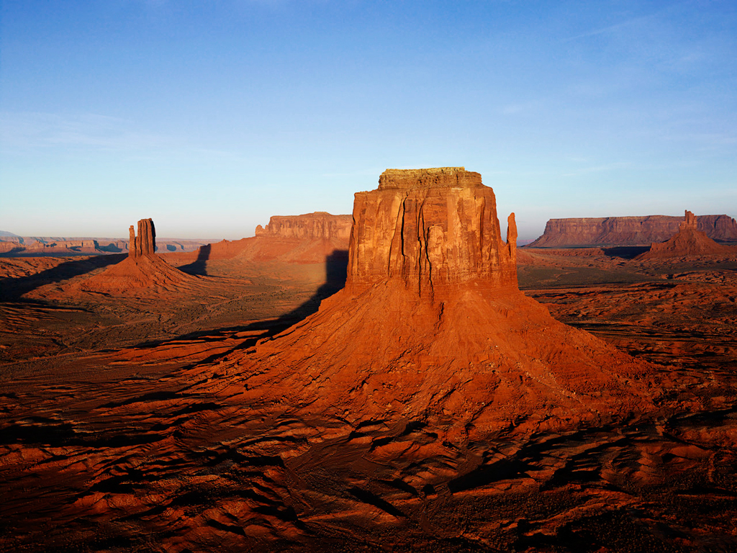
Sunday Morning 9:00 June 9, 2013

Slide 3
Mark 16:15–16
And he said to them, "Go into all the world and proclaim the gospel to the whole creation. Whoever believes and is baptized will be saved, but whoever does not believe will be condemned.

Slide 6
Why do we need a website?
An expedient: “something done o used to achieve a particular end.”
Ephesians 5:19;Hebrews 10:24–25; 1 Timothy 4:13; Acts 17:11
It is a tool for evangelism (Mark 16:15–16).
It helps us connect with each other (John 13:34–35).

Slide 7
Reasons to have a website…
It brings people to church.
It connects people.
It organizes church events.
It answers questions about our congregation.
It tells people who we are.
It broadcasts the message globally.
It saves money on advertising.
It stores media.

Slide 8
Why change?
Tom Lahman did a great job.
But he needed some relief!
The eldership asked for a change.
Individual registration.

Slide 9
East Shelby Website

