Slide 1
Esther 1:10–12
On the seventh day, when the heart of the king was merry with wine, he commanded Mehuman, Biztha, Harbona, Bigtha and Abagtha, Zethar and Carkas, the seven eunuchs who served in the presence of King Ahasuerus, to bring Queen Vashti before the king with her royal crown, in order to show the peoples and the princes her beauty, for she was lovely to look at. But Queen Vashti refused to come at the king's command delivered by the eunuchs. At this the king became enraged, and his anger burned within him.

Slide 4
Different types of immodesty.
Sexual immodesty.
Proverbs 5:15–20
Economic immodesty.
1 Timothy 2:8–10; James 2:1–6
Circumstantial immodesty.
1 Timothy 2:8–10

Slide 5
The root of the problem…
All forms of immodesty seek to attract attention for one’s self.
Matthew 23:2–7
The key is balance!

Slide 6
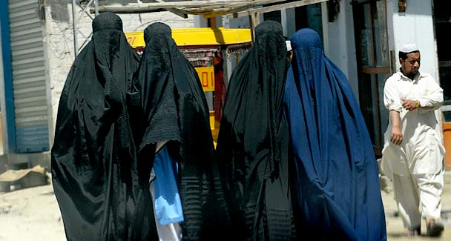

Slide 7
Applications…
We need more men who lead their homes to be modest.
We need women who promote modesty and support their husbands.
Save yourself for your mate.
Save yourself for the Lord.

