Slide 1
Philippians 2:12–13
¹²Therefore, my beloved, as you have always obeyed, so now, not only as in my presence but much more in my absence, work out your own salvation with fear and trembling, ¹³for it is God who works in you, both to will and to work for his good pleasure.

Slide 2
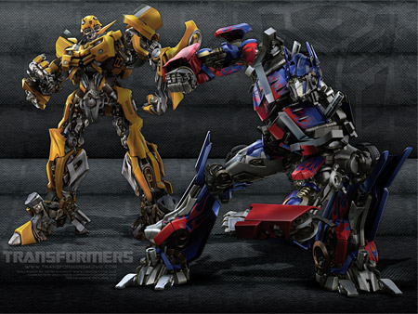

Slide 4
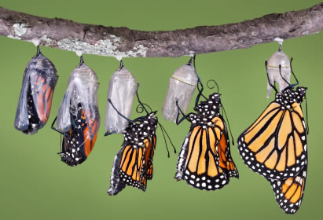
We must be transformed.
Romans 12:1–2
Transformed = Metamorphosis
Philippians 2:12–13
Philippians 2:6–7; Galatians 4:19

Slide 5
We all long to morph.
John 10:10
Romans 8:24–30

Slide 6
Spiritual Metamorphosis
Death.
Resurrection.
Growth.
Teaching.

