Slide 1
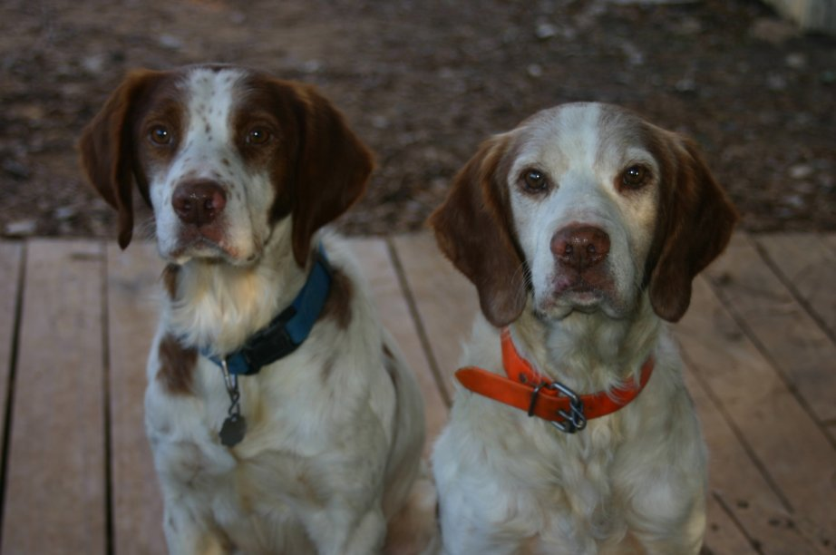
The Parable of the Lost Dogs

Slide 2
The Parable of the Lost Dogs
It’s stupid to get lost
Finding the lost takes a lot of effort
There is great joy when the lost are found

