Slide 2
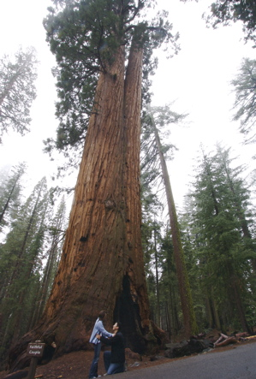
Having A ONENESS Marriage
- Proverbs 24:3,4 -

Slide 3
God’s Plan - Proverbs 24:3,4
People mock marriage like discipleship (Luke 14:27-30)
A Oneness Marriage is formed when a husband and wife continually weave intimacy, trust, and understanding into their relationship

Slide 4
Components of a ONENESS Marriage
Knowledge - Being informed by God of His expectations of me in marriage - accountability

Slide 5
Components of a ONENESS Marriage
Understanding - Clear realization and sight of marriage - Looking at marriage through God’s eyes
See the differences
Gives you insight to lead wisely (husband) or to follow carefully (wife)
Takes time
A matter of communication

Slide 6
Components of a ONENESS Marriage
Wisdom
James 1:5 “ask of God, who giveth to all”
Taking God’s design and respond to circumstances the way He intended
Proverbs 1:2,7,10,15,33
James 3:13-16
Wisdom in marriage is having a teachable spirit

Slide 7
ONENESS Depends on Submission
“subjecting yourselves one to another in the fear of Christ” (Ephesians 5:21)
Philippians 2:1-5
Romans 12:10
Commitment even if the other is unlovable
Sacrificial and surrendering
“What can I do for my wife/husband today?”

Slide 8
Oneness in Marriage is about… Dependence Preference Commitment Embracing the difference

Slide 9
ONENESS in marriage is… Aquila and Priscilla (Acts 18:1-3; 18,26; Romans 16:3,4)

Slide 10
A ONENESS marriage is a reflection of God’s image
Marriage is about the glory of God

