Slide 1
²⁵ “To whom then will you compare Me That I would be his equal?” says the Holy One. ²⁶ Raise your eyes on high And see who has created these stars, The One who brings out their multitude by number, He calls them all by name; Because of the greatness of His might and the strength of His power, Not one of them is missing.
²⁷ Why do you say, Jacob, and you assert, Israel, “My way is hidden from the Lord, And the justice due me escapes the notice of my God”? ²⁸ Do you not know? Have you not heard? The Everlasting God, the Lord, the Creator of the ends of the earth Does not become weary or tired. His understanding is unsearchable.
Isaiah 40:25-28

Slide 2
SEEKING GOD IN THE DEEP WATER

Slide 3
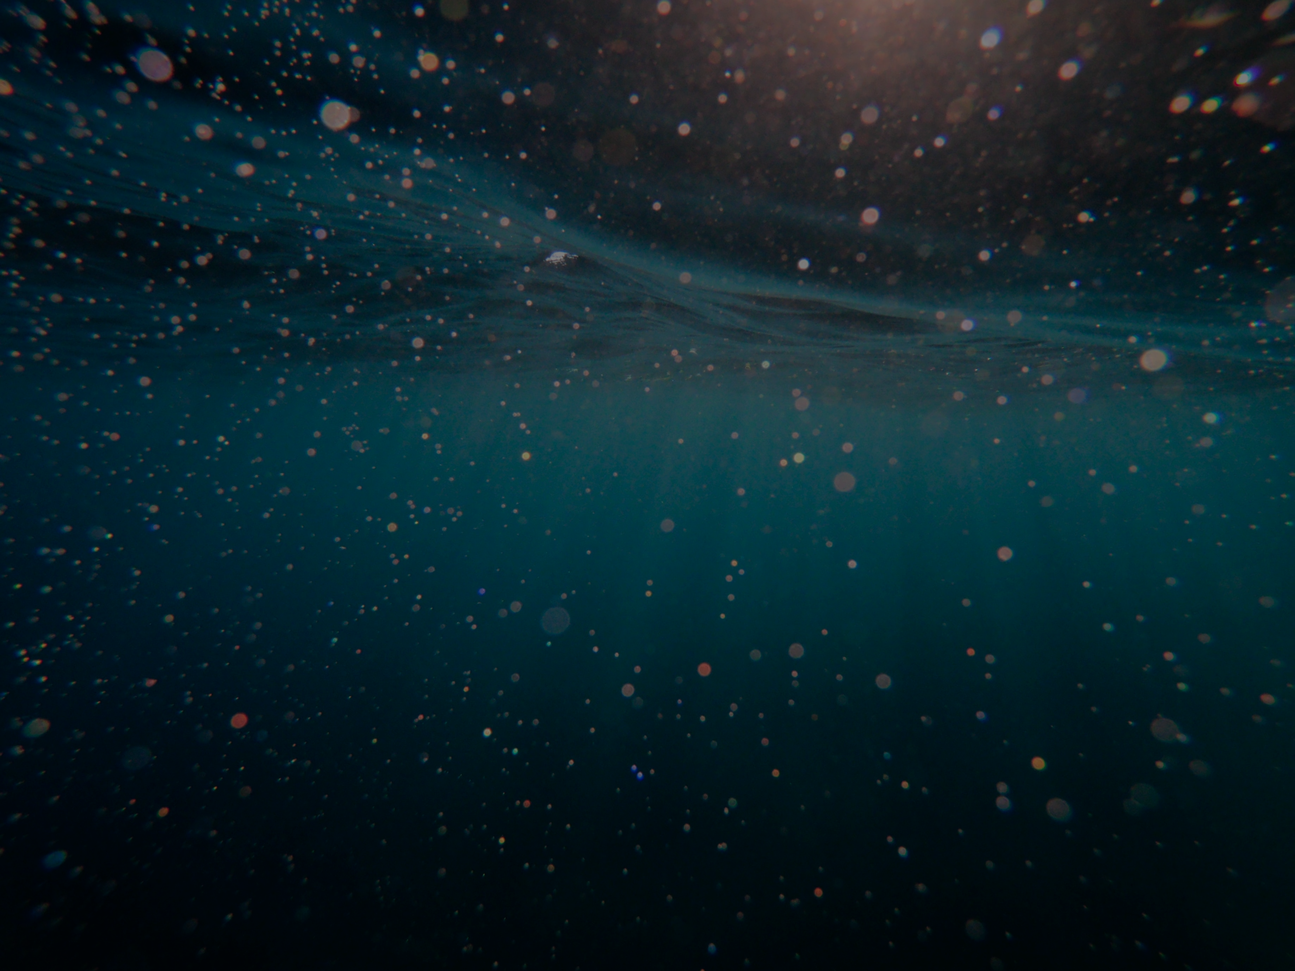
“Seek, and you will find” says the Lord in Matthew 7:7.
“That they should seek God, if perhaps they might grope for Him and find Him, though He is not far from each one of us” (Acts 17:27).
“But as for Israel He says, ‘All the day long I have stretched out My hands to a disobedient and obstinate people’” (Romans 10:21, Isaiah 65:2).
“Draw near to God and He will draw near to you” (James 4:8).
“Behold, I stand at the door and knock; if anyone hears My voice and opens the door, I will come in to him, and will dine with him, and he with me” (Revelation 3:20).

Slide 4
“Here, then, is the crucial question which we have been leading up to. Have we ever opened our door to Christ? Have we ever invited him in? This was exactly the question which I needed to have put to me. For, intellectually speaking, I had believed in Jesus all my life, on the other side of the door. I had regularly struggled to say my prayers through the key-hole. I had even pushed pennies under the door in a vain attempt to pacify him. I had been baptized, yes and confirmed as well. I went to church, read my Bible, had high ideals, and tried to be good and do good. But all the time, often without realizing it, I was holding Christ at arm's length, and keeping him outside. I knew that to open the door might have momentous consequences.”
John R.W. Stott

Slide 5
His judgments are unsearchable (Rom. 11:33)
His ways are inscrutable (Rom. 11:33f)
No one has been his counselor (Rom. 11:34)
His greatness is unsearchable (Psalm 145:3)
His understanding is unsearchable (Isa. 40:28)
Heaven, even the highest heaven cannot contain him (1 Kings 8:27)
He inhabits eternity (Isa. 57:15)
From everlasting to everlasting he is God (Psalm 90:2)
The depths of God are searched by the Spirit, and the Spirit comprehends the thoughts of God (1 Cor. 2:10-11)
No one has seen God any time; God the only begotten, who is at the Father's side, has made him known (John 1:18)
The love of Christ surpasses knowledge (Ephesians 3:19)

Slide 6
“Until and unless the weight of God's infinite being is straining your thoughts to [the] breaking point, until and unless you have felt the finitude of your mental powers in contemplating the Father, the Son and the Holy Spirit, you have not even begun to fathom the unfathomable depths of the One, Living, True, and Triune God”
(“There Is No Shallow End Of the Theological Pool”)

Slide 7
SO HOW DO I DO THIS?

Slide 8
SQUEEZE YOURSELF THROUGH THE NARROW PATH

Slide 9
SQUEEZE YOURSELF THROUGH THE NARROW PATH
SEEK HIM HUMBLY

Slide 10
SQUEEZE YOURSELF THROUGH THE NARROW PATH
SEEK HIM HUMBLY
LET GOD BE GOD

Slide 11
SQUEEZE YOURSELF THROUGH THE NARROW PATH
SEEK HIM HUMBLY
LET GOD BE GOD
BEING KNOWN IS BETTER THAN KNOWING

Slide 12
SQUEEZE YOURSELF THROUGH THE NARROW PATH
SEEK HIM HUMBLY
LET GOD BE GOD
BEING KNOWN IS BETTER THAN KNOWING
A DECISION IS NECESSARY

Slide 13
“That a decision is necessary in order to become a Christian is an idea quite foreign to many people. Some imagine that they are already Christians because they were born in a Christian country. We cannot remain neutral. Nor can we drift into Christianity. Nor can anybody else settle the matter for us. We must decide for ourselves. We may concede that the evidence for the deity of Jesus is compelling, even conclusive, and that He was in fact the Son of God; we may believe that He came and died to be the Savior of the world; we may also admit that we are sinners and need such a Savior. But none of these things makes us Christians”
John R.W. Stott

