Slide 1
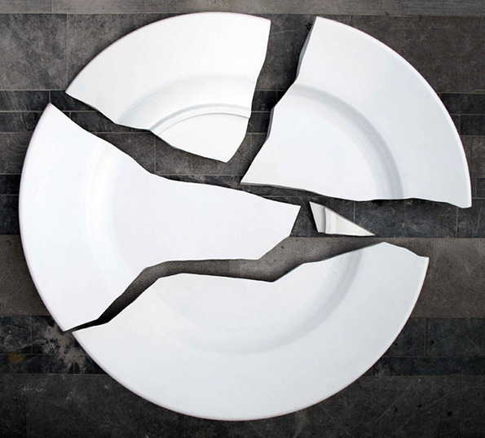
Broken Pieces
Philippians
3:1-11

Slide 2
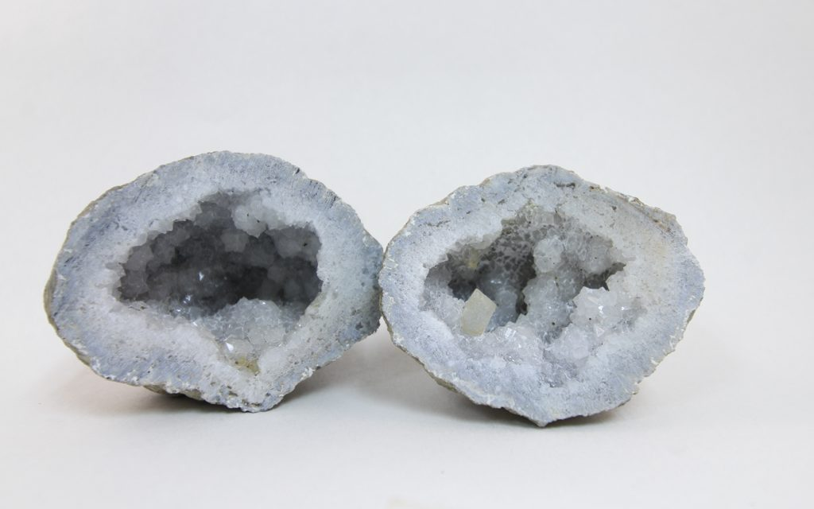
Broken Pieces
Like something that is precious to us that has been dropped and shattered into many pieces, that is now worthless; so too are our past accomplishments to God before we became Christians.
Paul mentioned five broken pieces
to discard in Philippians 3:1-11.
What are the broken pieces that Paul wished to discard?

Slide 3
Broken Pieces
#1 Past Circumstances. (v.2)
“Beware of the dogs, beware of the evil workers, beware of the false circumcision;”
(2 Co 5:17; Rev 21:4-5)
Discard an impure mind!

Slide 4
Broken Pieces
#2 Past Guidance. (v.3)
“for we are the true circumcision, who worship in the Spirit of God and glory in Christ Jesus and put no confidence in the flesh,”
(Isa 2:22; Jer 17:5-6)
Discard trusting in others!

Slide 5
Broken Pieces
#3 Past Understanding. (v.4-5)
“although I myself might have confidence even in the flesh. If anyone else has a mind to put confidence in the flesh, I far more: circumcised the eighth day, of the nation of Israel, of the tribe of Benjamin, a Hebrew of Hebrews; as to the Law, a Pharisee;”
(Acts 10:9-16, 34-35; 11:3, 18)
Discard false teaching!

Slide 6
Broken Pieces
#4 Past Offenses. (v.6)
“as to zeal, a persecutor of the church; as to the righteousness which is in the Law, found blameless.”
(Heb 8:12; 10:17; 1 Ti 1:12-17; Eph 3:8)
Discard guilt!

Slide 7
Broken Pieces
#5 Past Achievements. (v.7-11)
“7 But whatever things were gain to me, those things I have counted as loss for the sake of Christ. 8 More than that, I count all things to be loss in view of the surpassing value of knowing Christ Jesus my Lord, for whom I have suffered the loss of all things, and count them but rubbish so that I may gain Christ, 9 and may be found in Him, not having a righteousness of my own derived from the Law, but that which is through faith in Christ, the righteousness which comes from God on the basis of faith, 10 that I may know Him and the power of His resurrection and the fellowship of His sufferings, being conformed to His death; 11 in order that I may attain to the resurrection from the dead.”
(1 Co 9:27; Ecc 10:1)
Discard personal victories!

Slide 8
Broken Pieces
Give the Lord the broken pieces of your life to have a restored, minded or saved relationship with God. Obey the Gospel today!
If your life is in pieces today, it can be made whole! Be baptized into Christ for the remission of sins today!

