Slide 1
THREE VIGNETTES From Jeremiah 17

Slide 2
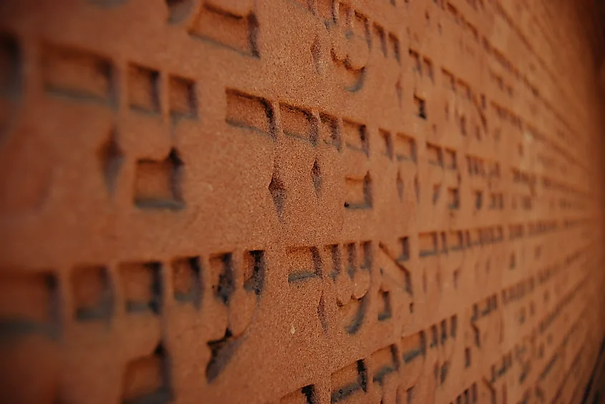
¹ The sin of Judah is written with an iron stylus; With a diamond point it is engraved on the tablet of their hearts And on the horns of their altars, ² As they remember their children, So they remember their altars and their Asherim By green trees on the high hills. ³ Mountain of Mine in the countryside, I will turn over your wealth and all your treasures as plunder, Your high places for sin throughout your borders. ⁴ And you will, even of yourself, let go of your inheritance That I gave you; And I will make you serve your enemies In the land which you do not know; For you have kindled a fire in My anger Which will burn forever.

Slide 3
LESSONS
Sin has a way of sticking with you.

Slide 4
LESSONS
Sin has a way of sticking with you.
Sin eventually takes over your whole life.

Slide 5
LESSONS
Sin has a way of sticking with you.
Sin eventually takes over your whole life.
Sin has consequences.

Slide 6
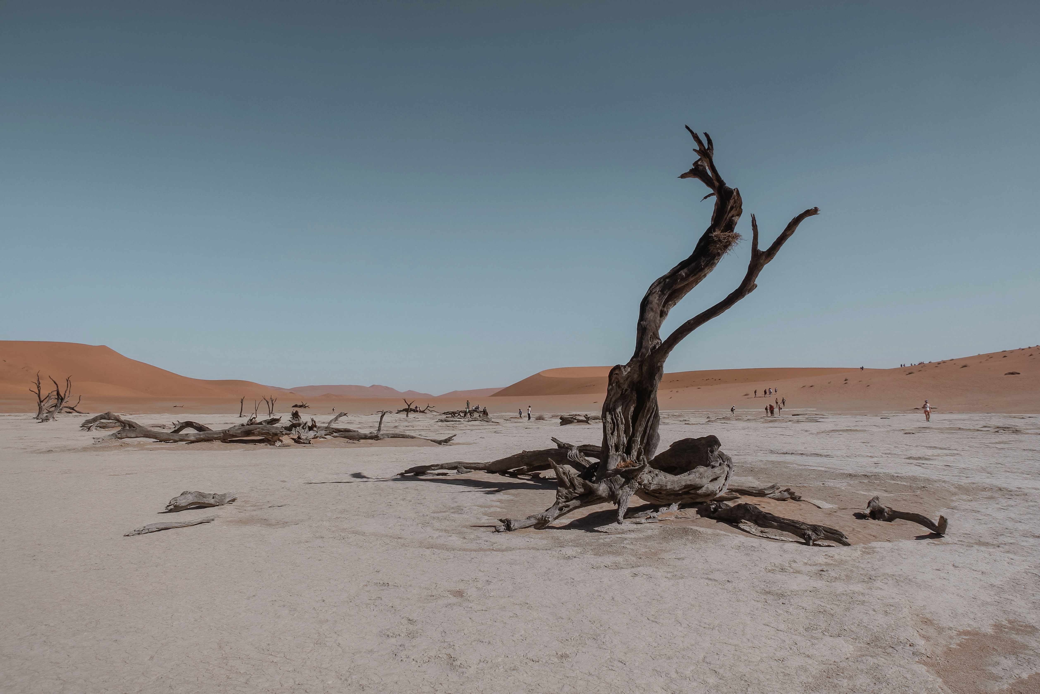
⁵ This is what the Lord says: “Cursed is the man who trusts in mankind And makes flesh his strength, And whose heart turns away from the Lord. ⁶ For he will be like a bush in the desert, And will not see when prosperity comes, But will live in stony wastes in the wilderness, A land of salt that is not inhabited. ⁷ Blessed is the man who trusts in the Lord, And whose trust is the Lord. ⁸ For he will be like a tree planted by the water That extends its roots by a stream, And does not fear when the heat comes; But its leaves will be green, And it will not be anxious in a year of drought, nor cease to yield fruit.

Slide 7
LESSONS
Everything worldly eventually fails.

Slide 8
LESSONS
Everything worldly eventually fails.
Desert life has a blinding effect.

Slide 9
LESSONS
Everything worldly eventually fails.
Desert life has a blinding effect.
Everybody faces the drought.

Slide 10
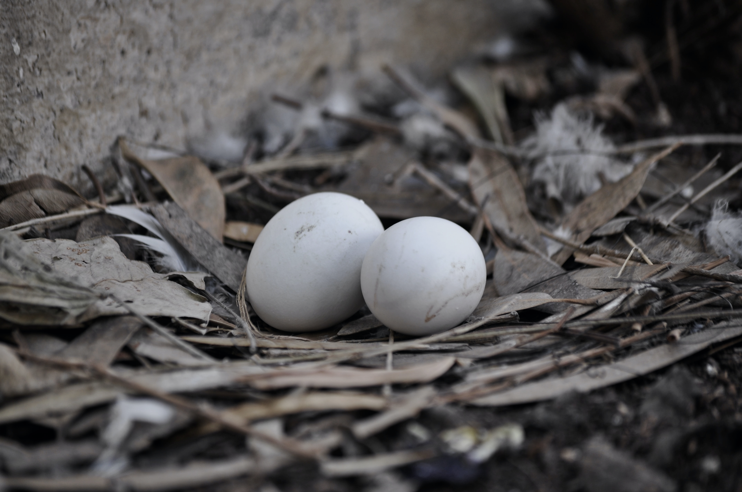
⁹ “The heart is more deceitful than all else And is desperately sick; Who can understand it? ¹⁰ I, the Lord, search the heart, I test the mind, To give to each person according to his ways, According to the results of his deeds. ¹¹ As a partridge that hatches eggs which it has not laid, So is a person who makes a fortune, but unjustly; In the middle of his days it will abandon him, And in the end he will be a fool.”

Slide 11
LESSONS
Watch out for what the heart wants.

Slide 12
LESSONS
Watch out for what the heart wants.
God won’t be fooled.

Slide 13
LESSONS
Watch out for what the heart wants.
God won’t be fooled.
Sin hides its costs on the “back end.”

Slide 14
What ties these vignettes together is the HEART. It is restless, easily swayed, often mistaken – but it is the engine that can drive an incredible life is calibrated and fueled properly. (Proverbs 3:5-6)

