Slide 1
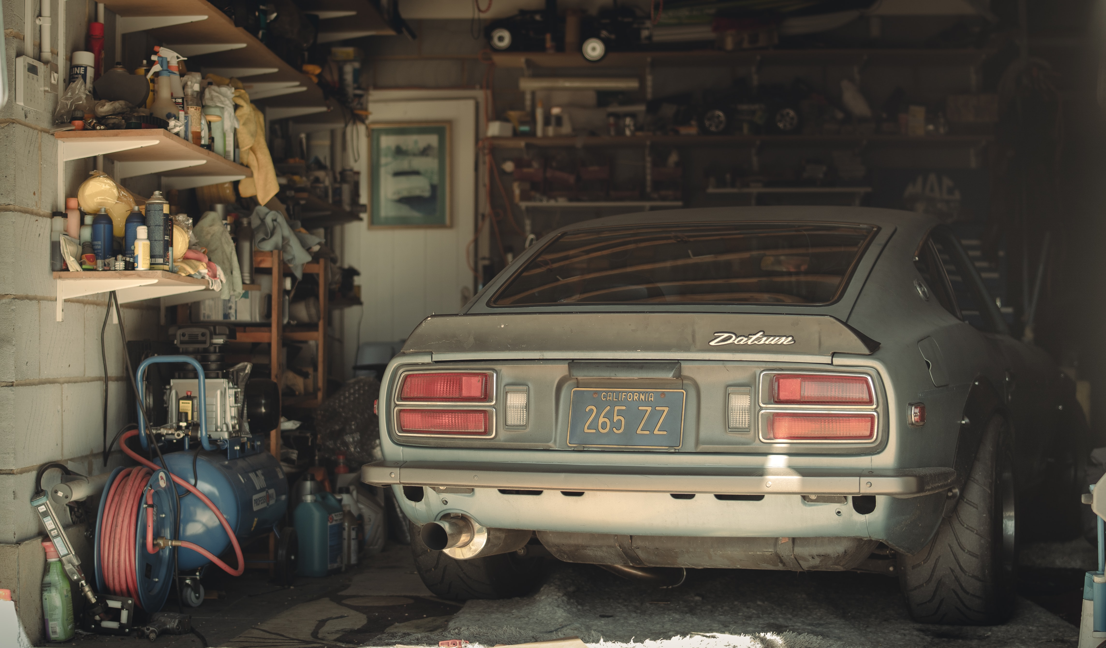
Spring Cleaning

Slide 2
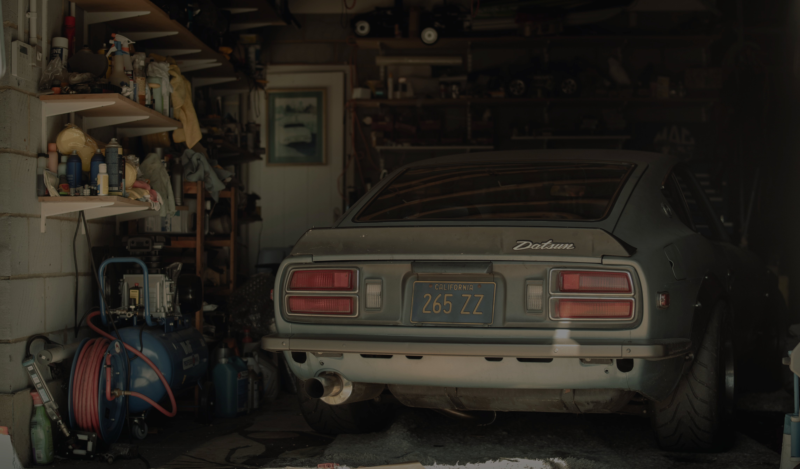
Spring Cleaning
“You blind Pharisee, first clean the inside of the cup and of the dish, so that the outside of it may become clean also” (Matthew 23:25-26).
“Clean out the old leaven, that you may be a new lump of dough…” (1 Corinthians 5:7).
“Set in order the things that are lacking” (Titus 1:5).
“Cleanse your hands, you sinners; and purify your hearts, you double-minded” (James 4:8).

Slide 3
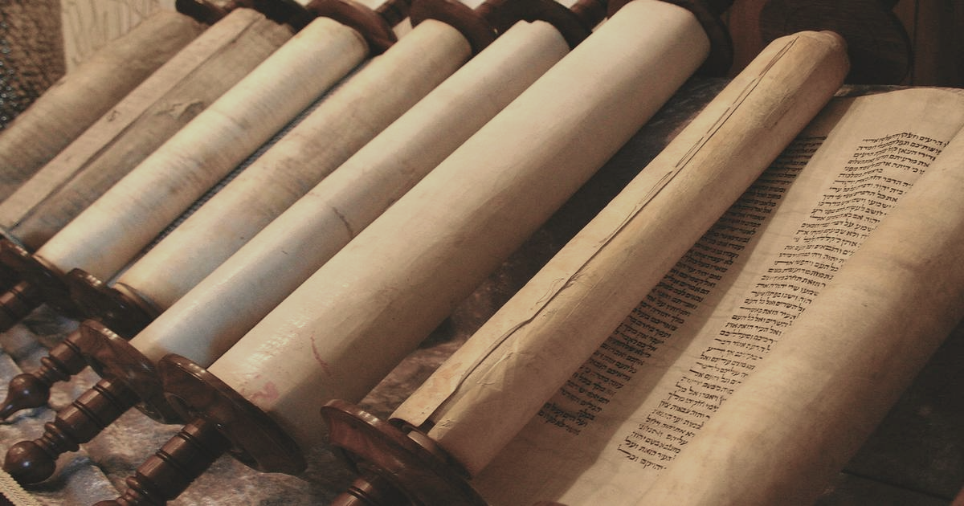
Josiah’s “Spring Cleaning”
2 Kings 22

Slide 4
You never know what you will find
Spring cleaning often reveals the hidden treasures that were there the entire time:
Relationships that you thought were lost;
Attitudes that you used to have before you became bitter;
Romance that had been set aside and ignored because of the distractions of life;
Innocence that used to be your constant companion;
A relationship with God that had been covered in a sheet and shoved to the back;
A love and zeal for reading the Bible;
A meaningful prayer life that was muted by the noise of a busy life;
A sense of usefulness and innate value that comes with participating at church.

Slide 5
The job is never done if you only do it halfway

Slide 6
Notice the resolve in Josiah’s voice as he states, quite boldly, that he and the people would “walk after the Lord, and to keep His commandments… with all his heart and all his soul, to carry out the word of this covenant… and all the people entered into the covenant with him” (2 Kings 23:1-3).

Slide 7
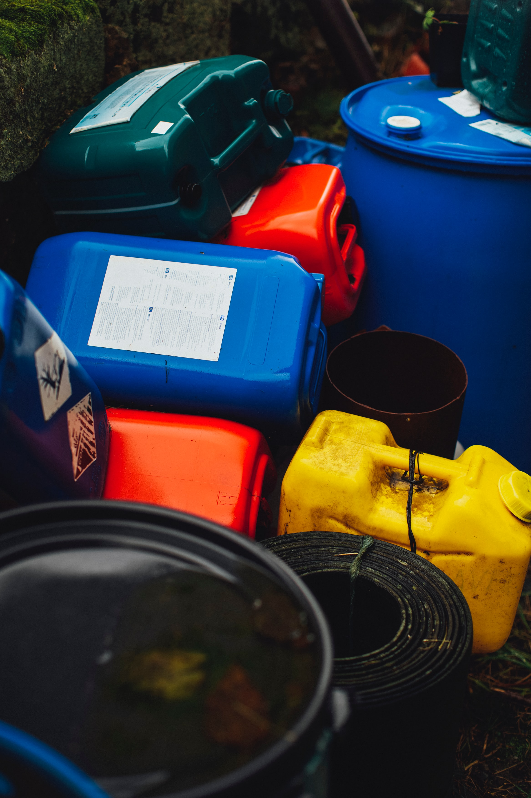
Take stuff to the dump
2 Kings 23:4-14

Slide 8
Take stuff to the dump
2 Kings 23:4-14
Toxic – Like used oil or expired chemicals, we sometimes find very toxic attitudes that need to be disposed of immediately and properly (Luke 17:2-3, James 3:13-18).

Slide 9
Take stuff to the dump
2 Kings 23:4-14
Toxic – Like used oil or expired chemicals, we sometimes find very toxic attitudes that need to be disposed of immediately and properly (Luke 17:2-3, James 3:13-18).
Outdated – Similarly, holding on to immature attitudes, youthful lusts (2 Timothy 2:22, 1 Timothy 6:11), and rebellion only brings heartache.

Slide 10
Take stuff to the dump
2 Kings 23:4-14
Toxic – Like used oil or expired chemicals, we sometimes find very toxic attitudes that need to be disposed of immediately and properly (Luke 17:2-3, James 3:13-18).
Outdated – Similarly, holding on to immature attitudes, youthful lusts (2 Timothy 2:22, 1 Timothy 6:11), and rebellion only brings heartache.
Refuse – Most people have piles of old boxes, cans, bottles, papers, and other refuse items that just need to be thrown away. Spiritually speaking, these would be unproductive, wasted moments. Consider Martha (Luke 10:38-42).

Slide 11
Have a spiritual garage sale
Share your old treasures (at a rock-bottom price!) with people who need them more than you (2 Kings 23:21-23):
Parenting advice to young couples (Titus 2:3-5);
Experiences you have had which made you stronger;
Basically EVERYTHING from Romans 12;
Marital advice;
Insight into the Bible (2 Peter 1:12-13);
Financial wisdom;
Your faith with unbelievers (2 Timothy 2:2).

