Slide 1
Isaiah 61:10
I will greatly rejoice in the Lord, My soul shall be joyful in my God; For He has clothed me with the garments of salvation, He has covered me with the robe of righteousness, As a bridegroom decks himself with ornaments, And as a bride adorns herself with her jewels

Slide 3
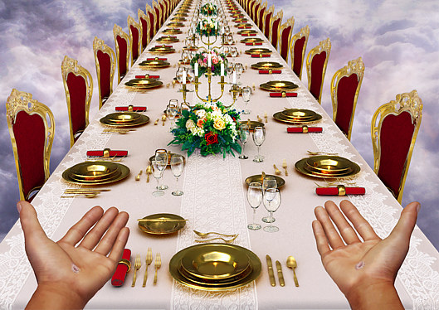
Dressed for the Wedding

Slide 4
Matthew 22:1-7
And Jesus answered and spoke to them again by parables and said: ² “The kingdom of heaven is like a certain king who arranged a marriage for his son, ³ and sent out his servants to call those who were invited to the wedding; and they were not willing to come. ⁴ Again, he sent out other servants, saying, ‘Tell those who are invited, “See, I have prepared my dinner; my oxen and fatted cattle are killed, and all things are ready. Come to the wedding.” ⁵ But they made light of it and went their ways, one to his own farm, another to his business. ⁶ And the rest seized his servants, treated them spitefully, and killed them. ⁷ But when the king heard about it, he was furious. And he sent out his armies, destroyed those murderers, and burned up their city.

Slide 5
Matthew 22:8
Then he said to his servants, ‘The wedding is ready, but those who were invited were not worthy.

Slide 6
Matthew 22:9-10
Therefore go into the highways, and as many as you find, invite to the wedding.’ ¹⁰ So those servants went out into the highways and gathered together all whom they found, both bad and good. And the wedding hall was filled with guests.

Slide 7
Matthew 22:11-12
“But when the king came in to see the guests, he saw a man there who did not have on a wedding garment. ¹² So he said to him, ‘Friend, how did you come in here without a wedding garment?’ And he was speechless.

Slide 8
Matt 22:13-14
Then the king said to the servants, ‘Bind him hand and foot, take him away, and cast him into outer darkness; there will be weeping and gnashing of teeth.’
¹⁴ “For many are called, but few are chosen.”

Slide 9
Revelation 7:13-14
Then one of the elders answered, saying to me, “Who are these arrayed in white robes, and where did they come from?”
¹⁴ And I said to him, “Sir, you know.”
So he said to me, “These are the ones who come out of the great tribulation, and washed their robes and made them white in the blood of the Lamb.

Slide 10
Revelation 7:16-17
They shall neither hunger anymore nor thirst anymore; the sun shall not strike them, nor any heat; ¹⁷ for the Lamb who is in the midst of the throne will shepherd them and lead them to living fountains of waters. And God will wipe away every tear from their eyes

Slide 11
Will you come

