Slide 1
Revelation 14:6-7
Then I saw another angel flying in the midst of heaven, having the everlasting gospel to preach to those who dwell on the earth—to every nation, tribe, tongue, and people— ⁷ saying with a loud voice, “Fear God and give glory to Him, for the hour of His judgment has come; and worship Him who made heaven and earth, the sea and springs of water

Slide 3
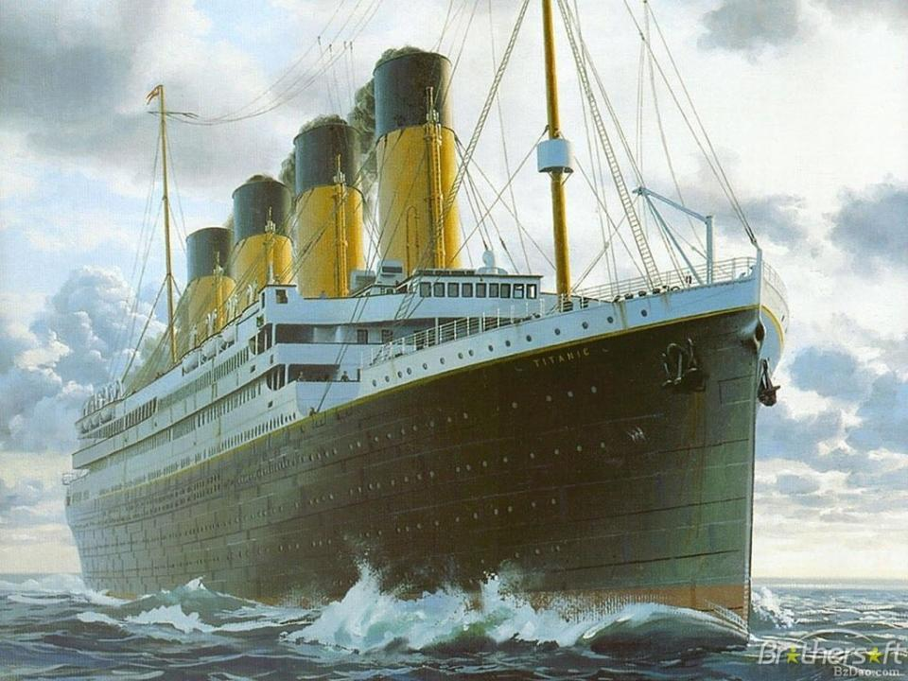

Slide 5
Daniel 4:4-7
I, Nebuchadnezzar, was at rest in my house, and flourishing in my palace. ⁵ I saw a dream which made me afraid, and the thoughts on my bed and the visions of my head troubled me. ⁶ Therefore I issued a decree to bring in all the wise men of Babylon before me, that they might make known to me the interpretation of the dream. ⁷ Then the magicians, the astrologers, the Chaldeans, and the soothsayers came in, and I told them the dream; but they did not make known to me its interpretation

Slide 6
Daniel 4:8-9
But at last Daniel came before me (his name is Belteshazzar, according to the name of my god; in him is the Spirit of the Holy God), and I told the dream before him, saying: ⁹ “Belteshazzar, chief of the magicians, because I know that the Spirit of the Holy God is in you, and no secret troubles you, explain to me the visions of my dream that I have seen, and its interpretation

Slide 7
Daniel 10-11
These were the visions of my head while on my bed:
I was looking, and behold, A tree in the midst of the earth, And its height was great. ¹¹ The tree grew and became strong; Its height reached to the heavens, And it could be seen to the ends of all the earth

Slide 8
Daniel 4:12
Its leaves were lovely, Its fruit abundant, And in it was food for all. The beasts of the field found shade under it, The birds of the heavens dwelt in its branches, And all flesh was fed from it.

Slide 9
Daniel 4:13-14
I saw in the visions of my head while on my bed, and there was a watcher, a holy one, coming down from heaven. ¹⁴ He cried aloud and said thus:
‘Chop down the tree and cut off its branches, Strip off its leaves and scatter its fruit. Let the beasts get out from under it, And the birds from its branches

Slide 10
Daniel 4:15-16
Nevertheless leave the stump and roots in the earth, Bound with a band of iron and bronze, In the tender grass of the field. Let it be wet with the dew of heaven, And let him graze with the beasts On the grass of the earth. ¹⁶ Let his heart be changed from that of a man, Let him be given the heart of a beast, And let seven times^{[a]} pass over him

Slide 11
Daniel 4:17
‘This decision is by the decree of the watchers, And the sentence by the word of the holy ones, In order that the living may know That the Most High rules in the kingdom of men, Gives it to whomever He will, And sets over it the lowest of men

Slide 12
Daniel 4:19
Then Daniel, whose name was Belteshazzar, was astonished for a time, and his thoughts troubled him. So the king spoke, and said, “Belteshazzar, do not let the dream or its interpretation trouble you.” Belteshazzar answered and said, “My lord, may the dream concern those who hate you, and its interpretation concern your enemies!

Slide 13
Daniel 4:28-30
All this came upon King Nebuchadnezzar. ²⁹ At the end of the twelve months he was walking about the royal palace of Babylon. ³⁰ The king spoke, saying, “Is not this great Babylon, that I have built for a royal dwelling by my mighty power and for the honor of my majesty?”

Slide 14
Daniel 4:31-32
While the word was still in the king’s mouth, a voice fell from heaven: “King Nebuchadnezzar, to you it is spoken: the kingdom has departed from you! ³² And they shall drive you from men, and your dwelling shall be with the beasts of the field. They shall make you eat grass like oxen; and seven times shall pass over you, until you know that the Most High rules in the kingdom of men, and gives it to whomever He chooses

Slide 15
Daniel 4:33
That very hour the word was fulfilled concerning Nebuchadnezzar; he was driven from men and ate grass like oxen; his body was wet with the dew of heaven till his hair had grown like eagles’ feathers and his nails like birds’ claws

Slide 16
Daniel 2:47
The king answered Daniel, and said, “Truly your God is the God of gods, the Lord of kings, and a revealer of secrets, since you could reveal this secret

Slide 17
Daniel 3:28
²⁸ Nebuchadnezzar spoke, saying, “Blessed be the God of Shadrach, Meshach, and Abed-Nego, who sent His Angel and delivered His servants who trusted in Him, and they have frustrated the king’s word, and yielded their bodies, that they should not serve nor worship any god except their own God

Slide 18
Daniel 4:34
And at the end of the time^{[b]} I, Nebuchadnezzar, lifted my eyes to heaven, and my understanding returned to me; and I blessed the Most High and praised and honored Him who lives forever For His dominion is an everlasting dominion, And His kingdom is from generation to generation.

Slide 19
Daniel 4:35
All the inhabitants of the earth are reputed as nothing; He does according to His will in the army of heaven And among the inhabitants of the earth. No one can restrain His hand Or say to Him, “What have You done?”

Slide 20
Romans 11:36
For of Him and through Him and to Him are all things, to whom be glory forever. Amen

