Slide 1
Proverbs 13:25
The righteous eats to the satisfying of his soul, But the stomach of the wicked shall be in want.

Slide 3
85,629

Slide 4
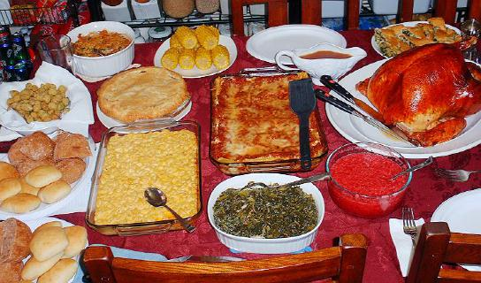

Slide 5
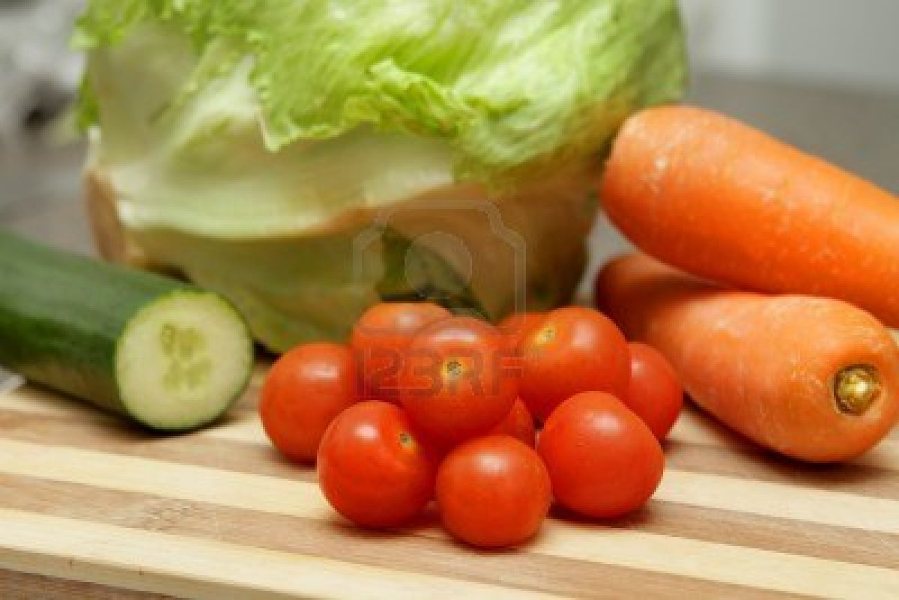

Slide 6
Satisfy Your Craving

Slide 7
1 Kings 3:5
At Gibeon the Lord appeared to Solomon in a dream by night; and God said, “Ask! What shall I give you?”

Slide 8
1 Kings 3:9
Therefore give to Your servant an understanding heart to judge Your people, that I may discern between good and evil. For who is able to judge this great people of Yours?”

Slide 9
1 Kings 3:12
behold, I have done according to your words; see, I have given you a wise and understanding heart, so that there has not been anyone like you before you, nor shall any like you arise after you

Slide 10
1 Kings 3:13
And I have also given you what you have not asked: both riches and honor, so that there shall not be anyone like you among the kings all your days.

Slide 11
Ecclesiastes 2:4-8
I made my works great, I built myself houses, and planted myself vineyards. ⁵ I made myself gardens and orchards, and I planted all kinds of fruit trees in them. ⁶ I made myself water pools from which to water the growing trees of the grove. ⁷ I acquired male and female servants, and had servants born in my house. Yes, I had greater possessions of herds and flocks than all who were in Jerusalem before me

Slide 12
Ecclesiastes 2:8-10
I also gathered for myself silver and gold and the special treasures of kings and of the provinces. I acquired male and female singers, the delights of the sons of men, and musical instruments of all kinds.
⁹ So I became great and excelled more than all who were before me in Jerusalem. Also my wisdom remained with me.
¹⁰ Whatever my eyes desired I did not keep from them. I did not withhold my heart from any pleasure, For my heart rejoiced in all my labor; And this was my reward from all my labor.

Slide 13
Ecclesiastes 2:11
Then I looked on all the works that my hands had done And on the labor in which I had toiled; And indeed all was vanity and grasping for the wind. There was no profit under the sun

Slide 14
Matthew 5:6
Blessed are those who hunger and thirst for righteousness, For they shall be filled.

Slide 15
John 6:32-33
Then Jesus said to them, “Most assuredly, I say to you, Moses did not give you the bread from heaven but my father gives you the true bread from heaven. For the bread of God is he comes down from heaven and gives life to the world.

Slide 16
John 6:34-35
Then they said to him, “Lord give us this bread always.”

Slide 17
John 6:34-35
Then they said to him, “ Lord give us this bread always”.
And Jesus said to them, “ I am the bread of life. He who comes to me will never hunger, and he who believes in me shall never thirst.

Slide 18
Ecclesiastes 12:13
Let us hear the conclusion of the whole matter:
Fear God and keep His commandments, For this is man’s all.

