Slide 1
Acts 14:15-17 (ESV)
¹⁵ “Men, why are you doing these things? We also are men, of like nature with you, and we bring you good news, that you should turn from these vain things to a living God, who made the heaven and the earth and the sea and all that is in them. ¹⁶ In past generations he allowed all the nations to walk in their own ways. ¹⁷ Yet he did not leave himself without witness, for he did good by giving you rains from heaven and fruitful seasons, satisfying your hearts with food and gladness.”

Slide 6
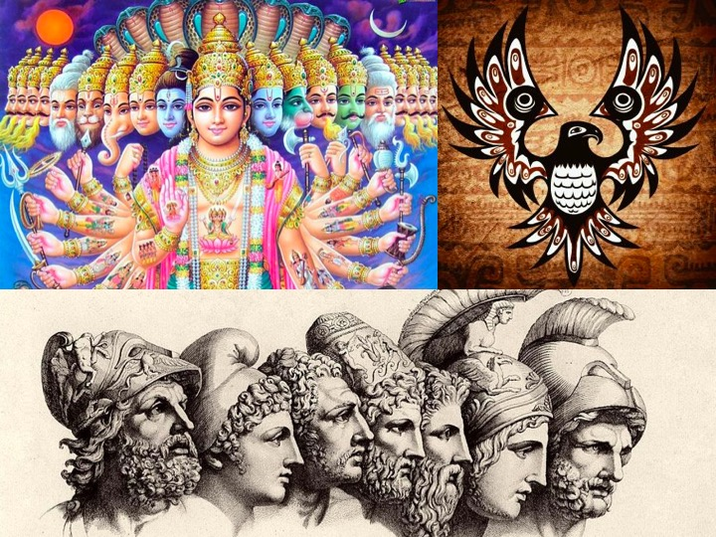

Slide 12
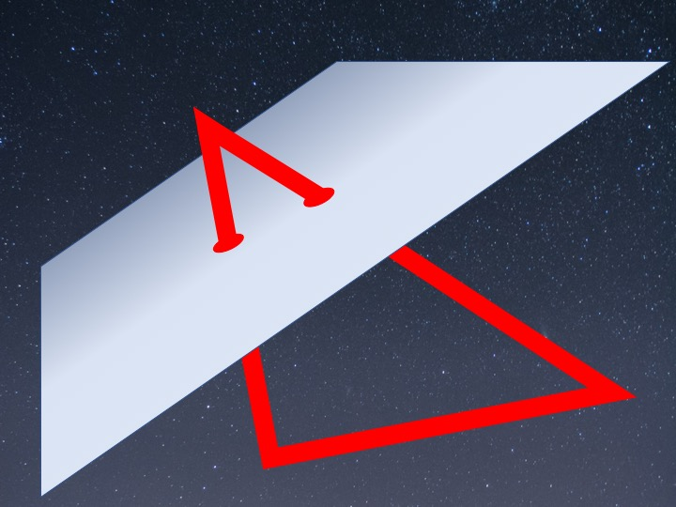

Slide 18
