Slide 1
Acts 19:17-20
¹⁷ And this became known to all the residents of Ephesus, both Jews and Greeks. And fear fell upon them all, and the name of the Lord Jesus was extolled. ¹⁸ Also many of those who were now believers came, confessing and divulging their practices. ¹⁹ And a number of those who had practiced magic arts brought their books together and burned them in the sight of all. And they counted the value of them and found it came to fifty thousand pieces of silver. ²⁰ So the word of the Lord continued to increase and prevail mightily.

Slide 7
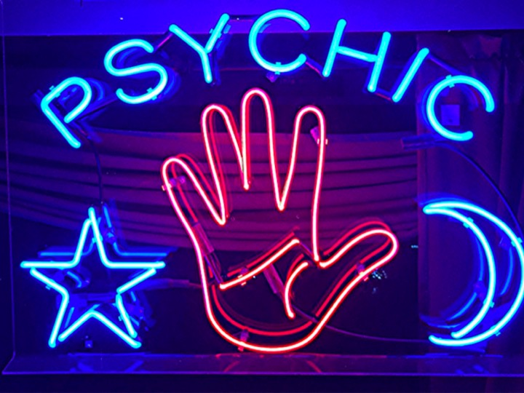

Slide 9
