Slide 1
Psalm 8 ESV
¹ O Lord, our Lord, how majestic is your name in all the earth! You have set your glory above the heavens. ² Out of the mouth of babies and infants, you have established strength because of your foes, to still the enemy and the avenger.
³ When I look at your heavens, the work of your fingers, the moon and the stars, which you have set in place, ⁴ what is man that you are mindful of him, and the son of man that you care for him?

Slide 2
Psalm 8 ESV
⁵ Yet you have made him a little lower than the heavenly beings and crowned him with glory and honor. ⁶ You have given him dominion over the works of your hands; you have put all things under his feet, ⁷ all sheep and oxen, and also the beasts of the field, ⁸ the birds of the heavens, and the fish of the sea, whatever passes along the paths of the seas.
⁹ O Lord, our Lord, how majestic is your name in all the earth!

Slide 4
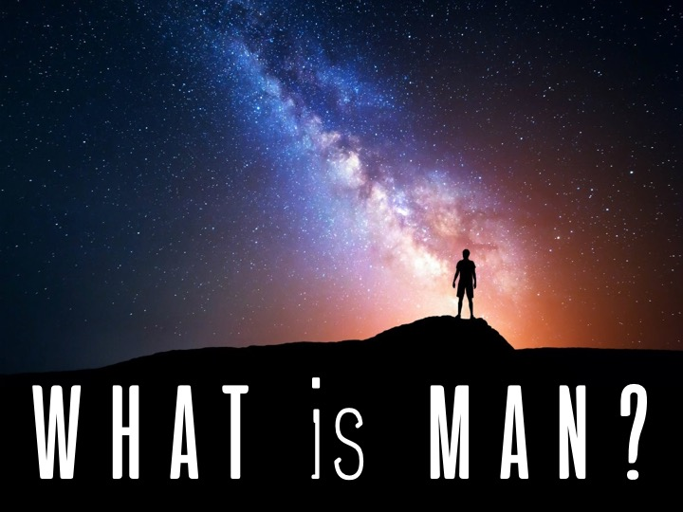

Slide 6
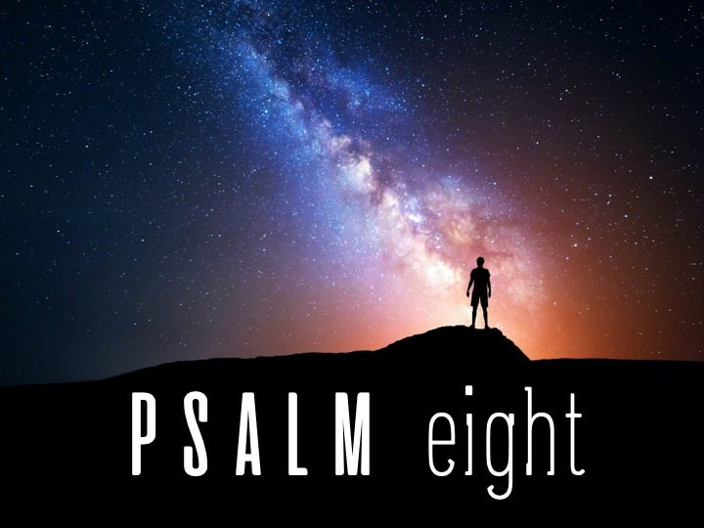

Slide 13
