Slide 1
I Cor. 10:14-17 (ESV)
¹⁴ Therefore, my beloved, flee from idolatry. ¹⁵ I speak as to sensible people; judge for yourselves what I say. ¹⁶ The cup of blessing that we bless, is it not a participation in the blood of Christ? The bread that we break, is it not a participation in the body of Christ? ¹⁷ Because there is one bread, we who are many are one body, for we all partake of the one bread.

Slide 3
Jesus instructed His disciples to regard their last meal together as a memorial for His body and blood, which would soon be given up on the cross. But what is included in “do this”? Do what?
Are we being inconsistent because we insist upon certain elements of the Lord’s supper, while seemingly ignoring a lot of details in the story? Should it be like a pageant? What about décor, dress, the sights and sounds? One cup or many? Time of day? Other Passover elements?
In this lesson, let us carefully consider what about the Lord’s supper is essential and binding…

Slide 4
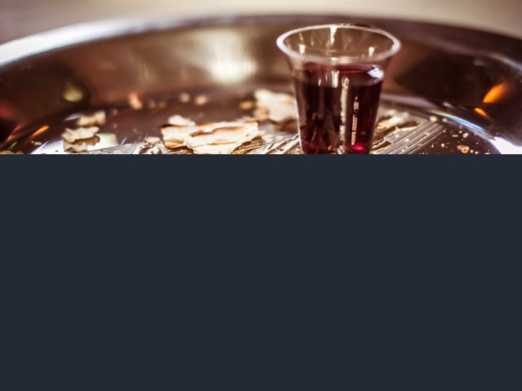
First, scripture teaches it is an essential and enduring part of Christian worship. The fact that Jesus leaves it “open-ended” in Luke 22:17-20 is telling.
In addition, Paul did not merely suggest the Lord’s supper to the Corinthians, but said it was delivered from the Lord (1 Cor. 11:23). Their failure to practice the communion properly was a real problem. If it wasn’t essential, why did Paul go out of his way to correct the issues associated with it?

Slide 5
Exact replication of the last supper is essentially impossible, and it’s not even what we find Christians doing in the First Century – they wore similar clothes, spoke the same language, had access to the same food, etc., and they didn’t even try to emulate the majority of details in the last supper.
It’s not part of the Passover meal. It’s also on a different day of the week (Acts 20:7). A single container would be impossible (Acts 2:41), same with an upper room.

Slide 6
Look what Paul actually says he “delivered” to the Corinthians in 1 Cor. 11:23ff. He did not deliver instructions regarding location, time of day, dress code, the number of containers, etc.
The elements of the Lord’s Supper are essential, functional, and straightforward. The only things Paul “received” and “delivered” were the bread, the fruit of the vine, and their meanings.
Important point: when we partake of the communion, it is not meant to take us back to the upper room (like some kind of re-enactment or pageant), but to the cross!

Slide 9
What questions should we be asking? Is the decision left up to preference? Habit/tradition? What is most convenient? Or should we be asking, “What did the apostles do?” There is no single definitive statement about frequency in the NT, but here are the facts:
Christians gathered on the first day of every week (1 Cor. 16:2) and communion was part of that (Acts 20:7). “When you come together” is used five times in 1 Cor. 11. This is clearly referring to coming together as a church (vv. 17-18).
There is no explanation more logical or consistent than saying the Lord’s Supper was a part of weekly worship on Sundays. There are also historical reasons…

Slide 10
The Didache, a “training manual” for new churches, written around A.D. 50-70 says, “Every Lord’s day, gather yourselves together, and break bread, and give thanksgiving after having confessed your transgressions.”
Describing the early church’s gatherings, Justin Martyr (A.D. 100-165) explains how communion was done every week. “When our prayer is ended, bread and wine and water are brought, and the president in like manner offers prayers and thanksgivings, according to his ability, and the people assent, saying, ‘Amen!’ Then the Eucharist is distributed to each one, and each one participates in that over which thanks has been given” (Historical Theology, Greg Allison, p.637).

