Slide 1
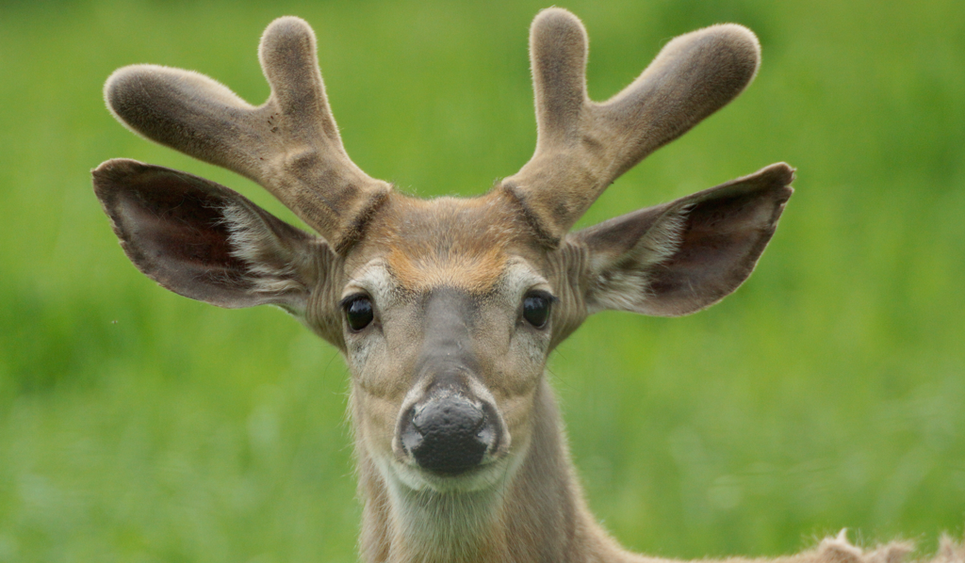
THIRSTING
for the Living God
Psalm 42-43

Slide 2
THE HUMAN PROBLEM
We are not God
We are far removed from God
We are far below God
We are unworthy of god
Our relationship with God is unimaginable, intangible, and unrealistic
We have no logical reason to have any expectation from such a mighty God

Slide 3
Psalm 42-43
A white-tailed deer drinks from the creek;
I want to drink God, deep draughts of God. I'm thirsty for God-alive.
I wonder, "Will I ever make it—
arrive and drink in God's presence?"
I'm on a diet of tears—tears for breakfast, tears for supper.
All day long people knock at my door, pestering,
"Where is this God of yours?”

Slide 4
Psalm 42-43
These are the things I go over and over, emptying out the pockets of my life.
I was always at the head of the worshiping crowd, right out in front,
Leading them all, eager to arrive and worship, shouting praises, singing thanksgiving—celebrating, all of us, God's feast!
Why are you down in the dumps, dear soul? Why are you crying the blues?
Fix my eyes on God—soon I'll be praising again. He puts a smile on my face. He's my God.

Slide 5
Psalm 42-43
When my soul is in the dumps, I rehearse everything I know of you,
From Jordan depths to Hermon heights, including Mount Mizar.
Chaos calls to chaos, to the tune of whitewater rapids.
Your breaking surf, your thundering breakers crash and crush me.
Then GOD promises to love me all day, sing songs all through the night!
My life is God's prayer.

Slide 6
Psalm 42-43
Sometimes I ask God, my rock-solid God, "Why did you let me down?
Why am I walking around in tears,
harassed by enemies?"
They're out for the kill, these
tormentors with their obscenities, Taunting day after day,
"Where is this God of yours?”
Why are you down in the dumps, dear soul?
Why are you crying the blues? Fix my eyes on God—soon I'll be praising again. He puts a smile on my face. He's my God.

Slide 7
Psalm 42-43
Clear my name, God; stick up for me
against these loveless, immoral people. Get me out of here, away
from these lying degenerates. I counted on you, God.
Why did you walk out on me?
Why am I pacing the floor, wringing my hands over these outrageous people?

Slide 8
Psalm 42-43
Give me your lantern and compass,
give me a map, so I can find my way to the sacred mountain, to the place of your presence, to enter the place of worship, meet my exuberant God,
Sing my thanks with a harp, magnificent God, my God.
Why are you down in the dumps, dear soul? Why are you crying the blues? Fix my eyes on God—soon I'll be praising again. He puts a smile on my face. He's my God.

Slide 9
1 - As The Deer
1.
As the deer pants for the water
so my soul longs after You.
You alone are my heart's desire
and I long to worship You.
Words and Music by: Martin Nystrom
Copyright © 1984 by Maranatha Praise, Inc. (Administered by The Copyright Company Nashville, TN)
All Rights Reserved. International Copyright Secured. Used By Permission.
© 2001 The Paperless Hymnal™

Slide 10
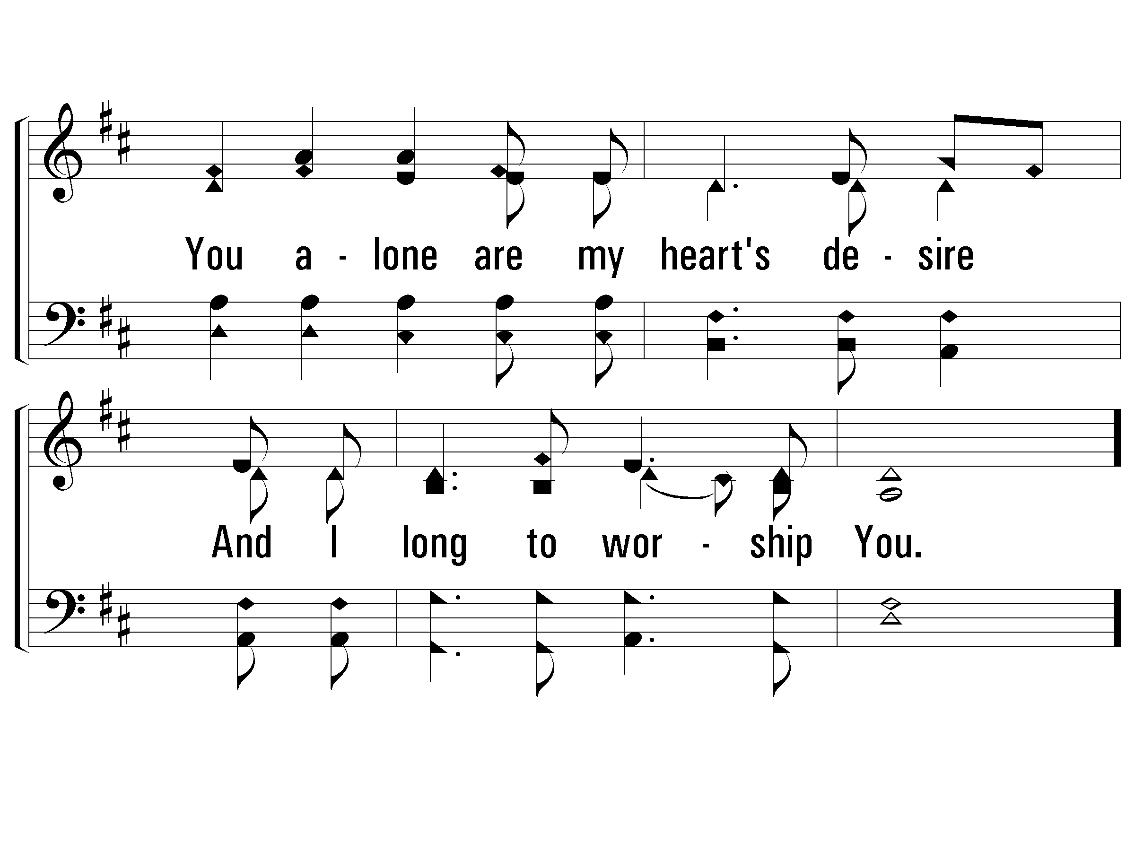
1 - As The Deer
© 2001 The Paperless Hymnal™

Slide 11
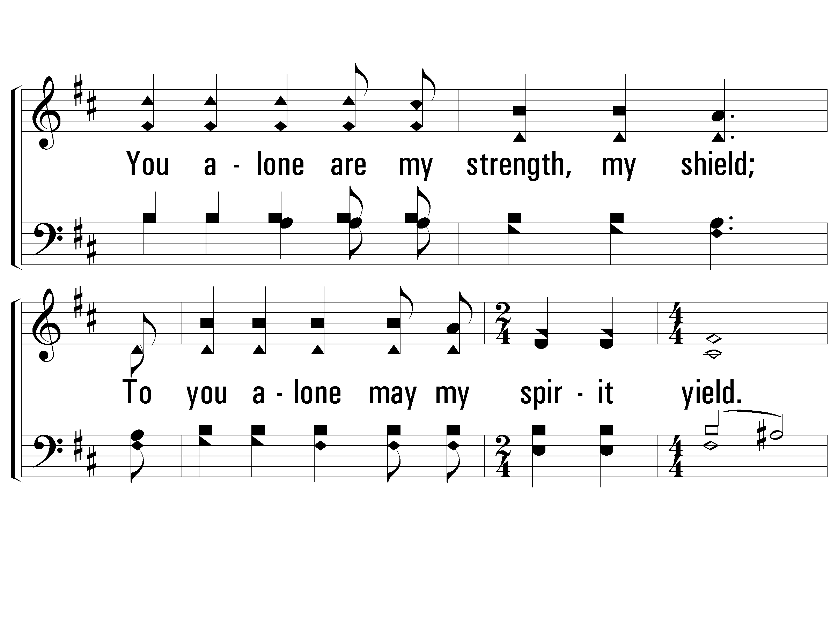
c - As The Deer
You alone are my strength, my shield;
To you alone may my spirit yield.
You alone are my heart's desire
and I long to worship You.
© 2001 The Paperless Hymnal™

Slide 12
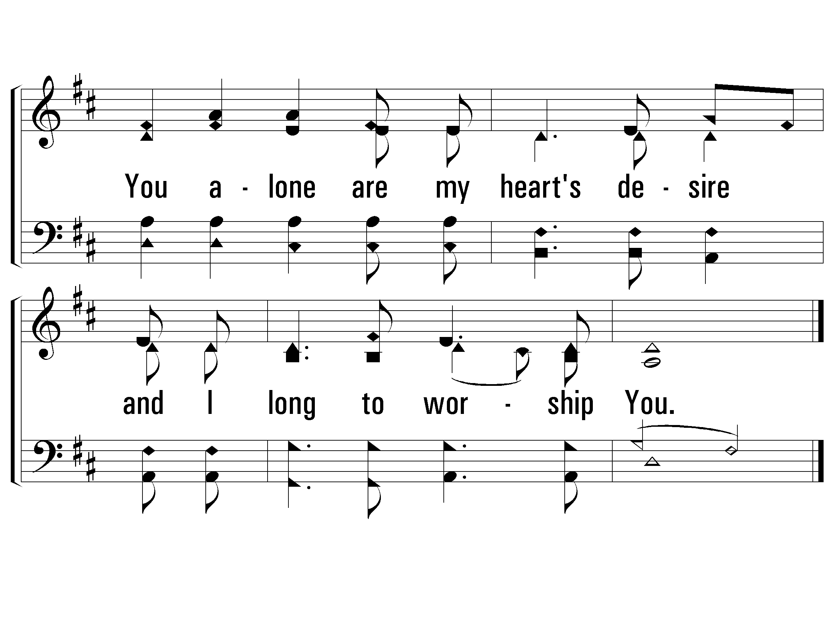
c - As The Deer
© 2001 The Paperless Hymnal™

Slide 13
2 - As The Deer
2.
You're my friend and You are my brother
Even though You are a King.
I love You more than any other,
So much more than anything.
Words and Music by: Martin Nystrom
Copyright © 1984 by Maranatha Praise, Inc. (Administered by The Copyright Company Nashville, TN)
All Rights Reserved. International Copyright Secured. Used By Permission.
© 2001 The Paperless Hymnal™

Slide 14
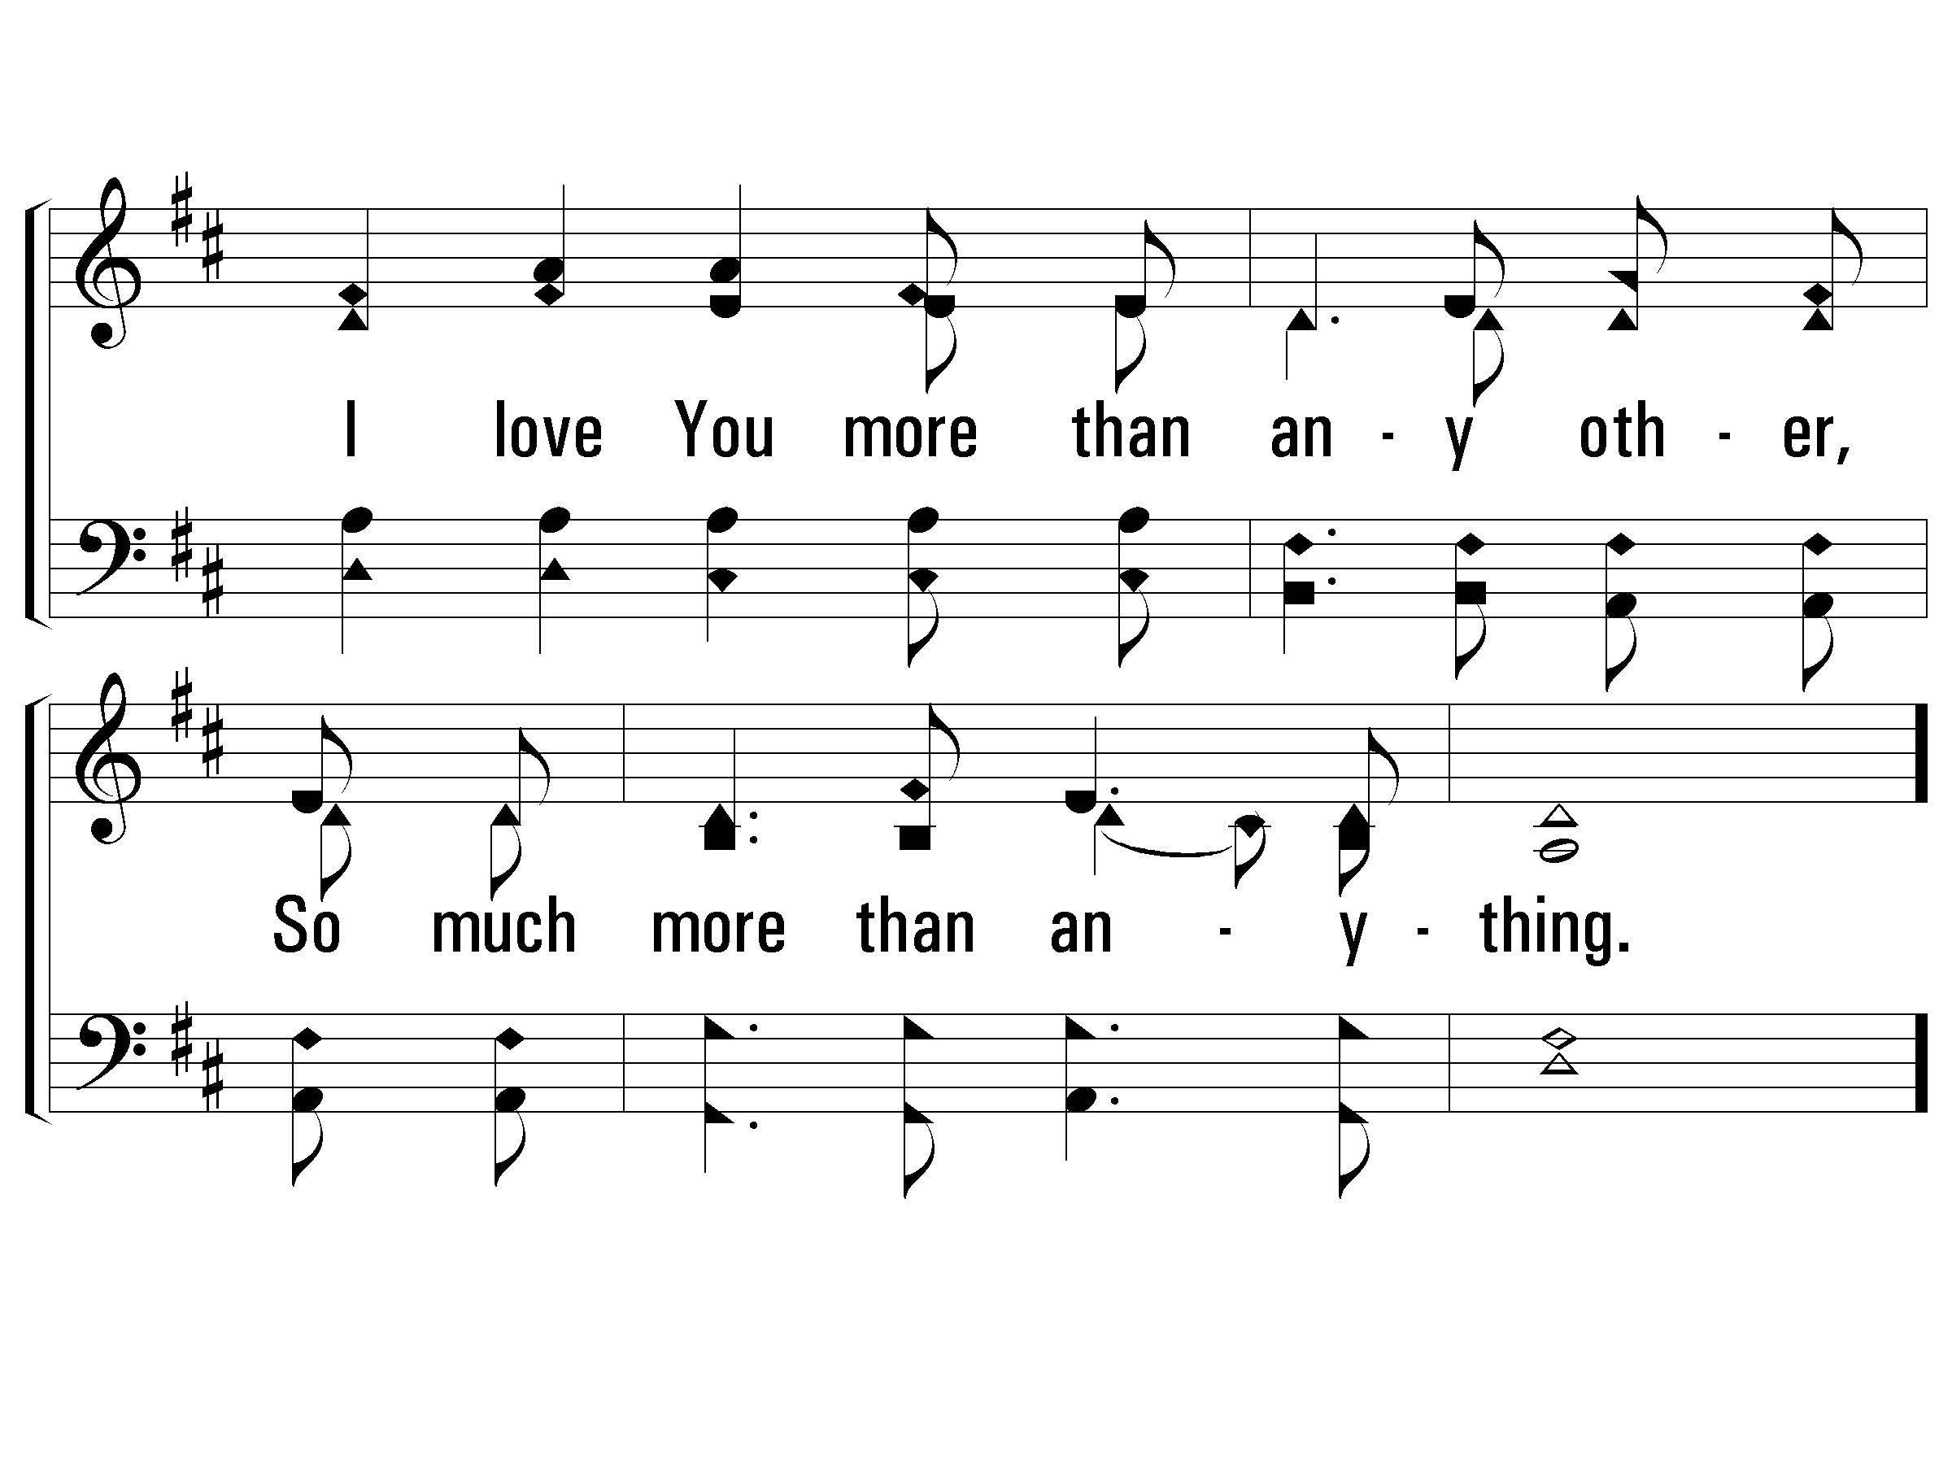
2 - As The Deer
© 2001 The Paperless Hymnal™

Slide 15
c - As The Deer
© 2001 The Paperless Hymnal™

Slide 16
c - As The Deer
© 2001 The Paperless Hymnal™

Slide 17
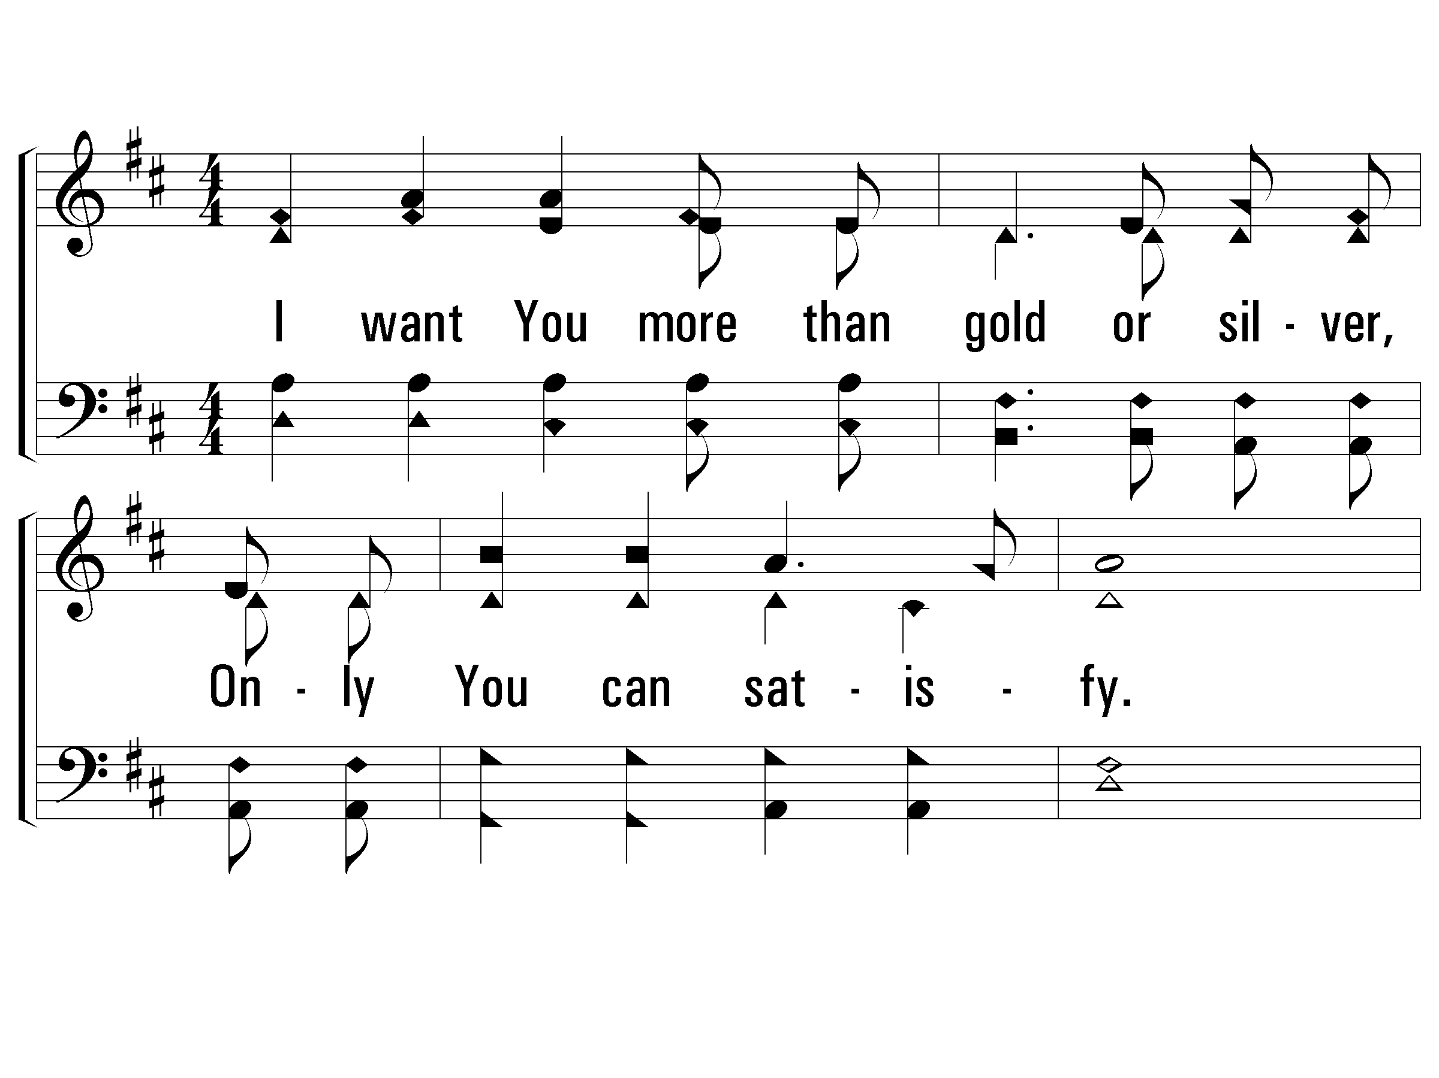
3 - As The Deer
3.
I want You more than gold or silver,
Only You can satisfy.
You alone are the real joy giver,
And the apple of my eye.
Words and Music by: Martin Nystrom
Copyright © 1984 by Maranatha Praise, Inc. (Administered by The Copyright Company Nashville, TN)
All Rights Reserved. International Copyright Secured. Used By Permission.
© 2001 The Paperless Hymnal™

Slide 18
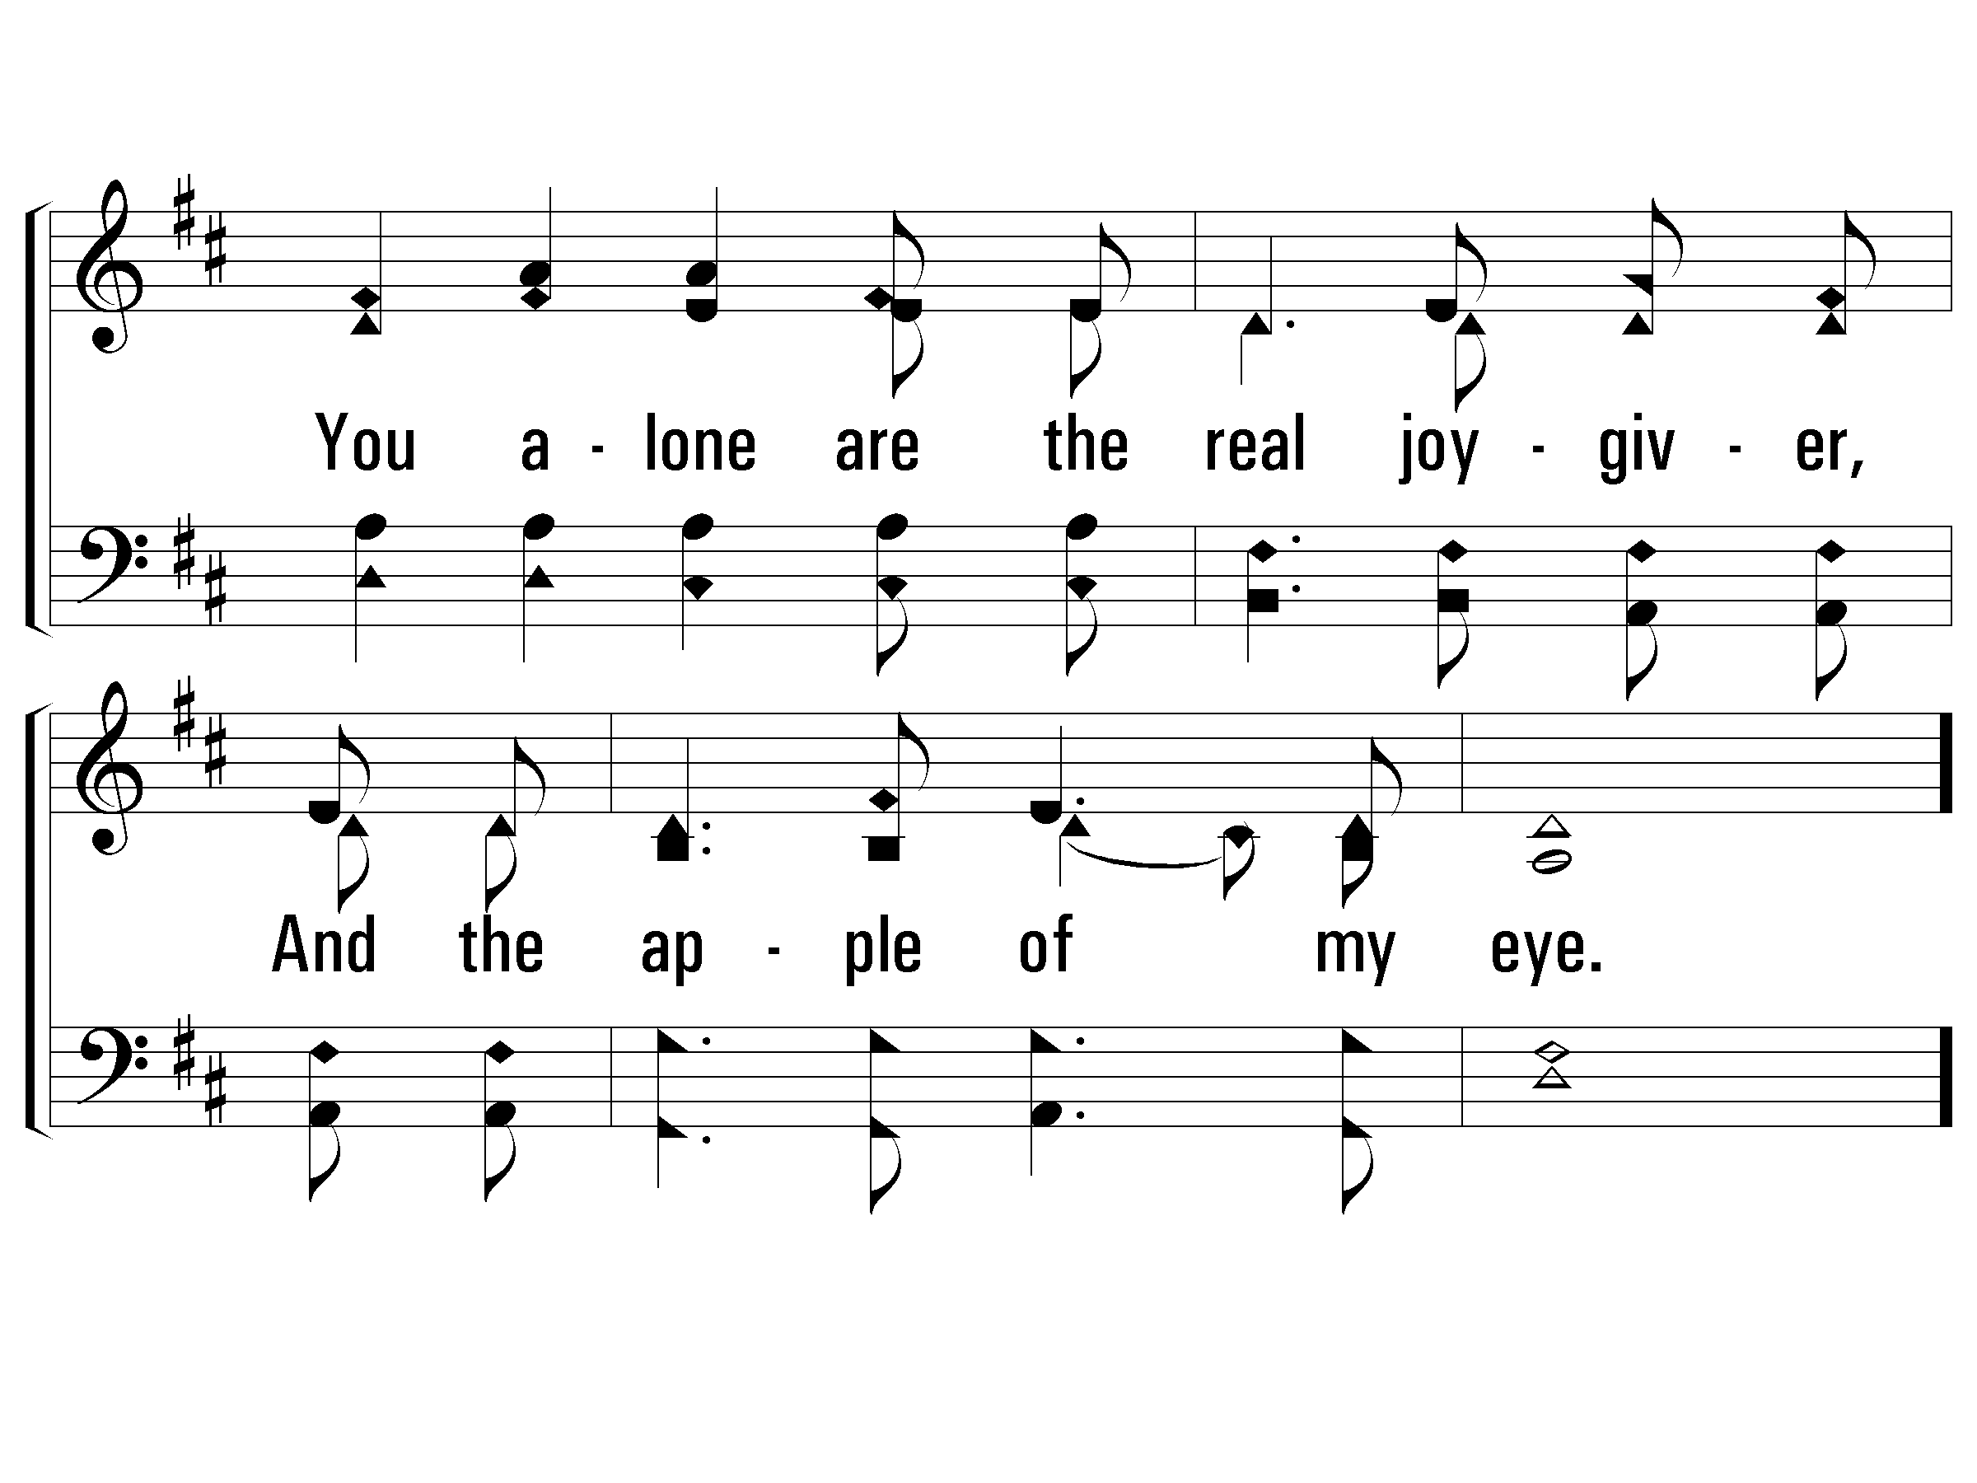
3 - As The Deer
© 2001 The Paperless Hymnal™

Slide 19
c - As The Deer
© 2001 The Paperless Hymnal™

Slide 20
c - As The Deer
© 2001 The Paperless Hymnal™

Slide 21
The Message of Psalm 42-43
“As the Deer” does not reflect the psalm’s somber tone
It is a psalm of desperation and abandonment
“Why are you in despair, O my soul? And why are you disturbed within me?” (42.5, 11; 43.5)
This soul longs for God because God feels distant
This soul recognizes its need for God

Slide 22
Man’s Best Methods
Man’s methods of dealing with sin:
Excuse Sin— “Don’t worry. We’re human. We all sin.”
Trivialize Sin— “God loves you anyway.”
Modernize Sin— “God doesn’t care about that sin anymore. God’s standard has changed.”
Overlook Sin— “God just cares about your faith.”
Redefine Sin— “That was a cultural issue.”
Dismiss Sin— “Don’t worry. God loves sinners too.”
Accept Sin— We categorize sin as acceptable.
No matter the method, we seek to change God, His standard, or His word instead of ourselves.
Instead of drawing near to God, we ask God to “get over it” and draw near to us

Slide 23
Drawing Near to God
We must learn to deal with our sin which separates us
The key is to deal with our sin purposefully - like cleaning off filth
We must deal with our sin promptly - we cannot let it linger
We must deal with our sin painfully - like refining gold in fire
We must deal with our sin passionately - we must take it serious
This take humility
Notes:
When our soul feels distant, what should we do?
“Draw near to God, and He will draw near to you” (James 4.8)
This sounds good, but do we know how to do this?
We all want to be close to God
We all want God to draw close to us?
If this is what we want, why does God sometimes feel distant?
The easy answer is sin, but is this always true?
There are some times we know of our sin yet we feel closer to God.
“Cleanse your hands, you sinners. Purify your hearts, you double-minded. Be miserable and mourn and weep; let your laughter be turned into mourning and your joy to gloom” (James 4.8-9).
The key is to deal with our sin purposefully - like cleaning off filth
We must deal with our sin promptly - we cannot let it linger
We must deal with our sin painfully - like refining gold in fire
We must deal with our sin passionately - we must take it serious
This takes humility
Humble yourselves in the presence of the Lord, and He will exalt you” (James 4.10).
When we deal with sin, we humble ourselves beneath the will and plan of God
Then God will lift us up from the darkest and deepest place
The key is that we be humble people. We don’t try to get to God. We humble ourselves and let God lift us up.
We don’t have to justify ourselves - God does it
We don’t have to feel good about ourselves - God loves you
We don’t have to make ourselves feel good - God does it

Slide 24
Thirsty People
Thirsty people deal with sin humbly:
Thirsty people pour out their hearts (Ps 42.4)
Thirsty people worship (42.5)
Thirsty people see God in everything (42.6-7)
Thirsty people devote themselves (42.8)
Thirsty people trust in God for protection, provision, vindication, comfort, and salvation from sin (42.9-43.2)
Thirsty people love to praise God (43.3-5; 30.11)
Notes:
I miss worshipping with God’s people
I get distracted by responsibility - as if that is more important
I get distracted by needs - as if our needs are more important than His praise
I get distracted by form - as if that makes a difference
I miss gathering with God’s people who want to worship and look forward to more songs and prayers
The answer is not to provide emotions in other ways (lights, sound, environment). The answer is not surroundings
The answer is who you’re surrounded with and Who you’re worshipping

Slide 25
Let’s Be Thirsty People
The key to closeness with God and unhindered worship is not:
Sinlessness
Perfection
Form
Environment
It’s humble, honest hearts willing to pour out exceeding joy and sorrow
It’s our willingness to get lost in messages of joy, sorrow, and His story.
It’s being thirsty for closeness to God
Notes:
I want us to be challenged to come to worship!
Not service. Not responsibility. Not obligation. Not tradition.
Let’s come together to worship! Praise! Thank! Submit! Let’s challenge ourselves to come to quench our insatiable thirst with God.

Slide 26
THIRSTING
for the Living God
Psalm 42-43

