Slide 1
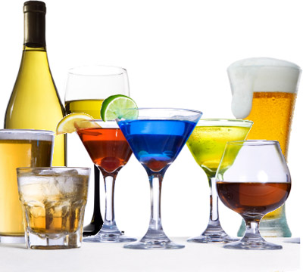
Alcohol: Death in a Bottle
(Canned Death)
        Art Adams, MSW, LCSW, LCAC, CADAC IV, NCPC, NCCE

Slide 2
Social Drinking (Moderate Drinking)
        When alcohol consumption results in a significant risk, whether physical damage or accidents, social or relational problems, legal difficulties or mental health issues, there is a problem.

Slide 3
        The amount of alcohol it takes to feel the effects varies from person to person due to body mass and metabolism differences.
        Women feel the effects of alcohol far more quickly than do men.
        Older adults are more easily affected.
        Alcohol more easily affects all on an empty stomach.

Slide 4
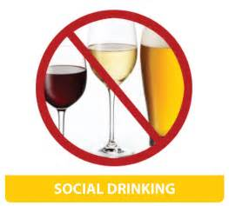
How Do You Know When You Crossed the Line From Social Drinking to Alcoholism

Slide 5
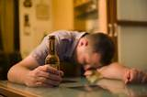
How The World Measure It
        The Subtle Power of Addiction

Slide 6
The Power of Addiction
“Cunning, baffling, deceitful”
A person can be an alcoholic before ever taking their first drink. (Case – T263)
A BIG WORD ABOUT PAIN.
A Choice – “man takes drink, drink takes drink, drink takes man.”
Drink to oblivion – to forget and be forgotten.
Cravings
Denial

Slide 7
First Use
Three Choices:
Ride it out
Increase the dosage
Add a stronger substance
Perceived
as normal
Baseline/Normal level

Slide 8
Social Learning Theory and Genetic Predisposition Models of Addiction
        Recovery Models
        Abstinence
        Harm Reduction
        Cross Addiction

Slide 9
Determining How many Drinks It Takes to Impair Function Varies

Slide 10
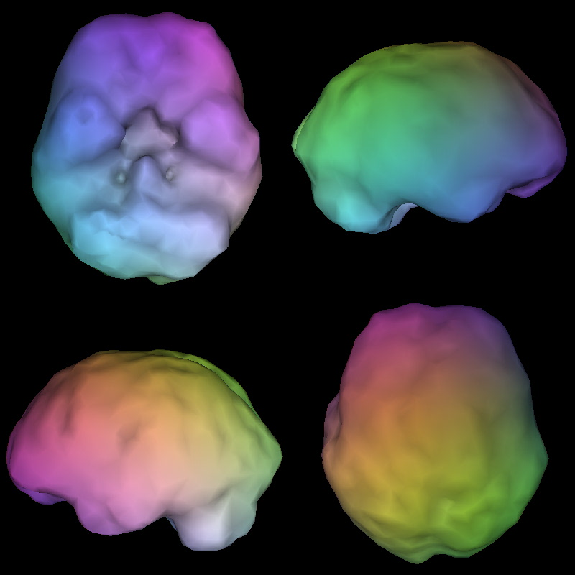
Normal

Slide 11
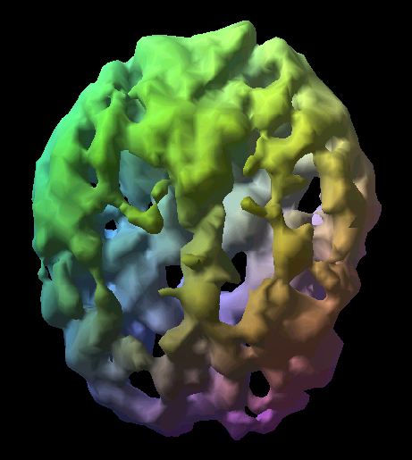
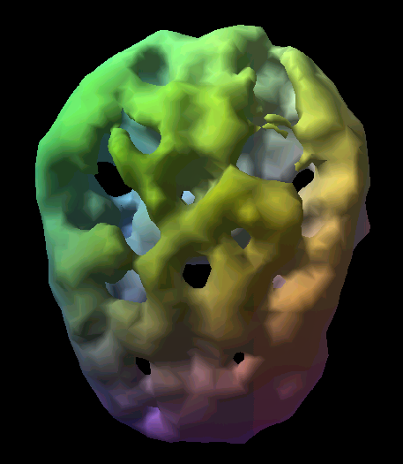
Alcohol Heroin

Slide 12
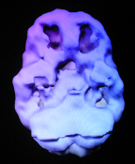
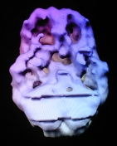
Cocaine/Alcohol -- before/after

Slide 13
Three Hallmarks Traits of Alcoholism
        Denial
        Minimizing
        Rationalizing

Slide 14

When Is The Boundary Crossed From Use To Abuse To Dependence?

Slide 15
DSM V
• Use • Abuse • Dependence
They are viewed as progressive
Criteria:
  Increased/decreased tolerance
  Withdrawal symptoms
  Inability to control or quit
  Using more over longer time than intended
  Continued use despite consequences
  Pre-occupation
  Blackouts

Slide 16
4 Key Questions
        Have you ever felt the need to cut down your drinking?
        Have people ever annoyed you by criticism of your drinking?

Slide 17
4 Key Questions
        Have you ever felt guilty about your drinking?
        Have you ever taken a morning eye-opener drink to steady your nerves or get rid of a hangover?

Slide 18

Clinical Criteria Woven Into The Assessment Process

Slide 19
For “Social Drinkers” To Gain Insight Into Their Drinking
        Go to a party an do not drink OR go for a month without drinking.
        Ask yourself whether this was hard for you.

Slide 20
For “Social Drinkers” To Gain Insight Into Their Drinking
        Did you need to provide a rationale for drinking despite your best intentions not to do so?
        If you cannot have fun with others without drinking, you have a problem.

Slide 21
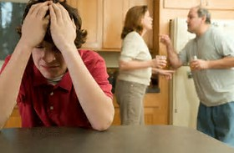
Impact On The Family

Slide 22
Family Healing
The healthiest looking can often be the sickest
1 in 4 children live in a home where Alcohol is used daily.
These children are at greater risk for
  Mental illnesses
  Depression
  Anxiety
  Mood disorders
  Health problems
  Learning difficulties

Slide 23
Family Healing
Distortion of family values
  Lack of trust
  secrets
Distorted family roles
  Enabler
  Lost child
  Super hero
  Mascot
  Rebel
ACTION: Titus 2:4
Dysfunctions will bleed into church life
Habilitation vs. Rehabilitation

Slide 24
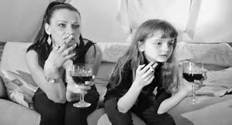
Role Model – Availability and Family Use
        How God Measures it

Slide 25
1 Peter 4:1-4
¹Therefore, since Christ has suffered in the flesh, arm yourselves also with the same purpose, because he who has suffered in the flesh has ceased from sin.
²so as to live the rest of the time in the flesh no longer for the lusts of men, but for the will of God.

Slide 26
1 Peter 4:1-4
³For the time already past is sufficient for you to have carried out the desire of the Gentiles, having pursued a course of sensuality, lusts, drunkenness, carousing, drinking parties and abominable idolatries.
⁴In all this, they are surprised that you do not run with them into the same excesses of dissipation, and they malign you;

Slide 27
1 Peter 4:1-4
Excess of wine (gr. Oinophlugia – an overflow of wine; Drunkenness; Falling down drunk),
Revellings (komos, gr. A nightly carousal; Half-drunken, revelry, drunken party);
Banquetings (carousings) (gr. Potos – a drinking, not of necessity excessive; A drinking party; To sip);
NOTE: ALL THREE LEVELS OF USE ARE CONDEMNED.

Slide 28
God’s Word is Sufficient
“Make no provision for the flesh to fulfill the lusts thereof.” (Rom. 13:14)
“By their fruits ye shall know them.” (Matt. 7:16)
“Be not among winebibbers.” (Prov. 23:20)
“Wine is a mocker, strong drink is a rage and whoever is deceived thereby is not wise.” (Prov. 20:1)
Notes:
Worship Layout

Slide 29
God’s Word is Sufficient
29Who hath woe? who hath sorrow? who hath contentions? who hath babbling? who hath wounds without cause? who hath redness of eyes? 30They that tarry long at the wine; they that go to seek mixed wine. 31Look not thou upon the wine when it is red, when it giveth his colour in the cup, when it moveth itself aright. 32At the last it biteth like a serpent, and stingeth like an adder. 33Thine eyes shall behold strange women, and thine heart shall utter perverse things. 34Yea, thou shalt be as he that lieth down in the midst of the sea, or as he that lieth upon the top of a mast. 35They have stricken me, shalt thou say, and I was not sick; they have beaten me, and I felt it not: when shall I awake? I will seek it yet again.” (Prov. 23:29-35)
Notes:
Worship Layout

Slide 30
God’s Word is Sufficient
“Do not drink wine or strong drink lest ye die…that ye put a difference between the holy and the unholy and the clean and the unclean.” (Lev. 10:9-10)
“What-know ye not that your body is the temple of the Holy Spirit, which is in you, which ye have of God and you are NOT YOUR OWN? FOR WE ARE BOUGHT AS A PRICE: THEREFORE GLORIFY GOD IN YOUR BODY AND IN YOUR SPIRIT WHICH ARE GOD’S.” (1 Cor. 6:14ff)
Notes:
Worship Layout

Slide 31
God’s Word is Sufficient
“Be not deceived, evil companions corrupt good morals.” (1 Cor. 15:33)
“The night is far spent, the day is at hand: let us therefore cast off the works of darkness and let us put on the armor of light. Let us walk honestly, as in the day. NOT IN RIOTING, and DRUNKENNESS, NOT IN CHAMBERING and WANTONNESS, NOT IN STRIFE AND ENVYING. But put ye on the LORD JESUS, and make NO PROVISION for the flesh, to fulfill the lusts thereof.” (Rom. 13:12-14)
Galatians 5:19ff
Notes:
Worship Layout

Slide 32
Addiction Is An Erosion Process
        Worse and Worse
        2 Timothy 3:13

Slide 33
What is our response…
Individual Role
“Dry Drunk” behaviors
Safe plan for slippery slopes
EDIFY THEM!!!
Bear each others’ burdens

Slide 34
How do I stop?
H – Honest
O – Open
W – Willing

Slide 35
Natural Supports
Shepherds
Trusted Family/Friends
Person further along on the same journey
Support Groups
Accountability Partners

Slide 36
Church’s Role
Availability of caring brothers and sisters
James 5:16
Luke 7:36-49
Elders
Confrontation vs. Compassion
Acceptance vs. judgmentalism (Matt. 7:1-4)

Slide 37

Empty House
You can’t survive in a vacuum.
H – Hungry
A – Angry
L – Lonely
T – Tired
Creates an empty house. (Lk. 11:24-26)

Slide 38

Best Thinking
“My best thinking got me here and it keeps me sick.”

Slide 39
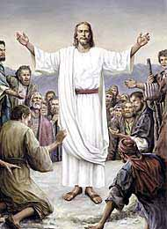
Learning from Jesus
“ ‘Nevertheless’ Relationship with God” (Lk. 22:39-43)
Tempted at the points of:
Faith
Endurance
Love for God

Slide 40
Mantras
“Thy word have I hid in my heart” why?
“That I may not sin against thee.” (Ps.119:11)
“Get behind me, Satan.” (Matt. 16:23)
“Greater is He that is in you than he that is in the world.” (I Jn. 4:4)

Slide 41
MUST CHANGE:
Play ground
Play Mates
Play Things

Slide 42
We Drank
        We drank for Happiness and became unhappy
        For Joy and became miserable
        For Sociability and became argumentative
        For Sophistication and became obnoxious
        For Friendship and became enemies
        For sleep and could not rest
        For Strength and became weak

Slide 43
We Drank
        For Relaxation and became shaking
        For Bravery and became afraid
        For Confidence and became doubtful
        To Start a conversation and slurred our speech
        To Forget and became forever haunted
        For Freedom and became a slave
        To Escape problems and they multiplied
        To Cope with life and died.

