Slide 2
Anxiety Disorders

Slide 3
Types Of Disorders
Children:
Separation Anxiety Disorder
Selective Mutism
Panic Disorder
Phobias
Obsessive Compulsive Disorder (OCD)
Post-Traumatic Stress Disorder (PTSD)
Social Anxiety Disorders

Slide 4
Types of Disorders
Adults:
Generalized Anxiety Disorder
Social Anxiety
Phobias
Panic Disorders
Acute Stress Disorders
Obsessive Compulsive Disorder (OCD)
Post-Traumatic Stress Disorder (PTSD)
Hoarding
Body Dysmorphic Disorder
Trichotillomania

Slide 5
Frequency
10% of Teens
40% of Adults
2/3 of Adults do not receive treatment (Source: NIMH Statistics 2013)
Only 1/5 of teen sufferers present for treatment
6-13 and 60+ are equally represented
14-18,19-40, 41-60 equally represented

Slide 6
Adults
Women are 60% more likely than men to experience an anxiety disorder over their lifetime.
Only 36.9% were receiving treatment.
63% do not get treatment. (Source: NIMH, 2005)

Slide 7
Children and Adolescents
Average Onset Age: 11 years old (Source: NIMH, 2005)
25.1% of 13-18 year olds experience an anxiety disorder.

Slide 8
Why Is This Happening?
The most common trait of anxiety is:
F alse
E vidence
A ppears
R eal

Slide 10
Why Is This Happening?
Three components to better understand Anxiety:
Physiological
Cognitive
Behavioral

Slide 11
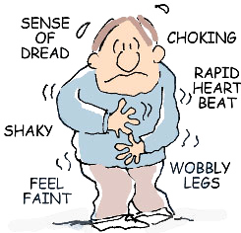
PHYSICAL SENSATIONS

Slide 12
Physiological Sensations
Rapid heartbeat, difficulty breathing, perspiration, jitteriness, numbness, feeling lightheaded, dizzy, disconnecting from the body, stomach distress (nausea, diarrhea), headache, sleep problems, irritability

Slide 13
Physiological Sensations
These reactions are a GOOD THING.
This what the body is supposed to do.
However, the feeling of danger is a lie (probably).

Slide 14
Physiological Sensations
THE BODY DOES NOT KNOW THE DIFFERENCE BETWEEN A REAL AND AN IMAGINED THREAT.
A panic attack is a FALSE ALARM.
The body is reacting to a danger which does not exist.

Slide 15
Physiological Sensations
Panic Attack symptoms:
Rapid heartbeat
Difficulty breathing
Sweating
Trembling or shaking
Feeling dizzy or faint

Slide 16
Physiological Sensations
6. Tingling or numbness in extremities
7. Digestive distress
8. Fear of dying
9. Fear of going crazy or losing control
10. Cognitive:
Racing thoughts
Unwanted thoughts
Feelings of disconnectedness

Slide 17
Physiological Sensations
These sensations are not harmful or dangerous.
These sensations are time limited.
However, you can keep the panic going by how you think about it.

Slide 18
Cognitive
Life is hard, but the way we think about it can make it worse.
What we have done or thought a long time comes natural.

Slide 19
Cognitive
Change our thinking=
Change our feelings=
Change our responses.

Slide 20
Cognitive Distortion Patterns
Fortune Telling
Catastrophic thinking
Mind reading
All or nothing thinking
Overgeneralization
Mental Filter
"Should" thoughts
Labeling
Discount the positive
Emotional Reasoning

Slide 21
Four Cognitive Biases of Anxiety
Overestimate the likelihood that bad thing will happen.
Overestimate the consequences should the bad thing happen.
Underestimate our ability to cope should the bad thing happen.
Prophecy that we might have great difficulty accepting the uncertainty.

Slide 22
Common Cognitive Distortions
Things must turn out the way I want.
People should meet my expectations.
It’s always my fault OR it’s never my fault, it’s always your fault.
People are against me.
Any failure is a sign of my inadequacy.
I’m not as good as other people OR I’m better than others.

Slide 23
Common Cognitive Distortions
7. I can’t stand this. This is awful.
8. I have to please everybody else. This must be first.
9. Other people are all critical or judgmental.
10. Bad thoughts make me a bad person.
11. If I don’t worry, something bad will happen.
12. Ignorance is bliss.

Slide 24
Behavioral
Whole body: Fatigue, restlessness, sweating.
Hypervigilance or irritability.
Anxiety, fear, feeling of impending doom, insomnia, nausea, sensation of an abnormal heartbeat, trembling.
Wearing a mask.
Low self image.

Slide 25
Behavioral
6. People pleasing.
7. Over-analyzing.
8. Perfectionism.
9. Abnormal fears of death and Hell.
10. Cognitive distortions of God.
11. Change in behavior to avoid attacks.

Slide 26
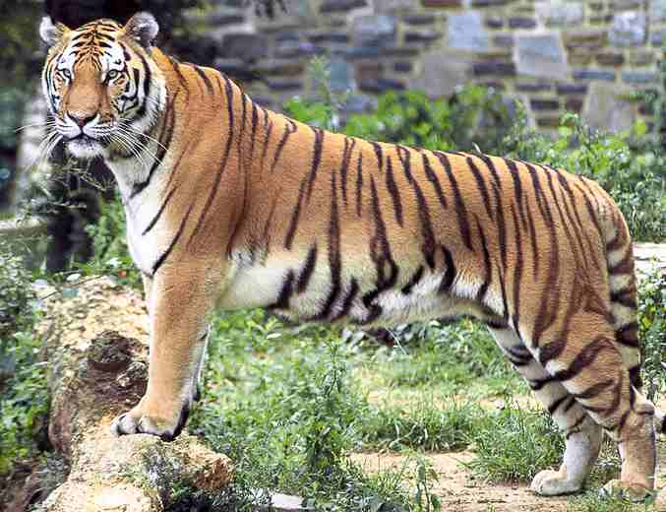
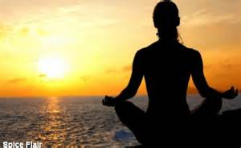
Healthy Stress Response
Sympathetic
Tiger Analogy
Parasympathetic
80-20% rule
***In The Zone***

Slide 27
Do You Have An ANT Problem?
A utomatic
N egative
T houghts

Slide 29
Questions Which Challenge ANTS
What ANTS do you recognize in your thoughts?
Apart from how you feel, what is the evidence your thought is accurate? What is the evidence it is inaccurate?
Are you 100% convinced your thought is accurate?
What is the worst thing that could happen? If it happens, what would still be good in your life?
Are there other outcomes possible?

Slide 30
Questions Which Challenge ANTS
6. What are other possible explanations for what happened?
7. What would you tell a valued friend who thought this way?
8. What might other people think about this?
9. What part of this do you have control over?
10. What are the advantages of thinking this way? What are the disadvantages?

Slide 31
ANT Colony
ANT Colonies are underlying/underground networks/hidden assumptions

Slide 32
ANT Colony
Catastrophic thoughts
More physical discomfort
More catastrophic thoughts
And so on…

Slide 33
Additional Thoughts
Genetic predisposition to anxiety.
Negative reaction to medication.
Food allergies or food poisoning.
Combinations: warm room, bad food, stressful situation, trouble catching breath/cold sweats, hands shaking.
Persistent worry about more attacks.
Worry about the implications of the attacks.

Slide 34
Commandments
Matthew 6: 25
Philippians 4: 6
1 Peter 5:7

Slide 35
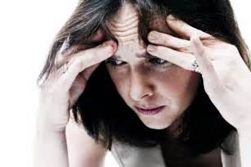
The Bible uses the word "Anguish" which is "extreme distress of body, mind or spirit". We call this anxiety.

Slide 36
Consider Paul:
2 Corinthians 2:4 - Paul wrote with much anguish of heart with tears
2 Corinthians 11:25 - Paul was beaten with rods 3 times, stoned 1 time, shipwrecked 3 times, and spent a night and day in the deep.
2 Corinthians 11:28 - Paul wrote "I face daily the anxiety for all the churches."

Slide 37
Consider Jesus:
Luke 22:44 - Jesus is described - "and being in anguish... His sweat became like great drops of blood..."
On the cross He cried out in anguish "My God, My God why have you forsaken Me? "

Slide 38
Consider David:
The rest of that Psalm Jesus quoted is "Why are you so far from saving me, from the words of my anguish?" So, These were words of anguish for both Jesus and David, the Psalmist.

Slide 39
Did Paul, David and Jesus sin when they were in anguish; otherwise known as anxious?

Slide 40
Where Is The Power?
Most anxiety results from thinking.
Example: Rape survivor – took job, assaulted on the job.
“I made the wrong decision coming here.” “I should have worn something different.” “I should have fought back.”
Exacerbated by, “payback for the things I’ve done.” “I’m worthless.” “I’m defective.” “I’m unlovable.” “I’m dirty.”

Slide 41
The Role of Medications
Truth: medication can prove effective for many anxiety sufferers.
Medication is NOT a cure.
Acts as an inhibitor, not an antibiotic.
Enormous negative side effects:
Depression
Seizures
Changes in sex drive
Deep depression
Suicide

Slide 42
Other Proven Methods
Reduce or delete caffeine and nicotine.
Reduce stress.
Natural supplements and vitamins.

Slide 43
Thoughts Journal
To counter, keep a “thoughts journal” which emphasized your ANTs.
What alternate thoughts do you want?
It is not the goal for the person to feel good.
Life is tough and negative feelings will come and go.

Slide 44
Test Your Fears During A Panic Attack
Breathing issue – Breathe heavier, hold your breath, recite the pledge to the flag.
Confront the fear – Complete the sentence: If I ____, then ____, and then____, and then ____, etc. to core fear.

Slide 45
Nine Strategies
Notice and name.
Develop a plan.
Move.
Breathe.
Nurture the spirit.
Reframe your thoughts.
Watch the toxins.
Don’t watch the news.
Don’t worry alone.

Slide 46
Role Of The Church
Three questions every congregation should ask of itself?
Is the church pulling harder than the world?
Do we really know each other?
Do people feel alive or dead in this congregation?

Slide 47
Role Of The Church
When we understand the underlying issues of:
Fear
Loneliness
Despair
Suicidality
We understand that our brethren need us and we need them.

Slide 48
Recommended Readings
When Panic Attacks, David D. Burns, M.D. Three Rivers Press, NY. 2006
Embracing the FEAR, Judith Bemis, Amr Barrda, PhD. Hazelden. 1994
Anxiety Treatment Techniques That Really Work, Stanley Hibbs, PhD. PESI Publishing, Eau Claire, WI. 2013

Slide 49
Recommended Readings
Brain Based Therapy for Anxiety, John B. Arden, PhD. PESI Publishing, Eau Claire, WI. 2014
Ten Days to Self-Esteem, David D. Burns, M.D. Harper, NY. 1999
The Self-Esteem Workbook, Glenn R. Schiraldi, PhD. New Harbinger Press, Oakland, CA. 2001

