Slide 2
Supporting The Depressed and Their Families
What To Do And Not Do
Presented By: Art Adams, MSW, LCSW, LCAC, CADACIV

Slide 3
Bible Characters Who Suffered Bouts of Depression
Abraham (Genesis 15)
Jonah (Jonah 4)
Job (Entire book of Job)
Elijah (1 Kings 19)
King Saul (1 Sam. 16: 14- 23ff)
Jeremiah (Entire book)
David (Psalms 6, 13, 18, 23, 25, 27, 31, 32, 34, 37,-40, 46, 51, 55, etc)

Slide 4
Some Depression Comes from Guilt & Shame
Consider David: “When I kept silent, my bones grew old through my groaning all the day long. For day and night Your hand was heavy upon me; My vitality was turned into the drought of summer. Selah.”
(Ps. 32: 3-4)

Slide 5
Suicidal Depression
Common misconceptions about Suicide
*False -People who talk about suicide won’t really do it
*False - People who talk about or attempt suicide want to die
*False - Anyone who tries to kill him/herself must be crazy
*False - If a person is determined to kill him/herself, nothing is going to stop them
*False - Talking about suicide may give someone the idea

Slide 6
Anger Often Underlies Depression
A working definition of depression is:
Anger turned inward.
Some personality types “act in” while others “act out”

Slide 7
Medical Causes of Depression
Pre-menstrual and postnatal hormone changes
Some types of manic depression have been shown to have a genetic basis
Hormone deficiencies (such as thyroid disturbances)
Generalized illnesses such as kidney or liver disease

Slide 8
Medical Causes of Depression
Lack of natural light during winter in some susceptible people
Alcoholism
Drug dependency
Food allergies and strange reactions to medicines, chemicals or food additives.

Slide 9
NOT ALL DEPRESSION IS THE SAME TYPE (9 types)
Major Depression
Dysthymia
Post Partum Depression
Seasonal Affective Disorder
Atypical Depression
Psychotic Depression
Bi-Polar Depression (Manic/Depression)
Premenstrual Dysphonic Disorder
Situational Depression

Slide 10
How To Help Yourself
Don’t expect too much of yourself
Take a break
Get some exercise
Avoid extra stress and big changes
Eat a proper, well-balanced diet
Let others comfort you
If you cannot resolve depression yourself, don’t wait, get professional help

Slide 11
How To Help Yourself
Set realistic goals in light of the depression and assume a reasonable amount of responsibility
Break large tasks into small ones, set some priorities, and do what you can as you can
Eliminate the use of alcohol or drugs
Expect your mood to improve gradually, not immediately. Feeling better takes time
Attend a depression recovery group that is confidential

Slide 12
Helping a Depressed Friend
Avoid critical or shaming statements
Empathize with feelings of sadness, grief, anger and frustration
Don’t try to “cheer up” a depressed person

Slide 13
Biblical
Elijah – A Character Study of Clinical Depression
Classic Symptoms
Fear (I Kings 19:3)
Death wish/suicidal tendencies (I Kings 19:4)
Excessive Tiredness (I Kings 19:5)
Feelings of Rejection (I Kings 19:10)

Slide 14
Biblical
Elijah – A Character Study
How does God heal Elijah?
God sent him to church
God had Elijah tell Him what the problem was
God dealt with cognitive distortions (false beliefs/ideas) that were fueling his depression
God gave Elijah something new and challenging to do

Slide 15
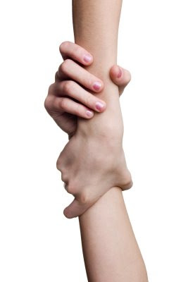
Intervening with a depressed friend
Don’t argue about how bad things are
Don’t insist that depression or sadness are the wrong feelings to be experiencing
Don’t try to “get them out of depression” by providing activities that “help”

Slide 16
When to Consult Professional Therapy
When pain or problems outweigh pleasures much of the time
When symptoms are so severe and persistent that day-to-day functioning is impaired
When stress seems so overwhelming that suicide seems to be a viable option.

Slide 17
TALKING TO A SUICIDAL PERSON
10 things NOT to say:
“How could you think of suicide? Your life is not that bad.”
“Don’t you know I would be devastated if you killed yourself? How could you think of hurting me like that?”
“Suicide is selfish.”
“Suicide is cowardly.”
“You don’t mean that. You don’t really want to die.”

Slide 18
TALKING TO A SUICIDAL PERSON
10 things NOT to say (cont.):
“You have so much to live for.”
“Things could be worse.”
“Other people have problems worse than you and they don’t want to die.”
“Suicide is a permanent solution to a temporary problem.”
“You will go straight to Hell if you kill yourself”

Slide 19
WHAT CAN I DO TO HELP A SUICIDAL PERSON?
Ask the question, “Are you thinking about hurting yourself?”
Take it seriously
Remember suicidal behavior is a cry for help
Be willing to give and get help sooner than later
Listen and let the person talk
If the person is acutely suicidal, do not leave him/her alone
Do not keep their intention as “a secret”
Urge professional help (211)

Slide 20
Summary / Wrap Up
Depression affects the brain and is paralyzing in nature
Depression Causes must be explored to relieve depressive symptoms
Helping ourselves by reaching out for help is necessary when depression is chronic
God’s compassion for the depressed can be expressed to friends who suffer, there are always alternatives to suicide

Slide 21
Coping Techniques from Scriptures
David and the Psalms
Journaling
Reflection
Meditation (Psalm 119:97)
Prayer
Look up at something bigger than yourself (Psalm 147:4)

Slide 22
Coping Techniques from Scriptures
Solomon (Wisdom literature)
Choose the course of wisdom
Be careful who you associate with (Prov. 1-10)
Life under the sun - vanity

Slide 23
Coping Techniques from Scriptures
King Saul
Power of soothing music (1 Sam. 16:22,23)

Slide 24
Coping Techniques from Scriptures
Amos
Look at the power that is greater than you (Amos 5:8)

Slide 25
Coping Techniques from Scriptures
Habakkuk
Stay on your side of the road (quit worrying about what God is doing – wait on Him)
Though the battle rages below – (3:17-18)

Slide 26
Coping Techniques from Scriptures
Paul
Set your affections (Col. 3:2 – i.e. 2-12)
Thought stopping (Think on These Things – Phil. 4:8)
Godliness with Contentment (1 Tim. 6:6)
One day at a time – sufficient unto a day is evil

Slide 27
Coping Techniques from Scriptures
James
Live in the day – (14:4f)
Avoid getting stuck on yourself (just a vapor)

Slide 28
Coping Techniques from Scriptures
Jesus (Matt. 5-7)
Faith sees backwards
He’s got the whole world in His hands
The World is sustained by word of His power (Heb. 1:2-6)
We have a Great High Priest (Heb. 4:14-16)
Boldly access the throne of Grace to find help in time of need

Slide 29
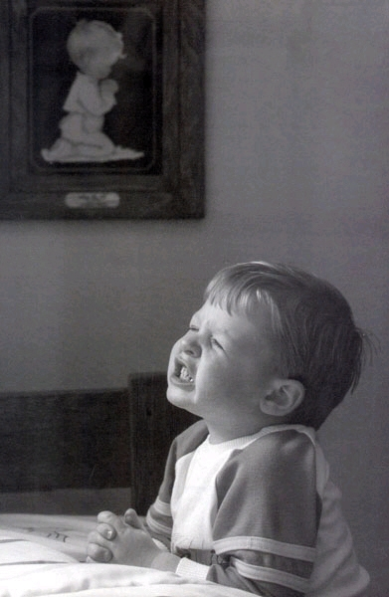
My Next Steps To Recovery
My next steps to resolving depression are:
Talk to God
Implement Self Help principles
Ask for support from friends or groups
Consider Professional Help

