Slide 1
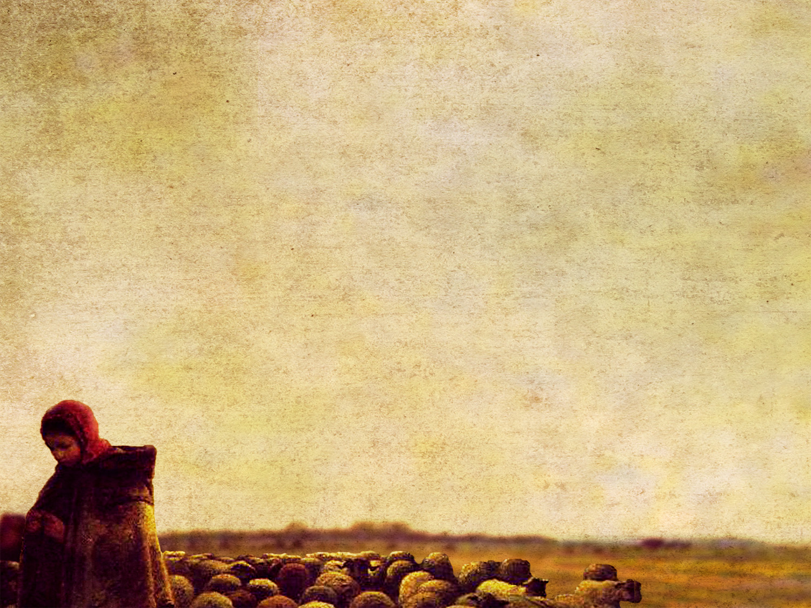
John 15:12–15
¹² “This is my commandment, that you love one another as I have loved you. ¹³ Greater love has no one than this, that someone lay down his life for his friends. ¹⁴ You are my friends if you do what I command you. ¹⁵ No longer do I call you servants, for the servant does not know what his master is doing; but I have called you friends, for all that I have heard from my Father I have made known to you.

Slide 2
John 15:16–17
¹⁶ You did not choose me, but I chose you and appointed you that you should go and bear fruit and that your fruit should abide, so that whatever you ask the Father in my name, he may give it to you. ¹⁷ These things I command you, so that you will love one another.

Slide 4
Shepherds love their sheep.
John 10:1–18
John 15:12–13
Romans 5:6–8

Slide 5
Parents need to love their children like shepherds.
Psalm 127:3–5
Hebrews 12:5–8
Titus 2:3–5

Slide 6
Four marks of true love…
Love is not optional.
Love is something you do.
Love strengthens.
Love is a long-term investment.

