Slide 1
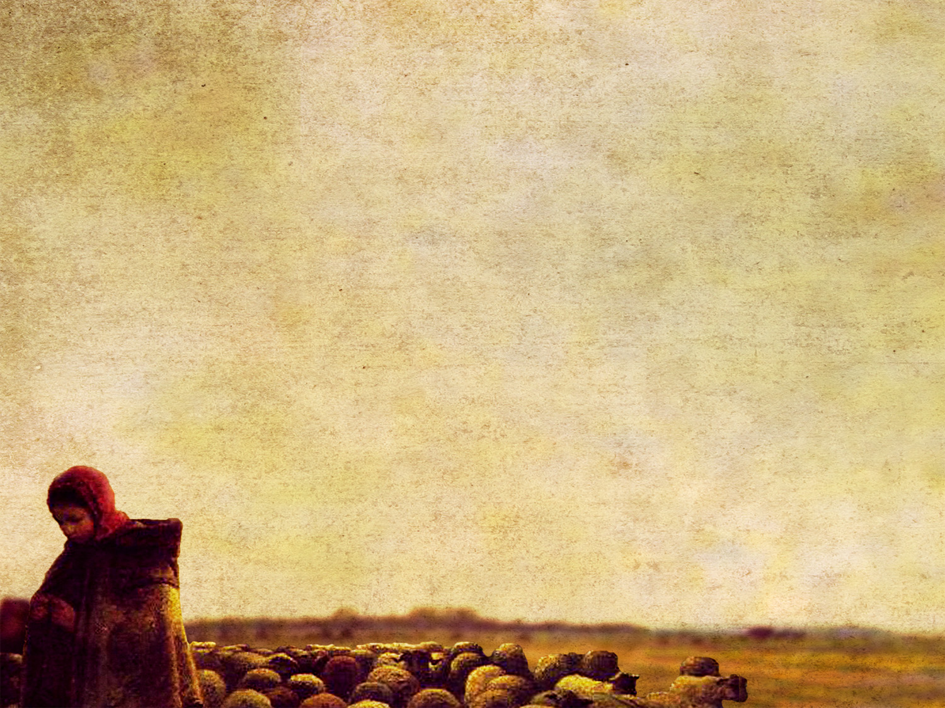
1 Peter 5:1–3
¹ So I exhort the elders among you, as a fellow elder and a witness of the sufferings of Christ, as well as a partaker in the glory that is going to be revealed: ² shepherd the flock of God that is among you, exercising oversight, not under compulsion, but willingly, as God would have you; not for shameful gain, but eagerly; ³ not domineering over those in your charge, but being examples to the flock.

Slide 3
Shepherds are willing.
1 Peter 5:2
1 Timothy 3:1
The word here for desire is “lust.”
Parents have a strong desire to become parents.
But do we parent out of obligation or willingness?
Ephesians 6:4

Slide 4
Shepherds are eager.
1 Peter 5:2
They don’t lead for personal gain.
Philippians 2:3–4
You cannot serve two masters.
Matthew 6:24, 33

Slide 5
Shepherds are gentle.
1 Peter 5:3
Shepherds are “proving” themselves as examples (NASB).
Hebrews 13:7
Parents could demand obedience.
Ephesians 6:1
Parents should be gentle leaders that prove themselves.

