Slide 1
Matthew 9:1–4
¹ And getting into a boat he crossed over and came to his own city. ² And behold, some people brought to him a paralytic, lying on a bed. And when Jesus saw their faith, he said to the paralytic, “Take heart, my son; your sins are forgiven.” ³ And behold, some of the scribes said to themselves, “This man is blaspheming.” ⁴ But Jesus, knowing their thoughts, said, “Why do you think evil in your hearts?

Slide 3
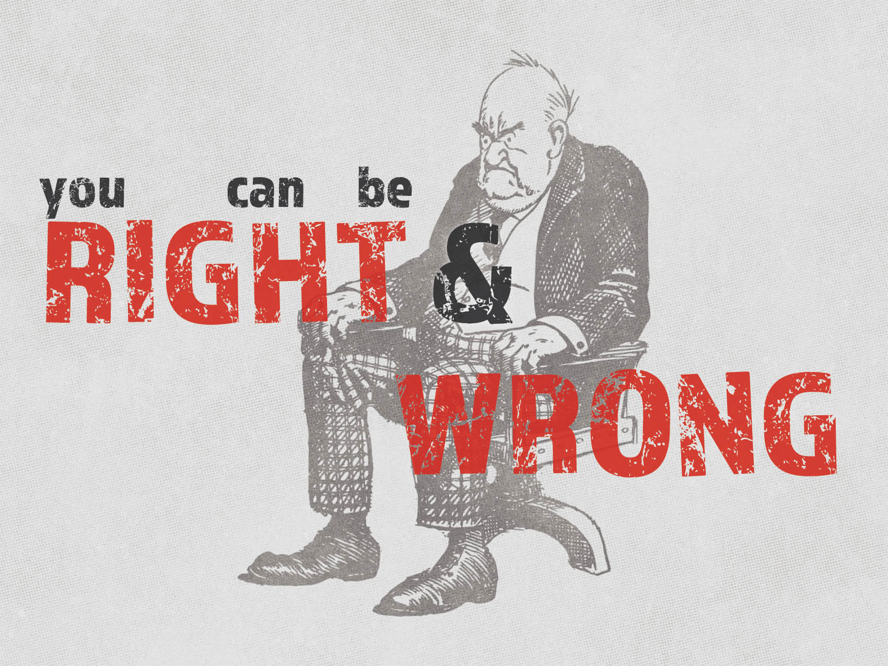

Slide 4
We are wrong when we are always in attack mode.
Some things are weightier than others.
Matthew 23:23–24
There are matters of doubt.
Romans 14:1–4
We need to be peaceable.
Romans 12:16–18
We need to put others above ourselves.
Philippians 2:3–4

Slide 5
We are wrong when we treat everyone like false prophets.
We use Jesus as an example.
Matthew 12:34
Matthew 23:13–15, 16–17
Jesus knew the hearts of people.
Matthew 9:4
We could be wrong.
Acts 18:24–26

Slide 6
We are wrong when we are rude.
This is a carnal attitude.
1 Corinthians 3:1–3
Galatians 5:19–21
We should be characterized by the fruit of the spirit.
Galatians 5:22–24

