Slide 1
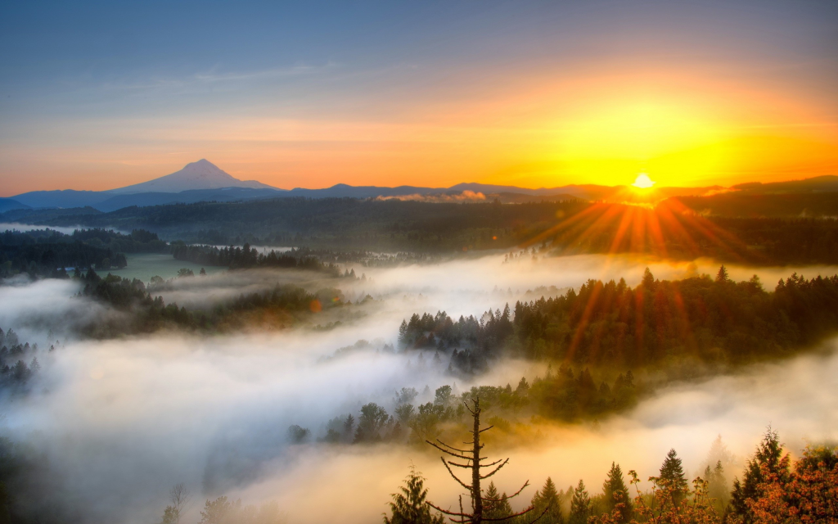
Sunday Morning, March 13, 2016
First song: There Is A Redeemer

Slide 2
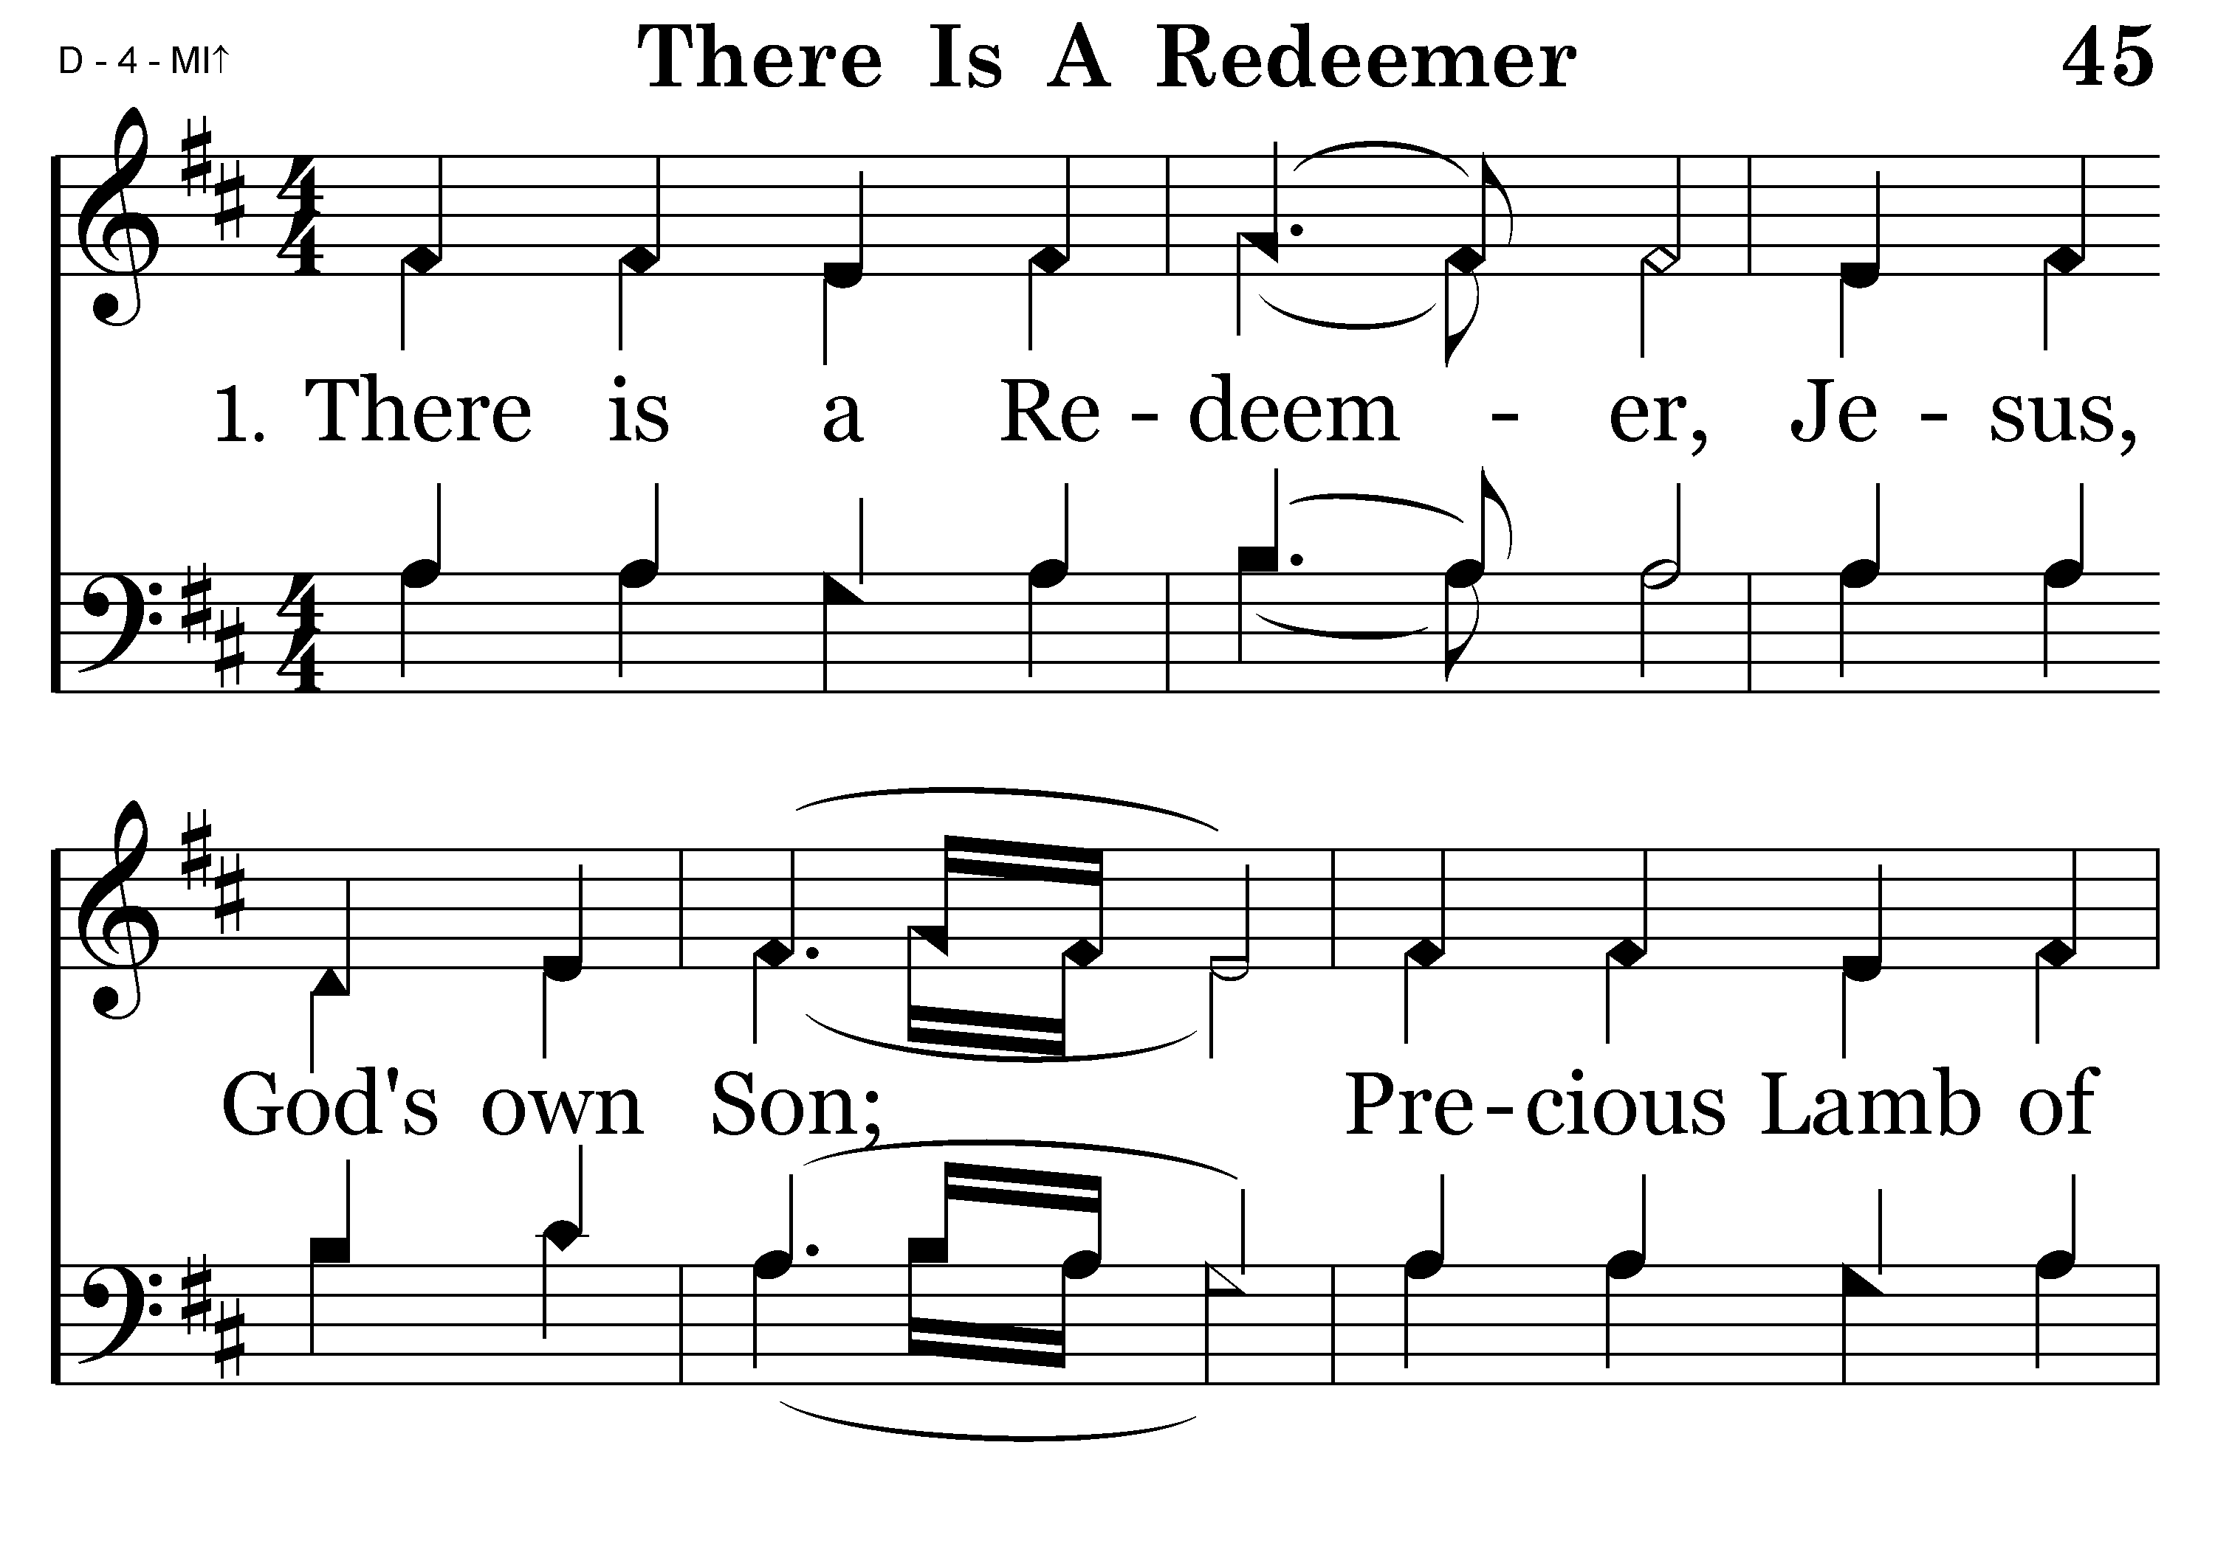
045 - There Is A Redeemer - 1.1

Slide 3
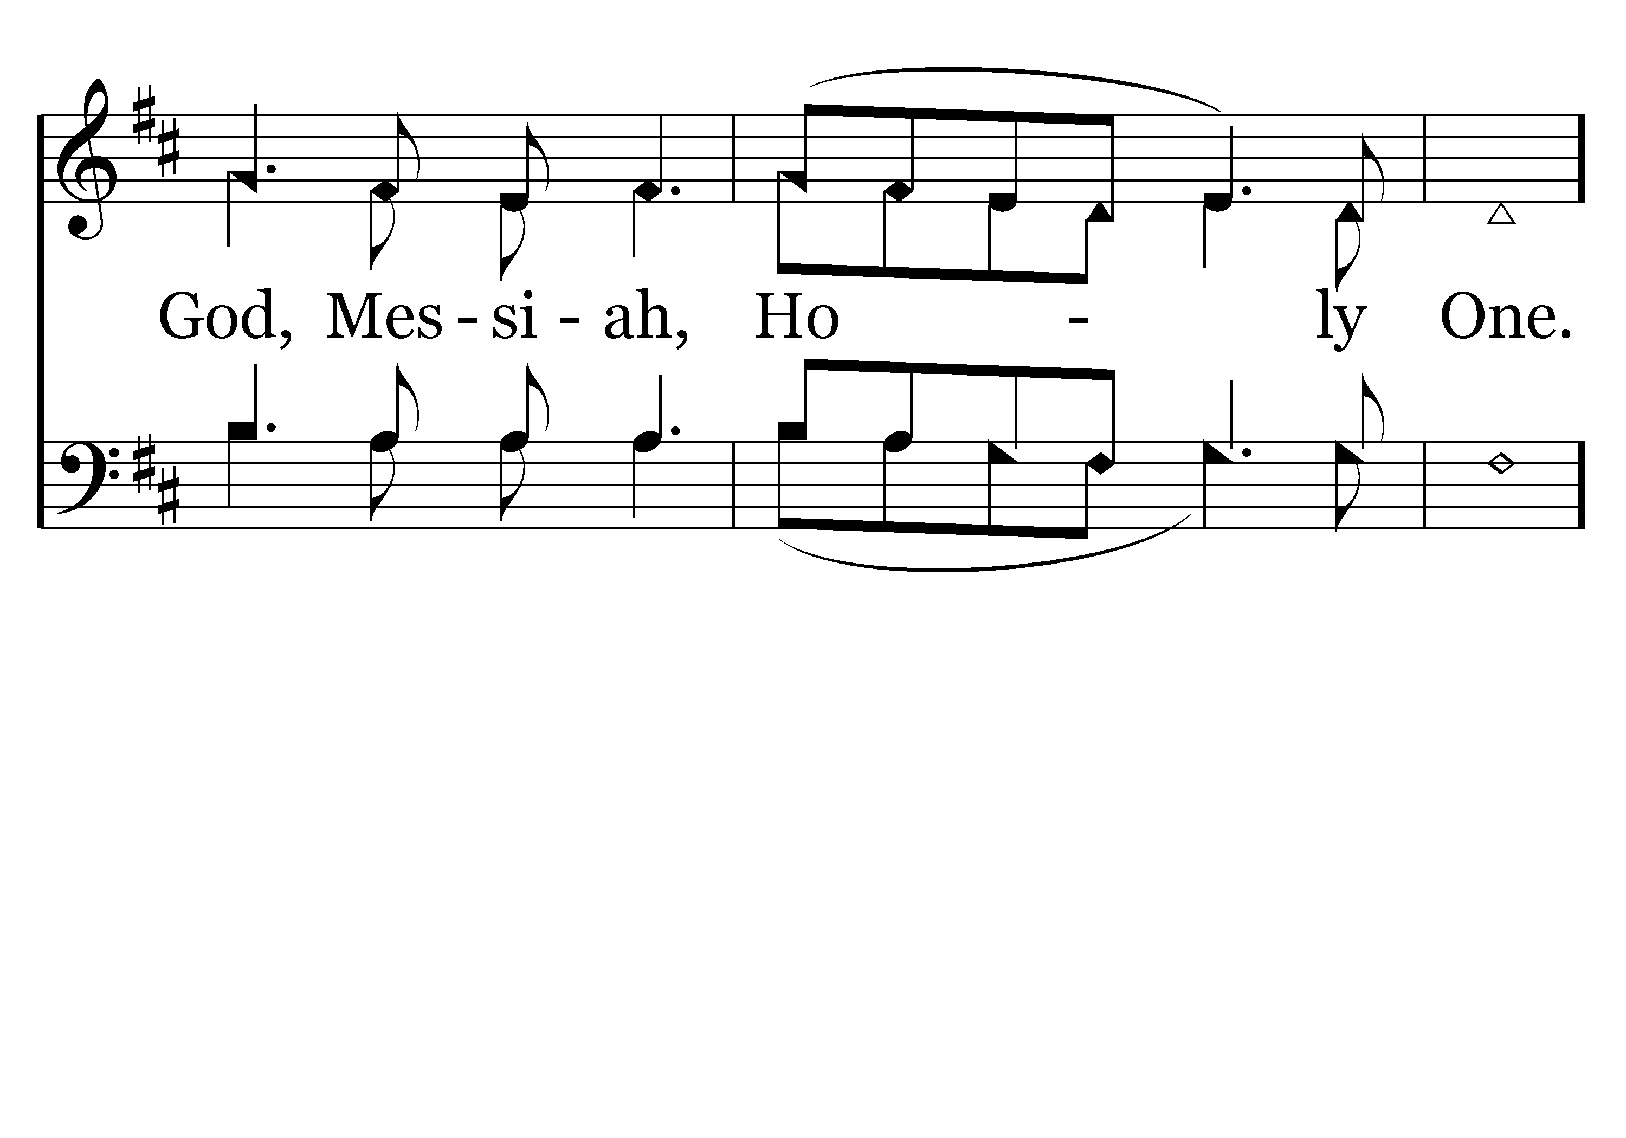
045 - There Is A Redeemer - 1.2

Slide 4
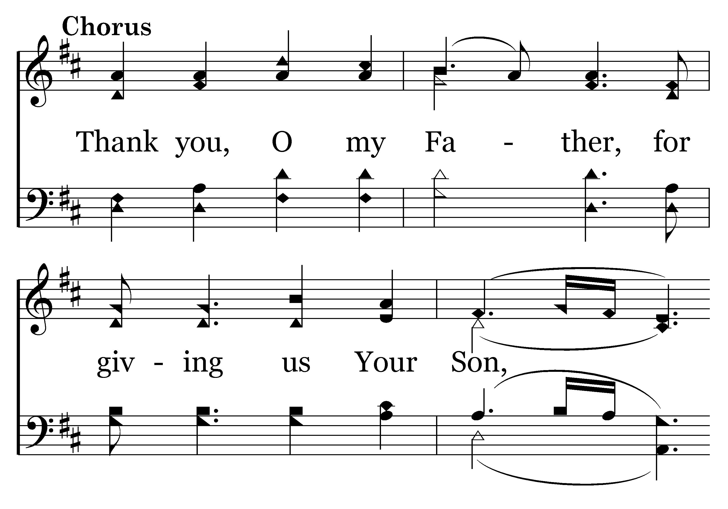
045 - There Is A Redeemer - C.1

Slide 5
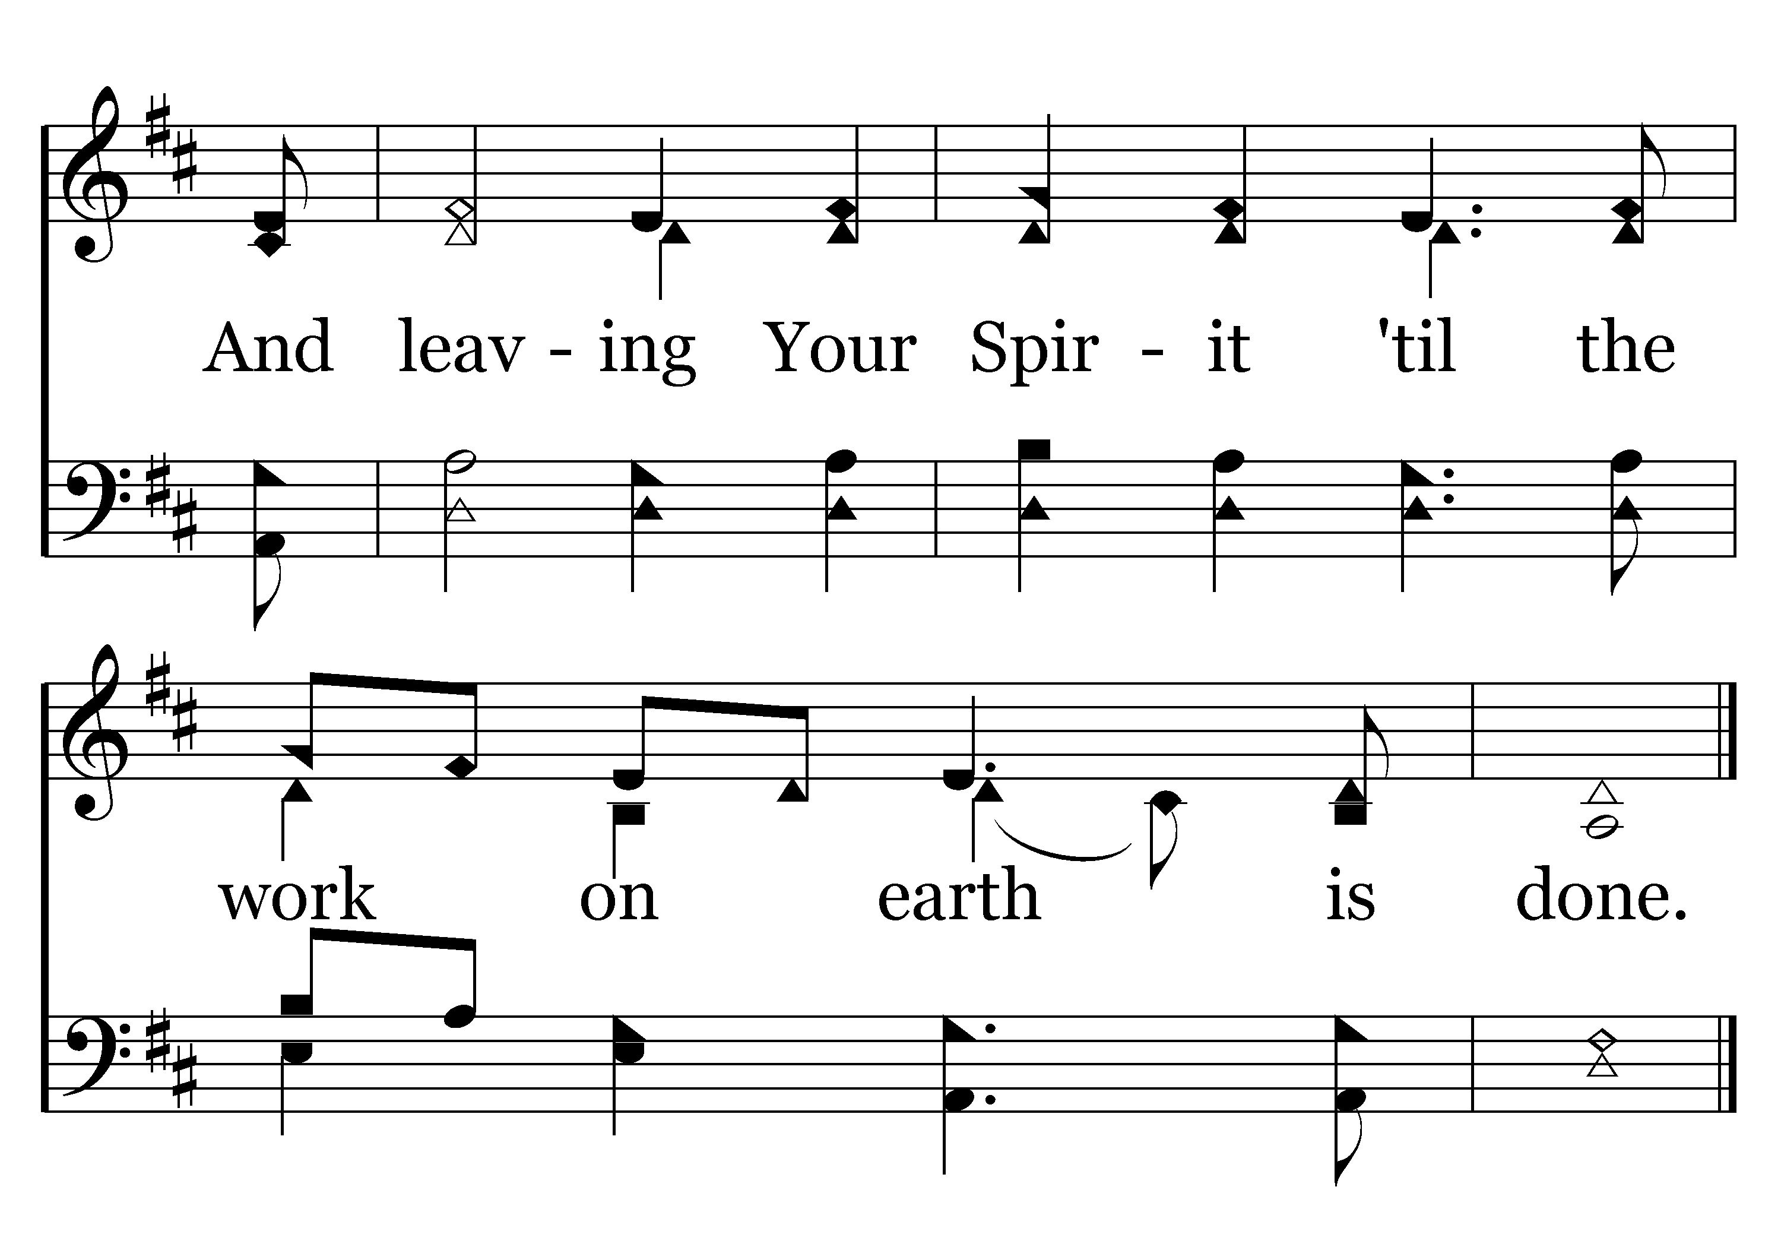
045 - There Is A Redeemer - C.2
End of Verse 1

Slide 6
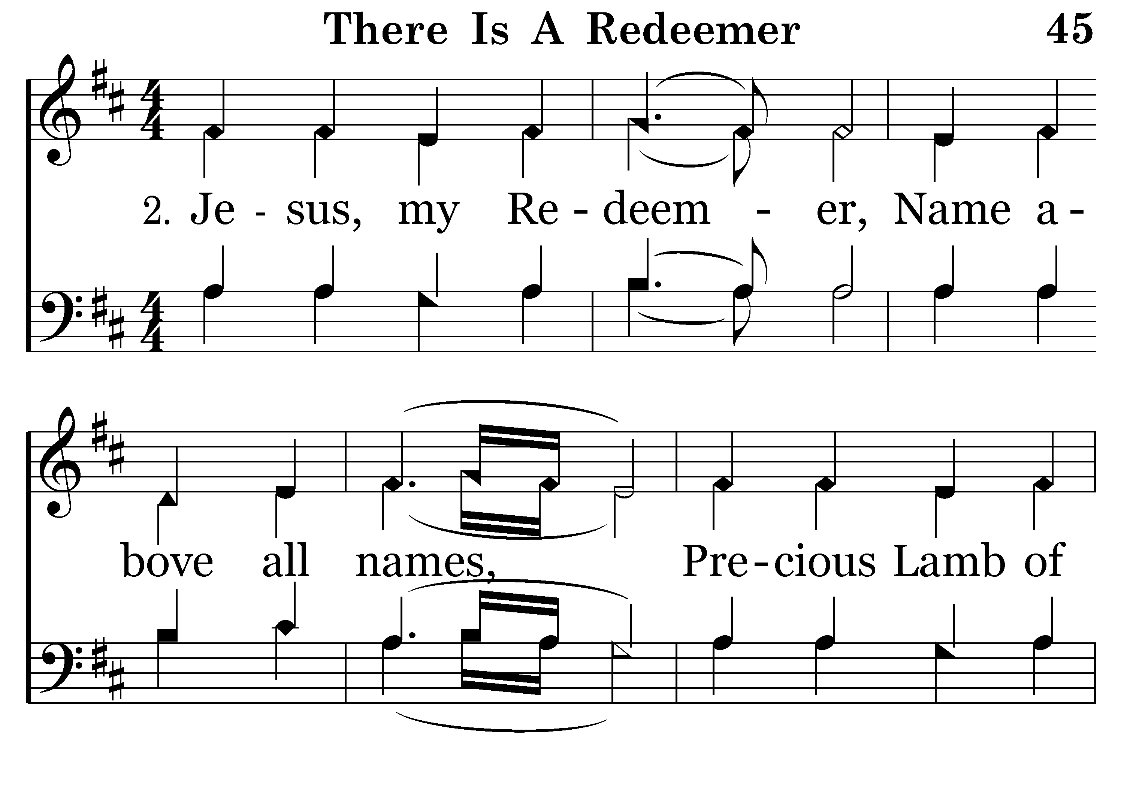
045 - There Is A Redeemer - 2.1

Slide 7
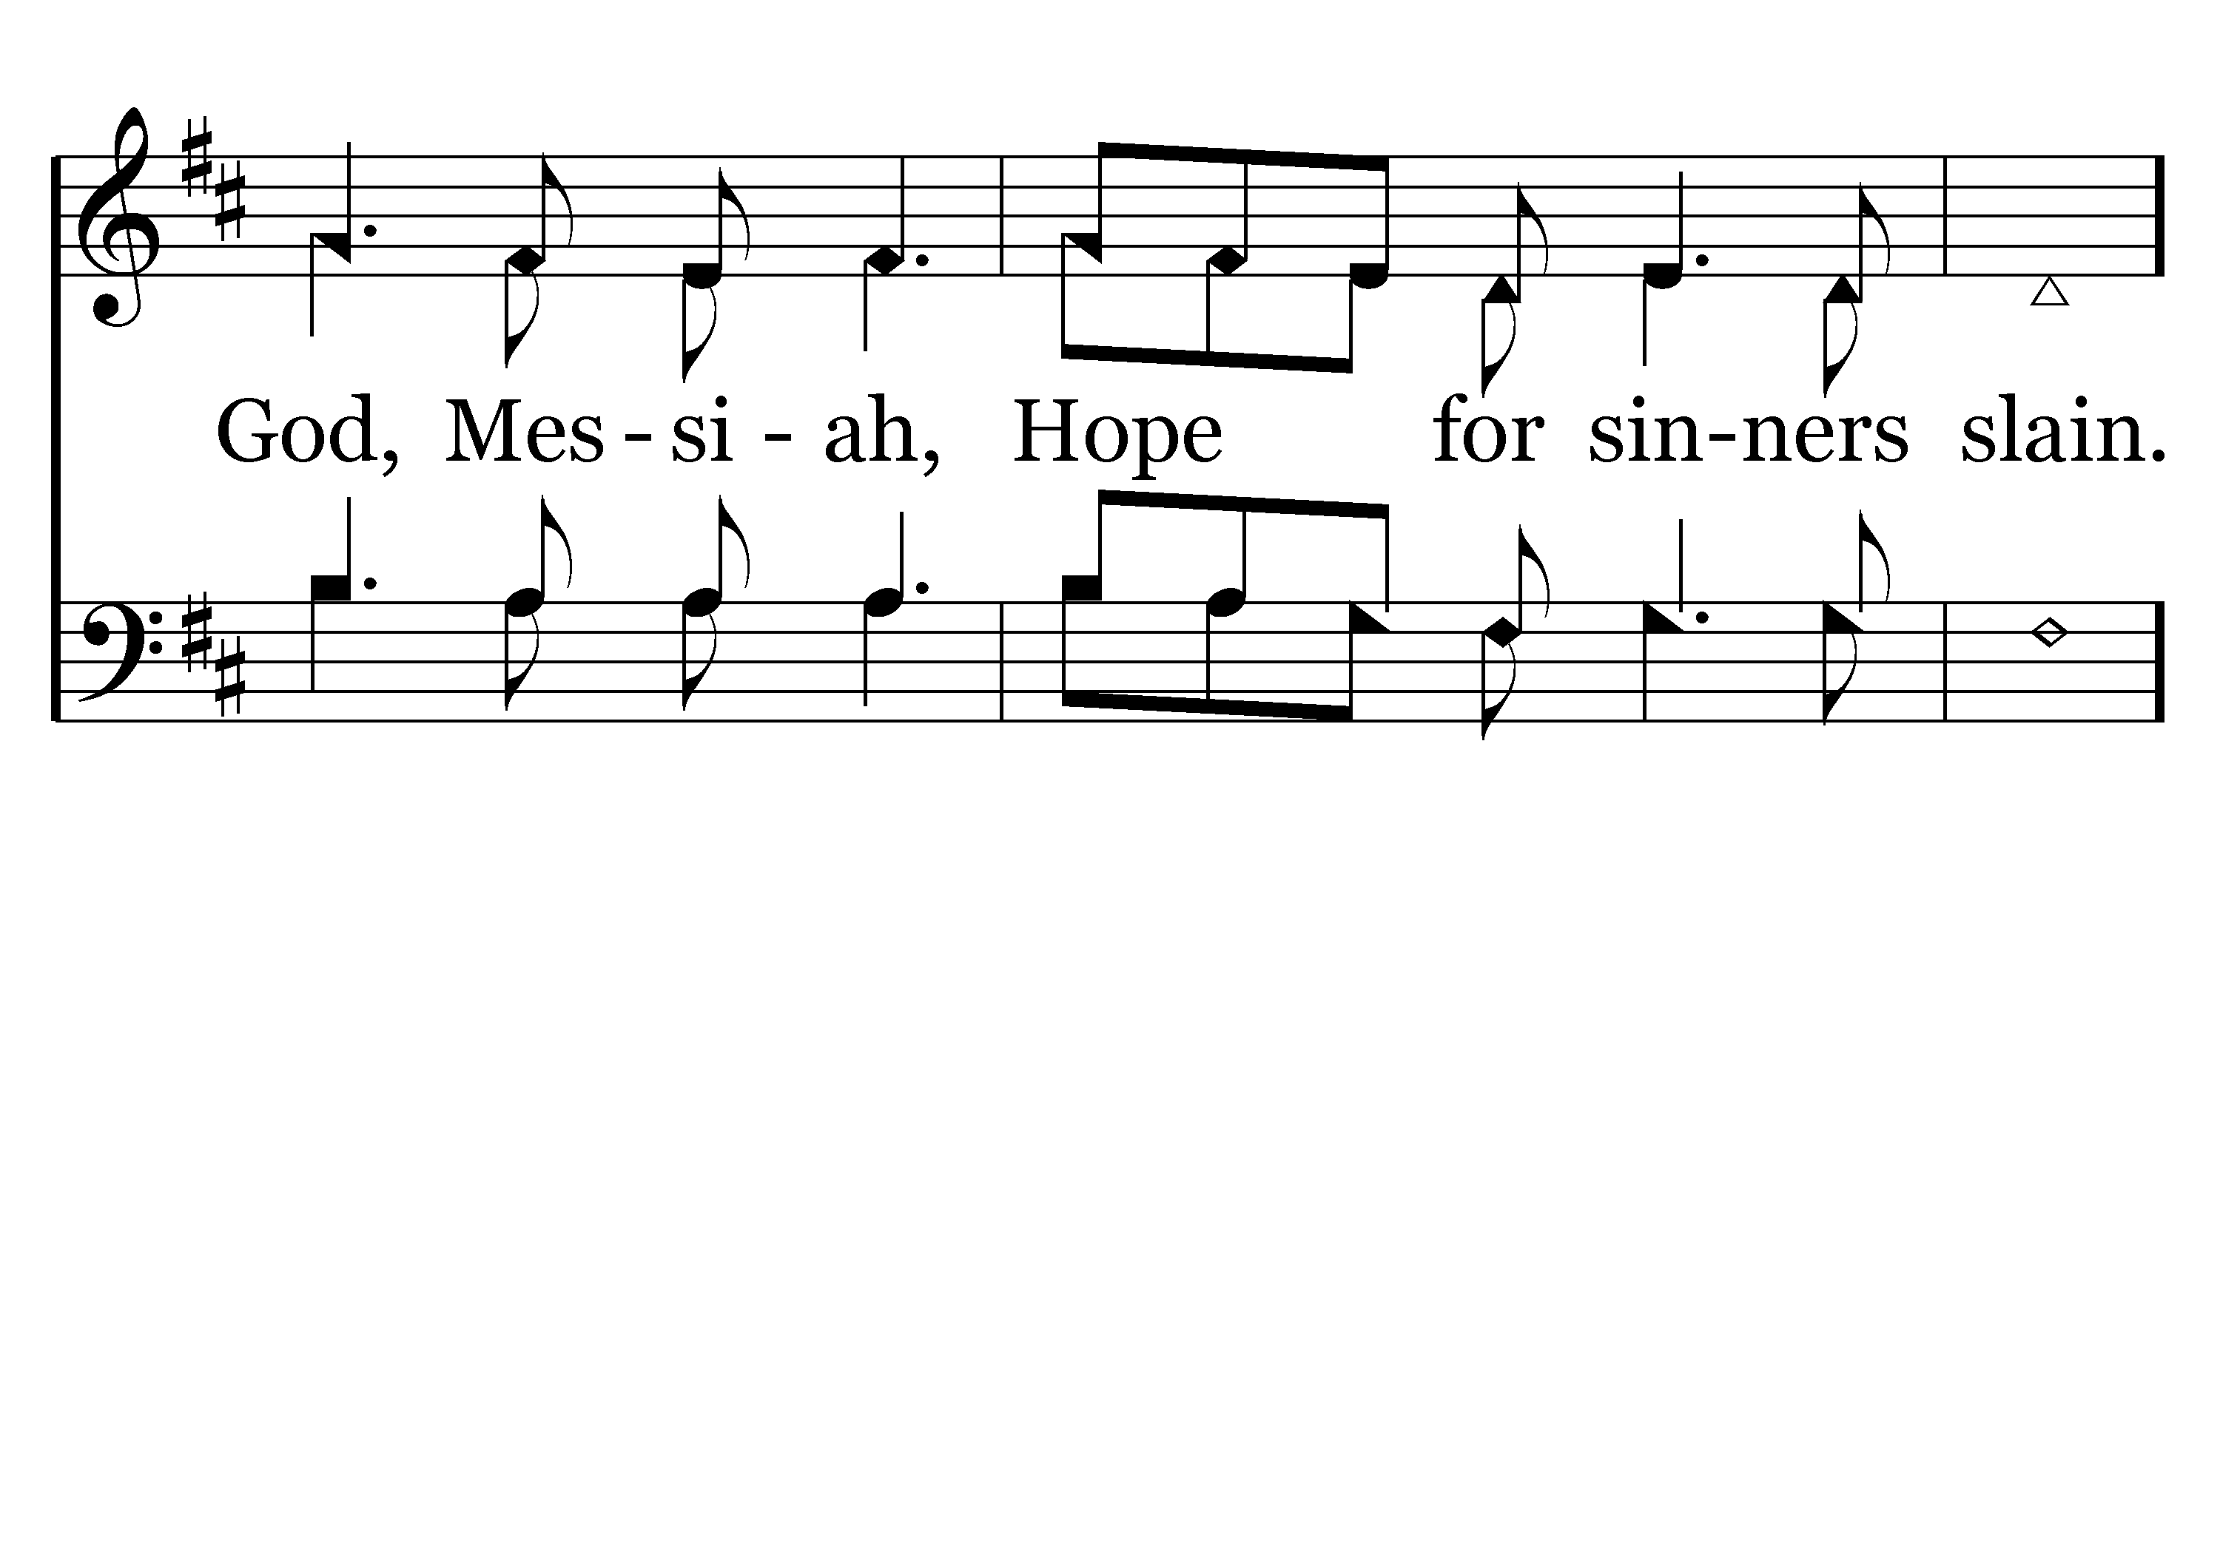
045 - There Is A Redeemer - 2.2

Slide 8
045 - There Is A Redeemer - C.1

Slide 9
045 - There Is A Redeemer - C.2
End of Verse 2

Slide 10
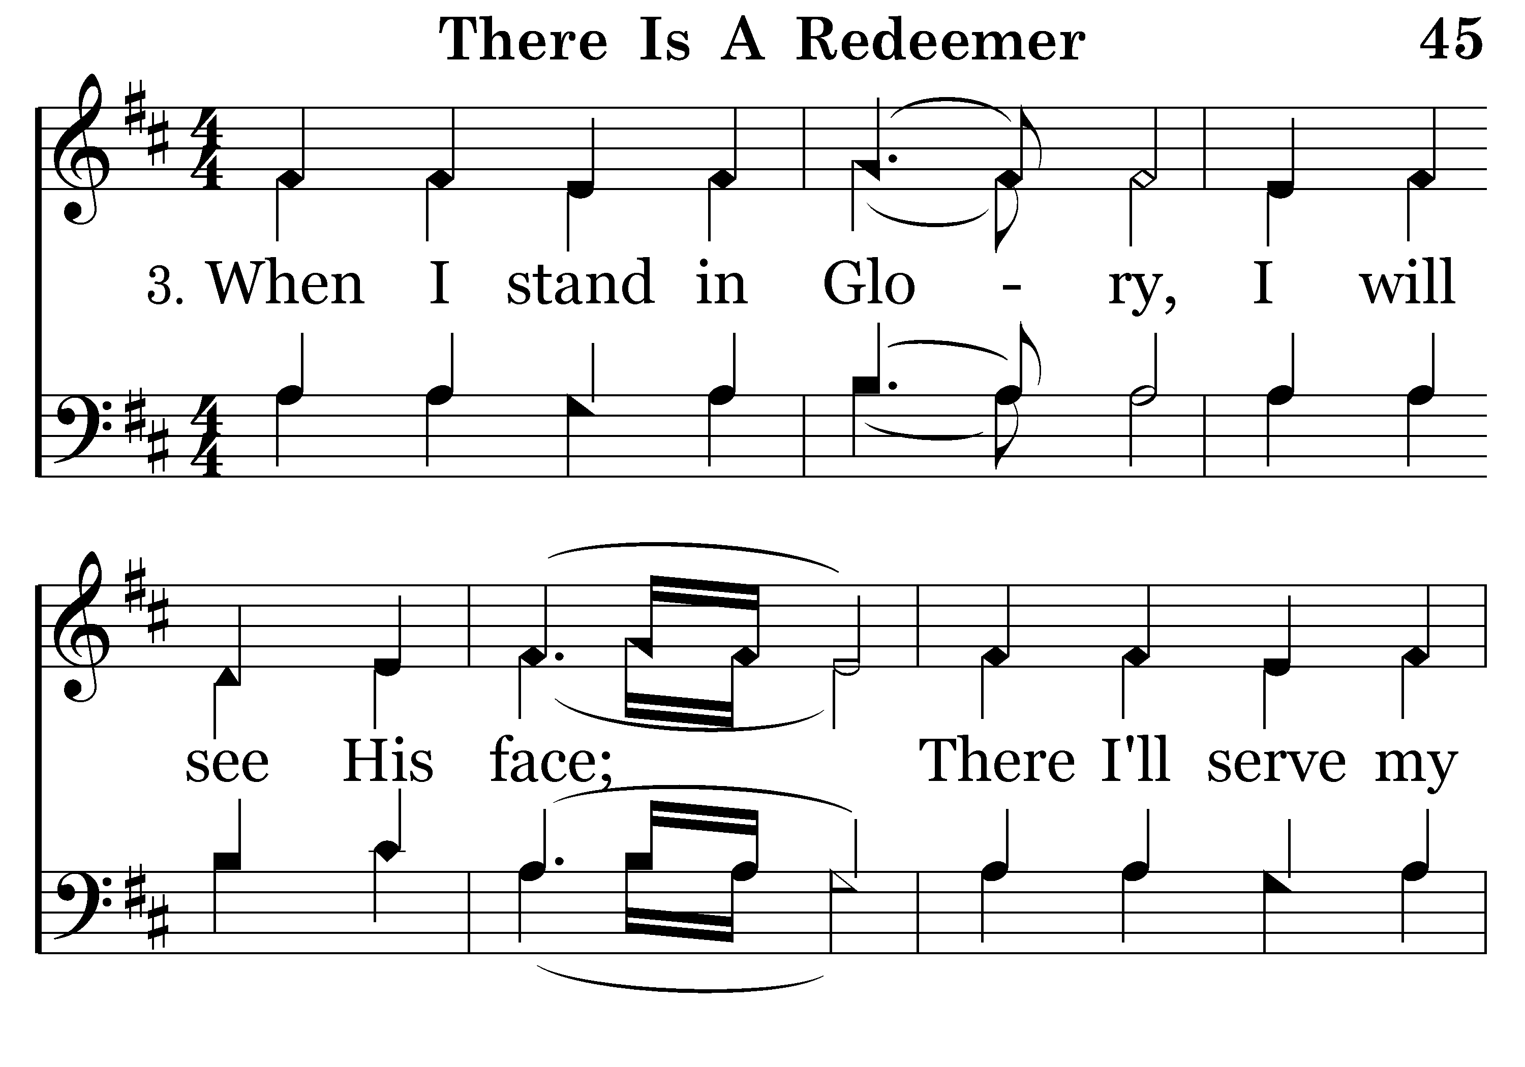
045 - There Is A Redeemer - 3.1

Slide 11
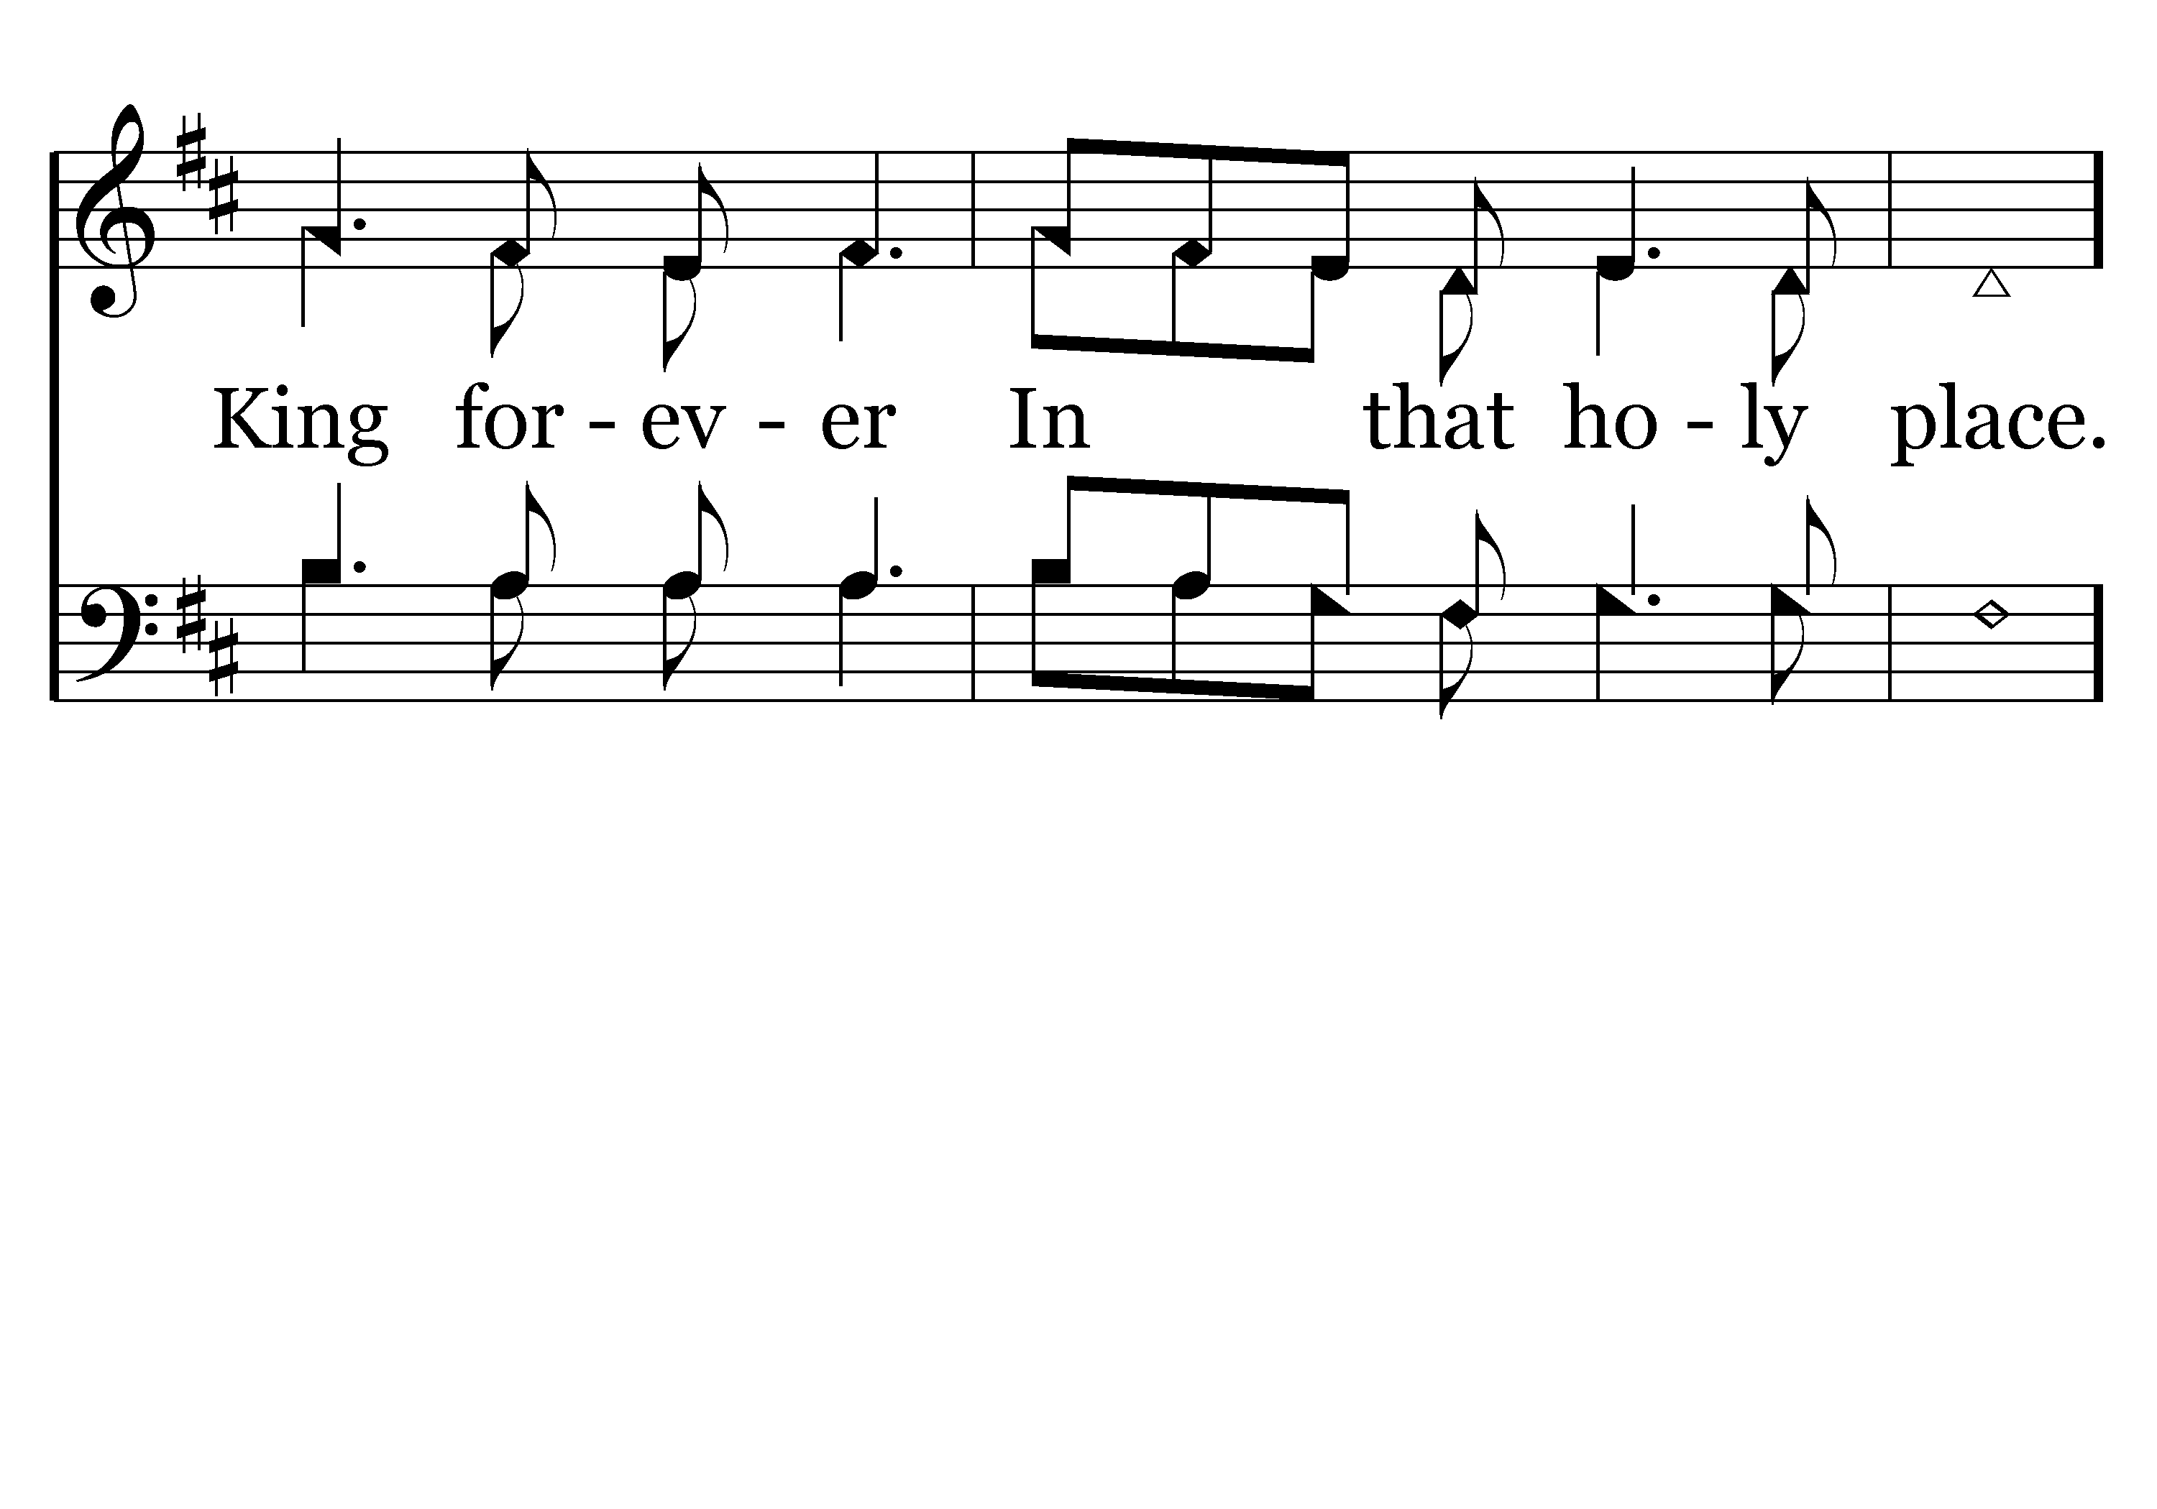
045 - There Is A Redeemer - 3.2

Slide 12
045 - There Is A Redeemer - C.1

Slide 13
045 - There Is A Redeemer - C.2
End of Song

Slide 15
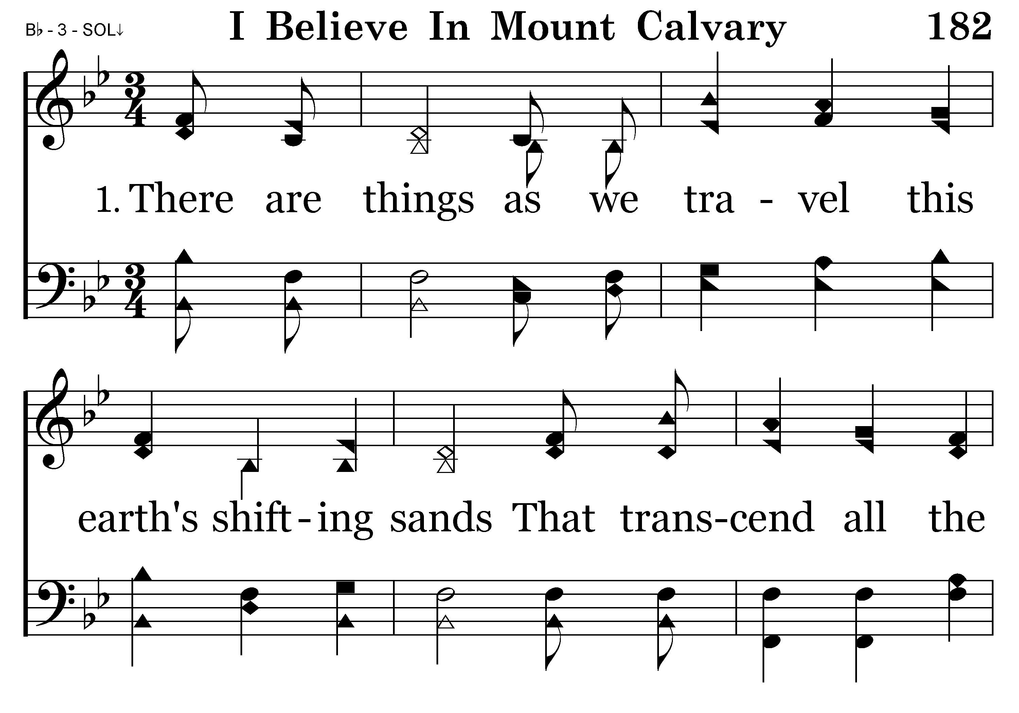
182 - I Believe In Mount Calvary - 1.1

Slide 16
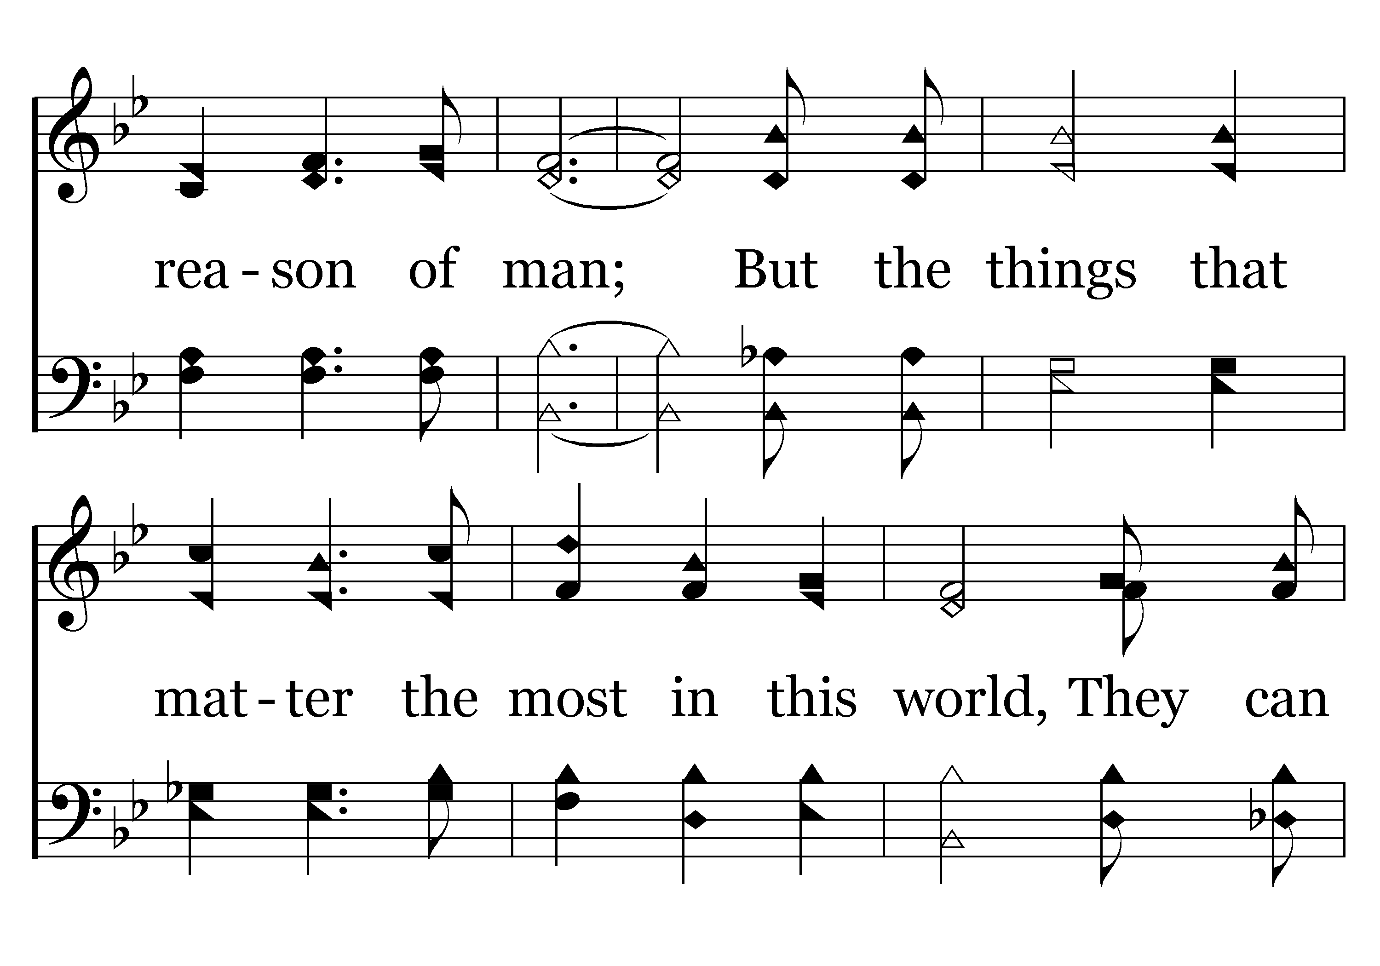
182 - I Believe In Mount Calvary - 1.2

Slide 17
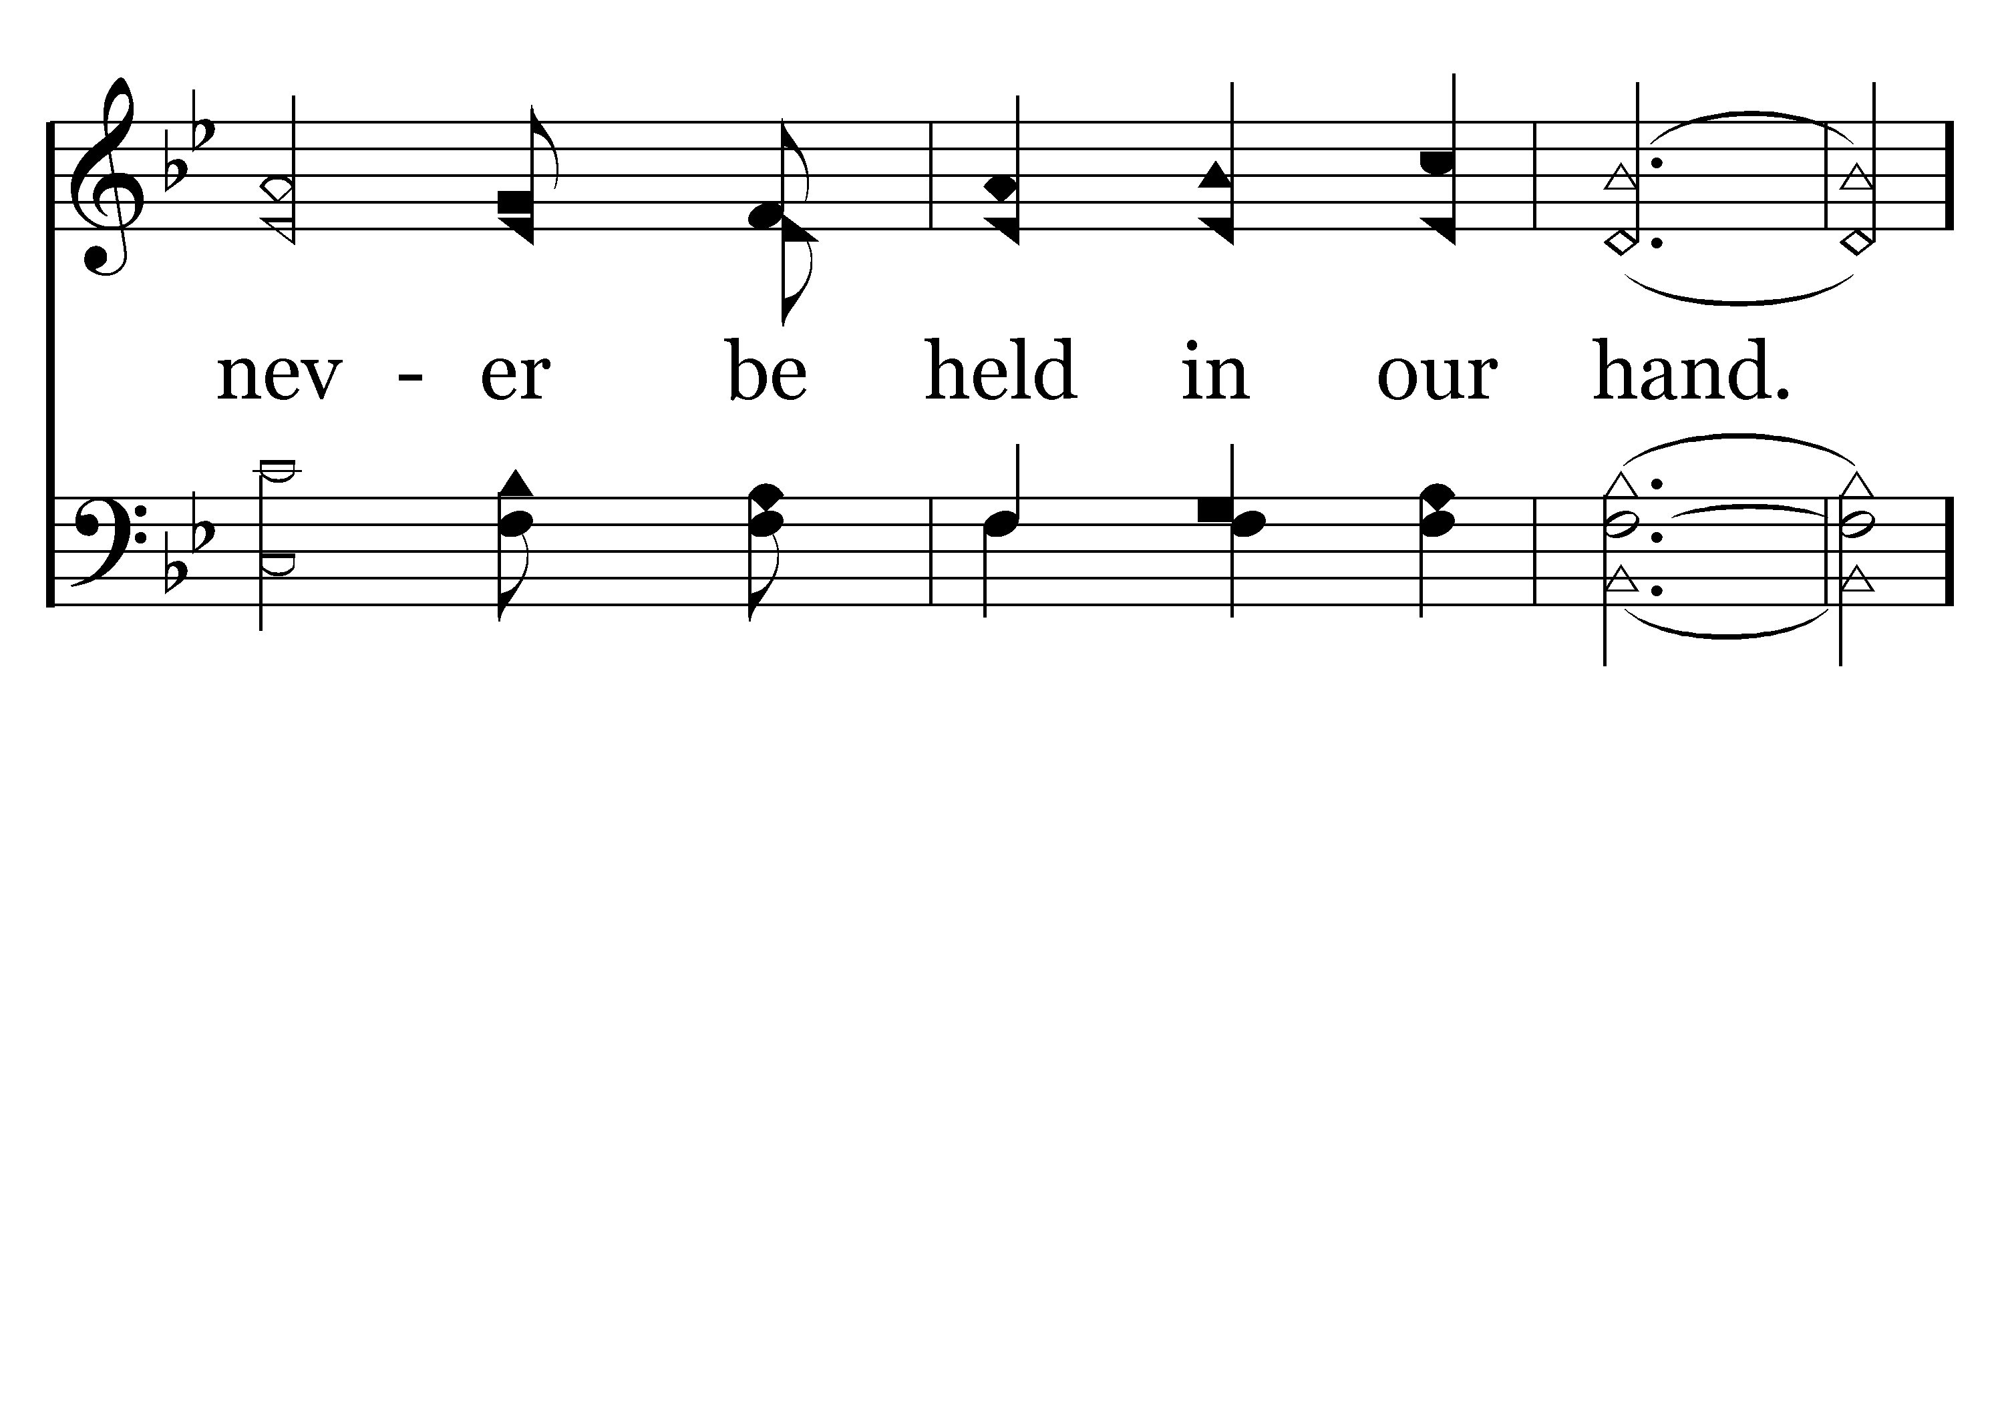
182 - I Believe In Mount Calvary - 1.3

Slide 18
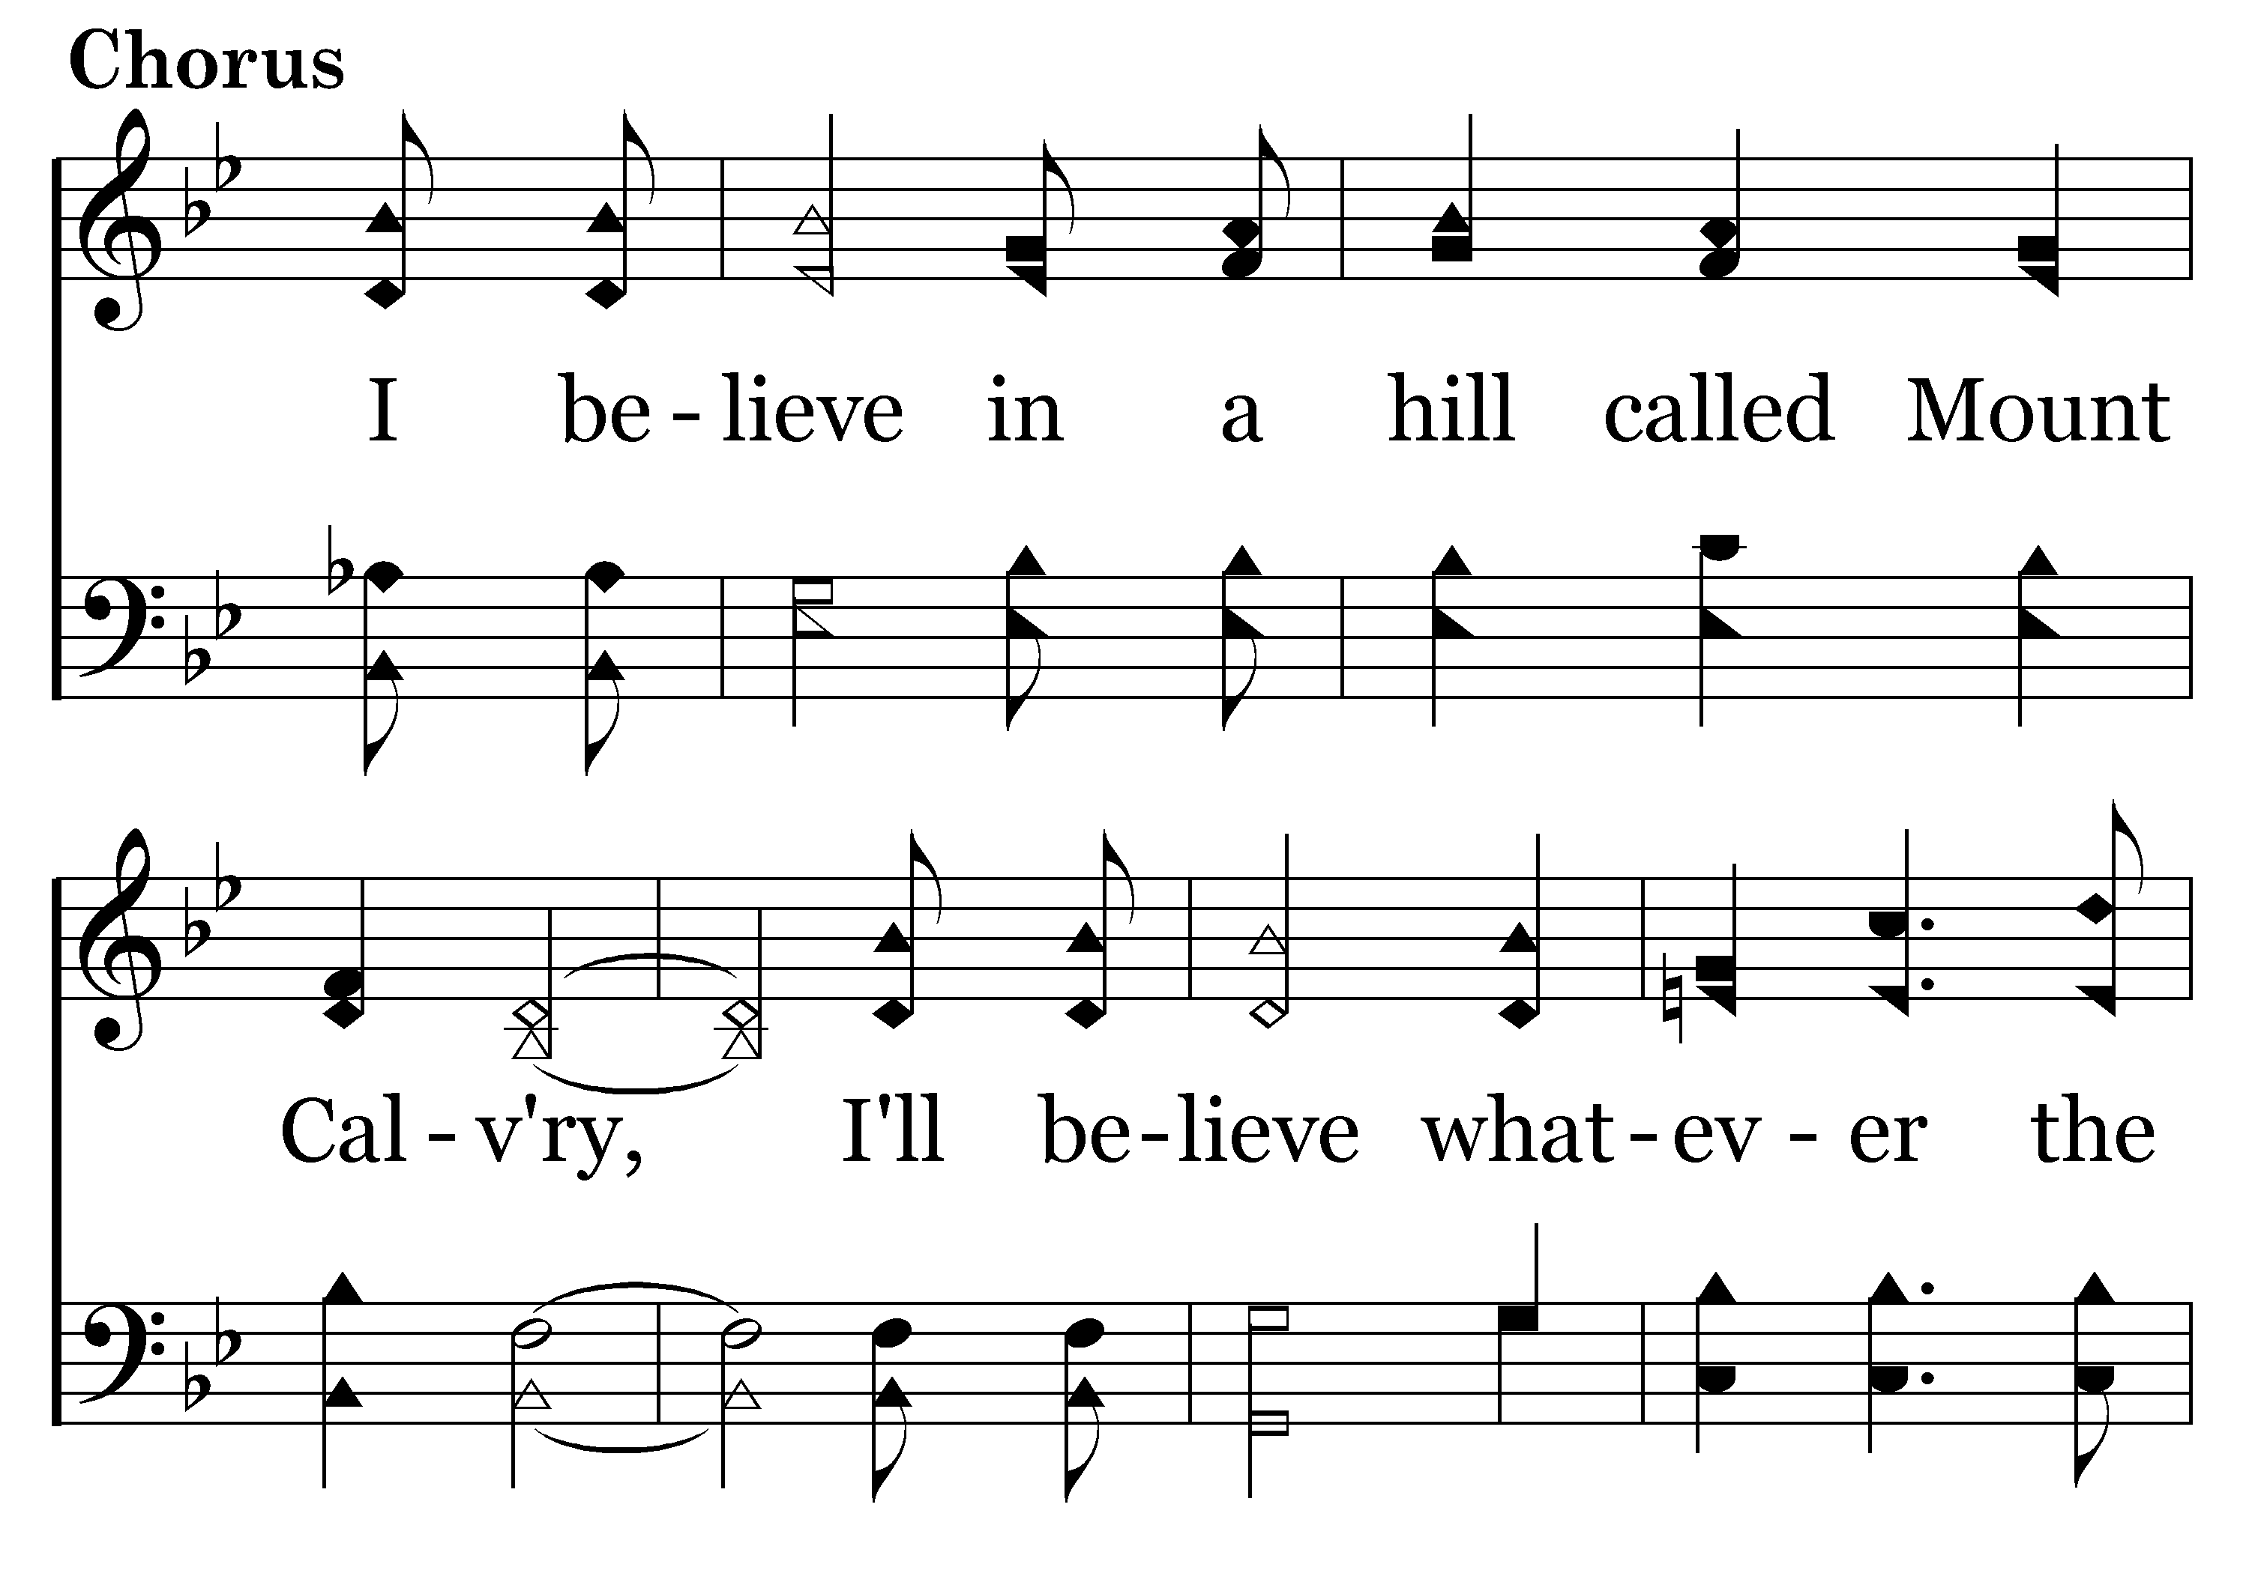
182 - I Believe In Mount Calvary - C.1

Slide 19
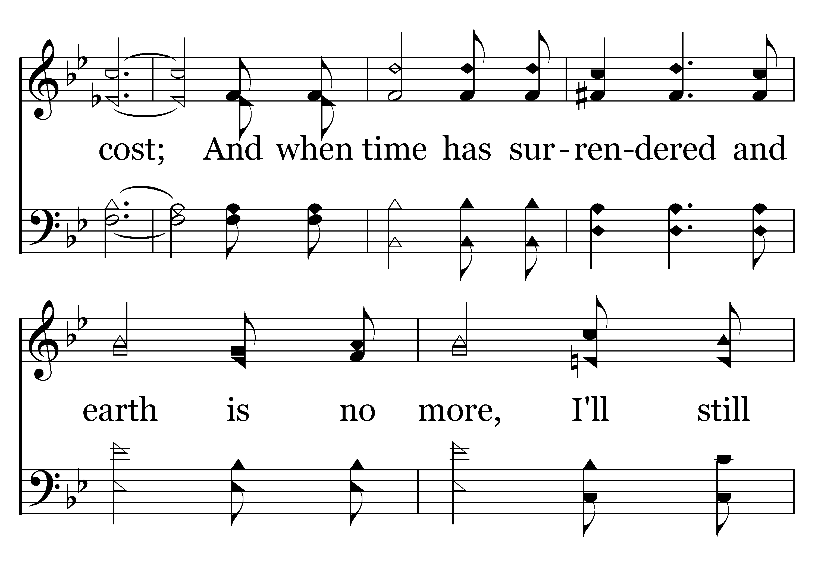
182 - I Believe In Mount Calvary - C.2

Slide 20
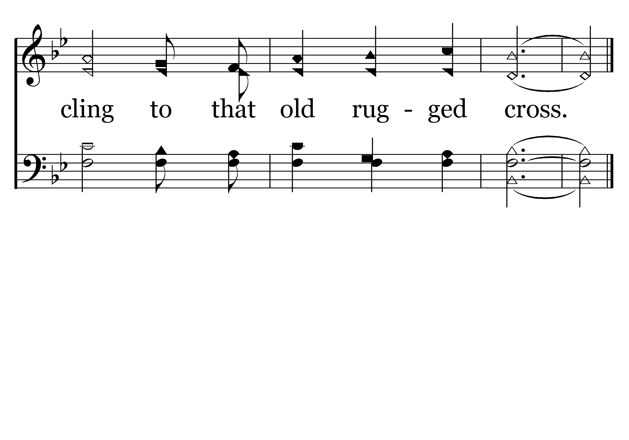
182 - I Believe In Mount Calvary - C.3
End of Verse 1

Slide 21
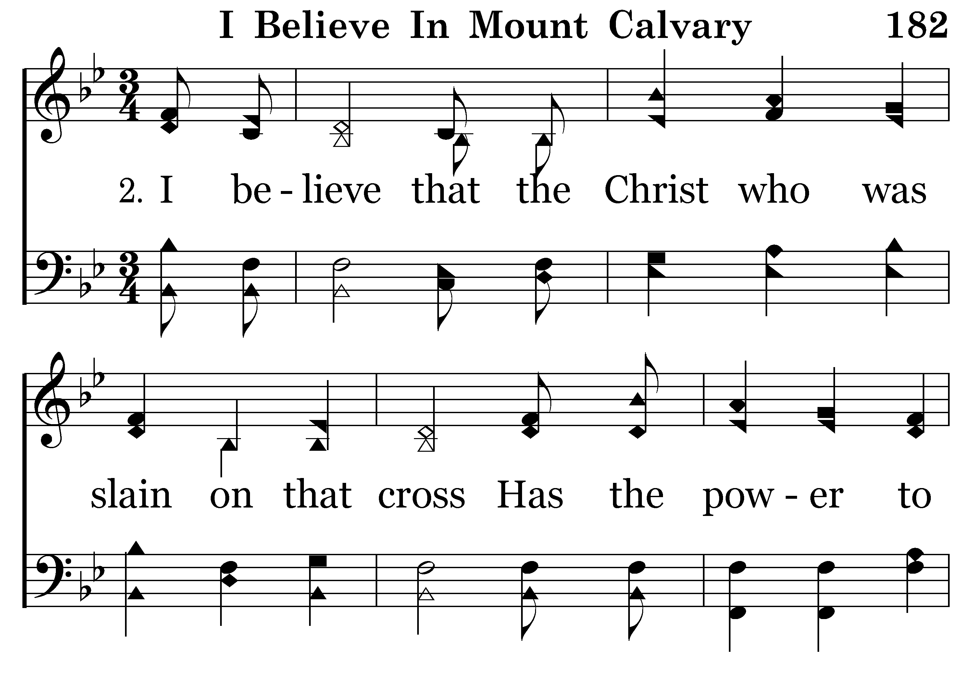
182 - I Believe In Mount Calvary - 2.1

Slide 22
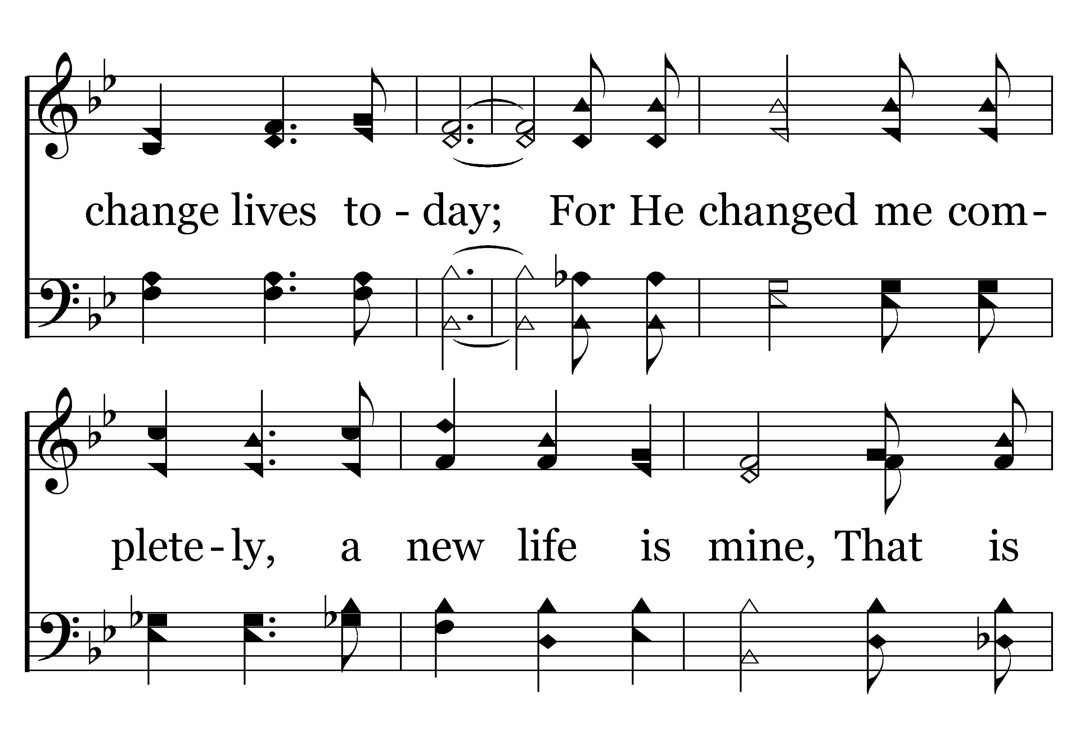
182 - I Believe In Mount Calvary - 2.2

Slide 23
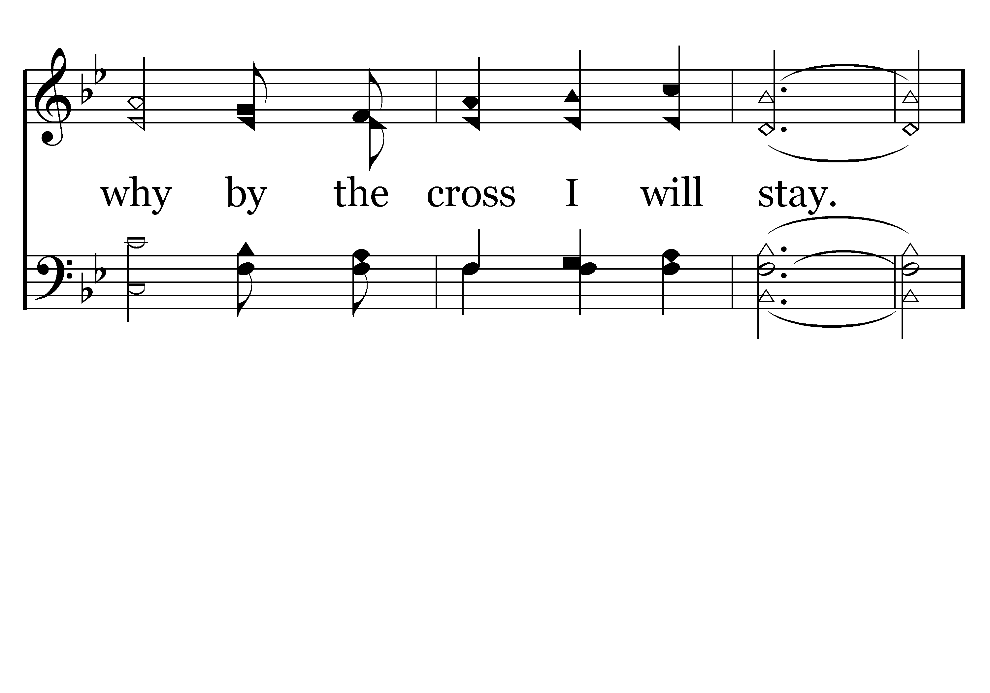
182 - I Believe In Mount Calvary - 2.3

Slide 24
182 - I Believe In Mount Calvary - C.1

Slide 25
182 - I Believe In Mount Calvary - C.2

Slide 26
182 - I Believe In Mount Calvary - C.3
End of Verse 2

Slide 27
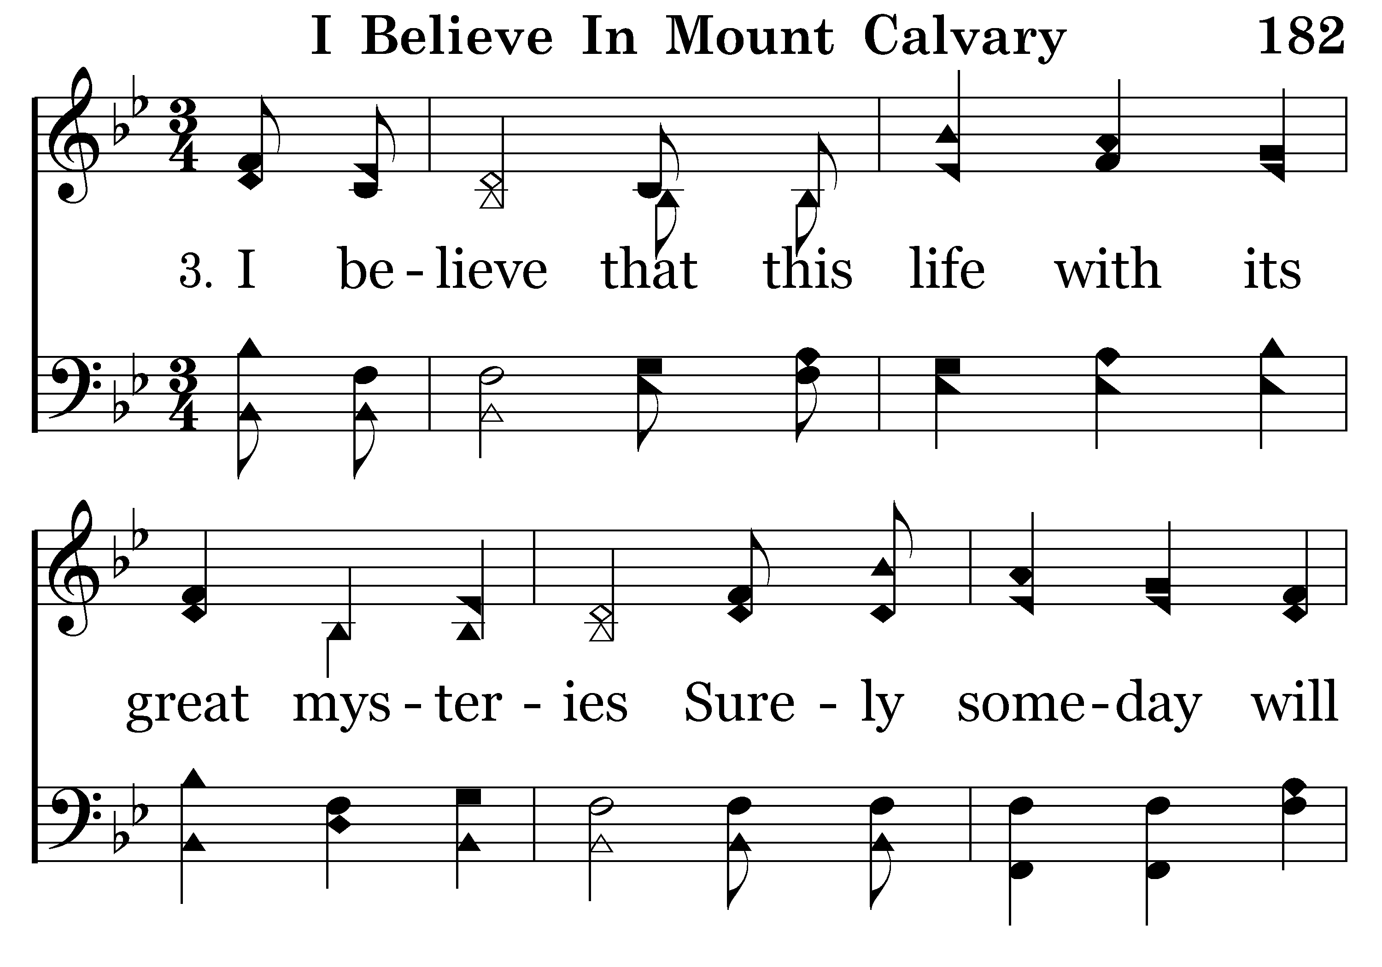
182 - I Believe In Mount Calvary - 3.1

Slide 28
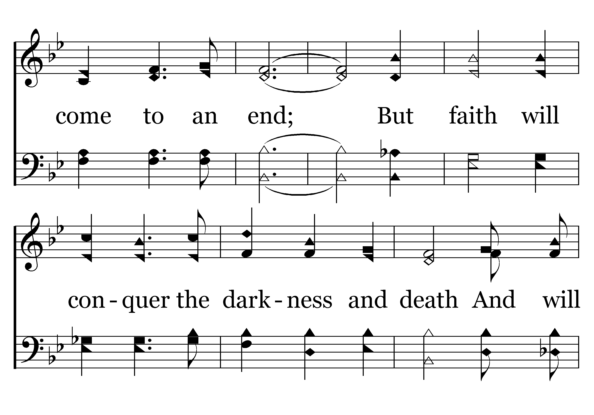
182 - I Believe In Mount Calvary - 3.2

Slide 29
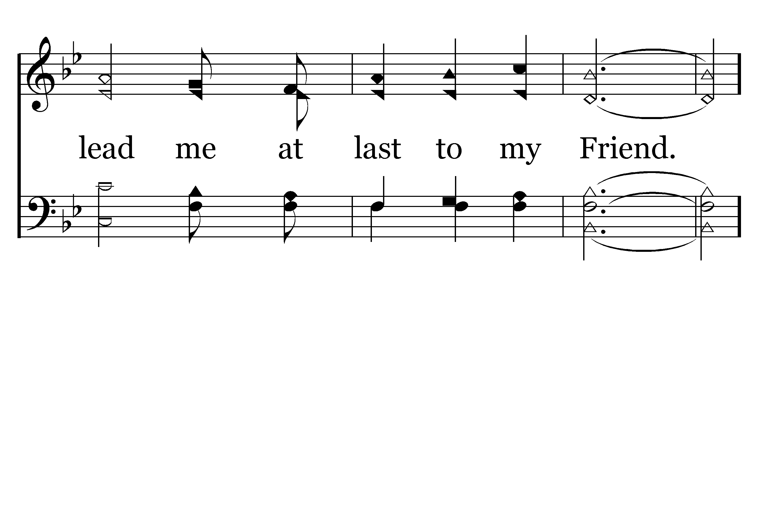
182 - I Believe In Mount Calvary - 3.3

Slide 30
182 - I Believe In Mount Calvary - C.1

Slide 31
182 - I Believe In Mount Calvary - C.2

Slide 32
182 - I Believe In Mount Calvary - C.3
End of Song

Slide 34
Philippians 3:12–14
¹² Not that I have already obtained this or am already perfect, but I press on to make it my own, because Christ Jesus has made me his own. ¹³ Brothers, I do not consider that I have made it my own. But one thing I do: forgetting what lies behind and straining forward to what lies ahead, ¹⁴ I press on toward the goal for the prize of the upward call of God in Christ Jesus.

Slide 36


Slide 37
Beware of Law-Keepers.
They are not the true people of God (3:2–3).
Paul has more reason to boast in the flesh than they do (3:4–16).

Slide 38
Imitate Paul.
A direct instruction (3:17).
Because many are enemies of the cross (3:18–19).
Because we have a heavenly citizenship (3:20–21).

Slide 39
What do we learn?
Walk in the spirit, not in the flesh.
Give up everything for Christ.
Keep on keeping on.
This world is not my home.
Long for the resurrection.

