Slide 1
Matthew 13:34–35
³⁴ All these things Jesus said to the crowds in parables; indeed, he said nothing to them without a parable. ³⁵ This was to fulfill what was spoken by the prophet: “I will open my mouth in parables; I will utter what has been hidden since the foundation of the world.”

Slide 3
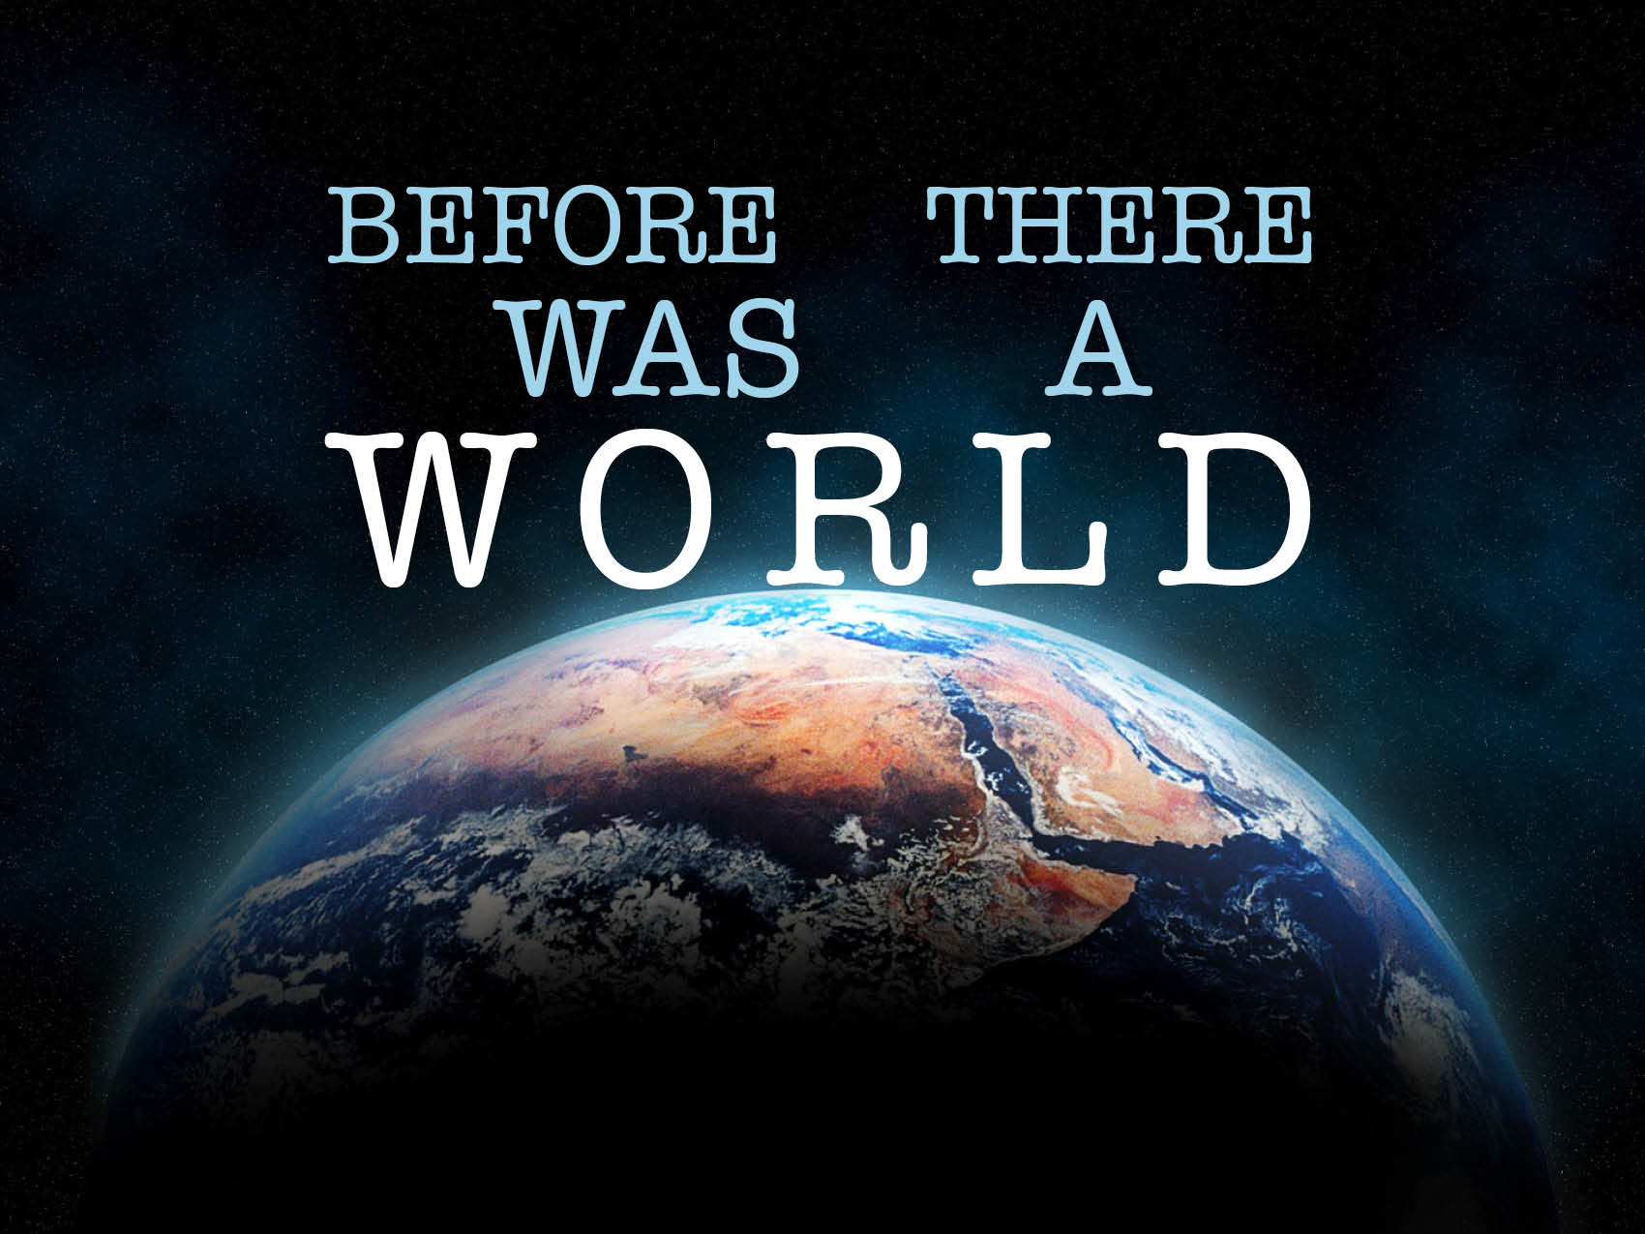

Slide 4
Before there was guilt, there was grace.
Psalm 32:3–5
John 1:29
Genesis 3:15
1 Peter 1:18–20

Slide 5
Before there was a sinner, there was a Savior.
Genesis 3:6
Romans 3:23
Isaiah 64:6
John 3:16
2 Timothy 1:9
Ephesians 1:3–6

Slide 6
Before there was a hell, there was a heaven.
Matthew 13:42
Matthew 25:30, 46
Matthew 25:41
Titus 1:2
Ephesians 1:4
Matthew 25:34

