Slide 1
Matthew 15:10–12
¹⁰ And he called the people to him and said to them, “Hear and understand: ¹¹ it is not what goes into the mouth that defiles a person, but what comes out of the mouth; this defiles a person.” ¹² Then the disciples came and said to him, “Do you know that the Pharisees were offended when they heard this saying?”

Slide 2
Matthew 15:13–14
¹³ He answered, “Every plant that my heavenly Father has not planted will be rooted up. ¹⁴ Let them alone; they are blind guides. And if the blind lead the blind, both will fall into a pit.”

Slide 6
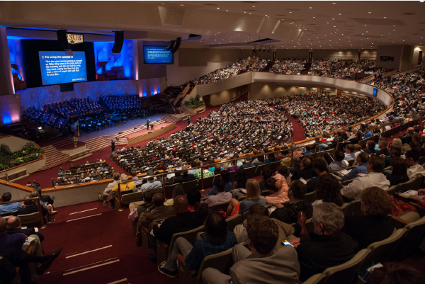

Slide 7
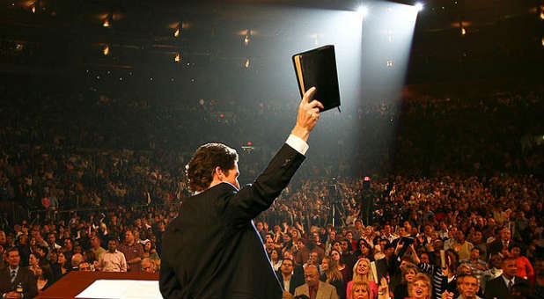

Slide 8
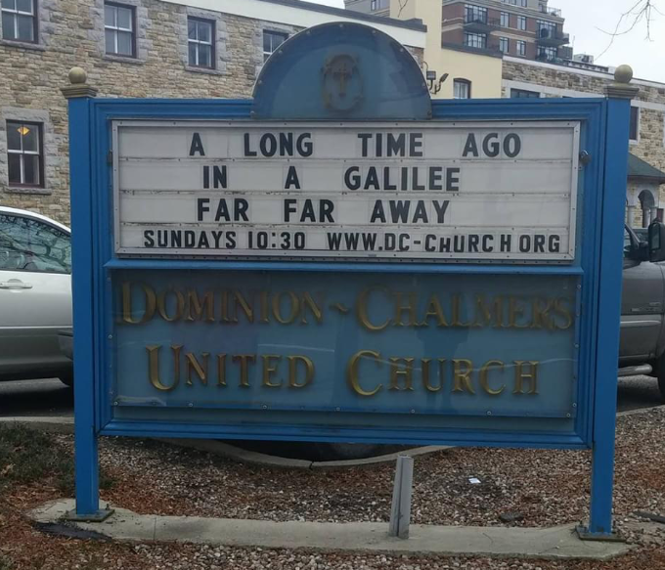

Slide 9
What is commonly looked for…
Are there people here like me?
What do you offer young people?
Is the preacher and worship enjoyable and entertaining?
What can you offer me?

Slide 10
What should be looked for…
Do you view the Bible correctly?
2 Timothy 3:16–17
Do you practice the truth?
James 1:22–25
1 Timothy 3:14–15

Slide 11
What should be looked for…
Is the leadership qualified and fulfilling its work?
1 Timothy 3:1–7; Titus 1:5–9
1 Peter 5:1–3
Psalm 23

Slide 12
What should be looked for…
Will the leaders hold me accountable?
Hebrews 13:17
Titus 3:9–11
2 Thessalonians 3:14–15
Do you value souls?
Matthew 28:19–20; Mark 16:15–16
1 Thessalonians 1:4–8

Slide 13
What should be looked for…
How can I help this church?
Romans 12:4–8
Will you help me sacrifice?
2 Samuel 24:21–24

