Slide 1
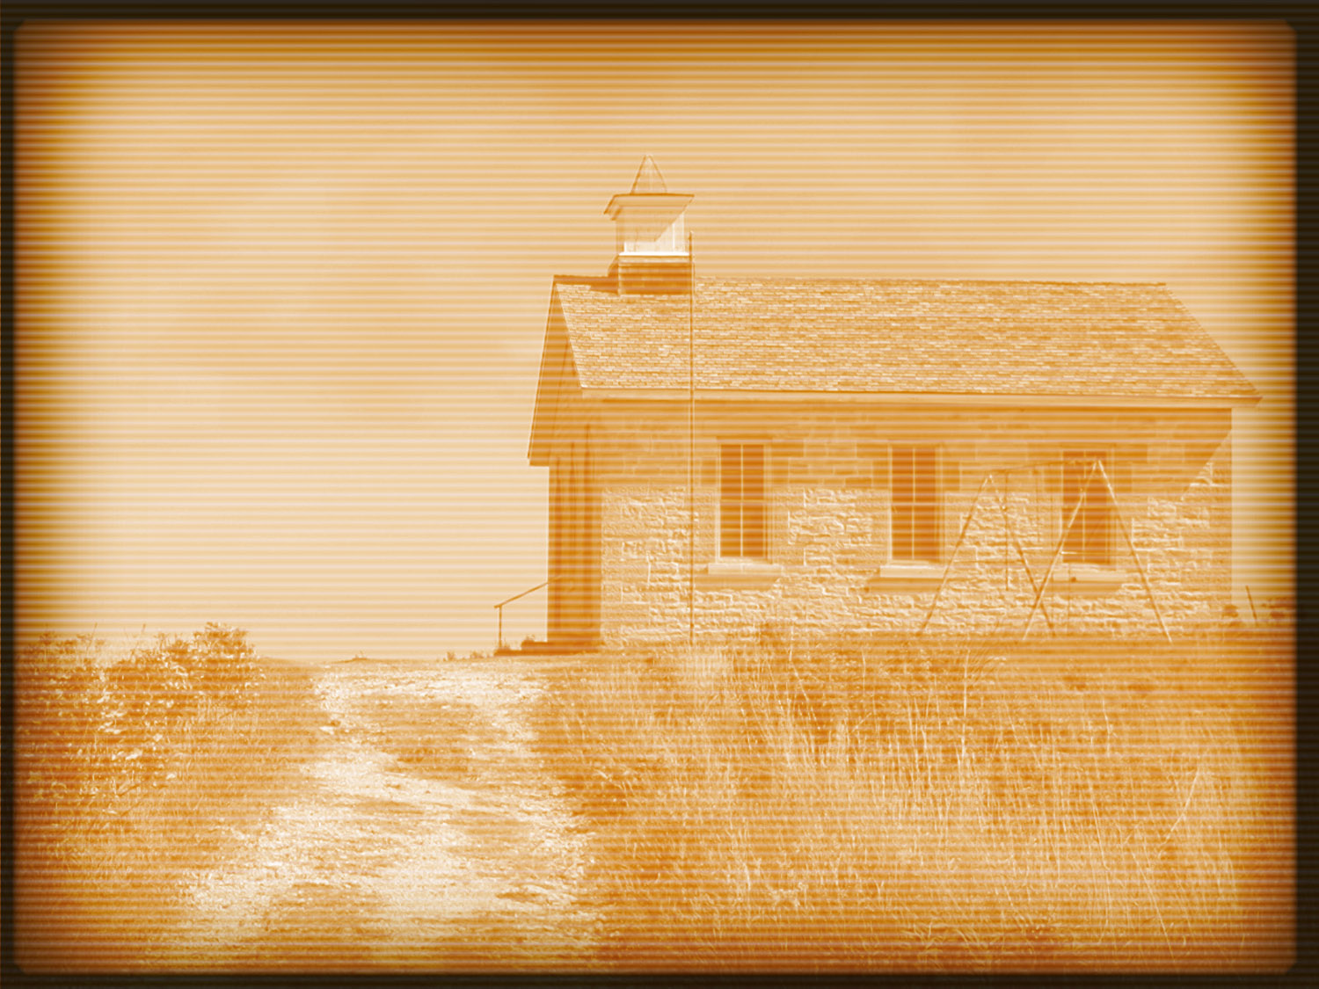
Acts 13:1–3
1 Now there were in the church at Antioch prophets and teachers, Barnabas, Simeon who was called Niger, Lucius of Cyrene, Manaen a lifelong friend of Herod the tetrarch, and Saul. 2 While they were worshiping the Lord and fasting, the Holy Spirit said, “Set apart for me Barnabas and Saul for the work to which I have called them.” 3 Then after fasting and praying they laid their hands on them and sent them off.

Slide 4
Free Agent Pattern vs. the Jerusalem Church Model
Romans 1:13
Acts 11:25–26

Slide 5
We must get past the “one evangelist” mindset.
Acts 2:14
Acts 11:20
Acts 20:13
Acts 16:3
Titus 1:5
Acts 2:46–47
Acts 20:20

Slide 6
We must get past the “preacher does the evangelizing” mindset.
Acts 8:1
1 Peter 3:15

Slide 7
We must get past the “church has to train me” mindset.
Ephesians 4:11–12
2 Peter 1:5–8
1 Timothy 4:7
Hebrews 11:5–6:2

Slide 8
We must get past the “our preachers are supposed to stay here” mindset.
Acts 8:14, 25
Acts 9:32
Acts 13:1–3
Acts 8:1, 4

