Slide 1

Titus 2:11–14
11 For the grace of God has appeared, bringing salvation for all people, 12 training us to renounce ungodliness and worldly passions, and to live self-controlled, upright, and godly lives in the present age, 13 waiting for our blessed hope, the appearing of the glory of our great God and Savior Jesus Christ, 14 who gave himself for us to redeem us from all lawlessness and to purify for himself a people for his own possession who are zealous for good works.

Slide 3


Slide 4
What is Grace?
Romans 7:15–25
Grace is Jesus Christ.

Slide 5
Why Do We Need Grace?
Psalm 18:1–3
We Need God’s Grace to Overcome Sin.
  2 Corinthians 12:7–10
We Need God’s Grace to Communicate with Him.
  Hebrews 4:16

Slide 6
Why Do We Need Grace?
We Need God’s Grace to Grow Our Faith.
  2 Peter 3:17–18
We Need God’s Grace to Get to Heaven.
  Titus 2:11–14

Slide 8
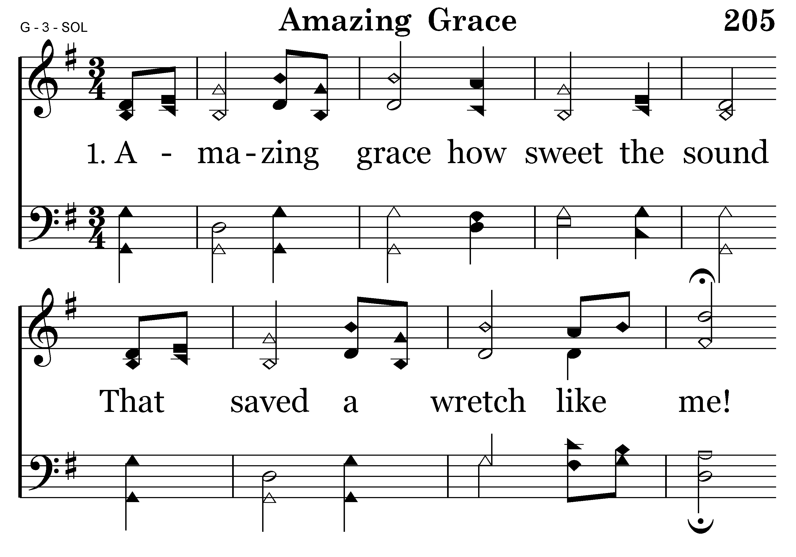
205 - Amazing Grace - 1.1

Slide 9
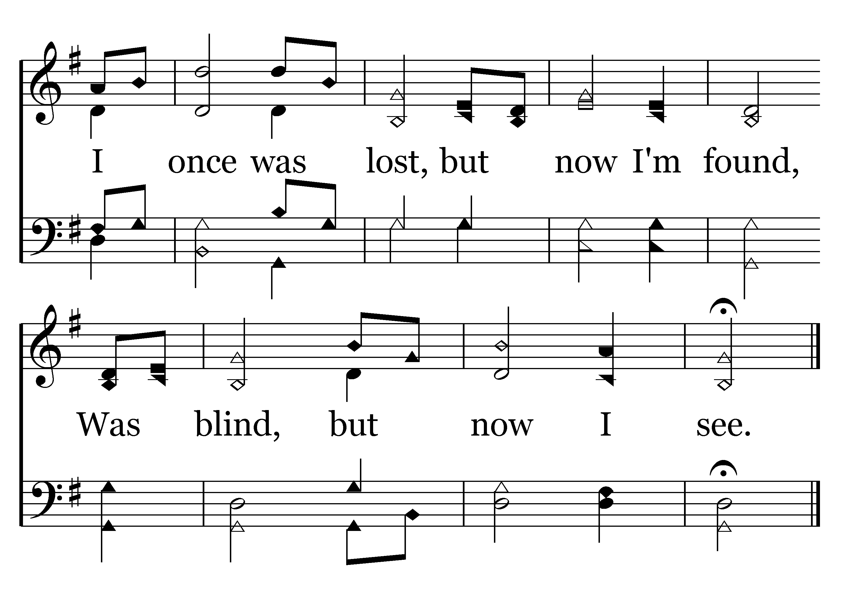
205 - Amazing Grace - 1.2
End of Verse 1

Slide 10
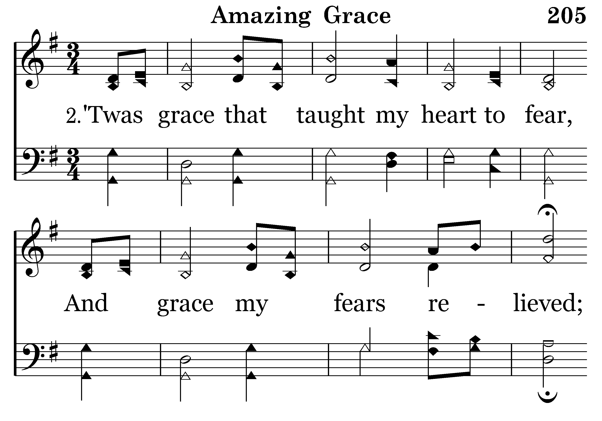
205 - Amazing Grace - 2.1

Slide 11
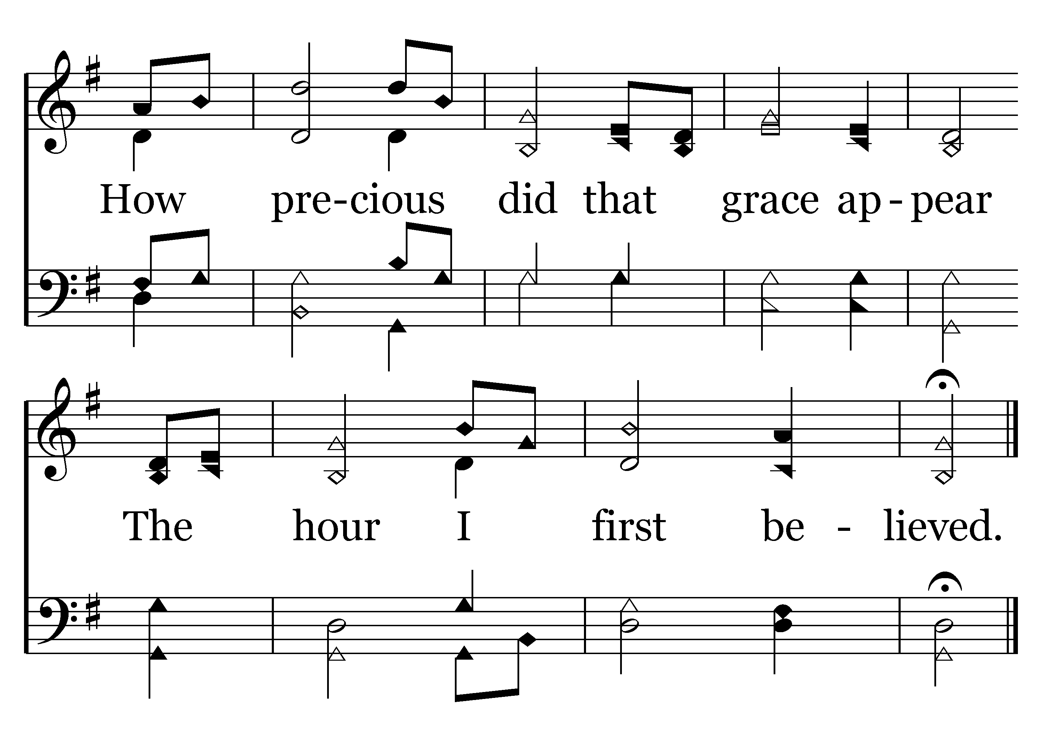
205 - Amazing Grace - 2.2
End of Verse 2

Slide 12
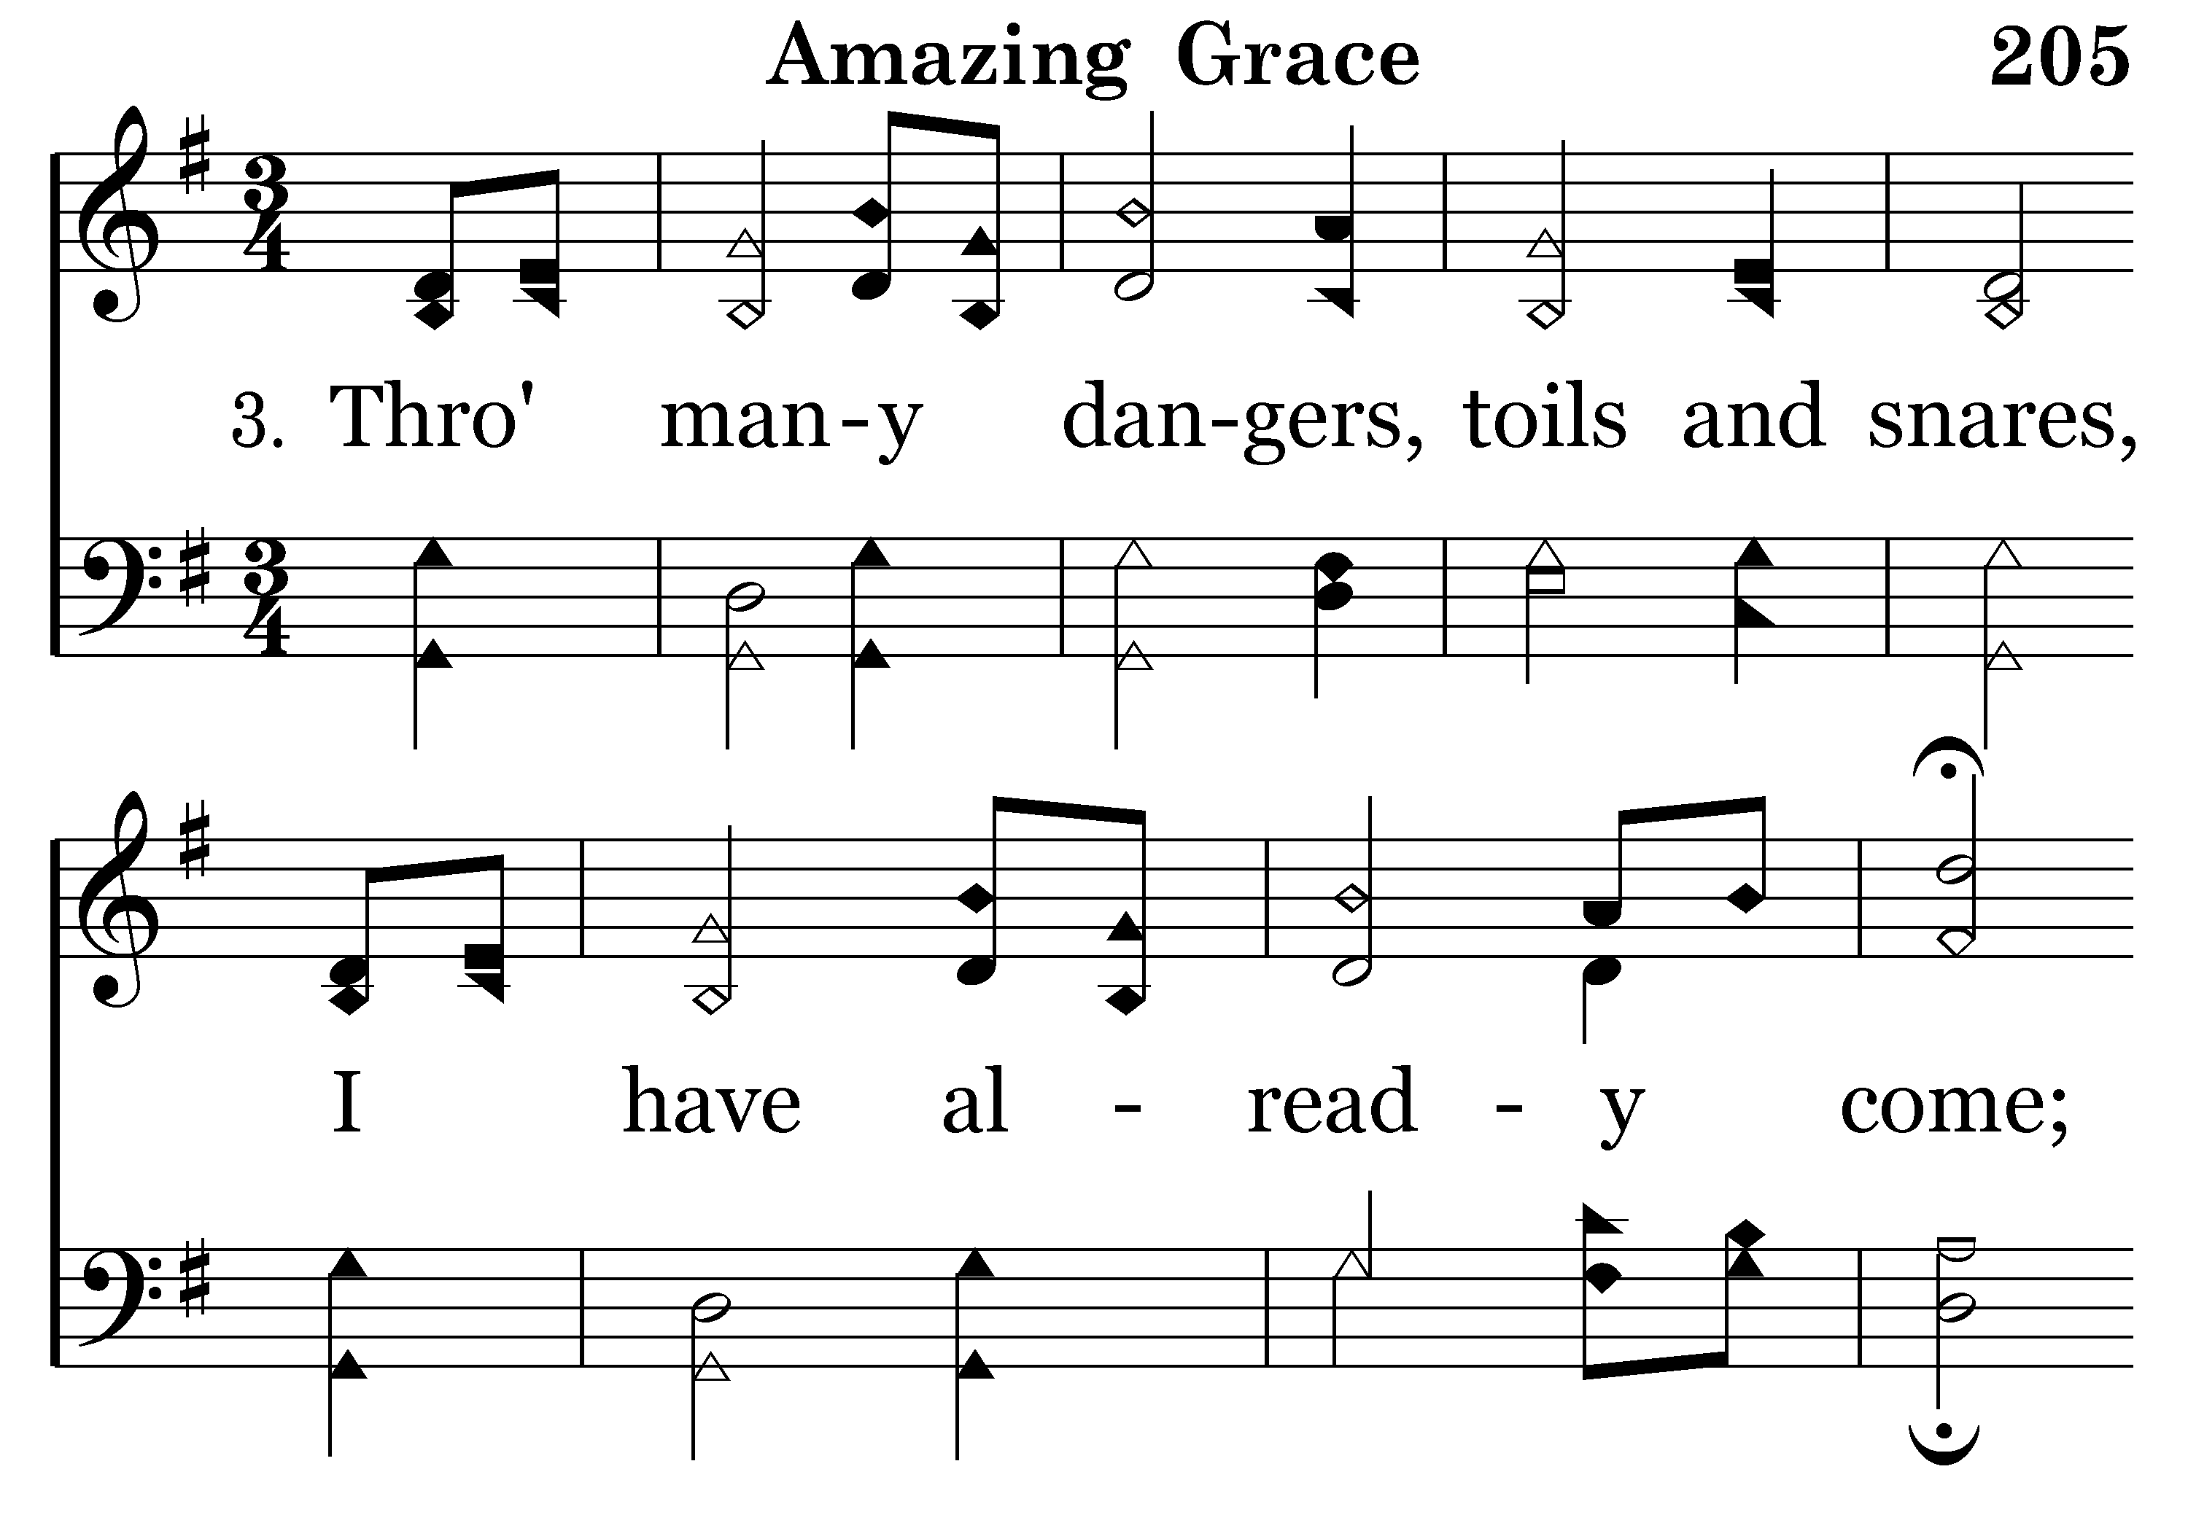
205 - Amazing Grace - 3.1

Slide 13
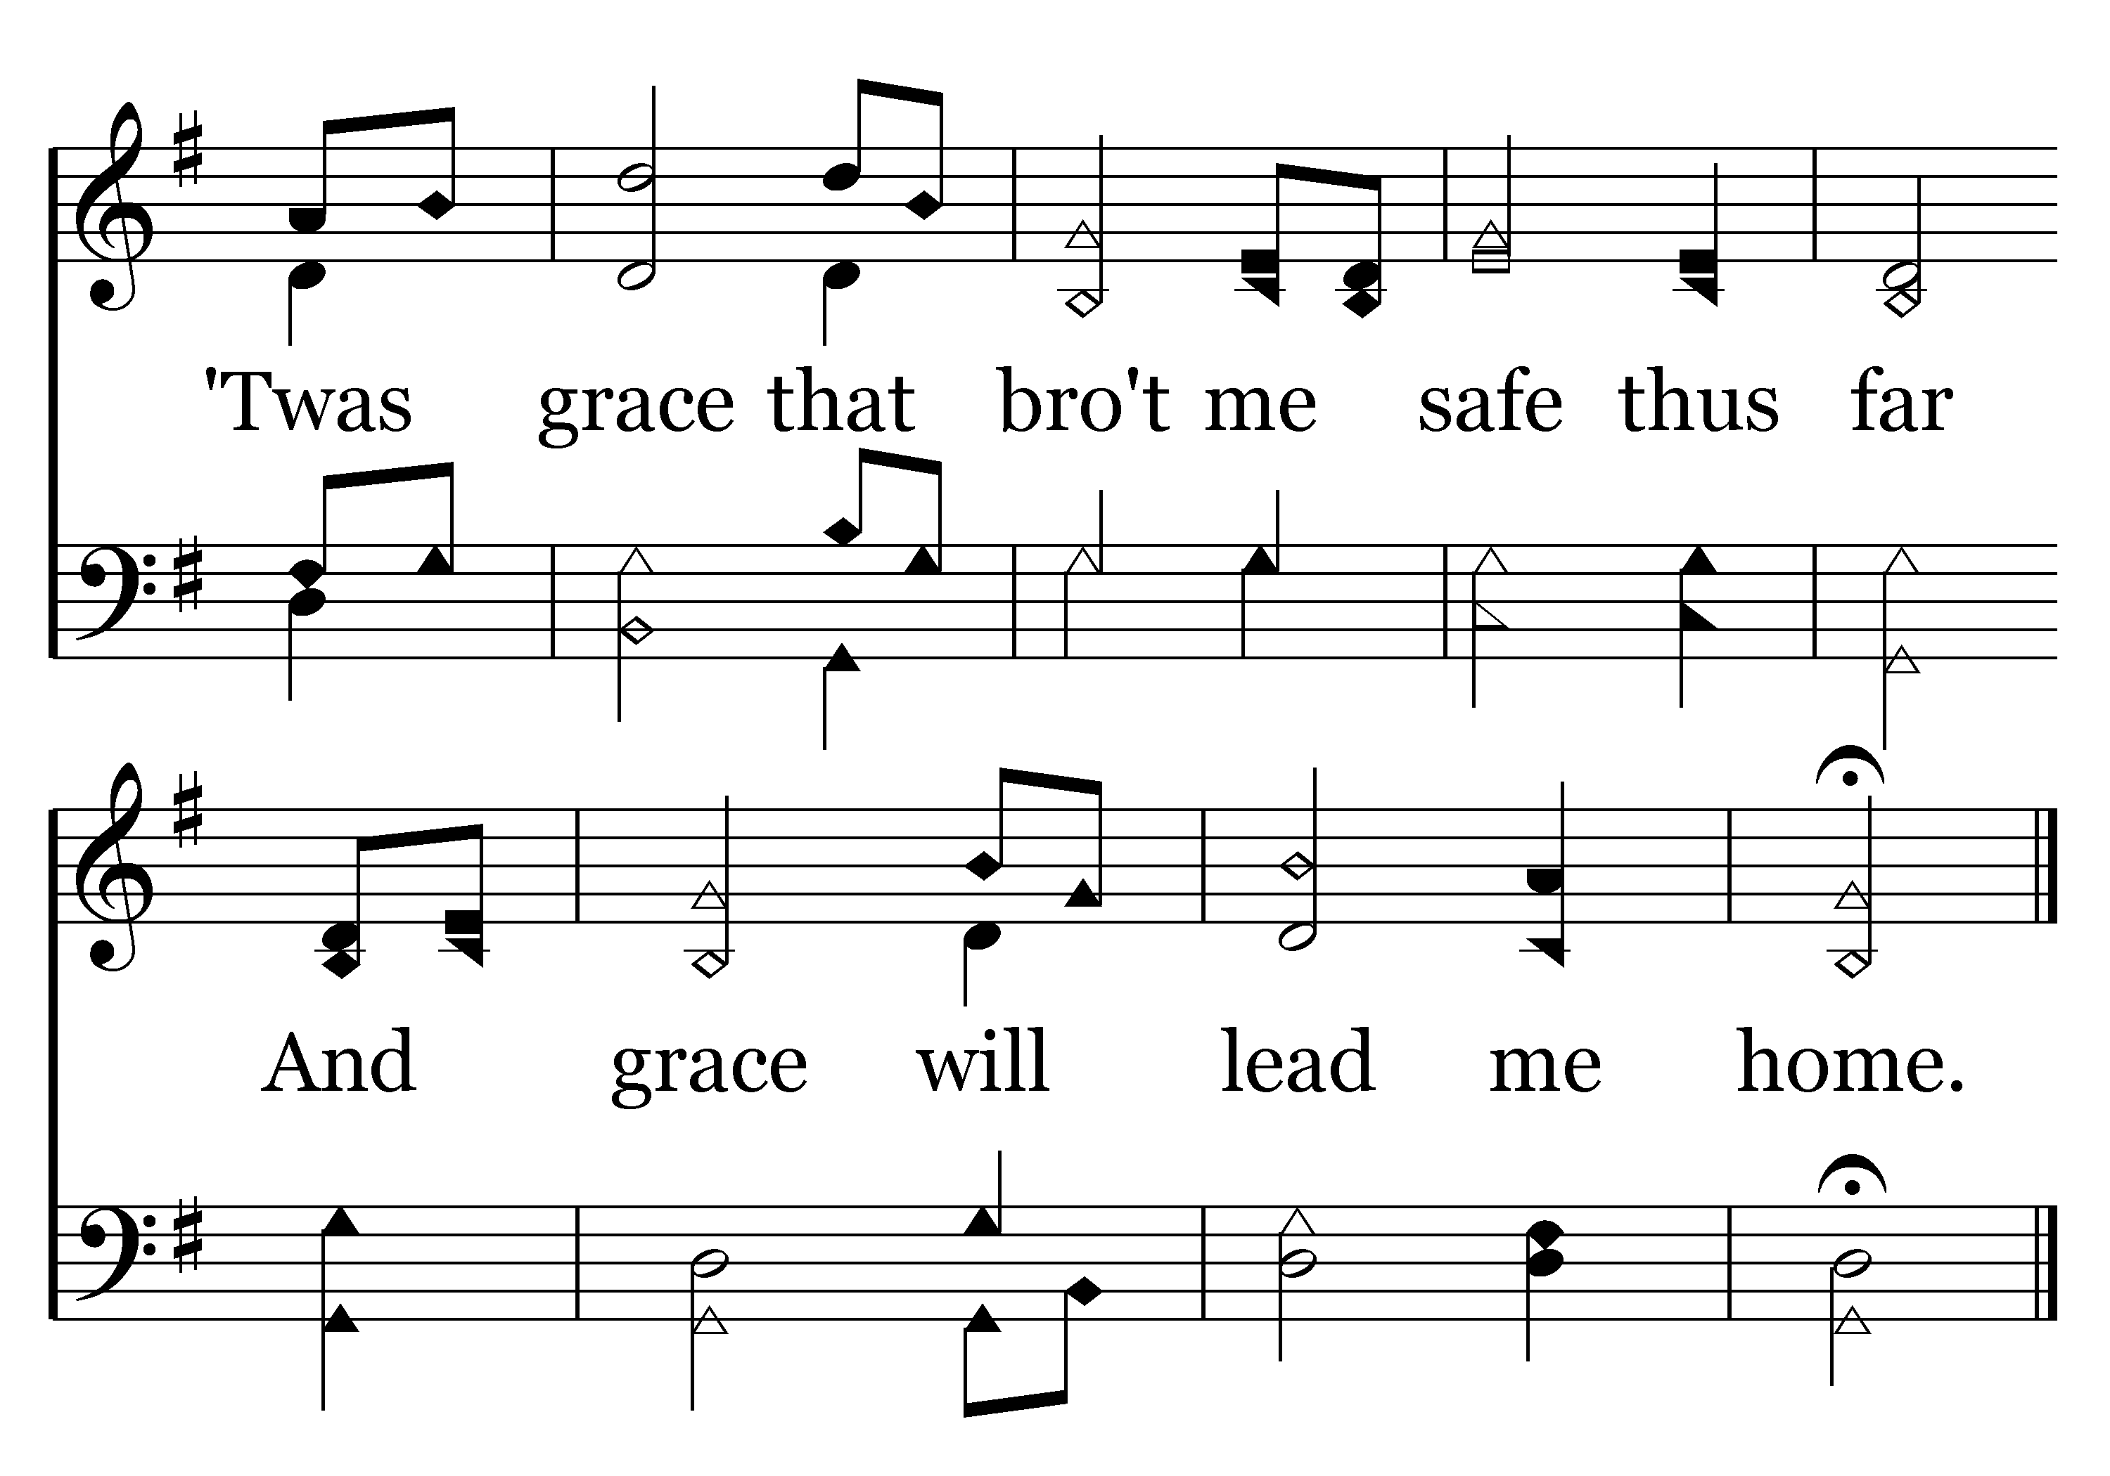
205 - Amazing Grace - 3.2
End of Verse 3

Slide 14
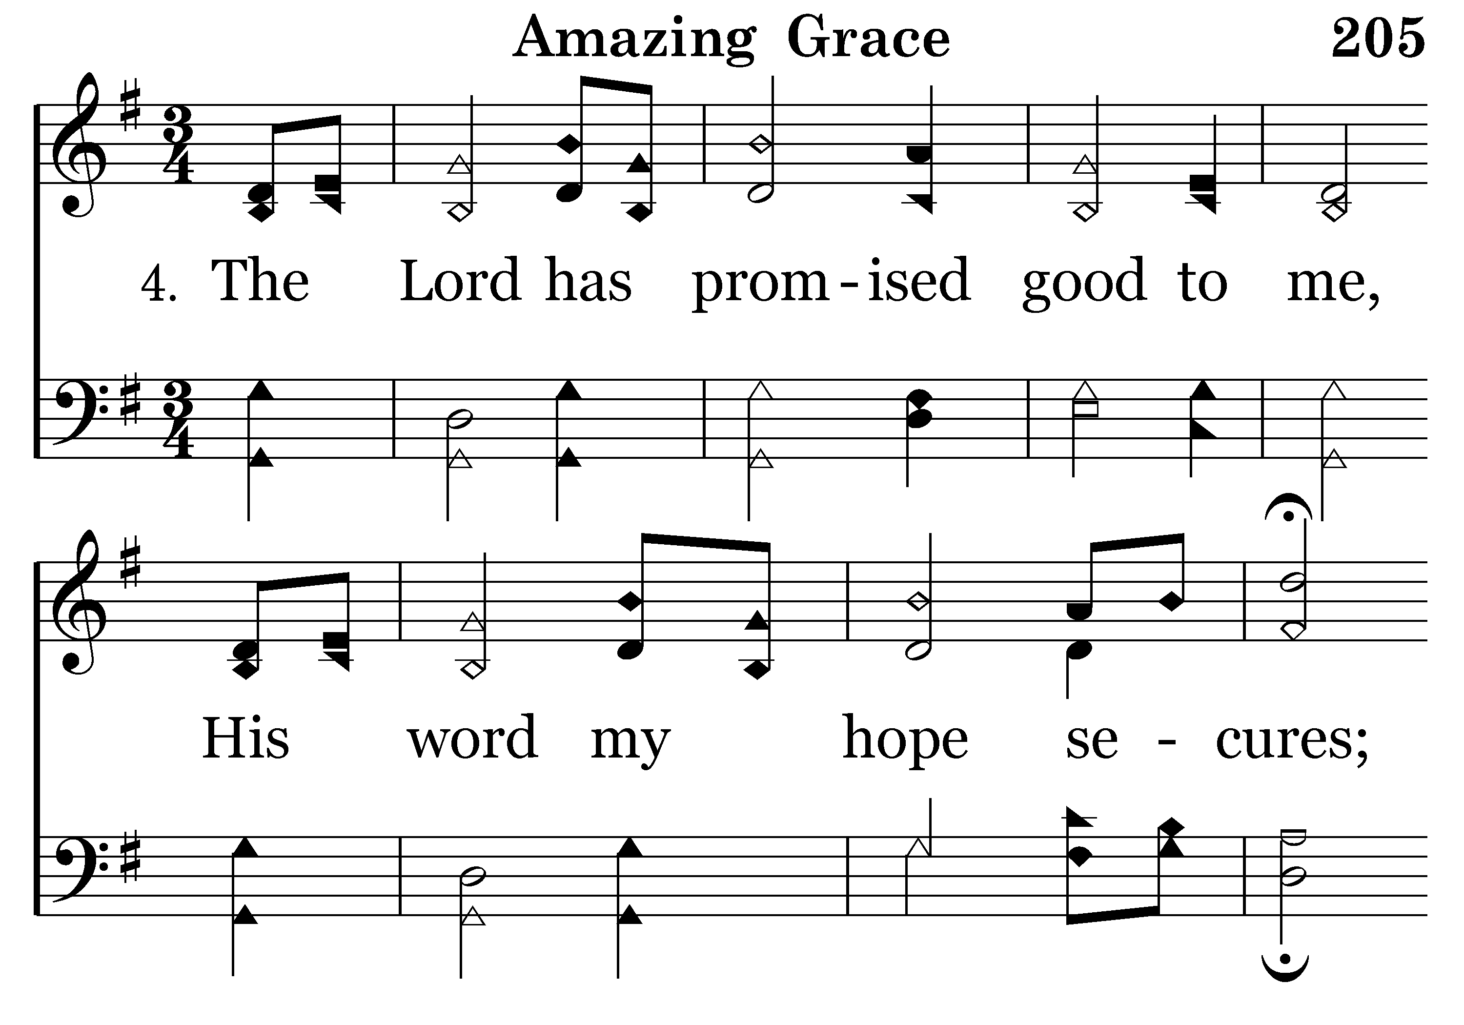
205 - Amazing Grace - 4.1

Slide 15
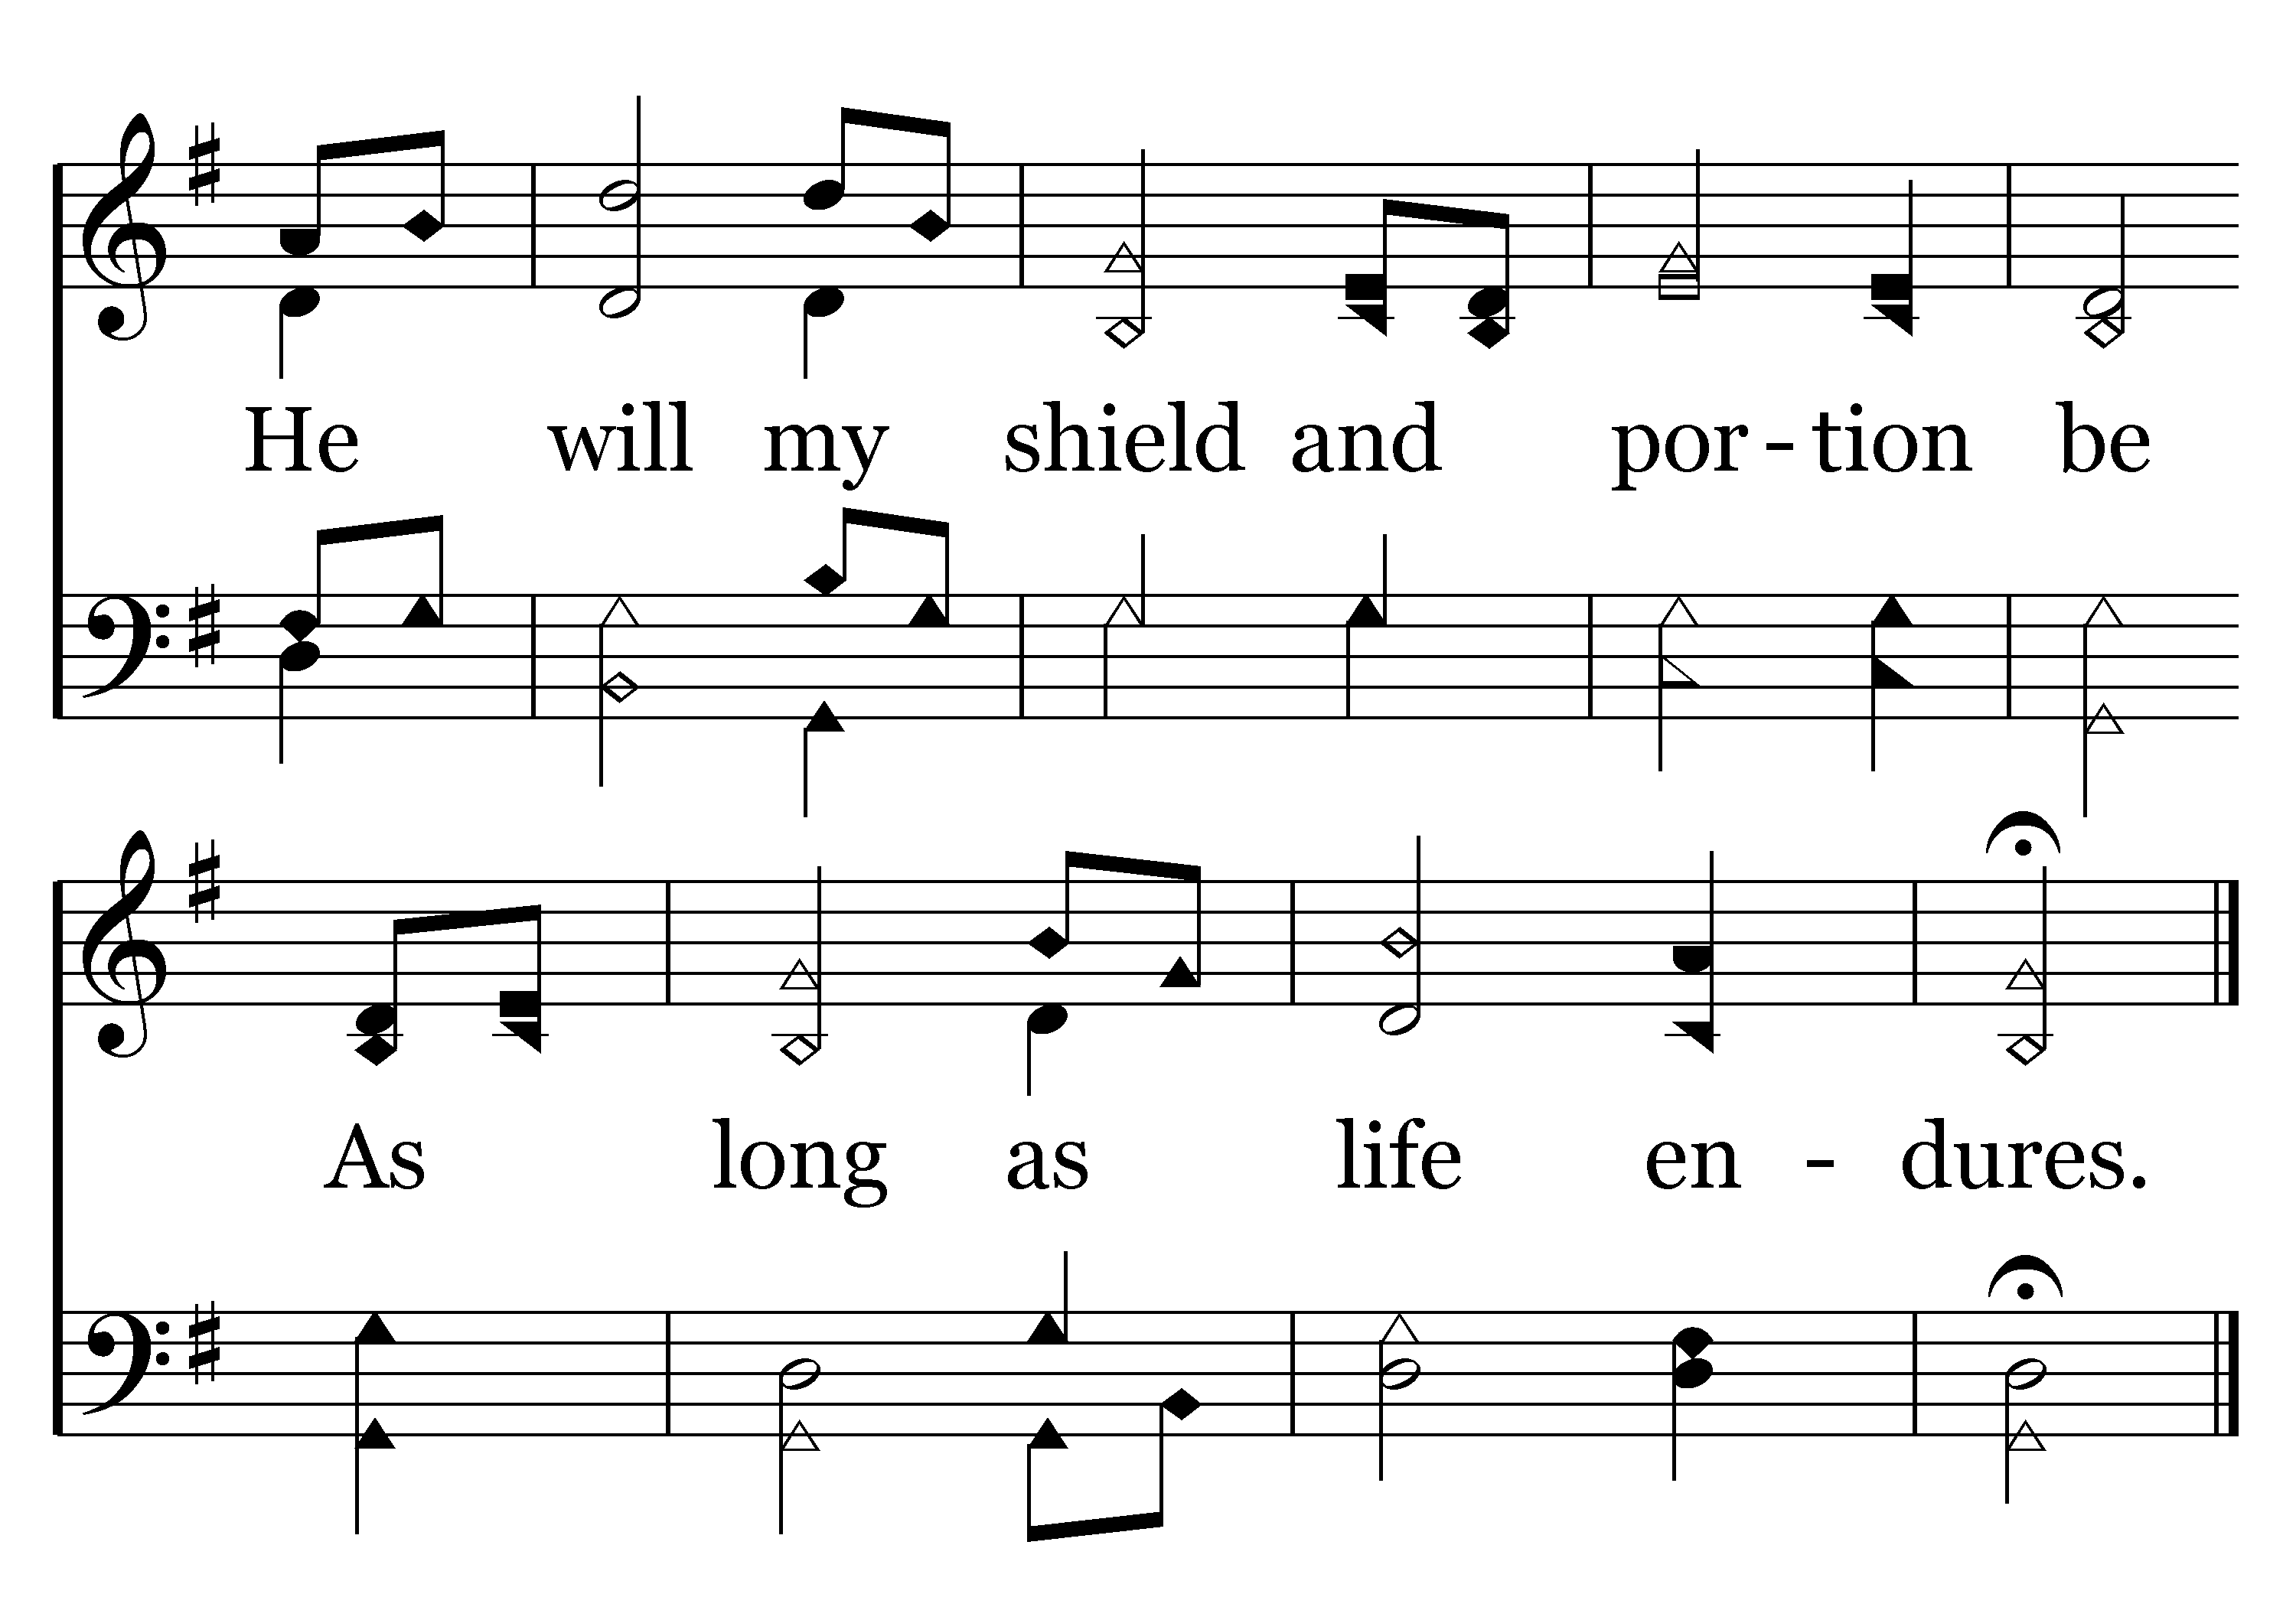
205 - Amazing Grace - 4.2
End of Verse 4

Slide 16
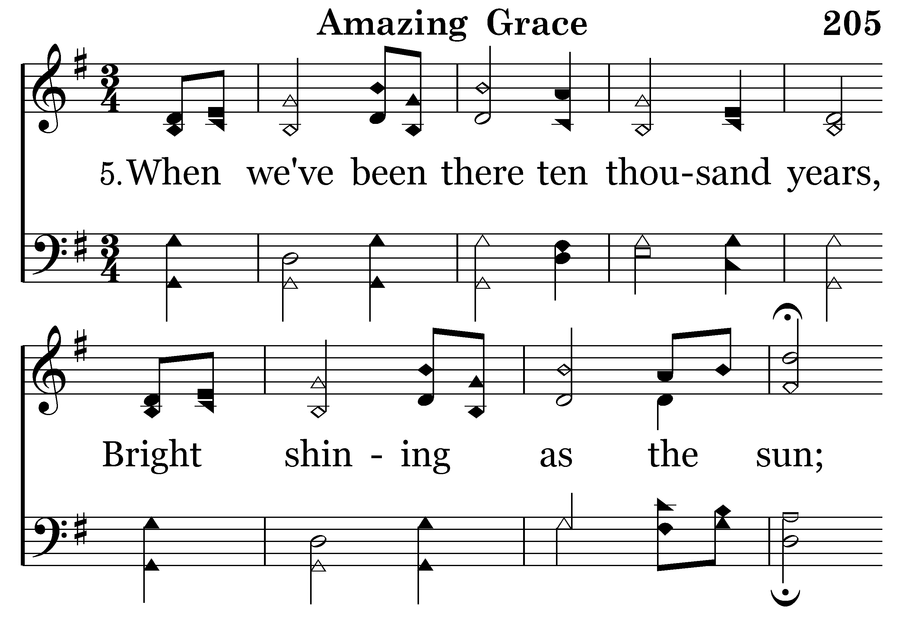
205 - Amazing Grace - 5.1

Slide 17
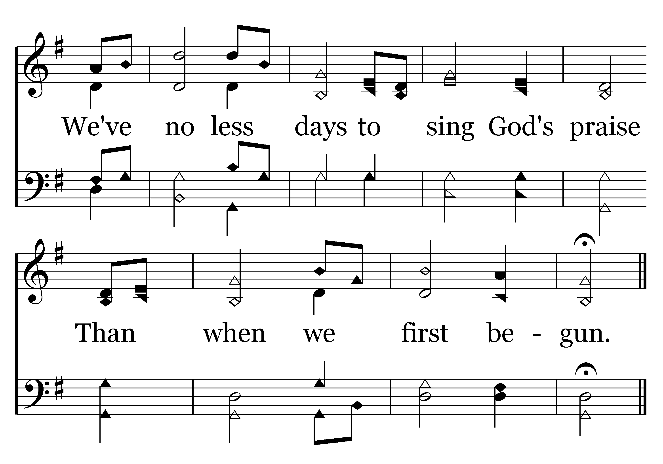
205 - Amazing Grace - 5.2
End of Song

