Slide 1
Hebrews 11:29-30
29 By faith the people crossed the Red Sea as on dry land, but the Egyptians, when they attempted to do the same, were drowned.
30 By faith the walls of Jericho fell down after they had been encircled for seven days.

Slide 3
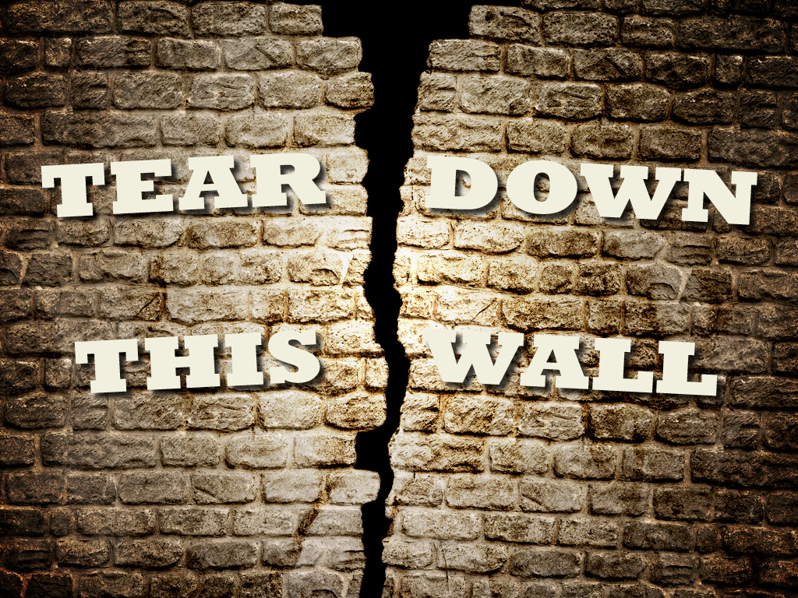

Slide 4
The Story of Jericho
Joshua 5
10–12
13–15
The ground was holy
A symbol of authority

Slide 5
The Story of Jericho
Joshua 6
1–7
8-14
15-21
22-27

Slide 6
What we can learn:
The Uniqueness in God’s Plan
The Power in God’s Plan
He gives us power to defeat Satan
He gives us power to get to Heaven
The Success in God’s Plan

