Slide 1
Philippians 4:4-6
Rejoice in the Lord always; again I will say, rejoice. ⁵ Let your reasonableness be known to everyone. The Lord is at hand; ⁶ do not be anxious about anything, but in everything by prayer and supplication with thanksgiving let your requests be made known to God

Slide 3
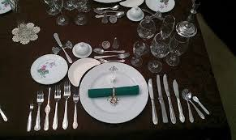

Slide 4
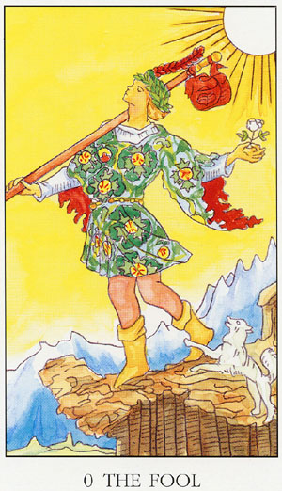
Blessed are the Foolish

Slide 5
2 Samuel 6:8-9
And David became angry because of the Lord’s outbreak against Uzzah; and he called the name of the place Perez Uzzah to this day.
⁹ David was afraid of the Lord that day; and he said, “How can the ark of the Lord come to me

Slide 6
2 Samuel 6:12
And it was told King David, “The Lord has blessed the household of Obed-edom and all that belongs to him, because of the ark of God.” So David went and brought up the ark of God from the house of Obed-edom to the city of David with rejoicing.

Slide 7
1 Chronicles 15:13-15
Because you did not carry it the first time, the Lord our God broke out against us, because we did not seek him according to the rule.” ¹⁴ So the priests and the Levites consecrated themselves to bring up the ark of the Lord, the God of Israel. ¹⁵ And the Levites carried the ark of God on their shoulders with the poles, as Moses had commanded according to the word of the Lord

Slide 8
2 samuel 6:13
And when those who bore the ark of the Lord had gone six steps, he sacrificed an ox and a fattened animal

Slide 9
2 Samuel 6:14-15
And David danced before the Lord with all his might. And David was wearing a linen ephod. ¹⁵ So David and all the house of Israel brought up the ark of the Lord with shouting and with the sound of the horn

Slide 10
2 Samuel 6:16
As the ark of the Lord came into the city of David, Michal the daughter of Saul looked out of the window and saw King David leaping and dancing before the Lord, and she despised him in her heart

Slide 11
2 Samuel 6:20
And David returned to bless his household. But Michal the daughter of Saul came out to meet David and said, “How the king of Israel honored himself today, uncovering himself today before the eyes of his servants' female servants, as one of the vulgar fellows shamelessly uncovers himself

Slide 12
2 Samuel 6:21-22
And David said to Michal, “It was before the Lord, who chose me above your father and above all his house, to appoint me as prince over Israel, the people of the Lord—and I will celebrate before the Lord. ²² I will make myself yet more contemptible than this, and I will be abased in your eyes. But by the female servants of whom you have spoken, by them I shall be held in honor

Slide 13
1 Corinthians 1:26-27
For consider your calling, brothers: not many of you were wise according to worldly standards, not many were powerful, not many were of noble birth. ²⁷ But God chose what is foolish in the world to shame the wise; God chose what is weak in the world to shame the strong

Slide 14
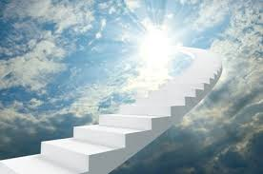
Blessed Are the Foolish

