Slide 1
Ephesians 2:1–3
¹ And you were dead in the trespasses and sins ² in which you once walked, following the course of this world, following the prince of the power of the air, the spirit that is now at work in the sons of disobedience— ³ among whom we all once lived in the passions of our flesh, carrying out the desires of the body and the mind, and were by nature children of wrath, like the rest of mankind.

Slide 3
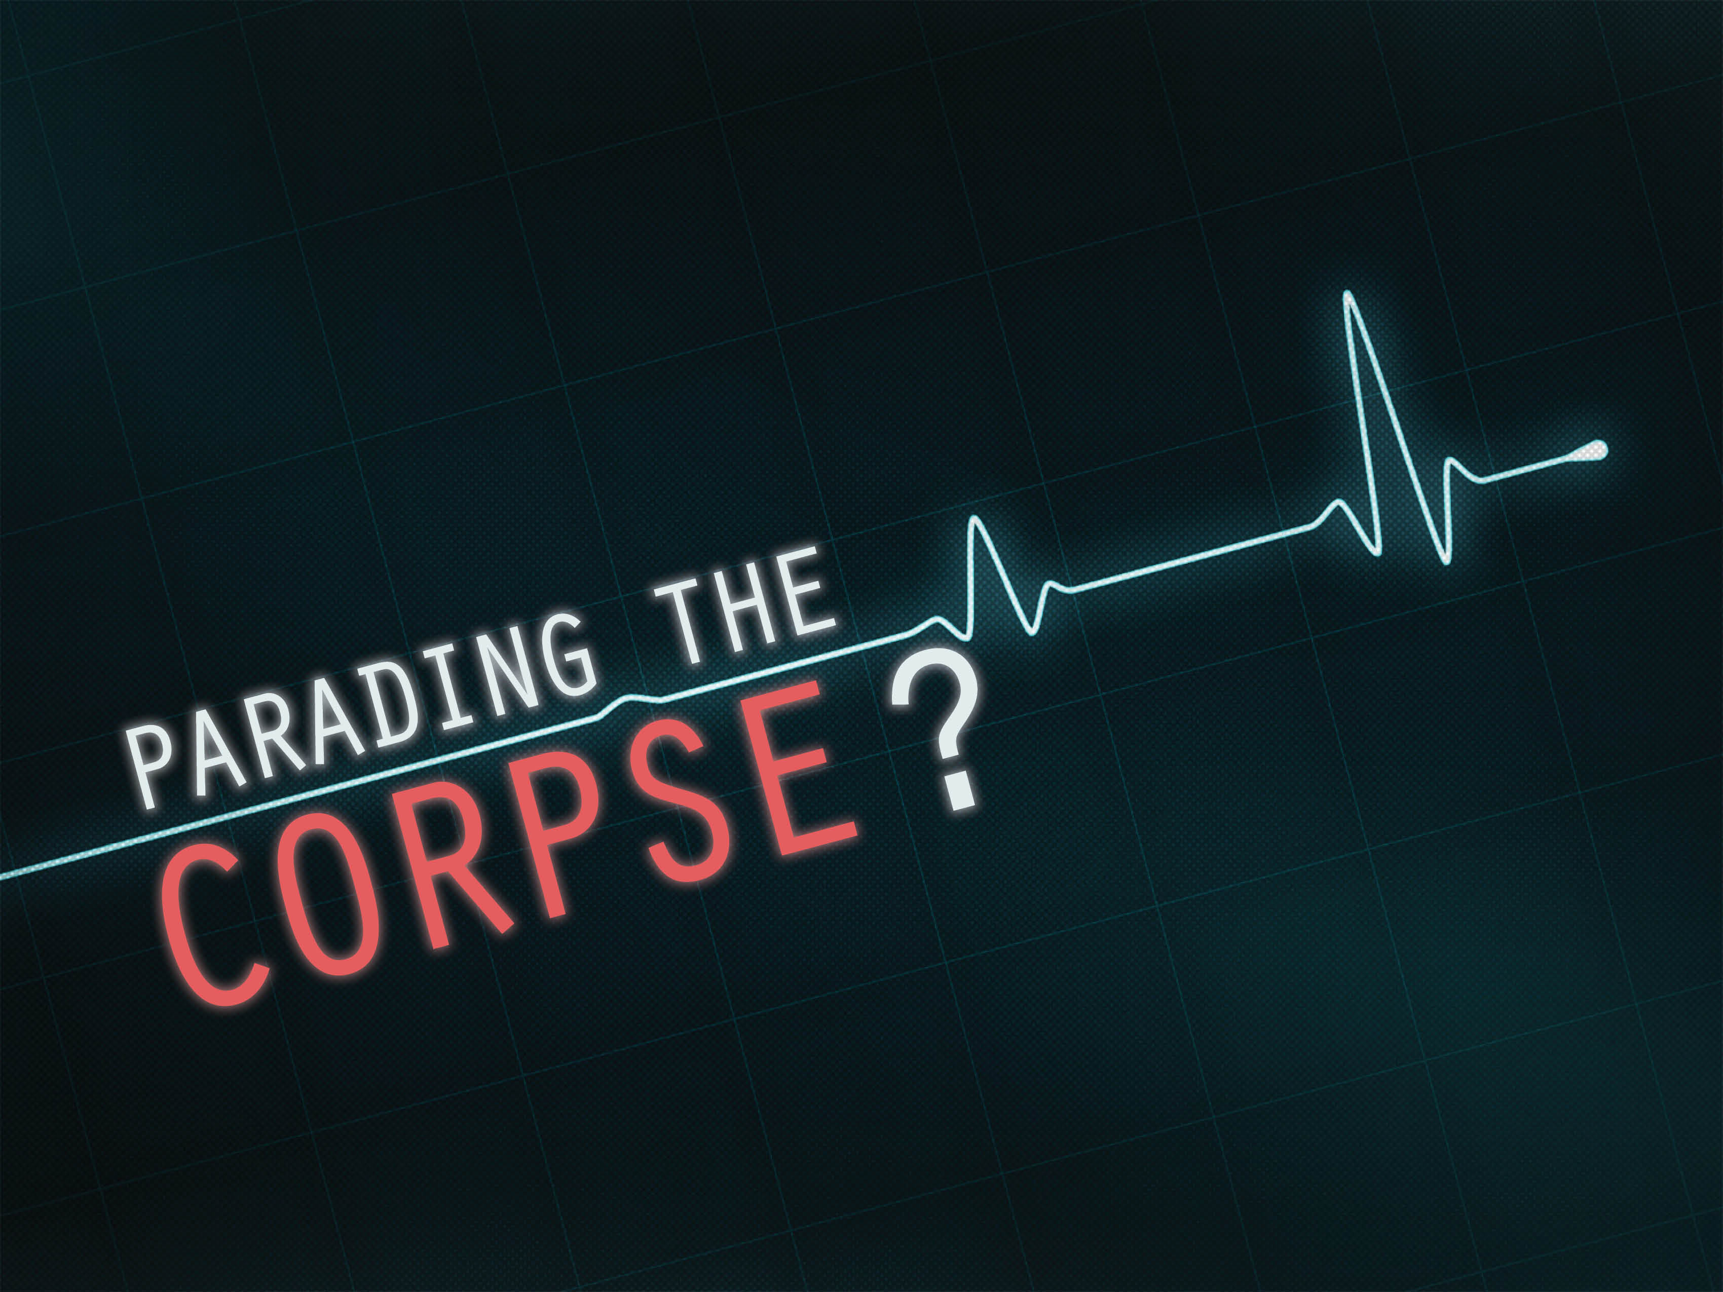

Slide 4
If we fail to reconcile with our brother…
Matthew 5:23–24
Psalm 32:3–4

Slide 5
If we refuse to repent of our sins…
Psalm 66:18
Ephesians 2:1–10
Isaiah 59:1–2
Psalm 32:5

Slide 6
If we practice a passive faith…
James 2:14–26
Matthew 25:34–40

Slide 7
If we do as little as possible…
Matthew 6:33

