Slide 1
1 Peter 2:6–8
For it stands in Scripture: "Behold, I am laying in Zion a stone, a cornerstone chosen and precious, and whoever believes in him will not be put to shame." So the honor is for you who believe, but for those who do not believe, "The stone that the builders rejected has become the cornerstone," and "A stone of stumbling, and a rock of offense." They stumble because they disobey the word, as they were destined to do.

Slide 3
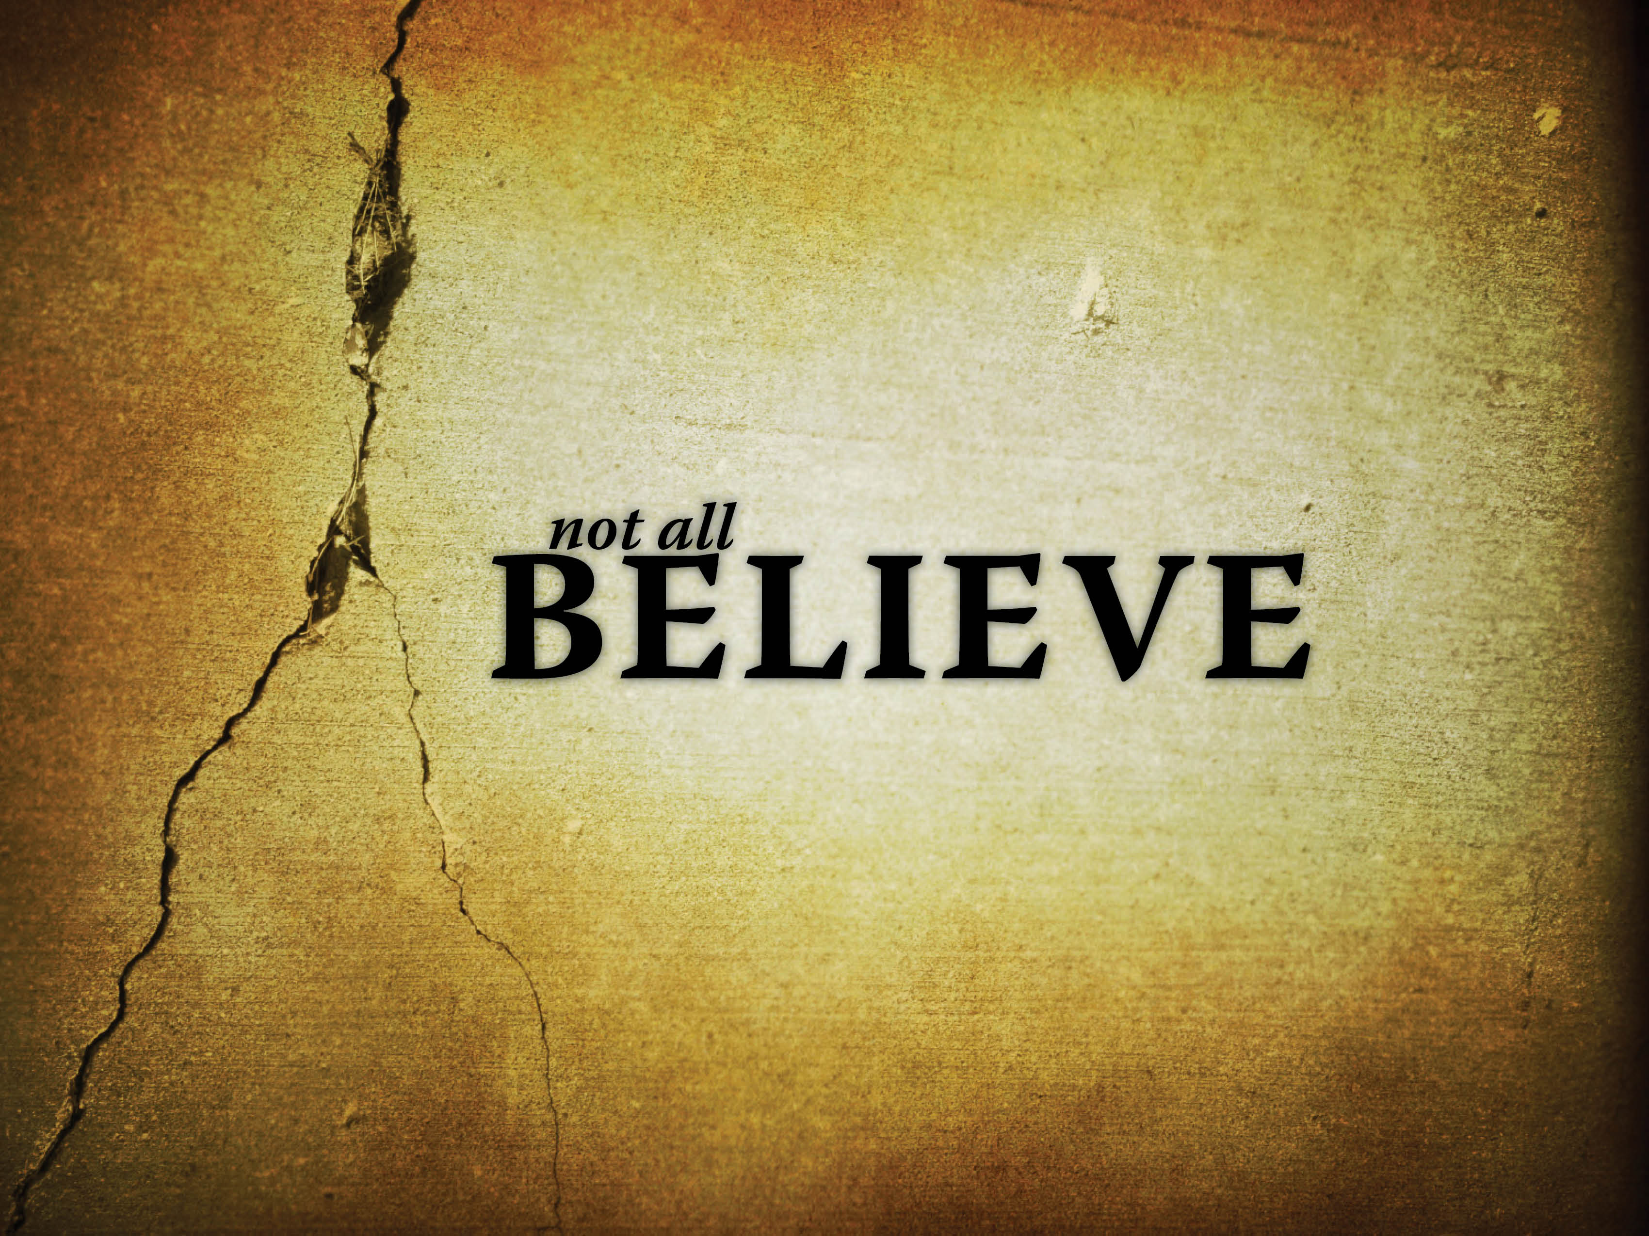

Slide 4
Some don’t believe because of envy, pride, and tradition.
The Jewish Rulers.
They were told to repent (Acts 3:19).
They responded with threats.
Acts 4:1–2, 4, 16–17, 21
Acts 2:37 contrasted with Acts 5:33
The Jews rejected the truth because of envy, pride, and 1,500 years of tradition.

Slide 5
Some don’t believe because of human wisdom.
The Athenians.
Acts17:16–34
They mocked the truth because of their philosophy and academia.
1 Corinthians 1:21–24

Slide 6
Some don’t believe because of greed.
The Ephesian Tradesmen.
Acts 19:10, 20, 23–28
Today some are too focused on this world.

Slide 7
Some don’t believe because of position.
Felix, the governor.
Acts 24:22–26
Agrippa, the procurator.
Acts 25:13, 25–28
1 Corinthians 1:26

