Slide 1
What God Has Done
God’s Plan
To Walk Worthy

Slide 2
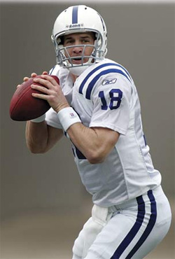
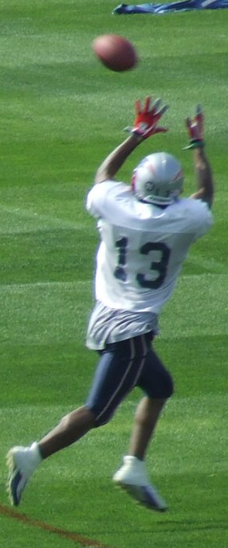
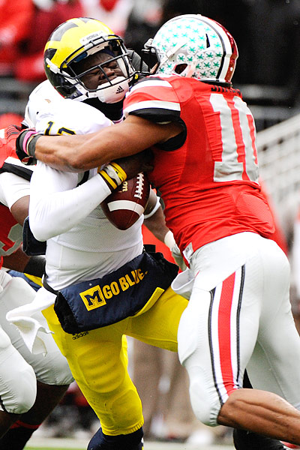
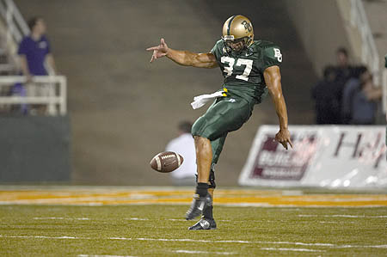

Slide 3
And to one he gave five talents, to another two, and to another one, to each according to his own ability; and immediately he went on a journey.
(Matthew 25:15)
To Use Your Gifts
God graces us with gifts (v. 7)
Given to us by Christ (v. 8)
Matthew 25:15
The Gifts

Slide 4
And to one he gave five talents, to another two, and to another one, to each according to his own ability; and immediately he went on a journey.
(Matthew 25:15)
To Use Your Gifts
God graces us with gifts (v. 7)
Given to us by Christ (v. 8)
Matthew 25:15
Some natural
Some developed
The Gifts

Slide 5
To Use Your Gifts
God graces us with gifts (v. 7)
“each one of us”
The Gifts

Slide 6
To Use Your Gifts
God graces us with gifts (v. 7)
“each one of us”
Everyone can do something!
The Gifts

Slide 7
To Use Your Gifts
What are the gifts?
Paul lists those dealing with teaching. Foundational.
The Gifts

Slide 8
To Use Your Gifts
What are the gifts?
Paul lists those dealing with teaching. Foundational.
Some are inspired; some are not
The Gifts

Slide 9
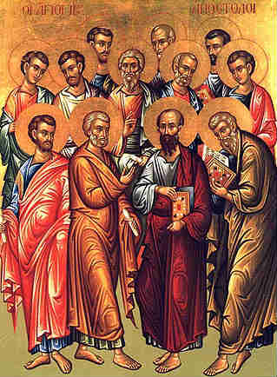
To Use Your Gifts
What are the gifts?
Apostles
The twelve; Paul
Those who had seen the resurrected Christ
The Gifts

Slide 10
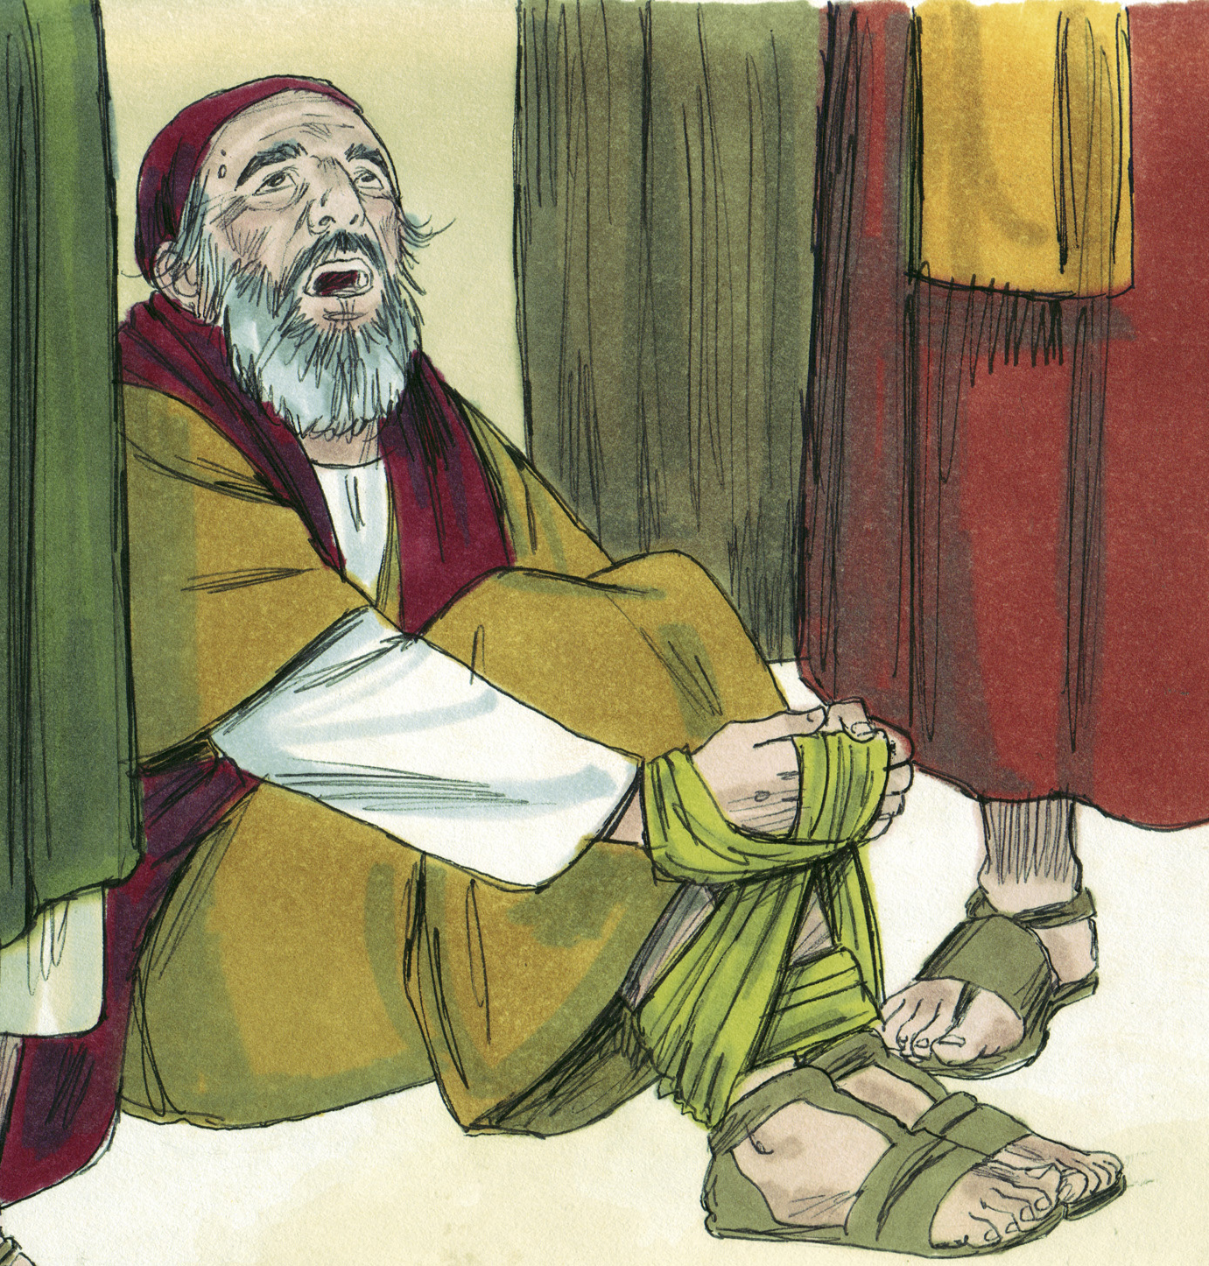
To Use Your Gifts
What are the gifts?
Apostles
Prophets
Inspired teachers
Gave revelation
The Gifts

Slide 11
To Use Your Gifts
What are the gifts?
Apostles
Prophets
Evangelists
“Bringers of good news”
The Gifts

Slide 12
To Use Your Gifts
What are the gifts?
Apostles
Prophets
Evangelists
Pastors
Elders/ Bishops/Shepherds
1 Timothy 3:1-7; 1 Peter 5:1-4
The Gifts

Slide 13
To Use Your Gifts
What are the gifts?
Apostles
Prophets
Evangelists
Pastors
Teachers
One who instructs
The Gifts

Slide 14
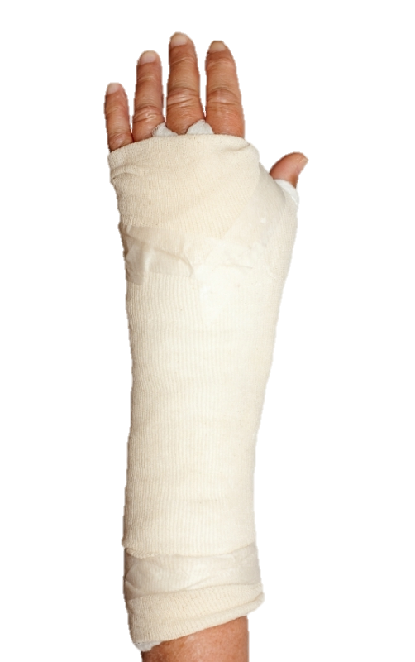
To Use Your Gifts
To equip the saints to minister and edify
“Equip”– to set something broken
The Goals

Slide 15
To Use Your Gifts
To equip the saints to minister and edify
“Equip”– to set something broken
Useful in spiritual service
The Goals

Slide 16
To Use Your Gifts
To equip the saints to minister and edify
“Equip”– to set something broken
Useful in spiritual service
Able to “Edify”– build up
The Goals

Slide 17
To Use Your Gifts
To equip the saints to minister and edify
Unity of the faith
V. 5
A standard of belief; body of truth
Common understanding of right and wrong
“There is… ONE faith…”
The Goals

Slide 18
To Use Your Gifts
To equip the saints to minister and edify
Unity of the faith
V. 5
A standard of belief; body of truth
Common understanding of right and wrong
Desire to bring people to…
“There is… ONE faith…”
“…the knowledge of the Son of God…”
The Goals

Slide 19
To Use Your Gifts
“…not having my own righteousness, which is from the law, but that which is through faith in Christ, the righteousness which is from God by faith; that I may know Him and the power of His resurrection, and the fellowship of His sufferings, being conformed to His death, 11 if, by any means, I may attain to the resurrection from the dead.”
(Philippians 3:9-11)
To equip the saints to minister and edify
Unity of the faith
V. 5
A standard of belief; body of truth
Common understanding of right and wrong
Based on…
“There is… ONE faith…”
“…the knowledge of the Son of God…”
The Goals

Slide 20
To Use Your Gifts
Spiritual Maturity
“Perfect”– complete, not lacking
The Goals

Slide 21
To Use Your Gifts
The process of becoming more like Christ every day
Spiritual Maturity
“Perfect”– complete, not lacking
“The measure of the stature of the fullness of Christ”
For whom He foreknew, He also predestined to be conformed to the image of His Son, that He might be the firstborn among many brethren.
(Romans 8:29)
The Goals

Slide 22
To Use Your Gifts
Doctrinal Stability
Sound, healthy teaching
Titus 1:9; 2 Timothy 2:18
“…Holding fast the faithful word, as he has been taught, that he may be able, by sound doctrine, both to exhort and convict those who contradict.”
“…Hymenaeus and Philetus are of this sort, who have strayed concerning the truth, saying that the resurrection is already past; and they have overthrown the faith of some.”
The Goals

Slide 23
To Use Your Gifts
When taught properly, proper people want to be useful!
The Growth
(Ephesians 4:15-16)

Slide 24
To Use Your Gifts
Isaiah 6:8
When taught properly, proper people want to serve!
For whom He foreknew, He also predestined to be conformed to the image of His Son, that He might be the firstborn among many brethren.
(Romans 8:29)
The Goals
(Ephesians 4:15-16)

Slide 25
Having then gifts differing according to the grace that is given to us, let us use them: if prophecy, let us prophesy in proportion to our faith; or ministry, let us use it in our ministering; he who teaches, in teaching; he who exhorts, in exhortation; he who gives, with liberality; he who leads, with diligence; he who shows mercy, with cheerfulness.
(Romans 12:6-9)
To Use Your Gifts
When taught properly, proper people want to be useful!
Using our gifts! (Romans 12:6-9)
The Growth
(Ephesians 4:15-16)

Slide 26
Having then gifts differing according to the grace that is given to us, let us use them: if prophecy, let us prophesy in proportion to our faith; or ministry, let us use it in our ministering; he who teaches, in teaching; he who exhorts, in exhortation; he who gives, with liberality; he who leads, with diligence; he who shows mercy, with cheerfulness.
(Romans 12:6-9)
To Use Your Gifts
When taught properly, proper people want to be useful!
Using our gifts! (Romans 12:6-9)
The Growth
(Ephesians 4:15-16)

Slide 27
Having then gifts differing according to the grace that is given to us, let us use them: if prophecy, let us prophesy in proportion to our faith; or ministry, let us use it in our ministering; he who teaches, in teaching; he who exhorts, in exhortation; he who gives, with liberality; he who leads, with diligence; he who shows mercy, with cheerfulness.
(Romans 12:6-9)
To Use Your Gifts
When taught properly, proper people want to be useful!
Using our gifts! (Romans 12:6-9)
The Growth
(Ephesians 4:15-16)

Slide 28
Having then gifts differing according to the grace that is given to us, let us use them: if prophecy, let us prophesy in proportion to our faith; or ministry, let us use it in our ministering; he who teaches, in teaching; he who exhorts, in exhortation; he who gives, with liberality; he who leads, with diligence; he who shows mercy, with cheerfulness.
(Romans 12:6-9)
To Use Your Gifts
When taught properly, proper people want to be useful!
Using our gifts! (Romans 12:6-9)
The Growth
(Ephesians 4:15-16)

Slide 29
Having then gifts differing according to the grace that is given to us, let us use them: if prophecy, let us prophesy in proportion to our faith; or ministry, let us use it in our ministering; he who teaches, in teaching; he who exhorts, in exhortation; he who gives, with liberality; he who leads, with diligence; he who shows mercy, with cheerfulness.
(Romans 12:6-9)
To Use Your Gifts
When taught properly, proper people want to be useful!
Using our gifts! (Romans 12:6-9)
The Growth
(Ephesians 4:15-16)

Slide 30
Having then gifts differing according to the grace that is given to us, let us use them: if prophecy, let us prophesy in proportion to our faith; or ministry, let us use it in our ministering; he who teaches, in teaching; he who exhorts, in exhortation; he who gives, with liberality; he who leads, with diligence; he who shows mercy, with cheerfulness.
(Romans 12:6-9)
To Use Your Gifts
When taught properly, proper people want to be useful!
Using our gifts! (Romans 12:6-9)
The Growth
(Ephesians 4:15-16)

Slide 31
Having then gifts differing according to the grace that is given to us, let us use them: if prophecy, let us prophesy in proportion to our faith; or ministry, let us use it in our ministering; he who teaches, in teaching; he who exhorts, in exhortation; he who gives, with liberality; he who leads, with diligence; he who shows mercy, with cheerfulness.
(Romans 12:6-9)
To Use Your Gifts
When taught properly, proper people want to be useful!
Using our gifts! (Romans 12:6-9)
The Growth
(Ephesians 4:15-16)

Slide 32
Having then gifts differing according to the grace that is given to us, let us use them: if prophecy, let us prophesy in proportion to our faith; or ministry, let us use it in our ministering; he who teaches, in teaching; he who exhorts, in exhortation; he who gives, with liberality; he who leads, with diligence; he who shows mercy, with cheerfulness.
(Romans 12:6-9)
To Use Your Gifts
When taught properly, proper people want to be useful!
Using our gifts! (Romans 12:6-9)
The Growth
(Ephesians 4:15-16)

Slide 33
Having then gifts differing according to the grace that is given to us, let us use them: if prophecy, let us prophesy in proportion to our faith; or ministry, let us use it in our ministering; he who teaches, in teaching; he who exhorts, in exhortation; he who gives, with liberality; he who leads, with diligence; he who shows mercy, with cheerfulness.
(Romans 12:6-9)
To Use Your Gifts
When taught properly, proper people want to be useful!
Using our gifts! (Romans 12:6-9)
The Growth
(Ephesians 4:15-16)

Slide 34
To Use Your Gifts
What is your ability?
Your talent?
Your bent in life?
Your GIFT?
The Growth
(Ephesians 4:15-16)

Slide 35
Your GIFT?

Slide 36
Remember
Your GIFT

