Slide 2
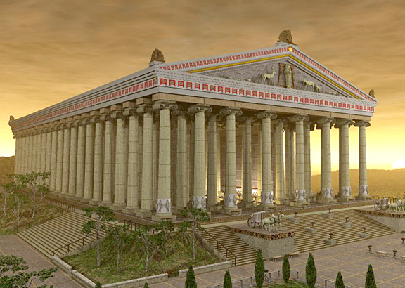
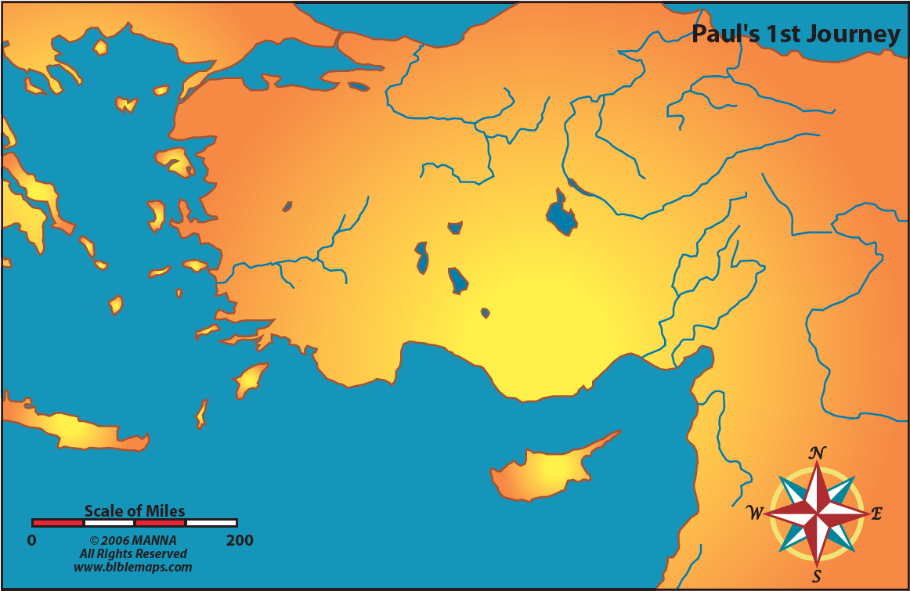
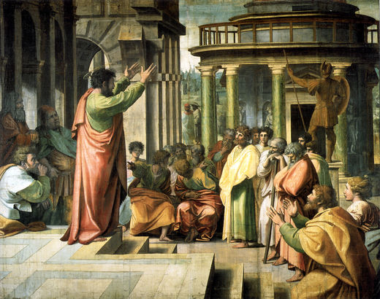
Philippi
Thessalonica
Athens
Ephesus
Crete
Cyprus

Slide 4
What God Has Done
“Every spiritual blessings in the heavenly places…”
He Has Blessed Us With Every Spiritual Blessing

Slide 5
What God Has Done
Do we really value them???
“Every spiritual blessings in the heavenly places…”
He chose us • He predestined us
He adopted us • He accepted us
• He forgave us
• He revealed to us
• He gathered us
• He gave an inheritance
He Has Blessed Us With Every Spiritual Blessing

Slide 6
What God Has Done
Do we really value them???
Our challenge is to grow to appreciate what God has done!
“Every spiritual blessings in the heavenly places…”
He chose us • He predestined us
He adopted us • He accepted us
• He forgave us
• He revealed to us
• He gathered us
• He gave an inheritance
He Has Blessed Us With Every Spiritual Blessing

Slide 7
WISDOM!

Slide 8
What God Has Done
“Therefore I also, after I heard of your faith in the Lord Jesus and your love for all the saints, do not cease to give thanks for you, making mention of you in my prayers: that the God of our Lord Jesus Christ, the Father of glory, may give to you the spirit of wisdom and revelation in the knowledge of Him, the eyes of your understanding being enlightened; that you may know what is the hope of His calling, what are the riches of the glory of His inheritance in the saints, and what is the exceeding greatness of His power toward us who believe, according to the working of His mighty power which He worked in Christ when He raised Him from the dead and seated Him at His right hand in the heavenly places…” (Ephesians 1:15-20)
“Every spiritual blessings in the heavenly places…”
He chose us • He predestined us
He adopted us • He accepted us
• He forgave us
• He revealed to us
• He gathered us
• He gave an inheritance
He Has Blessed Us With Every Spiritual Blessing

Slide 9
What God Has Done
“Therefore I also, after I heard of your faith in the Lord Jesus and your love for all the saints, do not cease to give thanks for you, making mention of you in my prayers: that the God of our Lord Jesus Christ, the Father of glory, may give to you the spirit of wisdom and revelation in the knowledge of Him, the eyes of your understanding being enlightened; that you may know what is the hope of His calling, what are the riches of the glory of His inheritance in the saints, and what is the exceeding greatness of His power toward us who believe, according to the working of His mighty power which He worked in Christ when He raised Him from the dead and seated Him at His right hand in the heavenly places…” (Ephesians 1:15-20)
“Every spiritual blessings in the heavenly places…”
He chose us • He predestined us
He adopted us • He accepted us
• He forgave us
• He revealed to us
• He gathered us
• He gave an inheritance
He Has Blessed Us With Every Spiritual Blessing

Slide 10
What God Has Done
“Therefore I also, after I heard of your faith in the Lord Jesus and your love for all the saints, do not cease to give thanks for you, making mention of you in my prayers: that the God of our Lord Jesus Christ, the Father of glory, may give to you the spirit of wisdom and revelation in the knowledge of Him, the eyes of your understanding being enlightened; that you may know what is the hope of His calling, what are the riches of the glory of His inheritance in the saints, and what is the exceeding greatness of His power toward us who believe, according to the working of His mighty power which He worked in Christ when He raised Him from the dead and seated Him at His right hand in the heavenly places…” (Ephesians 1:15-20)
“Every spiritual blessings in the heavenly places…”
He chose us • He predestined us
He adopted us • He accepted us
• He forgave us
• He revealed to us
• He gathered us
• He gave an inheritance
He Has Blessed Us With Every Spiritual Blessing

Slide 11
What God Has Done
“…that the God of our Lord Jesus Christ, the Father of glory, may give to you the spirit of wisdom and revelation in the knowledge of Him, the eyes of your understanding being enlightened; that you may know what is the hope of His calling, …”
Not that God may not give…
He Has Blessed Us With Every Spiritual Blessing

Slide 12
What God Has Done
“…that the God of our Lord Jesus Christ, the Father of glory, may give to you the spirit of wisdom and revelation in the knowledge of Him, the eyes of your understanding being enlightened; that you may know what is the hope of His calling, …”
Not that God may not give…
…but that that He gives and we accept!
He Has Blessed Us With Every Spiritual Blessing

Slide 13
What God Has Done
“…that the God of our Lord Jesus Christ, the Father of glory, may give to you the spirit of wisdom and revelation in the knowledge of Him, the eyes of your understanding being enlightened; that you may know what is the hope of His calling, …”
Not that God may not give…
…but that that He gives and we accept!
What Paul is speaking of is the maturing process
He Has Blessed Us With Every Spiritual Blessing

Slide 14
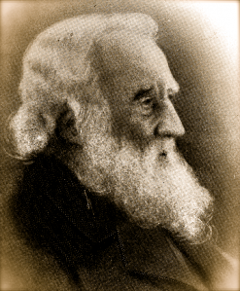
What God Has Done
R.C. Chapman
“Yes, but it is a wonderful burden– it is an overabundance of blessings for which I cannot find enough time or words to express my gratitude.”
He Has Blessed Us With Every Spiritual Blessing

Slide 15
What God Has Done
R.C. Chapman
“Yes, but it is a wonderful burden– it is an overabundance of blessings for which I cannot find enough time or words to express my gratitude.”
Blessed be the Lord, who daily loads us with benefits, the God of our salvation!
(Psalm 68:19)
He Has Blessed Us With Every Spiritual Blessing

Slide 16
What God Has Done
How do we gain this enlightenment? Wisdom?
“The entrance of Your words gives light; it gives understanding to the simple.”
(Psalm 119:130)
He Has Blessed Us With Every Spiritual Blessing

Slide 17
What God Has Done
Where is this wisdom and knowledge taking us?
Into a deeper appreciation of His “exceeding” great power
He Has Blessed Us With Every Spiritual Blessing

Slide 18
What God Has Done
(Ephesians 2:1-10)
And you He made alive, who were dead in trespasses and sins, in which you once walked according to the course of this world, according to the prince of the power of the air, the spirit who now works in the sons of disobedience, among whom also we all once conducted ourselves in the lusts of our flesh, fulfilling the desires of the flesh and of the mind, and were by nature children of wrath, just as the others.
But God, who is rich in mercy, because of His great love with which He loved us, even when we were dead in trespasses, made us alive together with Christ…

Slide 19
What God Has Done
...(by grace you have been saved), and raised us up together, and made us sit together in the heavenly places in Christ Jesus, that in the ages to come He might show the exceeding riches of His grace in His kindness toward us in Christ Jesus. For by grace you have been saved through faith, and that not of yourselves; it is the gift of God, not of works, lest anyone should boast. For we are His workmanship, created in Christ Jesus for good works, which God prepared beforehand that we should walk in them.
“Every spiritual blessings in the heavenly places…”
He chose us • He predestined us
He adopted us • He accepted us
• He forgave us
• He revealed to us
• He gathered us
• He gave an inheritance
He Has Blessed Us With Every Spiritual Blessing

Slide 20
What God Has Done
Upon whom are these blessings given?
Those alive? Worthy?
He Has Made Us Alive

Slide 21
What God Has Done
Upon whom are these blessings given?
Those alive? Worthy?
No, those DEAD & SEPARATED!
He Has Made Us Alive

Slide 22
What God Has Done
“But your iniquities have separated you from your God;
And your sins have hidden His face from you,
So that He will not hear.”
(Isaiah 59:2)
What killed us?
Our “trespasses” (Isaiah 59:2)
He Has Made Us Alive

Slide 23
What God Has Done
What killed us?
Our “trespasses” (Isaiah 59:2)
We followed the leadings of the world (v. 2)
He Has Made Us Alive

Slide 24
What God Has Done
What killed us?
Our “trespasses” (Isaiah 59:2)
We followed the leadings of the world
We followed the leadings of Satan (v. 2)
He Has Made Us Alive

Slide 25
What God Has Done
What killed us?
Our “trespasses” (Isaiah 59:2)
We followed the leadings of the world
We followed the leadings of Satan
We followed our own lust (v. 3)
He Has Made Us Alive

Slide 26
What God Has Done
What killed us?
Our “trespasses” (Isaiah 59:2)
We followed the leadings of the world
We followed the leadings of Satan
We followed our own lust
Sin became our “nature” (v. 3)
He Has Made Us Alive

Slide 27
What God Has Done
Paul’s point: Without God, we are without hope
We accomplish NOTHING lasting or meaningful
He Has Made Us Alive

Slide 28
What God Has Done
Paul’s point: Without God, we are without hope
We are alive because HE made us alive!
He Has Made Us Alive

Slide 29
What God Has Done
“But God…” (v. 4)
He Has Given Us Grace

Slide 30
What God Has Done
“But God demonstrates His own love toward us, in that while we were still sinners, Christ died for us. Much more then, having now been justified by His blood, we shall be saved from wrath…
“But God…” (v. 4)
“Who is rich in mercy…”
Motivated by love
Expressed when were were enemies (Romans 5:8-10)
He Has Given Us Grace

Slide 31
What God Has Done
“…through Him. For if when we were enemies we were reconciled to God through the death of His Son, much more, having been reconciled, we shall be saved by His life.”
(Romans 5:8-10)
“But God…” (v. 4)
“Who is rich in mercy…”
Motivated by love
Expressed when were were enemies (Romans 5:8-10)
He Has Given Us Grace

Slide 32
What God Has Done
In showing mercy, He…
He gave us life through Jesus Christ (v. 10)
He Has Given Us Grace

Slide 33
What God Has Done
In showing mercy, He…
He gave us life through Jesus Christ (v. 10)
He “raised us up together in the heavenly places” (v. 6)
He Has Given Us Grace

Slide 34
What God Has Done
In showing mercy, He…
He gave us life through Jesus Christ (v. 10)
He “raised us up together in the heavenly places” (v. 6)
In heaven, He longs to bless even more (v. 7)
He Has Given Us Grace

Slide 35
What God Has Done
All because of GRACE.
He Has Given Us Grace

Slide 36
What God Has Done
All because of GRACE.
It is the “gift of God”-- we can’t earn it.
He Has Given Us Grace

Slide 37
What God Has Done
We are prone to forget…
How fortunate we are…
How useless we are…
How much we can’t fix our condition…
Conclusion

Slide 38
What God Has Done
Paul wants us to remember what God has done for us
He has blessed us
He made us alive
He saved us by grace
Conclusion

Slide 39
What God Has Done

