Slide 1
Romans 7:24–25
²⁴Wretched man that I am! Who will deliver me from this body of death? ²⁵Thanks be to God through Jesus Christ our Lord! So then, I myself serve the law of God with my mind, but with my flesh I serve the law of sin.

Slide 3
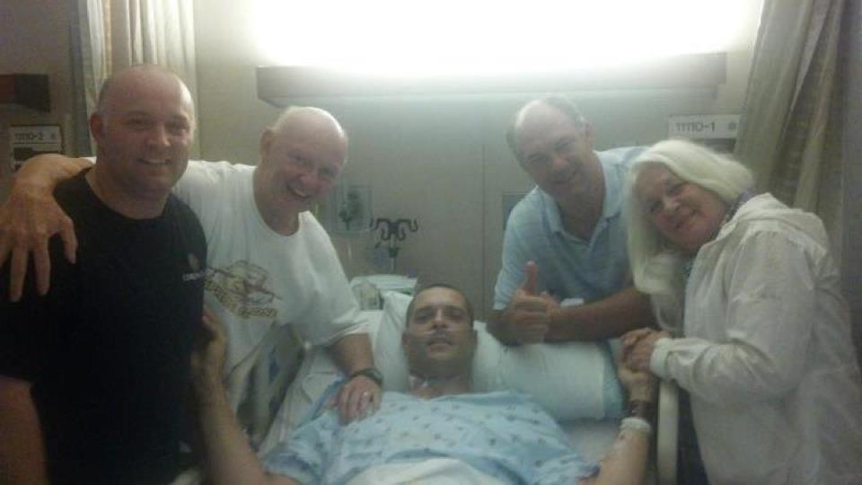

Slide 5
We must admit we are sick.
Romans 3:23; 6:23
Isaiah 1:5–6; 2 Peter 2:20–22
Why are we so concerned with our physical health and not our spiritual?
3 John 2

Slide 6
We need to make an appointment with the Physician
Matthew 9:9–13
He understands our sickness.
His diagnosis is never wrong.
He knows the treatment.

Slide 7
We must follow up with spiritual therapy.
Study and meditate on spiritual things.
Participate in “group therapy.”
Allow the Lord to keep working on your life.

