Slide 1
Proverbs 26:20–23
²⁰For lack of wood the fire goes out, and where there is no whisperer, quarreling ceases. ²¹As charcoal to hot embers and wood to fire, so is a quarrelsome man for kindling strife. ²²The words of a whisperer are like delicious morsels; they go down into the inner parts of the body. ²³Like the glaze covering an earthen vessel are fervent lips with an evil heart.

Slide 5
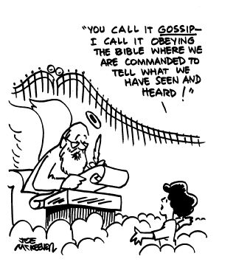

Slide 6
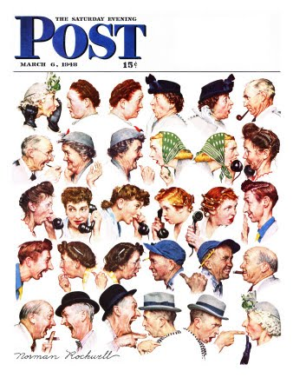

Slide 8
What is whispering?
Proverbs 16:28; 18:8; 26:20–23
Three areas of concern:
Busybody
Gossip
Slander

Slide 9
What’s the big deal?
It’s divisive and disorderly.
2 Thessalonians 3:10–12, 14
It is a sin worthy of death.
Romans 1:28–32
It simply shouldn’t be said.
1 Timothy 5:13

Slide 10
How do we stop?
Put down the microscope and the magnifying glass.
When you “just can’t wait to tell” somebody, the you shouldn’t tell anybody.
Stop listening.
Don’t talk about people, talk to people.
Honor your brother.

